Slide 1
tidyverse Intro
tidyverse: A collection of packages developed by Hadley Wickham to align R with common practice in other coding environments.
© Fall 2020 John Grego and the University of South Carolina

Slide 2
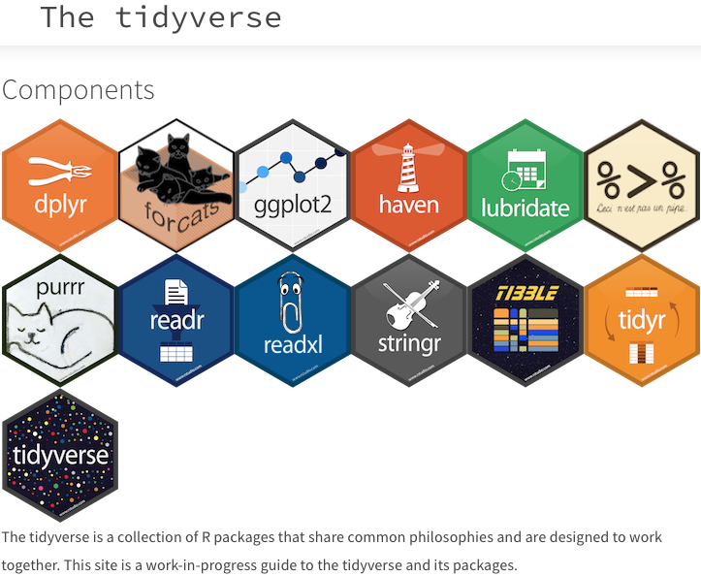
tidyverse packages
Notes:
Both packages and components. We will concentrate on dplyr, ggplot2, tibble, %>% (the pipe), but don’t be surprised if other packages come up: lubridate (dates), tidyr (data cleaning), readr: read delimited files, readxl: read Excel files, purrr: functions and vectors, stringr: character data, forcats: anagram for factors.

Slide 3
dplyr
Common functions:
mutate(): create new variables from old
select(): select variables by name
filter(): select cases
summarise(): summary statistics
arrange(): ordering of rows
We will focus on tools by solving a couple practical problems
Notes:
Use when analytical results are difficult, unavailable or unconfirmed. Students are used to analytical results.

Slide 4
COVID-19 Time Series
COVID-19 cases from January 21, 2020 to July 15, 2020
Data should be “tall” rather than “long” for each state
County data should be aggregated by state
Dates need to be converted from column labels to a factor variable
Territories could be removed
Notes:
Buffon’s Needle: why bother? The analytical result isn’t that difficult.

Slide 5
ggplot2
ggplot is the generic plotting function
Add dataframe (or tibble) as argument
Add aes() for default plot of variables and their aesthetics
Add plotting elements as layers (geom_point, geom_line, geom_smooth,geom_boxplot, etc)
Notes:
Use when analytical results are difficult, unavailable or unconfirmed. Students are used to analytical results.

Slide 6
COVID-19 Time Series
Time series for a single state
Time series for multiple states
Boxplots and dotplots
Histograms
Notes:
Buffon’s Needle: why bother? The analytical result isn’t that difficult.

