Slide 1
Chapter 4: Combining Tables Vertically using PROC SQL

Slide 2
Outline
Set Operations
Combining Columns
Keywords (CORR and ALL)
Except
Intersect
Union
Outer Union
Notes:
Combining columns using classic set operation (union, intersection, exclusive or)

Slide 3
Sample Tables
Google Grego
Bing Grego
Name | Residence
John | Columbia, SC
Laura | Cambridge, MA
Melissa | Los Angeles, CA
Michael | Orlando, FL
Joseph | London, England
Melissa | Los Angeles, CA
Mark | Napierville, IL
John | Washington, DC
Name | City
Mark | Napierville, IL
Joseph | London, England
Michael | Orlando, FL
Melissa | Los Angeles, CA
VG | Yerevan, Armenia
Notes:
Watch the duplicate record (Melissa) closely. This search doesn’t really turn up individual names as it did when this course was first developed.

Slide 4
Combining Tables Vertically
Standard syntax:
proc sql; select *
from google
(except/intersect/union/outer union)
(corr/all)
select * from bing;

Slide 5
Combining Tables Vertically
Multiple SELECT queries processed separately, then combined using set operator
Set operators select unique rows by default
Set operators overlay columns by default
Notes:
Our SELECT queries will simply be SELECT *. Bullet two: The second Melissa in google would be dropped. Bullet three: City would be replaced with Residence in Bing.

Slide 6
Combining Tables Vertically
Sequential columns in each query should be the same type
For three or more queries, set operators are evaluated sequentially
Keywords ALL and CORR modify the set operators
Notes:
Bullet 1: Interesting to see what happens when columns are NOT the same type

Slide 7
EXCEPT
Selects unique rows from first table that do not occur in the second table
Columns are simply overlaid (even if names are different)
Columns inherit names from the first table

Slide 8
EXCEPT
proc sql;
select * from google
except
select * from bing;
quit;
Name | Residence
John | Columbia, SC
John | Washington, DC
Laura | Cambridge, MA
Notes:
Emphasis on SELECT * is deceiving (see CE 4 to get a sense of the method’s flexibility). Note that Residence is from Google.

Slide 9
EXCEPT
In first sweep, the second occurrence of Melissa in google would be removed
In second sweep, Mark, Joseph, Michael, and the first occurrence of Melissa would be removed
The second column is called Residence rather than City
Data is sorted

Slide 10
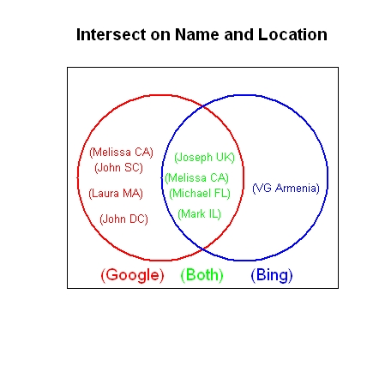
EXCEPT

Slide 11
EXCEPT ALL
Use the keyword ALL after EXCEPT so that duplicate rows in the first table that do not occur in the second table are not eliminated.
The second Melissa does not have a match.
Data is sorted
Name | Residence
John | Columbia, SC
John | Washington, DC
Laura | Cambridge, MA
Melissa | Los Angeles, CA
Notes:
EXCEPT All often requires only one pass through the data. Bullet two: Second Melissa is saved since it doesn’t have a match.

Slide 12
EXCEPT ALL
We would have different results if either John from SC, Laura from MA or John from DC were listed more than once.
Or….if Melissa from CA was not listed in the second table
Notes:
Bullet one: All occurrences in first table were kept. Bullet two: First occurrence of Melissa was eliminated.

Slide 13
EXCEPT CORR
The keyword CORR displays only columns with the same name in both tables
Columns are selected first
Unique rows are then extracted from the first table that do not appear in the second table
This ordering may generate sparser output than expected

Slide 14
EXCEPT CORR
proc sql;
select * from google
except corr
select * from bing;
quit;
Name
John
Laura
Notes:
Compare to EXCEPT ALL

Slide 15
EXCEPT CORR and ALL
If both keywords ALL and CORR are used with EXCEPT
Unique and duplicate rows from the first table will be saved, unless they have matches in the second table
Only columns with the same name in both tables will be displayed

Slide 16
EXCEPT CORR and ALL
All occurrences of John are retained
The unmatched duplicate occurrence of Melissa is retained
The unmatched occurrence of Laura is retained
Data is sorted
Name
John
John
Laura
Melissa
Notes:
Only one Melissa is retained.

Slide 17
INTERSECT
Selects unique rows common to both tables
Column labels are ignored
proc sql;
select * from google
intersect
select * from bing;
quit;

Slide 18
INTERSECT

Slide 19
INTERSECT
Melissa only appears once
The second column is labeled based on the first data set
Data is sorted
Name | Residence
Joseph | London England
Mark | Napierville, IL
Melissa | Los Angeles, CA
Michael | Orlando, FL
Notes:
Note Residence is column header again

Slide 20
INTERSECT ALL
Selects unique and duplicate rows common to both tables
Column labels are ignored
Data is sorted
20
Notes:
Only first Melissa is retained (not common to both tables)

Slide 21
INTERSECT ALL
proc sql;
select * from google
intersect all
select * from bing;
quit;
Name | Residence
Joseph | London England
Mark | Napierville, IL
Melissa | Los Angeles, CA
Michael | Orlando, FL

Slide 22
INTERSECT CORR
Selects unique rows common to both tables for matching column names
proc sql;
select * from google
intersect corr
select * from bing;
quit;
Name
Joseph
Mark
Melissa
Michael
Notes:
What you’d expect for the output table

Slide 23
INTERSECT CORR and ALL
proc sql;
select * from google
intersect all corr
select * from bing;
run;
Unique and duplicate rows that appear in both tables will be saved
Only columns with the same name in both tables will be displayed
Name
Joseph
Mark
Melissa
Michael
Notes:
The duplicate has to be common to BOTH tables (hence only one Melissa). End of Day 5 (50 minutes)

Slide 24
UNION
Selects unique rows in either table
Column labels are ignored
Rows are sorted
proc sql;
select * from google
union
select * from bing;
quit;

Slide 25
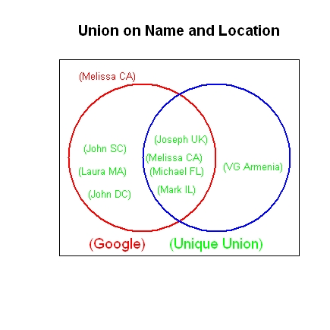
UNION

Slide 26
UNION
Name | Residence
John | Columbia, SC
John | Washington, DC
Joseph | London, England
Laura | Cambridge, MA
Mark | Napierville, IL
Melissa | Los Angeles, CA
Michael | Orlando, FL
VG | Armenia

Slide 27
UNION and ALL
Selects all rows in either table
Column labels are ignored
Not sorted
proc sql;
select * from google
union all
select * from bing;
quit;
Notes:
UNION and ALL stacks tables. Try SELECT NAME in place of SELECT *.

Slide 28
UNION and CORR
Selects all unique rows in either table based on matching column names
proc sql;
select * from google
union corr
select * from bing;
run;

Slide 29
UNION and CORR
Name
John
Joseph
Laura
Mark
Melissa
Michael
VG
29
Notes:
John is Columbia SC John

Slide 30
UNION CORR and ALL
Unique and duplicate rows that appear in either table will be saved
Only columns with the same name in both tables will be displayed
Output is unsorted
proc sql;
select * from google
union all corr
select * from bing;
quit;
Notes:
The code will print ALL names

Slide 31
OUTER UNION
Selects all rows in both tables, but does not overlay any of the information
Output will have r₁+r₂ rows and c₁+c₂ columns
proc sql;
select * from google
outer union
select * from bing;
quit;
Notes:
You can’t use ALL with OUTER UNION

Slide 32
OUTER UNION and CORR
Using CORR overlays columns with the same name
More useful than OUTER UNION, but still does not merge data
proc sql;
select * from google
outer union corr
select * from bing;
quit;

Slide 33
OUTER UNION with CORR
Name | Residence | City
John | Columbia, SC
Laura | Cambridge, MA
Melissa | Los Angeles, CA
Michael | Orlando, FL
Joseph | London, England
Melissa | Los Angeles, CA
Mark | Napierville, IL
John | Washington, DC
Mark |  | Napierville, IL
Joseph |  | London, England
Melissa |  | Orlando, FL
Michael |  | Los Angeles, CA
VG |  | Yerevan, Armenia
Notes:
The text has a handful of exercises combining these operations with earlier techniques. And see Class Exercise 4.

