Slide 1
Improved grey prediction models for the trans‐pacific air passenger market
Chaug‐Ing Hsu & Yuh‐Horng Wen (1998)
Transportation Planning and Technology

Slide 2
My Background
Boeing Intern
787 Finance Operations (summer 2018)
Forecasting production costs and completion dates
Short term, day-to-day cost reduction
Engineering Mathematics group (summer 2019)
Statistical consulting among Boeing subsidiaries
Join team after graduation

Slide 3
Introduction
This paper is from 1998
Air traffic in the region has grown since then, this unique model continues to be relevant
Economic growth of Asian-Pacific countries has increased the amount of air traffic to the region
A model is needed to better predict the amount of air travel passengers to the region
Many different uses and needs for forecasting in the commercial airline industry
Short-term: daily operations
Medium-term: market planning
Long-term: route and fleet planning

Slide 4
Introduction
Models before this paper use:
Time series
Causal Methods e.g. regression and econometric techniques
This paper will attempt to use Grey Theory to create a prediction model for international air traffic.
Introduce ideas for residual modification residual Markov-chain sign estimation to increase accuracy of the model
Compared to multiple regression models and autoregressive integrated moving-average models

Slide 5
Grey Theory: Background
Grey System- a system in which part of the information is known and part is unknown. This uncertainty forms a “grey area”
Developed by Deng (Huazhong University of Science and Technology) in 1982
Much of the literature is in Chinese due to its origin
Multidisciplinary and generic
Deals with systems that have lacking or poor information
Many fields and applications including:
Systems analysis, data processing, prediction, modelling
Accumulated generating operation (AGO)- one of the most important characteristics of grey theory,
Main purpose is to reduce the randomness of data.
Well fitted to exponential distributions

Slide 6
Grey Theory: Background
The Grey Forecasting Model GM(1,1) is a time-series prediction model encompassing a group of differential equations adapted for parameter variance
data must be taken at equal intervals and in consecutive order without bypassing any data
Assumptions of statistical distribution of the data are not necessary

Slide 7
Data/ Design Choices
Market is defined as all passengers travelling on scheduled and charter flights between the United States and most countries in Asia.
The growth of airline traffic in Asia parallels the growing importance of the area in political, social, and economic sectors
The number of observations is small, growth has occurred in years close to the article
It is difficult to collect enough data to use traditional statistical methods
Grey theory is used because of the sparseness of the data
data must be taken at equal intervals and in consecutive order without bypassing any data

Slide 8
Data/Design Choices
1974-1993 data
1974: k=1, 1993: k=20
Reported by Boeing in 1993
18 of the 20 observations are used for model fitting
Remaining 2 used for post-sample result comparisons

Slide 9
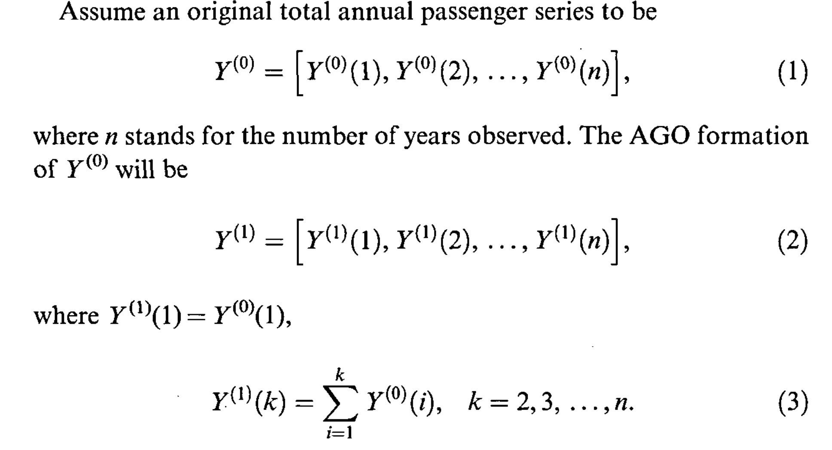
Statistical Models

Slide 10
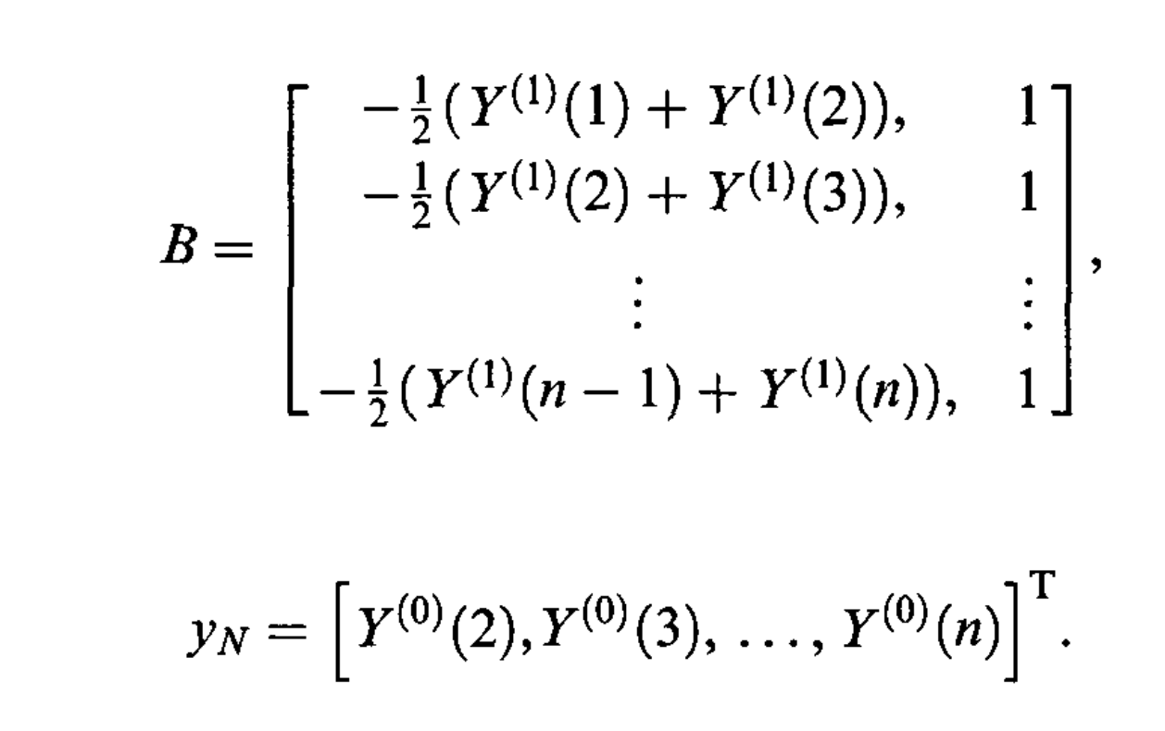
Statistical Models
The model is constructed using a first order differential equation:
The difference equations vary with time rather than being general
Using the Least Squares Method we plug in:
Where

Slide 11
Statistical Models
Plugging in we get our fitted values
Where:
Finally, applying the inverse accumulated generating function we get:

Slide 12
Statistical Models
Fitted values:
Forecast values:
Final Model:
The forecast values are:
1974 (k=2), 1975 (k=3), ….
The original value is:
Year = 1974

Slide 13
Statistical Models
Updating the model using Markov Chains
Similar techniques are used to create the model for residuals
AGO- accumulated generating function is created
Difference equations are calculated
Model is created using the values of k
Improved model:

Slide 14
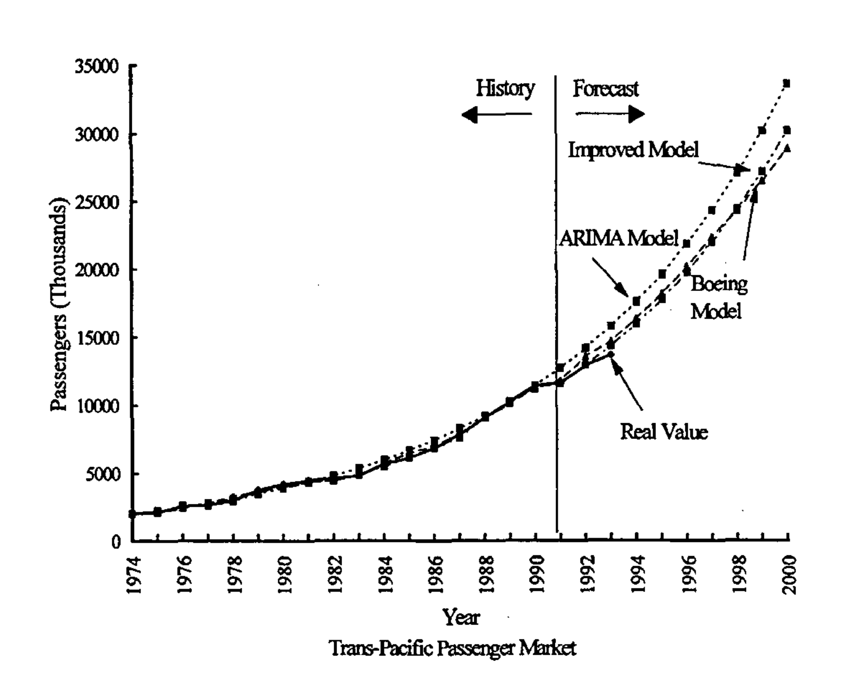
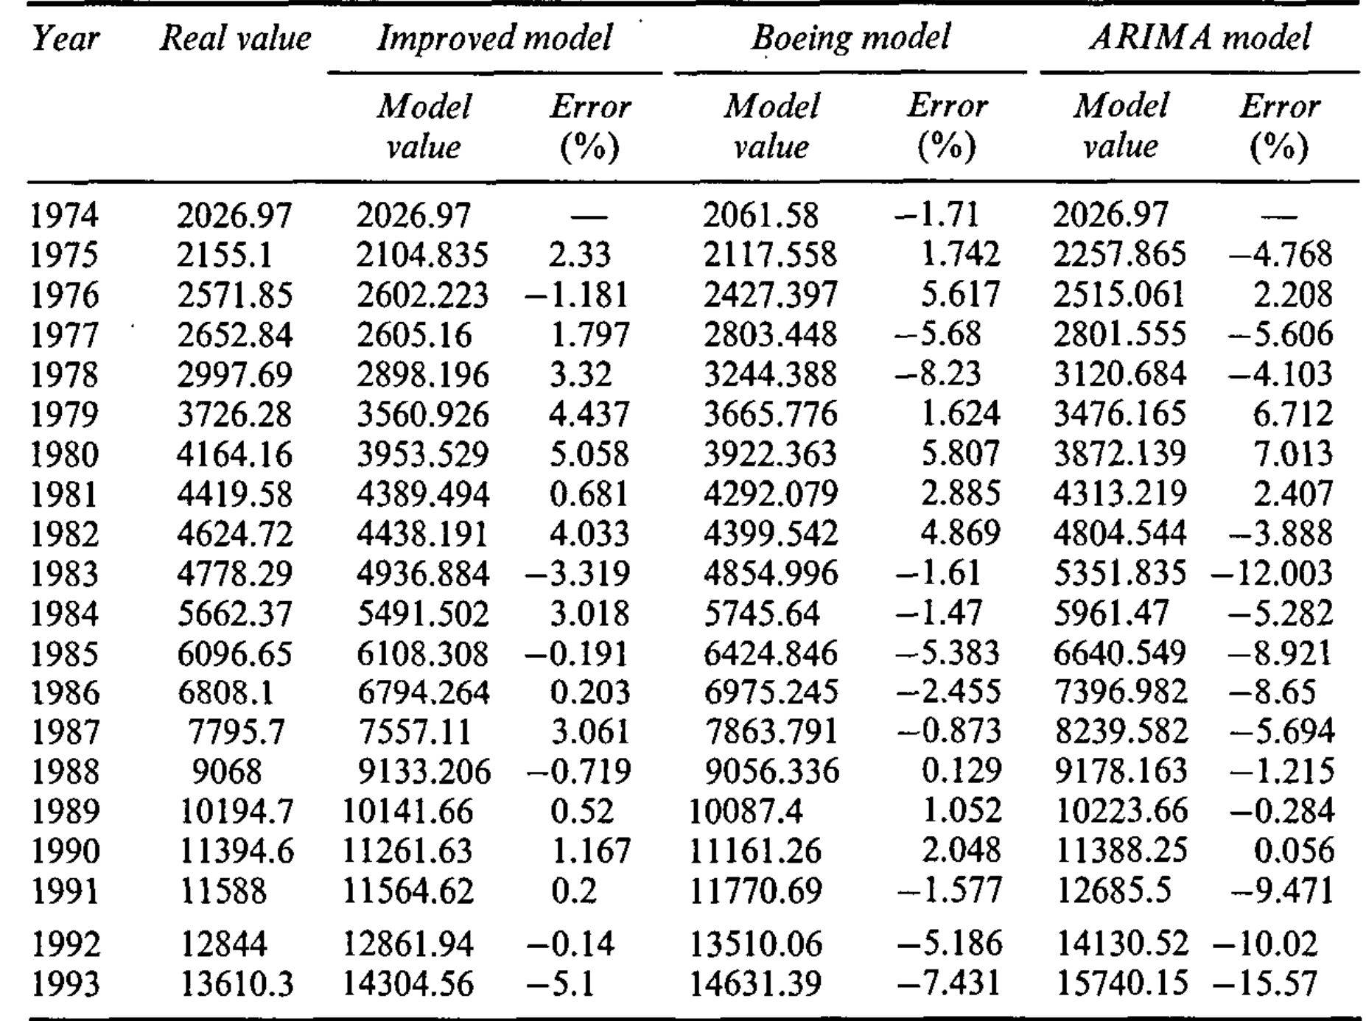
Data Analysis

Slide 15
Conclusion
The model created in this paper is more precise than the current existing models
Adding the residuals to the grey model increases accuracy
The model created is not suitable for use overtime due to problems with convergence
It can continually be updated with new data
Models were compared with Boeing 1995 forecasts for predictive accuracy
Airline traffic in the trans-Pacific market was expected to increase by 11% annually through 2000
China was expected to be higher at 12%
Further analysis of specific country pairs can be conducted

Slide 16
THANK YOU!
QUESTIONS?

