Slide 1
Bootstrapping and Bootstrapping Regression Models
Tong Shan
2019.4

Slide 2
Outline
1. Advantages of bootstrapping
2. Bootstrapping method
3. Bootstrapping regression models
4. Concluding Marked

Slide 3
A number of advantages
The bootstrap is quite general.
Because it does not require distributional assumptions, the bootstrap can provide more accurate inferences when the data are not well behaved or when the sample size is small.
It is possible to apply the bootstrap to statistics with sampling distributions that are difficult to derive.
It is simple to apply the bootstrap to complex data-collection plans.

Slide 4
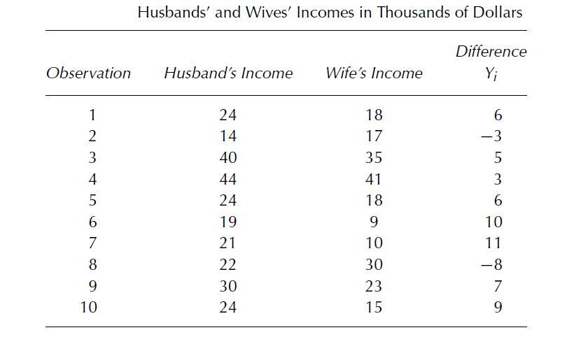
Bootstrapping Basic ------ Husbands’ and Wives’ Incomes Data

Slide 5
We saw first four first.
We calculated the confidence interval.
Too wide!!!
Includes 0!!!

Slide 6
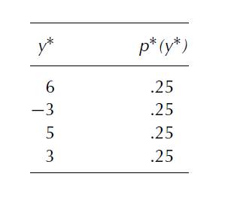
Picture of bootstrapping!
If we use bootstrap, we can have $4^{4}=256$ different bootstrap samples, each selected with probability 1/256
The mean of the 256 bootstrap sample means is just the original sample mean
The standard deviation of the bootstrap means is
$n^{n}$ rather than by $n^{n}−1$because the bootstrap
sample means is known, not estimated
SE $=2.015$ Better!!!

Slide 7
Bootstrapping procedure
1. Let r denote the number of bootstrap replications—that is, the number of bootstrap samples to be selected.
2. For each bootstrap sample b = 1, . . . , r, randomly draw n observations with replacement from among the n sample values, and calculate the bootstrap sample mean
3. From the r bootstrap samples, estimate the standard deviation of the bootstrap means

Slide 8
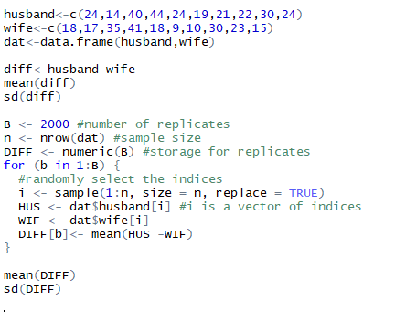
R code for bootstrapping
I used R to solve this problem to get much better result using bootstrapping.

Slide 9
Bootstrapping Regression Models
The most straightforward approach is to collect the response-variable value and regressors for each observation
These z can be resampled an the regression estimator computed for each of the resulting bootstrap samples. producing r sets of bootstrap regression coefficients, The methods of the previous slides can be applied to compute standard errors or confidence intervals for the regression estimates.
But if the data derive from an experimental design, we may want to treat the Xs as fixed!

Slide 10
Bootstrapping regression models procedure in the case of linear regression
1. Estimate the regression coefficients for the original sample, and calculate the fitted value and residual for each observation:
2. Select bootstrap samples of the residuals, and from these, calculate bootstrapped Y values, where
3. Regress the bootstrapped Y values on the fixed X values to obtain bootstrap regression coefficients. If estimates are calculated by least-squares regression, then
where b= 1, 2, … , r.
4. The resampled can be used to construct bootstrap standard errors and confidence intervals for the regression coefficients.

Slide 11
Examples
Duncan’s regression of occupational prestige on the income and educational levels of 45 U. S. occupations
Model:

Slide 12
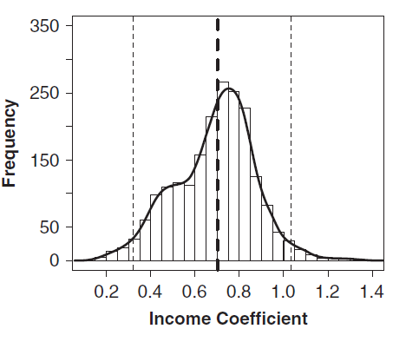
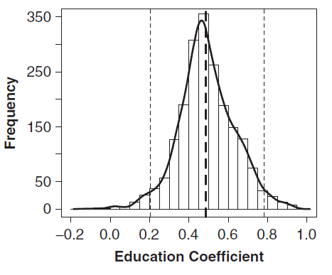
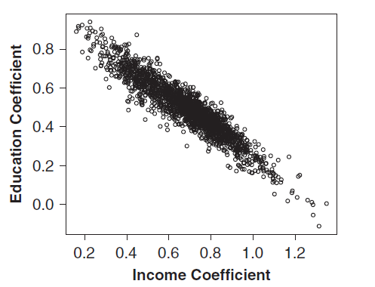
Using random resampling, drew r = 2, 000 bootstrap samples, calculating the estimator for each bootstrap sample.
The distributions of the bootstrapped regression coefficients for income and education are graphed
It is clear that the income and education coefficients are strongly negatively correlated

Slide 13
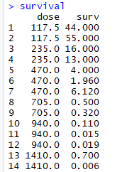
Example: Survival of Rats after Radiation Doses
The data measured the survival percentages of batches of rats who were given varying doses of radiation. At each of 6 doses there were two or three replications of the experiment.
dose: The dose of radiation administered (rads).
surv: The survival rate of the batches
expressed as a percentage.

Slide 14
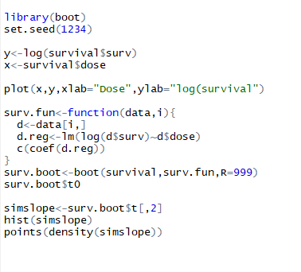
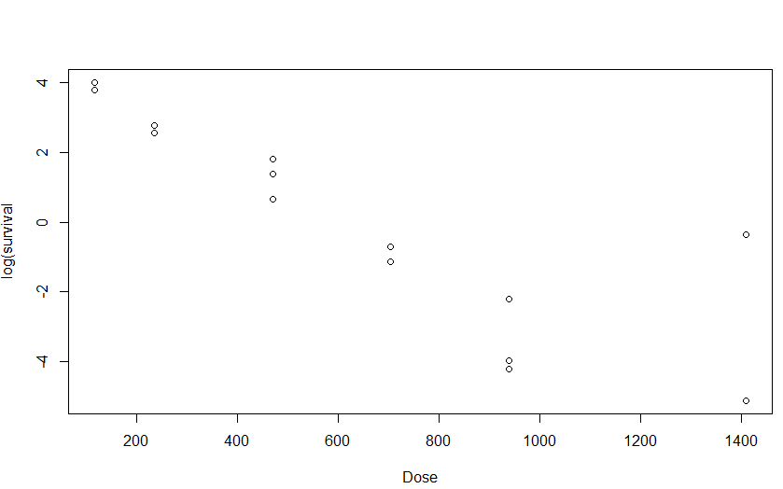
Example 2(survival data)
paired bootstrapping

Slide 15
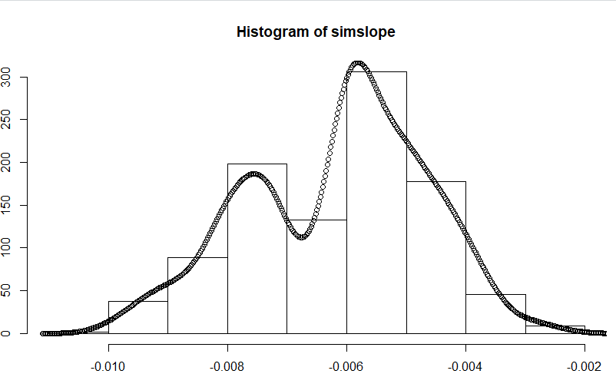
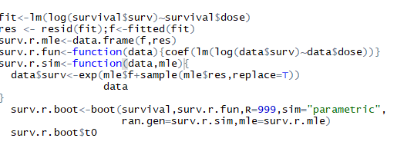
based on residuals

Slide 16
Concluding Remarks
Bootstrap can also be used in Estimation of Bias, Bootstrap Confidence Intervals, Bootstrap Hypothesis Tests
Although the bootstrap is so simple and of such broad application, it has some disadvantages so that it isn’t used more in the social sciences.

Slide 17
Thanks!

