Slide 1
Chapter 3: Combining Tables Horizontally using PROC SQL
©Spring 2012 Imelda Go, John Grego, Jennifer Lasecki and the University of South Carolina

Slide 2
Outline
Cartesian Product
Inner Joins
Outer Joins
Joins and DATA step match-merge
In-line views
Joining multiple tables

Slide 3
Generating a Cartesian Product
A cartesian product (think tensor product or Kronecker product or outer product or…) combines all possible combinations of records in multiple data sets
proc sql;
select *
from set1, set2;
If set1 had a1 rows and set2 had b1 rows, then the output table will have a1*b1 rows.
A cartesian product is rarely a practical query

Slide 4
Inner Joins
Combining records from two tables based on a matching criterion
Matching (or joining) is based on a WHERE clause
WHERE clause usually uses the = sign, but can use other logical operators

Slide 5
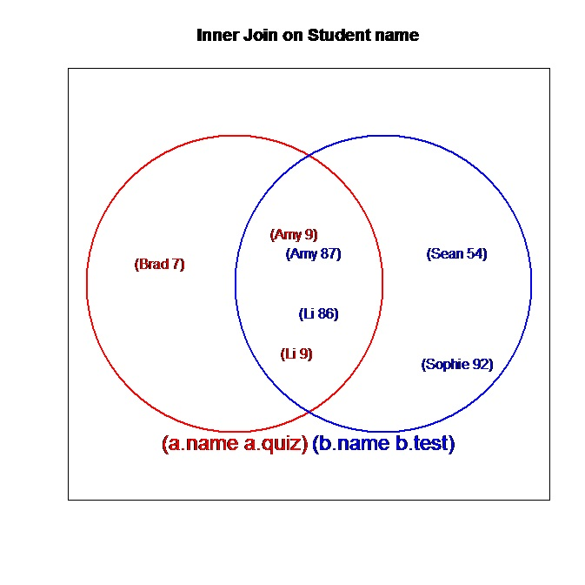
Inner Joins

Slide 6
Inner Joins
Name | Quiz
Amy | 9
Brad | 7
Li | 9
Name | Test
Amy | 87
Li | 86
Sean | 54
Sophie | 92

Slide 7
Inner Joins
proc sql;
select a.name, quiz, test from a, b
where a.name=b.name;
Inner Join syntax:
proc sql;
select a.name, quiz, test from a inner join b
on a.name=b.name;
Name | Quiz | Test
Amy | 9 | 87
Li | 9 | 86
7

Slide 8
Inner Joins
The output is a report, not a data set
Use of a.name in SELECT clause eliminates second name variable in output table
If we want to keep both copies of the same variable, we can specify a column alias using the AS clause.
Inner joins handle many-to-many matches (e.g., suppose two students were named “Amy”, and they both took a test and a quiz) by creating a cross-product table.
Long table names can be replaced with simple aliases, again using the AS clause
Notes:
654
.-- 9
.4\
]=-p0j

Slide 9
Inner Joins
proc sql;
select a.name as quizname, b.name as testname, quiz, test from a, b
where quizname=testname;
quiz name | test name | quiz | test
Amy | Amy | 9 | 87
Li | Li | 9 | 86
9

Slide 10
Additional Inner Joins
Examples with following features:
FORMAT statement
CALCULATE statement
GROUP statement

Slide 11
Inner Join
proc sql;
create table both as
select a.patient, a.date format date7. as date, a.pulse,
b.med, b.doses, b.amt format=4.1
from hospitnew a inner join dosing b
on (a.patient=b.patient) and (a.date=b.date)
order by patient,date;

Slide 12
Inner Join with Group
proc sql; create table both as
select a.date format date7. as date, avg(a.pulse) label="Average Daily Pulse" as avgPulse, count(b.patient) label="No. of Patients", sum(b.doses) label="Total Daily Doses" as NumDose, sum(b.amt) format=4.1 label="Total Amount (mg)" as Totamt from hospitnew a inner join dosing b on (a.patient=b.patient) and (a.date=b.date)
group by a.date
order by a.date;

Slide 13
Natural Joins
In a natural join, PROC SQL automatically selects columns from each table on which to match the rows.
It will select the column(s) with matching names, without you having to specify such columns (there is an implied ON clause).
If no columns have matching names, the result is a Cartesian product.
Coding is streamlined, but be careful in doing a natural join.

Slide 14
Left and Right Outer Joins
Left and right outer joins select common cases based on a WHERE statement (i.e., inner join cases), as well as all cases in the first (or second) data set without matches in the second (or first) data set.

Slide 15
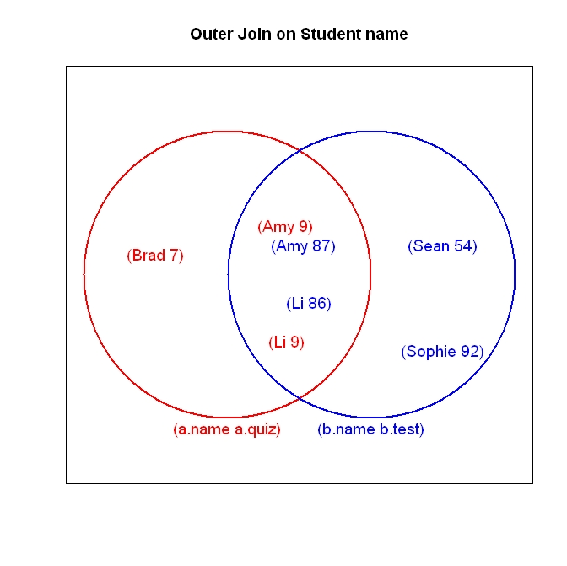
Left and Right Joins

Slide 16
Left Outer Join
proc sql;
select a.name, quiz, test from a
left join b
on a.name=b.name;
Name | Quiz | Test
Amy | 9 | 87
Li | 9 | 86
Brad | 7 | .

Slide 17
Right Outer Join
proc sql;
select b.name, quiz, test from a
right join b
on a.name=b.name;
Name | Quiz | Test
Amy | 9 | 87
Li | 9 | 86
Sean | . | 54
Sophie | . | 92

Slide 18
Full Outer Join
Combines all cases
proc sql;
select *
from a
full join b
on a.name=b.name;
Name | Quiz | Name | Test
Amy | 9 | Amy | 87
Li | 9 | Li | 86
Sean | . | . | 54
Sophie | . | . | 92
Brad | 7 | . | .

Slide 19
SQL Join vs DATA Step match-merge
When all values in both data sets match, SQL inner join and DATA step match-merge statements are quite straightforward
When some values do not match, a SQL full join is needed, along with adjustment of the standard commands.

Slide 20
Inner join vs. match-merge
data c; merge a b; by name; run;
proc sql; select a.name, major, school from a, b where a.name=b.name order by name;
a.Name | a.Major
Shan | Statistics
Iris | Biostatistics
Tim | Actuarial Sciences
b.Name | b.School
Iris | University of Missouri
Tim | University of New Mexico
Shan | North Carolina State University

Slide 21
Table merged
Name | Major | School
Iris | Biostatistics | University of Missouri
Shan | Statistics | North Carolina State University
Tim | Actuarial Sciences | University of New Mexico

Slide 22
Full join vs. match-merge
Data c; merge a b; by name; run;
Proc sql; select a.name, major, school from a full join b on a.name=b.name order by name;
A.Name | A.Major
Shan | Statistics
Iris | Biostatistics
Tim | Actuarial Sciences
B.Name | B.School
Iris | Mizzou
Tim | UNM
Josh | KSU

Slide 23
Full join vs. match merge
The full join fails, since it can only assign values to Name from the first table. SELECT * works, but generates two name columns.
Name | Major | School
Iris | Biostatistics | Mizzou
Josh |  | KSU
Shan | Statistics
Tim | Actuarial Sciences | UNM
Name | Major | School
 |  | KSU
Iris | Biostatistics | Mizzou
Shan | Statistics
Tim | Actuarial Sciences | UNM

Slide 24
Full join vs match-merge
The COALESCE statement resolves the problem:
proc sql;
title ‘Table Merged’;
select coalesce(a.name, b.name) as name, major, school
from a full join b
on a.name=b.name;

Slide 25
PROC SQL advantages
The tables do not have to be sorted beforehand
The matching variables do not have to have the same name
The logical operation can be more flexible.

Slide 26
In-line Views
An in-line view is a nested query
The in-line view does not create a permanent SQL table.
In-line views can be used to create joins of multiple data sets that would typically require multiple DATA steps

Slide 27
In-line Views
The outer query can select both from in-line views and tables
The in-line view can also select from multiple in-line views and tables
In-line views can be nested more than once

Slide 28
In-line Views-Example
LibSys | State | TotCirc | LocGvt
Haleyville | AL | 67031 | 12822
Jasper | AL | 187072 | 74289
Suniton | AL | 39401 | 12026
Ashland City | AL | 60994 | 21350
Athens | IL | 27366 | 22976
Freeburg | IL | 218749 | 26519
Pembroke | IL | 19100 | 526
Heermance | NY | 160316 | 48199
Greenville | NY | 131019 | 60863
Haines Falls | NY | 38734 | 11471

Slide 29
In-line Views-Example
In-line view portion of code:
from (select state,
avg(LocGvt) as average,
sum(TotCirc>150000) as large,
sum(TotCirc<150000) as small
from lib
group by state)

Slide 30
In-line Views-Example
State | average | large | small
AL | 30121.75 | 1 | 3
IL | 16673.67 | 1 | 2
NY | 40177.67 | 1 | 2

Slide 31
In-line Views-Example
Outer query portion of code:
proc sql;
select state,
average format=dollar12.2 label=‘Mean Local Government Support’,
small/(small+large) as prop format=percent5.2
label= ‘Small library percentage’ from…
order by average;

Slide 32
In-line Views-Example
State | Mean Local Government Support | Small Library Percentage
IL | $16,673.67 | 67%
AL | $30,121.75 | 75%
NY | $40,177.67 | 67%

