Slide 1
STAT 515 Statistical Methods I Chapter 1 Data Types and Data Collection Brian Habing Department of Statistics University of South Carolina Redistribution of these slides without permission is a violation of copyright law.

Slide 2
Outline
Introduction and Basic Terminology
Collecting Data to Describe a Population
Collecting Data to Compare Treatments

Slide 3
Chapter 1 - Statistics
Statistics Is the Science of Data…
Gathering Data: Design of Experiments and Surveys
Describing Data: Descriptive Statistics
Using Data to Make Decisions: Inference about Populations from Samples
The Theory Behind Analyzing Data: Mathematical Statistics and Theoretical Probability

Slide 4
Chapter 1 – Data in General
It is often easiest to picture data as being in the form of a spreadsheet

Slide 5
Chapter 1 – Cases and Variables
Each row is a different case, respondent, subject, participant, record, or experimental unit.
The variables are found in the columns and are the characteristics of the units.

Slide 6
Chapter 1 – Types of Data
Variables can be either quantitative (have a numerical value that works like a number) or qualitative (don’t have a meaningful numerical value; aka categorical variables).

Slide 7
Chapter 1 – Types of Data
Qualitative variables can be divided into ordinal variables (ordered in a specific way, less than or greater than makes sense) or nominal variables (no intrinsic ordering).

Slide 8
Chapter 1 – Types of Data
Quantitative variables are often divided into discrete variables (there are jumps between the possible values) and continuous variables (there is another possible value between any two values).

Slide 9
Chapter 1 - Population and Sample
The population is the set of all units that we are interested in studying.
A numerical summary of a variable across the entire population is a parameter.
The sample is the subset of the population that we actually have observations from.
A numerical summary of a variable across the entire sample is a statistic.

Slide 10
Chapter 1 - Population and Sample
Statistical inference (which we’re building up to) tells us how well the statistics that measure our sample capture the true parameter values that describe our population.
In order for the data from the sample to be useful, it must be representative of the population for the variable(s) we are interested in.

Slide 12
Chapter 1 – Collecting Data
Unfortunately, actually collecting data receives the most attention in STAT 110, and then is hardly mentioned in advanced courses (like this one).
This vastly understates how important collecting the right data in the right way is – if the data is bad, everything covered in any stats class is useless!

Slide 13
Chapter 1 – For Describing Populations
Random sampling (aka random selection) methods are designed to guarantee that our sample will be representative of the population on average for every variable.
Simple random samples (SRS’s) are often used to describe a population. This is where every subgroup of individuals has the same chance of being chosen as any other subgroup.

Slide 14
Chapter 1 – For Describing Populations
An SRS is easiest to work with mathematically, but other types of probabilistically based sampling methods can given even better results.
Actually getting an SRS and the data you really want can be very hard! (Do they have a phone? Is the question leading?)

Slide 15
Chapter 1 – For Describing Populations
A stratified sample is one where we have different sub-populations of known size. We take a simple random sample of each subpopulation and then combine the results in the right way.
The math is harder, but the results will have less variability (the statistic will usually be closer to the parameter) as long as the groups are related to the variable we’re measuring.

Slide 16
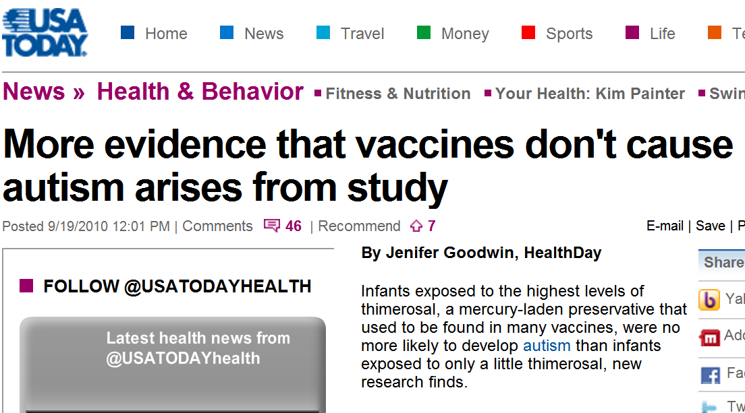

Slide 17
Chapter 1 – For Determining Efficacy
The “gold standard” in statistics for determining the efficacy of something is a scientifically controlled, randomized, comparative experiment with a large sample size from a representative population in a realistic setting.

Slide 18
Chapter 1 – Experiment
An experiment is where the treatment is imposed upon the subjects by the experimenter. This allows for conclusions about whether the treatment causes a given effect or not.
Consider trying to judge the efficacy of charter schools – in many situations the parent has to be motivated enough to enroll their child in the charter school…

Slide 19
Chapter 1 – Comparative
Comparative means that several treatments are being compared.
Historically a large number of medical procedures were adopted because they seemed reasonable and some patients improved… thousands of people receive arthroscopic knee surgery each year, but a 2002 study showed it doesn’t seem to give any better results than a “placebo surgery”!!

Slide 21
Chapter 1 – Randomization
All aspects that can be should be randomly assigned (aka randomly allocated).
Each subject in a drug trial is randomly assigned either the standard treatment or the proposed new treatment. But what if it is set up so that one doctor gives all the standard treatments, and a second doctor gives all the new treatments…

Slide 22
Chapter 1 – Scientifically Controlled
The effects of variables other than the one being investigated are minimized.
When examining the efficacy of a drug, what should it be compared to? What if the placebo has a better taste or is more easily digested or doesn’t have some of the side effects?

Slide 23
Chapter 1 – Large Sample Size
The number of subjects needs to be as large as possible.
Consider looking for the occurrence of a rare side effect…

Slide 24
Chapter 1 – Representative Population
From a representative population.
Consider trying to judge fuel economy by using professional drivers… do the estimates have any relationship to the real world?

Slide 25
Chapter 1 – Realistic Setting
In a realistic setting.
Consider trying to judge fuel economy by using drivers on a closed track where they know fuel economy is the subject of the study… do the estimates have any relationship to the real world?

Slide 26
Chapter 1 – Reality Sets In
Of course, in many cases it’s impossible to have a randomized comparative experiment with a large sample size from a representative population.
The effect of missing any of these conditions needs to be taken into account when determining what conclusions can be drawn from a study.

