Slide 1
STAT 515 Statistical Methods I Sections 2.1-2.3 Graphical Displays and Measures of Center Brian Habing Department of Statistics University of South Carolina Redistribution of these slides without permission is a violation of copyright law.

Slide 2
Outline
The main idea of descriptive statistics
Graphical displays for qualitative variables
Basic graphical displays for quantitative variables
Shapes of distributions
Mean, Median, and Mode

Slide 3
Chapter 2 – Descriptive Statistics
Once we’ve made sure to collect data that should contain the answers to our research questions, the next step is to find out what the answers are.
This can often be very daunting, consider that many of the large data sets used in research are huge – matrices with thousands or tens-of-thousands of rows (one for each person studied) and dozens or hundred of columns (one for each variable measured). It isn’t feasible to get all of the values of one variable on a single page to look at.

Slide 4
Chapter 2 – Descriptive Statistics
The goal of descriptive statistics is to use either graphical or numerical summaries of the data that are both
Succinct (the reader can easily take them in and understand them)
And
Not misleading (they don’t leave out important pieces of information or lead the reader to make false conclusions)

Slide 5
Chapter 2 – Graphical Displays
While being succinct is often easy, avoiding misleading the reader can be much more difficult. In the case of graphical displays, it involves:
Choosing appropriate titles, captions, and labels
Not abusing human spatial perception
Not using the methodology to hide statistical differences.

Slide 6
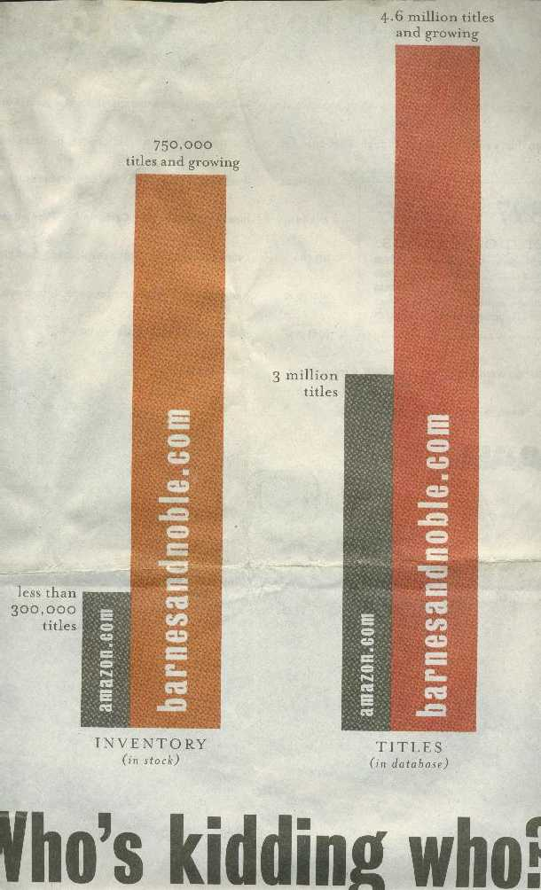

Slide 7
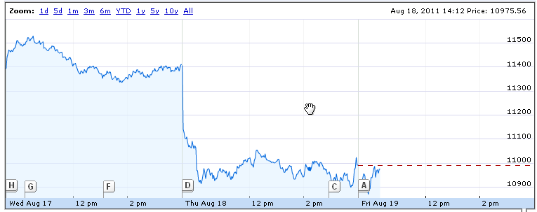

Slide 8
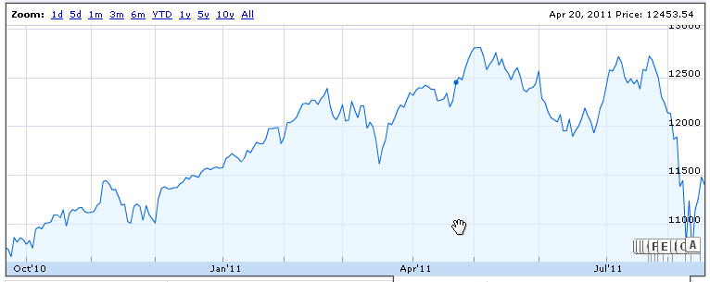

Slide 9
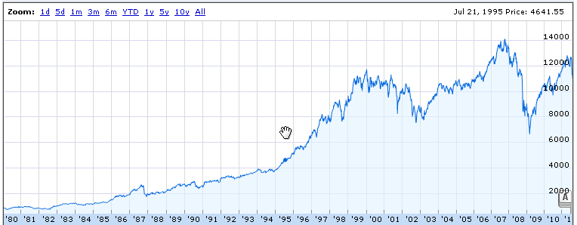

Slide 10
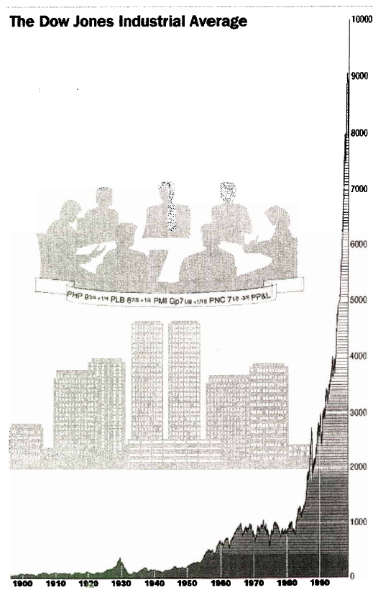

Slide 11
Eye Color of 46 Students
Relative
Eye Color Frequency Frequency
Brown 18 39%
Blue 17 37%
Green 6 13%
Hazel 4 9%
Other 1 2%
Total 46 100%

Slide 12
Frequency = Area
The most common graphical displays are based on calculating the relative frequency (percentage) that different groups occur, and then giving those groups areas based on those relative frequencies.

Slide 13
A pie chart is one common method of presenting such data… it’s generally not the best choice…

Slide 14
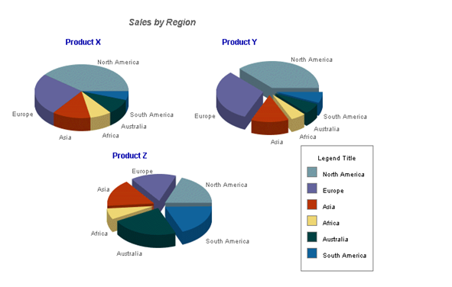
… and is often made even worse.

Slide 15
A bar graph (or bar chart) is another common, and better, choice…

Slide 16
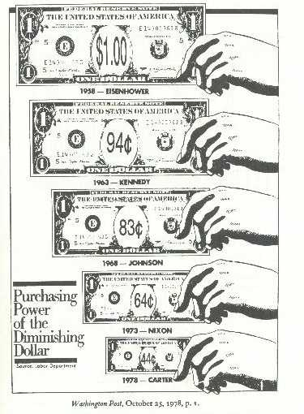
Pictograms use images besides bars… and are often made incorrectly.

Slide 17
Categorical versus Quantitative
Eye color above was an example of categorical data--there was no need to have the eye colors in a certain order.
When the data is quantitative (e.g. numeric) like age or income then a bar chart with the bars in order is commonly used, with the bars touching… and is called a histogram.

Slide 18
Classes
In many cases, quantitative data can take a large number of different values (consider annual salary), and the possible values are then broken into classes before calculating the frequency table.
For income, perhaps $0-$19,999.99, $20,000-$39,999.99, etc…

Slide 19
Which Classes
Section 2.2 gives some examples of constructing histograms and some general guidance on choosing the intervals. Most computer programs will have some default way of doing this.
Unfortunately histograms are very easy to manipulate…

Slide 20
0.0008
0.0008
D
D
0.0006
e
0.0006
e
n
n
s
0.0004
s
0.0004
i
i
t
0.0002
t
0.0002
y
y
0
3800
5000
6200
0
3600
4800
6000
salary
salary
D
0.0006
e
n
0.0004
s
i
t
0.0002
y
0
3700
4300
4900
5500
6100
6700
salary

Slide 21
Coming Later
Because of this, the boxplot (which is covered in section 2.8 in the fourth introductory video) and the quantile-quantile-plot (in section 5.4) are often much more reliable ways of getting a feeling about what a data set really looks like.

Slide 22
Shape, Center, and Spread
A data set is often described in terms of its shape, its center, and its spread, with shape being determined by looking at a graphical display.
Common descriptions of shape include:

Slide 23
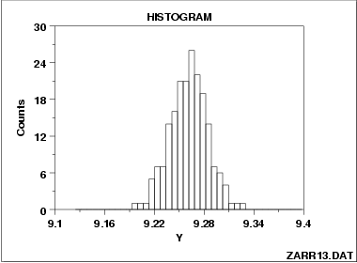
Approximately symmetric – the right and left sides of the histogram are approximately mirror images
unimodal – the data has one major peak

Slide 24
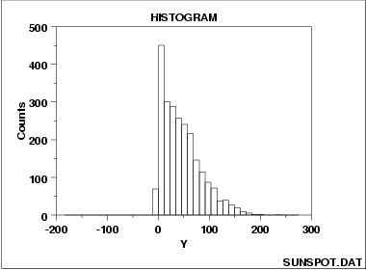
skewed right – the right side of the histogram (the half with the larger values) extends much farther than the left

Slide 25
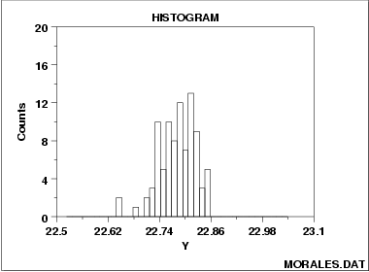
skewed left – the left side of the histogram (the half containing the smaller values) extends much farther than the right

Slide 26
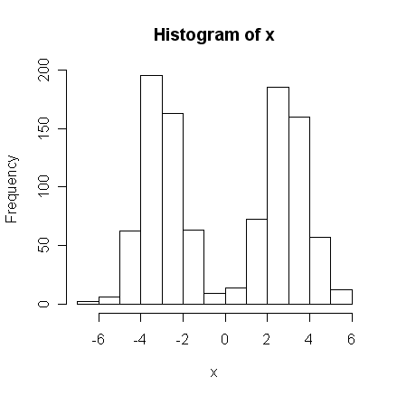
bimodal – the data set contains two major peaks

Slide 27
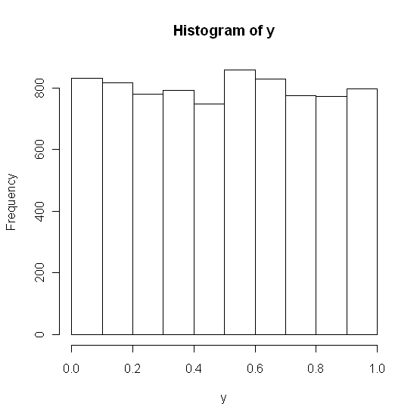
uniform – all values are roughly equally likely

Slide 28
Measures of Center
A measure of center is often informally called an “average” – but is often taken to mean “what value is typical”.
Three common measures of center are the mean, median, and mode.
(Section 2.4 gives examples of calculating these measures of center.)

Slide 29
The mean of a sample is found by adding up all of the values and dividing by the sample size.
Consider 1, 8, 3

Slide 30
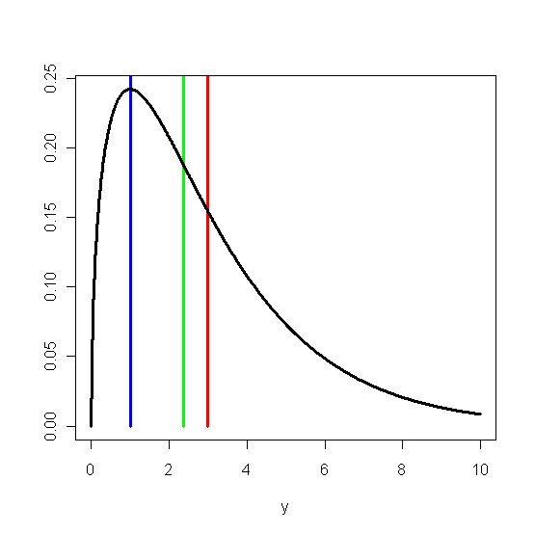
The red line in the graph to the right is the mean.

Slide 31
The sample median is the middle of the sorted values in a data set.
Consider 1, 8, 3
Consider 1, 8, 3, 4

Slide 32
The green line in the graph to the right is the median.
It is the value that has at least 50% of the observations greater than it and at least 50% of the observations less than it.

Slide 33
The blue line in the graph to the right is the mode – the most commonly occurring value.
It is the one that is least used as a statistic because there is often more than one, and it is difficult to develop theory for it.

Slide 34
Which to Use?
Mean and Median both have their own strengths and flaws.
Median – It is not affected by extreme values – if 49% of the observations are doubled, this “measure of center” doesn’t change at all.
Mean – It is strongly affected by outliers – adding one very large value to a data set can greatly change the mean, even though all of the data points but one are kept the same.

Slide 35
Example Revisited
Consider the data set 1, 3, 8 again

Slide 36
Which To Use?
Data is approximately symmetric and unimodal – use the mean (which in this case should be very close to the median)
Data is skewed – use the median
The mode is typically the odd measure out, but it occurs a great deal in mathematical statistics classes! There are also other (more complicated but possibly better) measures of center in more advanced classes (like STAT 518).

