Slide 1
STAT 515 Statistical Methods I Sections 2.4-2.5 The Variance and Standard Deviation Brian Habing Department of Statistics University of South Carolina Redistribution of these slides without permission is a violation of copyright law.

Slide 2
Outline
The logic behind the variance and standard deviation
The Empirical Rule and Chebychev’s Inequality
Z Scores

Slide 3
Example
Consider the data set 2, 3, 3, 4, 8

Slide 4
Measures of Variability
A measure of variability describes how spread out the data is.
Three common measures of spread are the range, the standard deviation, and the inter-quartile range.

Slide 5
The Range
The Range is the largest observation minus the smallest observation.

Slide 6
Something more informative?

Slide 10
The Standard Deviation
Variance:
Standard Deviation:

Slide 12
68-95-99.7
As we will see in Chapter 5, for a “normal distribution” roughly 68% of the observations fall within 1s of the mean, 95% within 2s, and 99.7 within 3s. (Text suggests range/4 to range/6 as an estimate of s.)

Slide 15
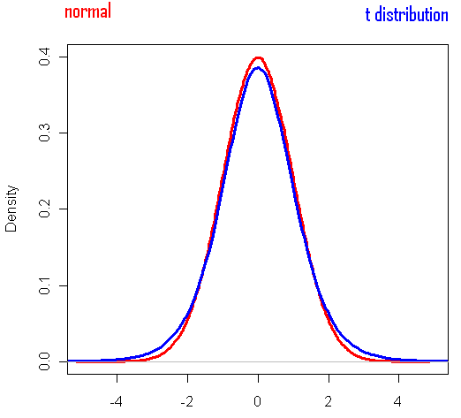

Slide 16
Chebyshev’s Inequality
Chebyshev’s inequality says that at least 1-1/k² of the data must be within k standard deviations of the mean for any distribution (that has a mean and sd).
Equivalently that at most 1/k² of the data can be further than k standard deviations away from the mean.

Slide 18
Example
Starting salaries in your field have a mean of $31,000 and a standard deviation of $5,000. What can we say about the percent with a starting salary between $26,000 and $36,000?

Slide 19
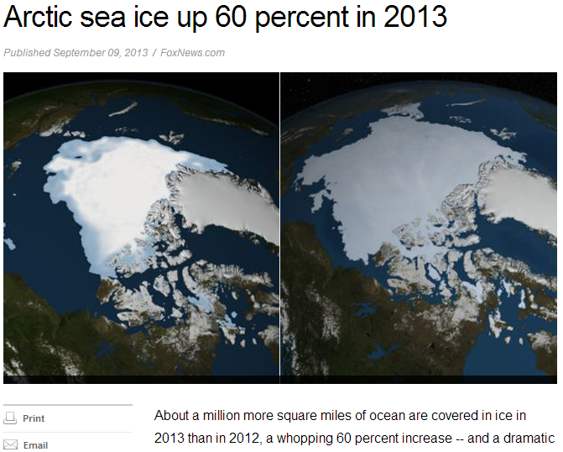

Slide 20
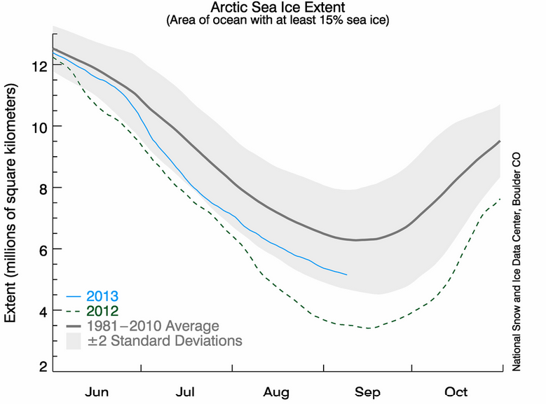

Slide 21
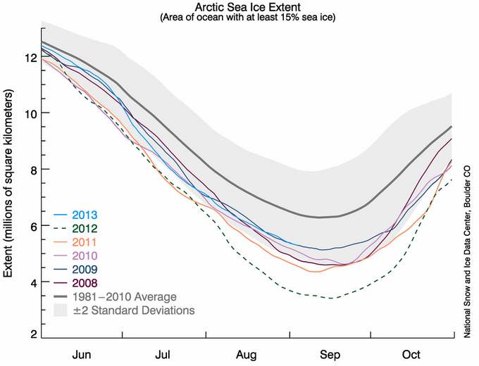

Slide 22
Others…
A huge number of other bounds also exist (check out Chebyshev’s inequality on Wikipedia for example).
The Vysochanskiï-Petunin inequality says that for a unimodal distribution that at most, the percent of observations more than k standard deviations from the mean is the maximum of (4/(3k²) -1/3 and 4 /(9k²) )
Conditions such as continuity and symmetry can also affect the bounds.

Slide 23
Z-Scores

