Slide 1
STAT 515 Statistical Methods I Sections 2.6-2.7 Percentiles and Boxplots Brian Habing Department of Statistics University of South Carolina Redistribution of these slides without permission is a violation of copyright law.

Slide 2
Outline
Percentiles
Five Number Summary
Outliers

Slide 3
Percentiles
The pth percentile of a set of measurements has at least p% of the measurements at or below it and at least (100-p)% of the measurements at or above it.

Slide 4
Example
Consider the data set 2, 3, 3, 4, 8

Slide 5
Percentiles
SAS has five ways of calculating percentiles!
http://support.sas.com/documentation/cdl/en/procstat/63104/HTML/default/viewer.htm#procstat_univariate_sect028.htm

Slide 6
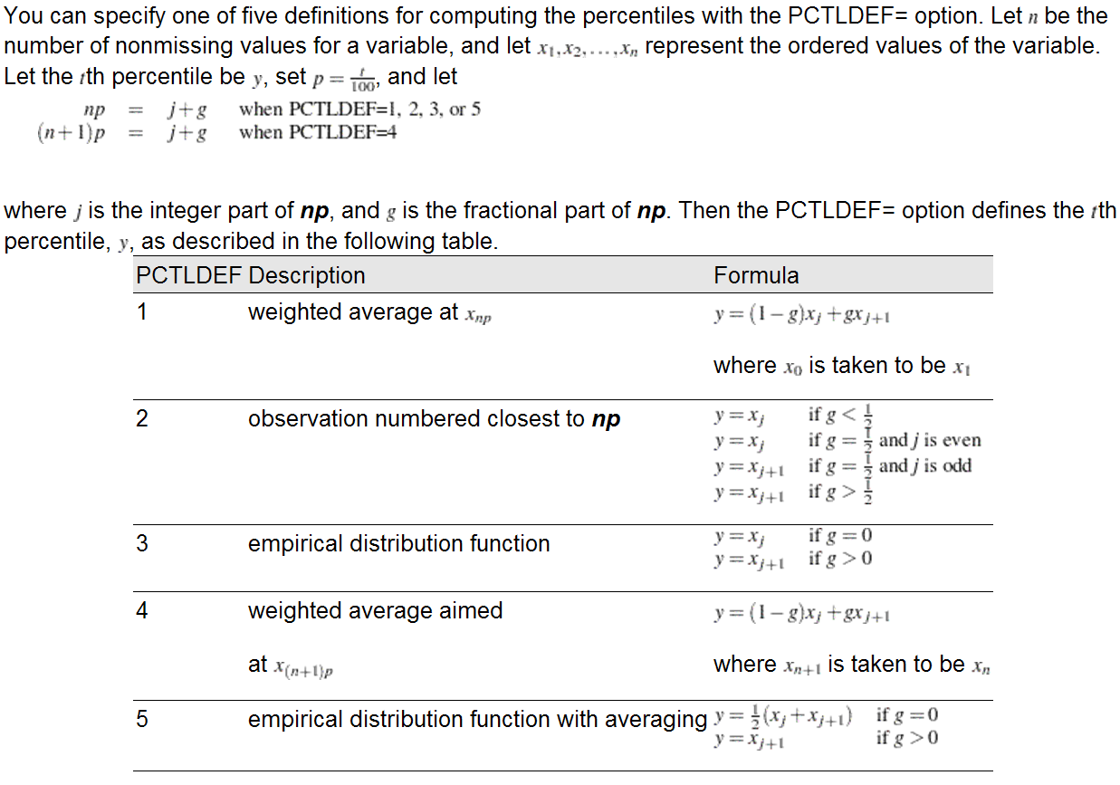

Slide 7
Quartiles
Consider the data set 2, 3, 3, 4, 8

Slide 8
Inter-quartile Range
IQR = 75th percentile – 25th percentile
“Five number summary” is the minimum, 25th percentile, median, 75th percentile, and the maximum.

Slide 9
Which To Use?
Data is approximately symmetric and unimodal – use the mean and standard deviation
Otherwise – use the five number summary

Slide 10
Box Plot

Slide 11
Box Plot

Slide 13
Example revisited
Consider the data set 2, 3, 3, 4, 8

Slide 14
Outliers
Outliers are values that are unusual in the context of the data set. If the data consists of one variable they are usually the values that are unusually large or unusually small.
Common explanations of outliers are:
Error in observing or recording the value
Comes from a different population
A rare event

Slide 15
Outliers
Outliers can only be removed in the case where it is clearly an error in observation or recording… not just because you think it was an error.
One option is to report the results both with and without the outlier(s).

