Slide 1
STAT 515 Statistical Methods I Lecture 1 August 22, 2019 Originally prepared by Brian Habing Department of Statistics University of South Carolina Redistribution of these slides without permission is a violation of copyright law.

Slide 2
Outline for Today
The Syllabus
What’s Coming Next
Brief Introduction to SAS
Brief Introduction to R (see online handouts)

Slide 3
To do…
Go over Chapter 1 and 2 if you haven’t already.
Homework 1, using your choice of SAS or R, will be posted on Blackboard. It is due Tuesday, September 3.

Slide 4
What Is Statistics? Dictionary definition
American Heritage® Dictionary: “The mathematics of the collection, organization, and interpretation of numerical data, especially the analysis of population characteristics by inference from sampling.”

Slide 5
What Is Statistics?
Statistics Is the Science of Data…
Gathering Data: Design of Experiments and Surveys
Describing Data: Descriptive Statistics
Using Data to Make Decisions: Inference about Populations from Samples
The Theory Behind Analyzing Data: Mathematical Statistics and Theoretical Probability

Slide 6
Syllabus
In particular, you will need access to a computer package (your choice, but we’ll be using R and SAS for examples)… and a copy of the textbook.

Slide 7
For the Record…
The central goal of the course is for you to be able to both carry out the various data analyses and intuitively understand why they should or shouldn’t work in a given circumstance. Because of this, we will skim the surface of some of the math hiding behind the scenes.

Slide 8
… It Will Be Ok!
Every so often, it might look like things are veering off a bit too mathematically – I will always highlight the results that you need to remember (and they will tie in to the practical things!) and you will never have to do any “proofs” on any homework or exams. That’s what STAT 511, 512, and 513 are for!

Slide 9
General Outline: First exam
The material covered before the first exam falls mostly into two areas:
Developing a working knowledge of the basic rules of probability so that what follows will make sense.
An overview of the most widely used discrete probability distributions and the normal distribution.

Slide 10
General Outline: Second Exam
The material covered between the first and second exams also falls into two main areas:
The probability distributions of the sample mean and the sample variance - results that form the core of most of the methods of STAT 515 (and 516).
Methods for making statistical statements about one or two means, proportions, or variances .
The concept of power and how to do basic calculations involving it.

Slide 11
General Outline
The material covered between the second exam and final exam is:
A hypothesis test for testing the equality of more than two means.
Simple linear regression – predicting one continuous variable from another.
Methods for analyzing qualitative data that come from counting the number of observations that fall in different groups.
A short introduction to Nonparametric methods.

Slide 12
General Outline: Final Exam
These last topics lead directly into STAT 516 (Statistical Methods II) and STAT 518 (Nonparametric Statistical Methods). STAT 515 also gives you the needed background to take other courses such as Sampling (519), Quality Control (525), Multivariate Statistics (530), and Computing in Statistics (540).

Slide 13
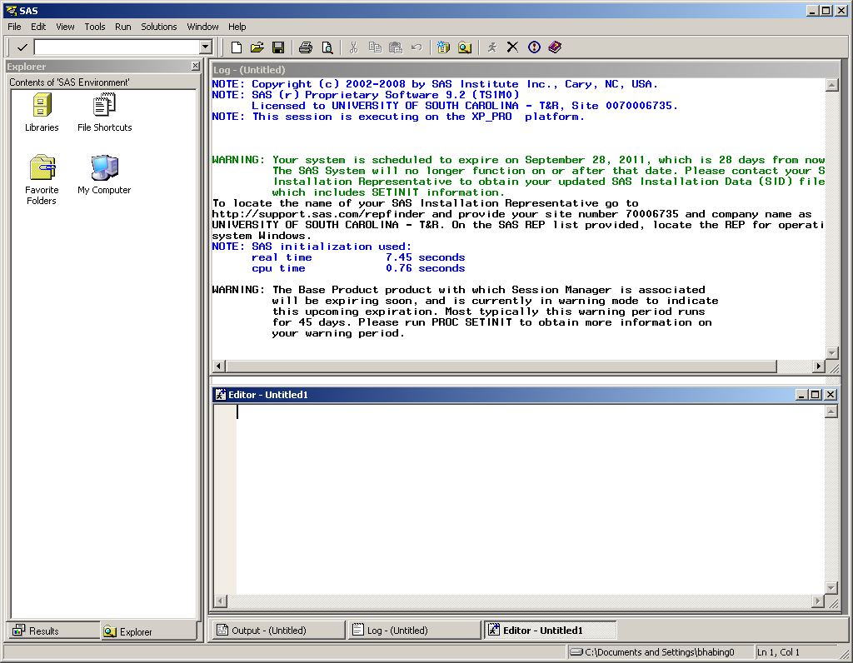
SAS Windows Opening Screen

Slide 14
SAS On Demand

Slide 15
Initial SAS Commands
proc format;
value $ groupfmt "new"="New"
"stand"="Standard";
run;
data examp94;
*The $ sign indicates a character variable;
*@@ allows multiple records to be read from a single line;
input Group $ Value @@; format Group groupfmt.;
datalines;
new 80 new 80 new 79 new 81
stand 79 stand 62 stand 70 stand 68
New 76 new 66 new 71 new 76
stand 73 stand 76 stand 86 stand 73
new 70 new 85
stand 72 stand 68 stand 75 stand 66 ;
run;
proc print data=examp94;
run;

Slide 16
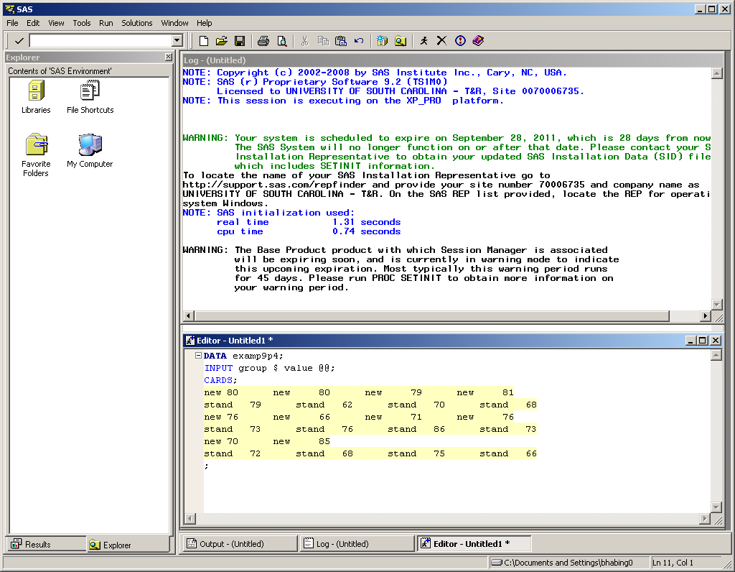
SAS for Windows

Slide 17
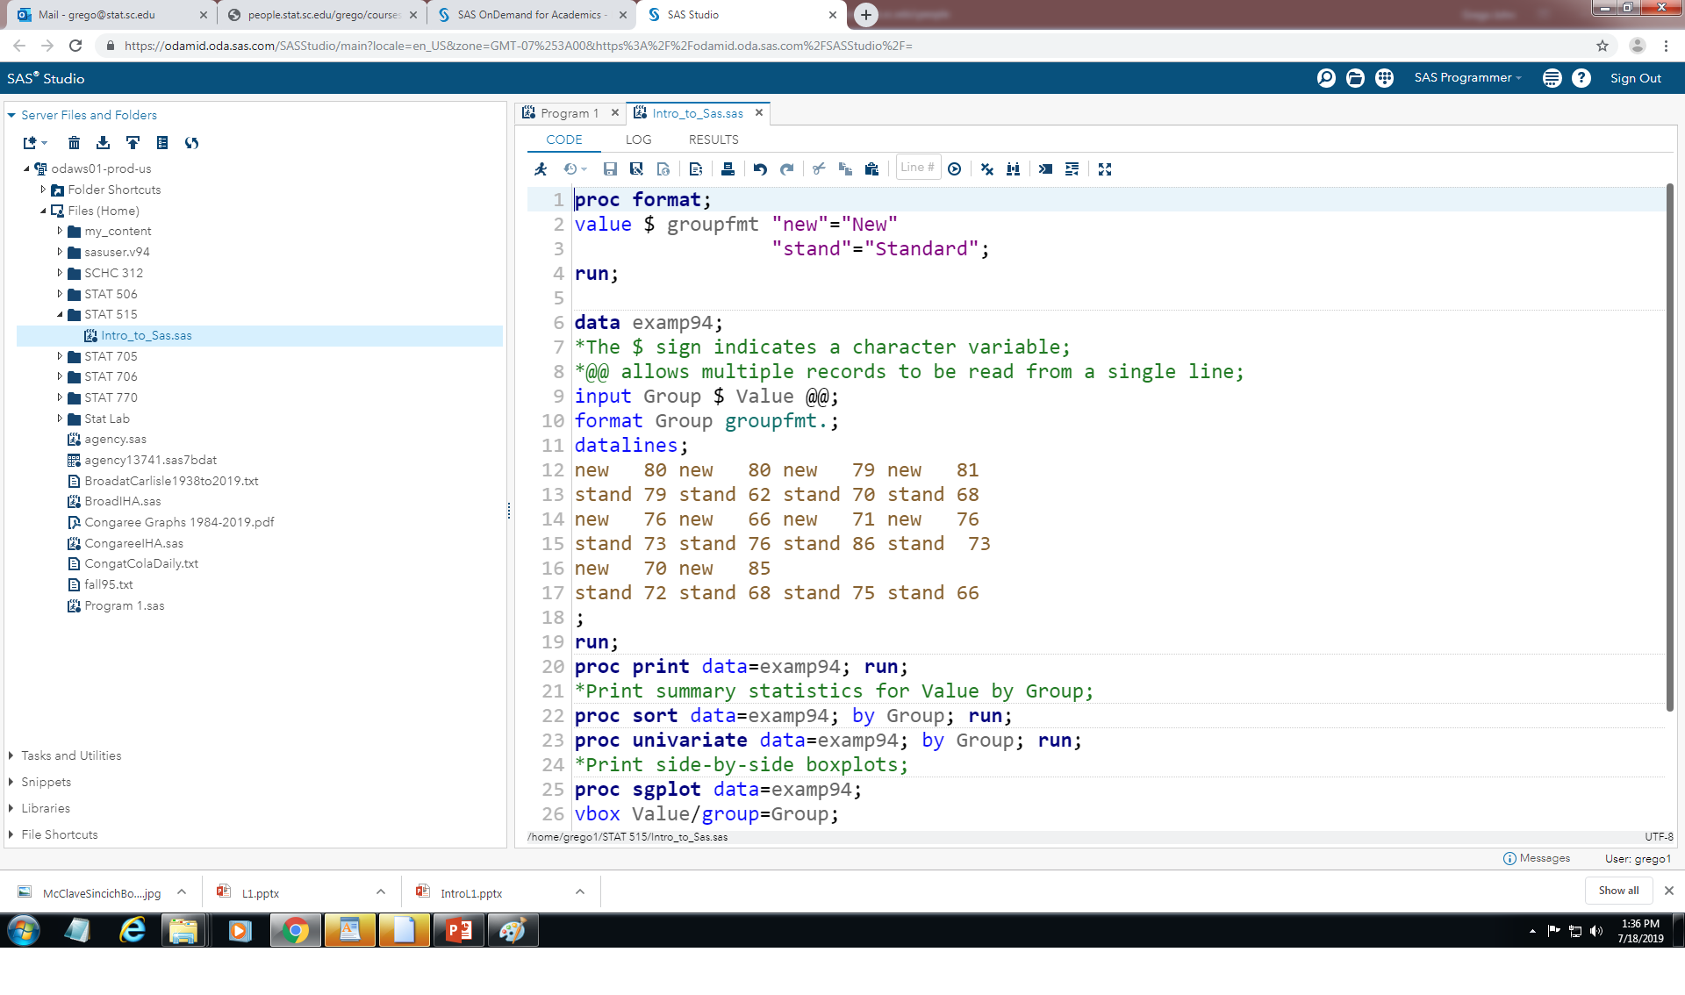
SAS Studio

Slide 18
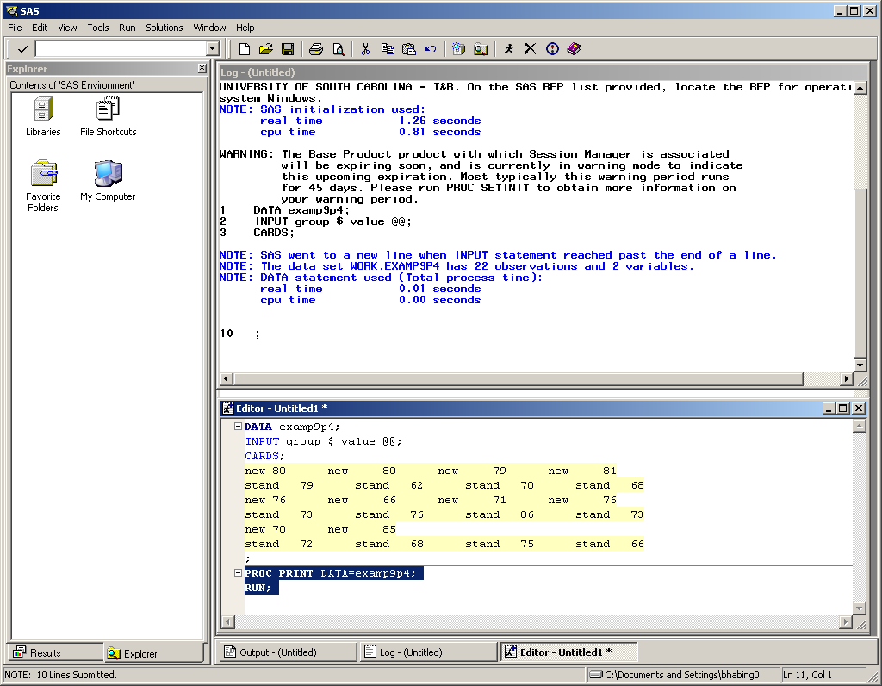
SAS for Windows: Initial commands

Slide 19
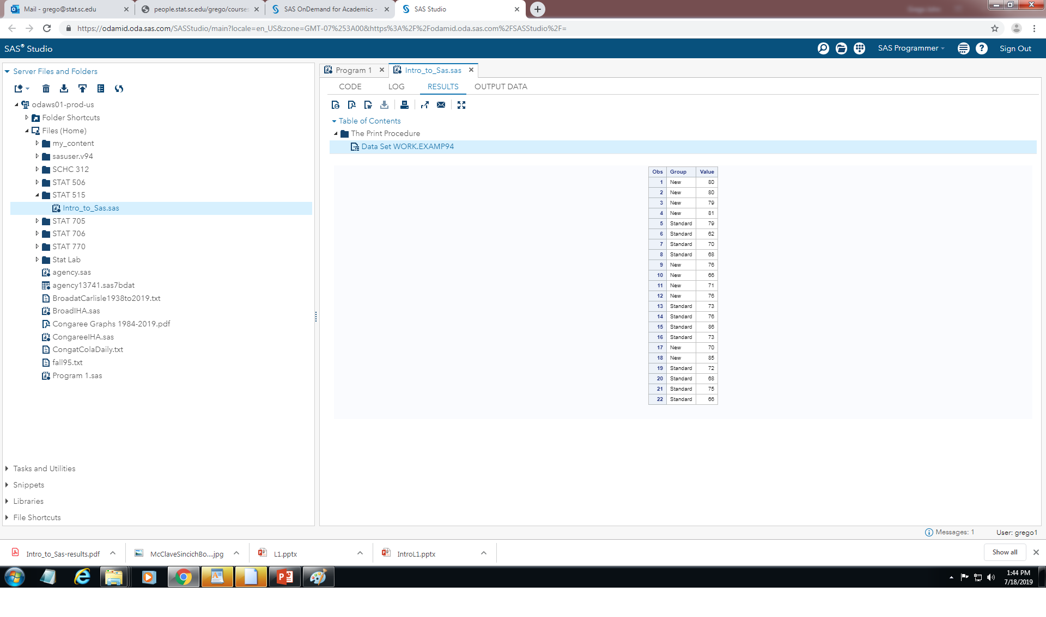
SAS Studio: PROC PRINT output

Slide 20
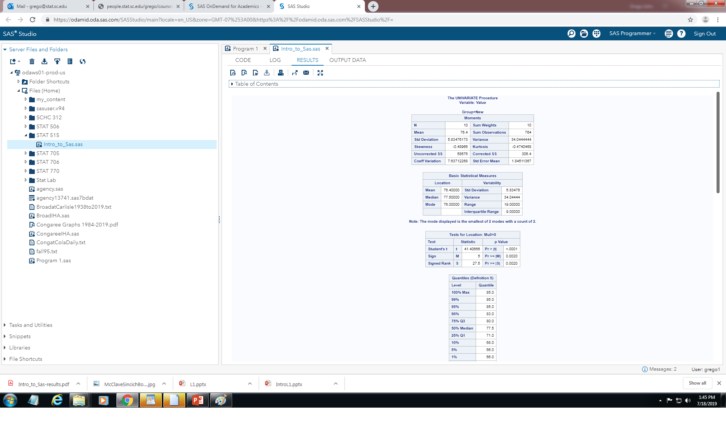
SAS Studio: PROC UNIVARIATE output

Slide 21
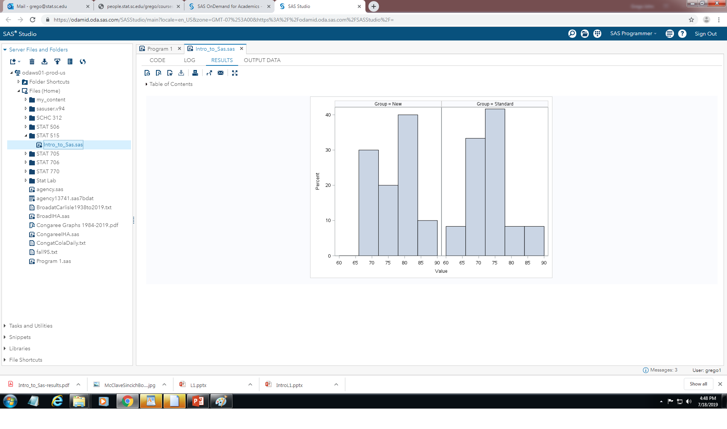
SAS Studio: PROC SGPANEL output

Slide 22
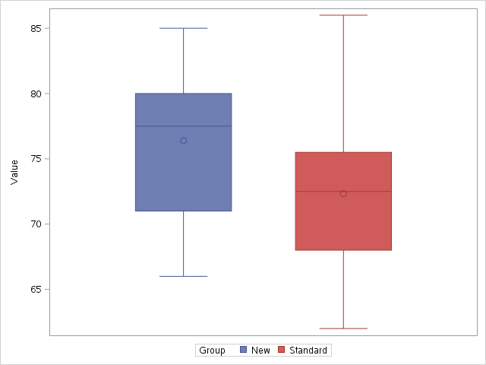
SAS Studio: PROC SGPLOT output

