Slide 1
STAT 515 Lecture 10 September 24, 2019
Originally prepared by Brian Habing
Department of Statistics
University of South Carolina
Redistribution of these slides without permission is a violation of copyright law.

Slide 2
Outline for Today
Sampling Distributions
You should read 6.1-6.3
Test 1 is this Thursday, September 26
HW 4 is due Thursday, October 3

Slide 3
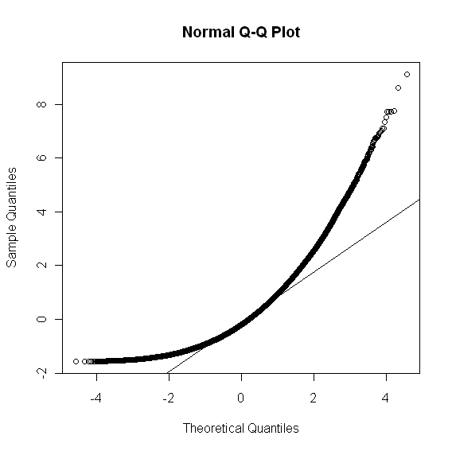
Robustness
What if the data wasn’t normal?
> z=matrix(rchisq(10000*20,df=5),ncol=20)
> z=(z-5)/sqrt(10)
> mean(c(z))
[1] 0.001372528
> sd(c(z))
[1] 1.003290
> qqnorm(c(z));qqline(c(z))

Slide 4
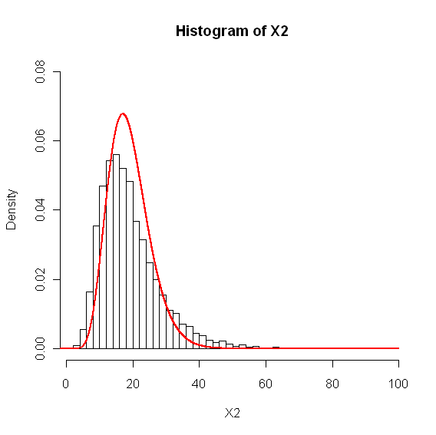
sig2=1
s2=apply(z,1,var)
X2=(20-1)*s2/sig2
hist(X2,freq=F,ylim=c(0,0.08),nclass=50)
vals=seq(0,65,by=0.01)
f=dchisq(vals,df=19)
lines(vals,f,col="red",lwd=2)

Slide 5
t Distribution
Let X ² be a Chi-squared random variable with n degrees of freedom and Z be an independent standard normal.
has a t distribution with n degrees of freedom.

Slide 6
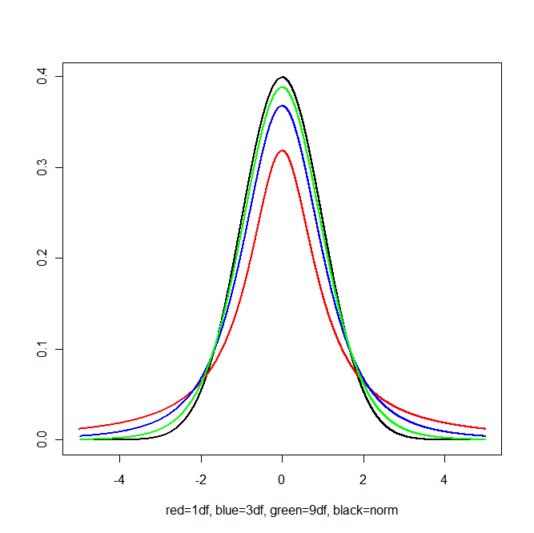
t Distribution

Slide 9
t Distribution
Let X₁, X₂, … X_{n} be i.i.d. normal random variables with mean μ and sd σ:
has a t distribution with n-1 degrees of freedom.
This relationship is fairly robust to non-normality, especially for large sample sizes.

Slide 11
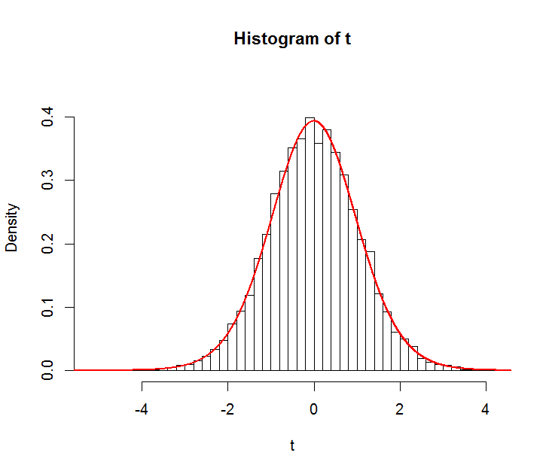
Robustness
Histogram of
for 10,000 samples of size 20 when the population is really normal.

Slide 12
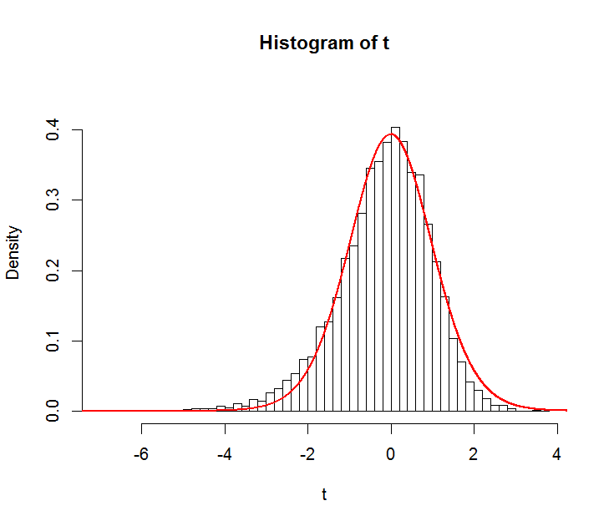
Robustness
Histogram of
for 10,000 samples of size 20 when the population is actually skewed right.

Slide 14
F Distribution
Let X ² be a Chi-squared random variable with n degrees of freedom and Y ² be an independent Chi-squared random variable with m degrees of freedom
has an F distribution with n and m degrees of freedom.

Slide 16
F Distribution
Let X₁₁, X₁₂, … X_{1n1} be i.i.d. normal random variables with mean μ₁ and sd σ₂ that are independent of X₂₁, X₂₂, … X_{2n2} which are i.i.d. normal random variables with mean μ₂ and sd σ₂. Then
has an F distribution with n₁-1 and n₂-1 degrees of freedom. This relationship is not robust to non-normality.

Slide 18
Example from last time…
The skidding distance of meters along a road is measured in meters at 20 randomly selected road sites. What can we say about the variance of all skidding distances?.
The observed values are:
488 350 457 199 285 409 435 574 439 546
385 295 184 261 273 400 311 312 141 425
(Journal of Forest Engineering, July 1999)

Slide 19
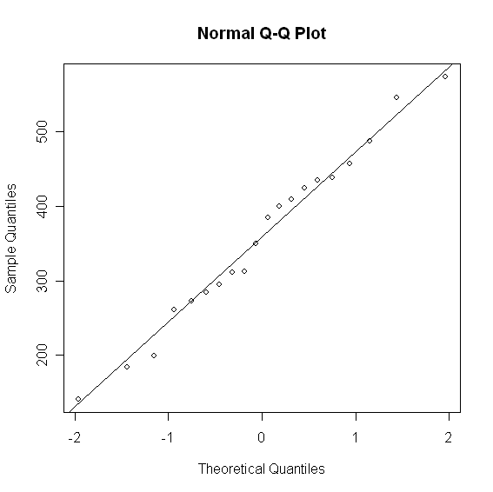
Descriptive Statistics for Skidding Data

Slide 20
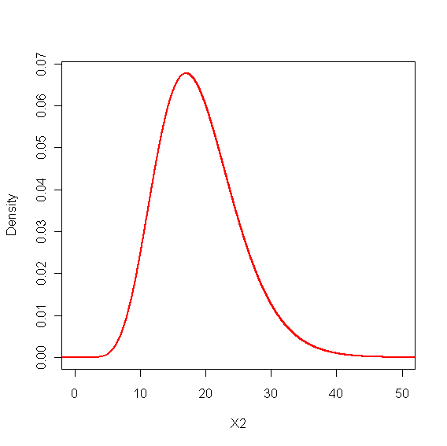
> qchisq(.025,df=19)
[1] 8.906516
> qchisq(.975,df=19)
[1] 32.85233

Slide 24
What about the mean?
The skidding distance of meters along a road is measured in meters at 20 randomly selected road sites. What can we say about the mean of all skidding distances?
The observed values are:
488 350 457 199 285 409 435 574 439 546
385 295 184 261 273 400 311 312 141 425
(Journal of Forest Engineering, July 1999)

Slide 25
Descriptive Statistics for This Data

Slide 26
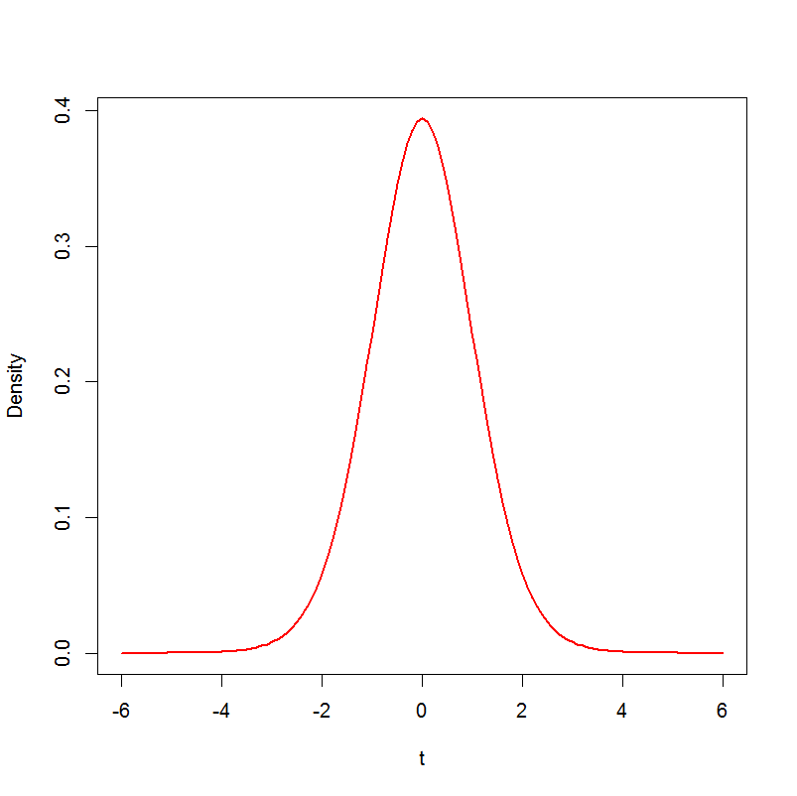
> qt(.025,df=19)
[1] -2.093024
> qt(.975,df=19)
[1] 2.093024

