Slide 1
STAT 515 Lecture 12 September 30, 2019
Originally prepared by Brian Habing
Department of Statistics
University of South Carolina
Redistribution of these slides without permission is a violation of copyright law.

Slide 2
Outline for Today
Introduction to Confidence Intervals
Should Read 7.1 to 7.3, 7.6
Homework 4 is due Thursday, Oct 3

Slide 3
Sampling Distributions
A sampling distribution is the probability distribution of a statistic.

Slide 4
The Central Limit Theorem
If X₁, X₂, … are an iid sequence of random variables from a population with mean μ and standard deviation σ then:
for large enough n.

Slide 5
Sampling Distribution for the Sample Percentage
Let X be a binomial random variable with sample size n and probability p , then
and
for large enough n.

Slide 6
Sampling Distribution for the Mean
If X₁, X₂, … are an iid sequence of random variables from a population with mean μ and standard deviation σ then the CLT says:
for large enough n.

Slide 7
Sampling Distribution for the Variance
Let X₁, X₂, … X_{n} be i.i.d. normal random variables with mean μ and sd σ:
has a Chi-squared distribution with n-1 degrees of freedom.
This relationship is not robust to non-normality.

Slide 8
Sampling Distribution for the Mean
Let X₁, X₂, … X_{n} be i.i.d. normal random variables with mean μ and sd σ:
has a t distribution with n-1 degrees of freedom.
This relationship is fairly robust to non-normality, especially for large sample sizes.

Slide 9
Sampling Distribution for the Ratio of Variances
Let X₁₁, X₁₂, … X_{1n1} be i.i.d. normal random variables with mean μ₁ and sd σ₂ that are independent of X₂₁, X₂₂, … X_{2n2} which are i.i.d. normal random variables with mean μ₂ and sd σ₂. Then
has an F distribution with n₁-1 and n₂-1 degrees of freedom. This relationship is not robust to non-normality.

Slide 10
For each of the following, what is the corresponding distribution, what are the assumptions, and what can we say about the robustness (if applicable)?

Slide 11
Example from last time…
The skidding distance of meters along a road is measured in meters at 20 randomly selected road sites. What can we say about the variance of all skidding distances?.
The observed values are:
488 350 457 199 285 409 435 574 439 546
385 295 184 261 273 400 311 312 141 425
(Journal of Forest Engineering, July 1999)

Slide 12
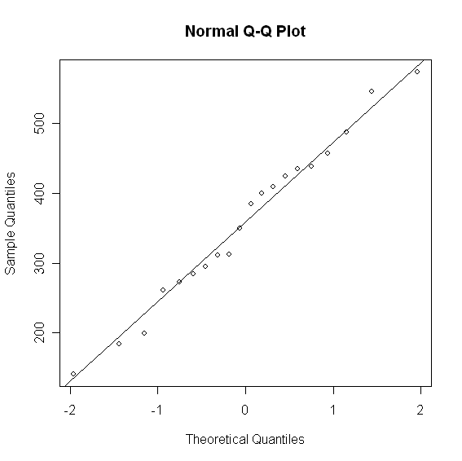
Descriptive Statistics for This Data

Slide 13
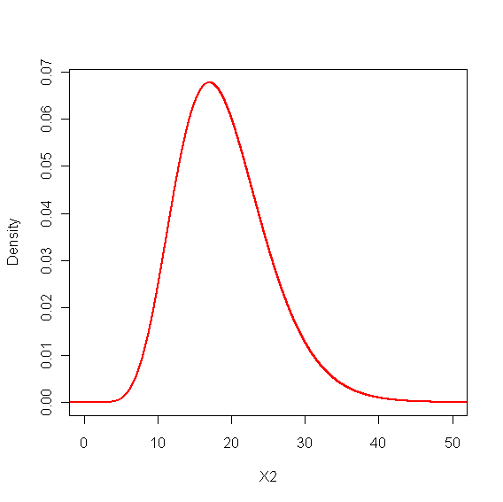
> qchisq(.025,df=19)
[1] 8.906516
> qchisq(.975,df=19)
[1] 32.85233

Slide 17
We are 95% confident that the population variance in skidding distance is between 8,028.0 and 29611.7 meters-squared.
So we are 95% confident that the population standard deviation in skidding distance is between 89.6 and 172.1 meters.

Slide 18
95% of all confidence intervals made for this experiment will contain the true population standard deviation of all skidding distances, 5% won’t.
This particular confidence interval of 89.6 to 172.1 meters either contains the true standard deviation of all skidding distances (is 100% correct), or it doesn’t (is 0% correct). We don’t know if it does or not.

Slide 19
What about the mean?
The skidding distance of meters along a road is measured in meters at 20 randomly selected road sites. What can we say about the mean of all skidding distances?
The observed values are:
488 350 457 199 285 409 435 574 439 546
385 295 184 261 273 400 311 312 141 425
(Journal of Forest Engineering, July 1999)

Slide 20
Descriptive Statistics for This Data

Slide 21
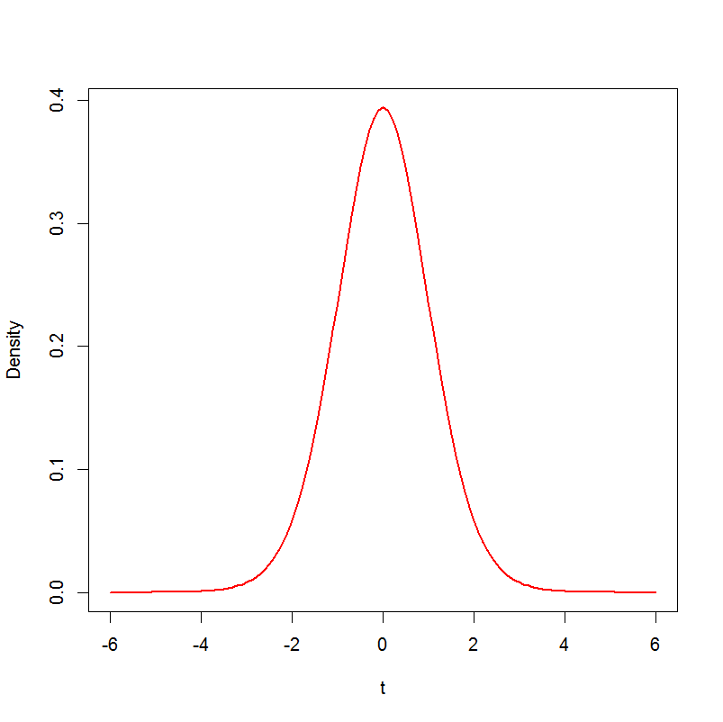
> qt(.025,df=19)
[1] -2.093024
> qt(.975,df=19)
[1] 2.093024

Slide 26
Example 2
The deviation intelligence quotients for 10 specifically language impaired (SLI) children and 10 younger, normally developing children are:
SLI: 86, 87, 84, 94, 86, 107, 89, 98, 95, 110
YND: 110, 90, 105, 92, 92, 96, 86, 100, 92, 90
Journal of Communication Disorders, March 1995

Slide 27
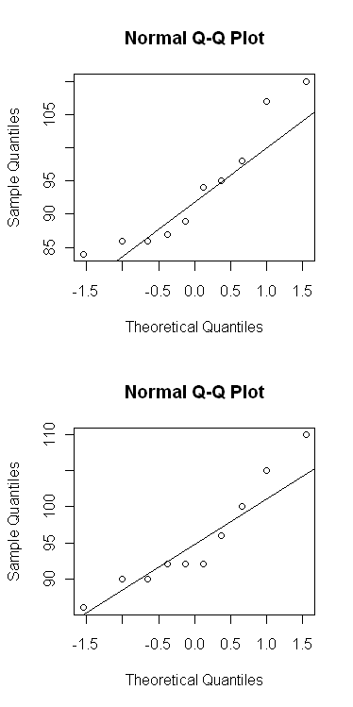
Descriptive Statistics for This Data

Slide 28
Construct a 95% CI for the ratio of the two standard deviations

