Slide 1
STAT 515 Lecture 13 October 3, 2019
Originally prepared by Brian Habing
Department of Statistics
University of South Carolina
Redistribution of these slides without permission is a violation of copyright law.

Slide 2
Outline for Today
Finishing Confidence Intervals (7.4-7.5)
Homework 4 is due today
Homework 5 is due Tuesday, October 15

Slide 3
For each of the following, what is the corresponding distribution, what are the assumptions, and what can we say about the robustness (if applicable)?

Slide 4
For each of the following, what is the corresponding distribution, what are the assumptions, and what can we say about the robustness (if applicable)?

Slide 7
Another CI Example
A candidate wants an estimate of what their current support is among all of the registered voters in South Carolina.
A random sample of 200 registered voters shows that 94 would currently vote for them. Construct a 95% confidence interval for the percent of support.

Slide 8
Example Continued

Slide 9
Example Continued

Slide 10
Approximate Approximate Confidence Interval

Slide 11
Approximate Approximate Confidence Interval

Slide 12
Example Continued

Slide 13
Agresti, A. & Coull, B.A. (1998). Approximate is Better than “Exact” for Interval Estimation of Binomial Proportions. The American Statistician, 52, 119-126.
(Available on a university computer or if logged in through the library.)

Slide 14
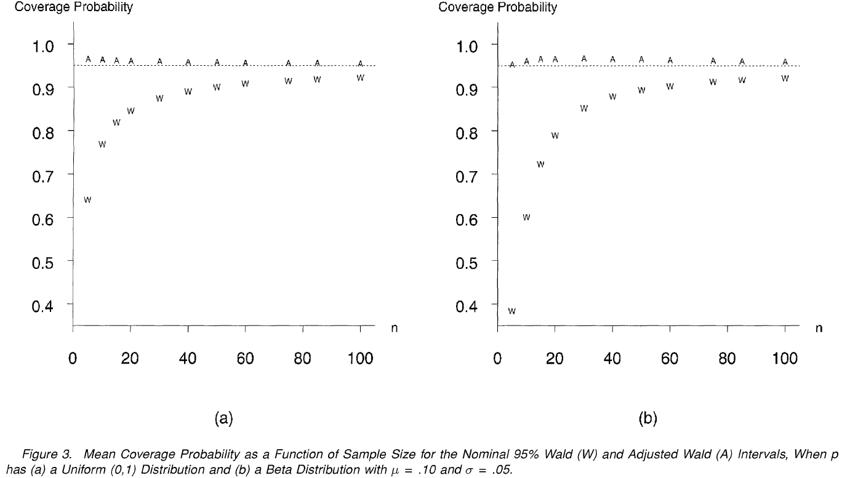

Slide 15
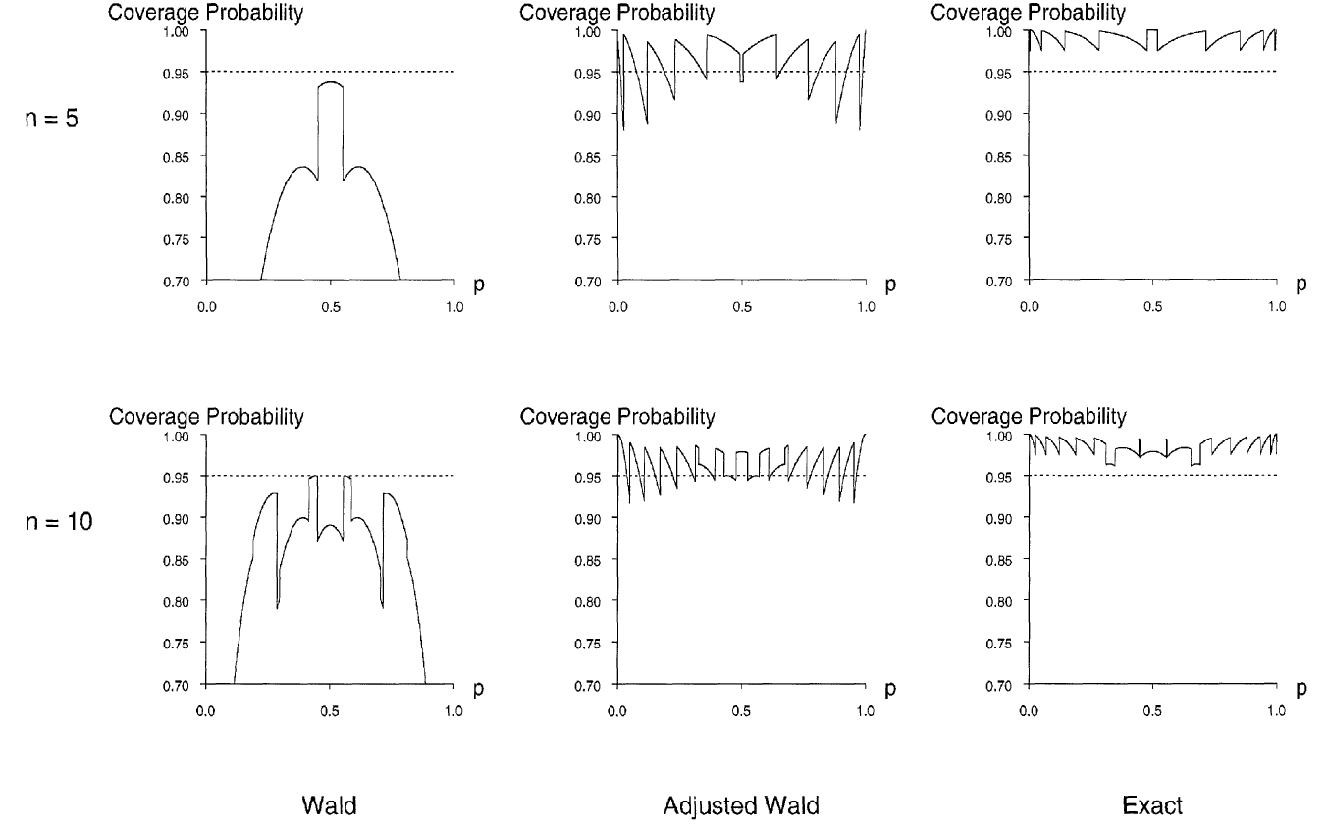

Slide 16
Adjusted Confidence Interval
Agresti, A. & Coull, B.A. (1998). Approximate is Better than “Exact” for Interval Estimation of Binomial Proportions. The American Statistician, 52, 119-126.

Slide 17
Example Continued

Slide 18
Width of Confidence Intervals

Slide 19
Determining Needed Sample Size
Say we expect σ to be approximately 15. Approximately how large does n need to be to have the 95% confidence level for μ to be ± 1?

Slide 20
Determining Needed Sample Size
What sample size is needed for a 95% confidence interval for a population proportion to be ± .03?

Slide 21
Determining Needed Sample Size

