Slide 1
STAT 515 Lecture 14 October 8, 2019
Originally prepared by Brian Habing
Department of Statistics
University of South Carolina
Redistribution of these slides without permission is a violation of copyright law.

Slide 2
Outline for Today
Finishing Confidence Intervals (7.5)
Starting Hypothesis Tests (Sections 8.1-8.4)
Homework 5 is due Tuesday, October 15.

Slide 3
For each of the following, what is the corresponding distribution, what are the assumptions, and what can we say about the robustness (if applicable)?

Slide 5
Hypothesis Tests - Example
A simple random sample of size 20 is taken from a normal population with standard deviation σ = 5.2. We’re trying to find evidence that the population mean is less than 100. We observe a sample mean of 98.3.
Is this small enough to conclude the population mean is less than 100?

Slide 6
Hypotheses
H₀ is the null hypothesis. It is the “status quo” and what we are looking for evidence against. It will always involve an equals sign.

Slide 7
Hypotheses
H_{A} (or H₁) is the alternate hypothesis. It is the “experimental hypothesis” and what we are looking for evidence of. It will typically involve either >, <, or ≠ .

Slide 8
Errors
If we make a decision involving our hypotheses, there are two types of errors we could make:
Type I error – we reject the null hypothesis when it is really true
Type II error – we fail to reject the null hypothesis when it is false

Slide 9
What Kind of Evidence?

Slide 10
Can We Use It?

Slide 11
What do we have?

Slide 12
How Much Evidence?
The α-level of a test is the probability that we are willing to make a Type I error if H₀ is true.
α=P(reject H₀ | H₀ is true)
Typically use α=0.10, 0.05, or 0.01.

Slide 13
Stating Your Conclusion
At an α=0.05 level of significance we fail to reject the null hypothesis. We do not have enough evidence to conclude the population mean is less than 100.
*The phrase “Accept the null hypothesis” is strongly discouraged.

Slide 14
Stating Your Conclusion
At an α=0.10 level of significance we reject the null hypothesis. We conclude the population mean is less than 100.
We need to select the α-level in advance!

Slide 15
Different H_{A}

Slide 16
Different H_{A}

Slide 17
We Could Be Wrong!!!
β is the probability that we are willing to make a Type II error if H₀ is false.
β=P(fail to reject H₀ | H₀ is false)
How it’s false depends on the true value of the parameter!
Power=P(reject H0 | H0 is false)

Slide 18
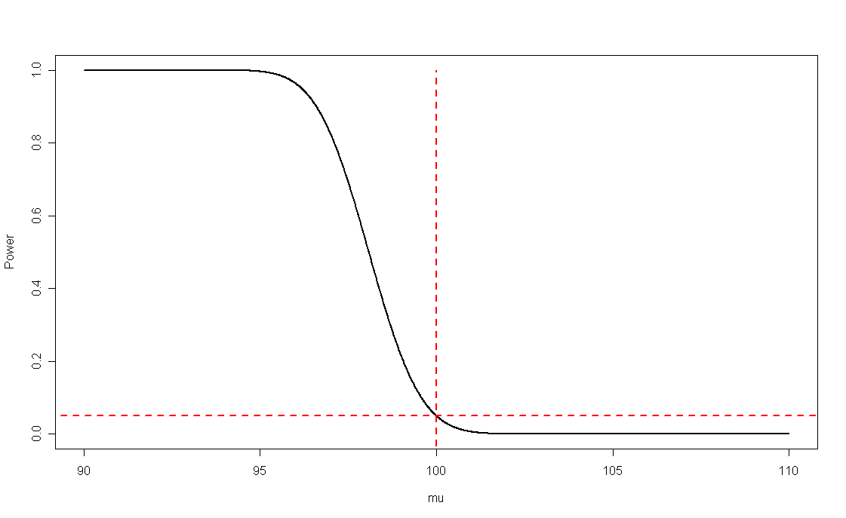
Power Curve

Slide 19
Choosing α
Often the α-level is set by law or some convention in your field.
In general, the size of α should be related to the consequence of a type I error.
We can’t set it to zero!

