Slide 1
STAT 515 Lecture 15 October 15, 2019
Originally prepared by Brian Habing
Department of Statistics
University of South Carolina
Redistribution of these slides without permission is a violation of copyright law.

Slide 2
Outline for Today
Continuing Hypothesis Tests (Sections 8.1-8.4)
Homework 6 is due Thursday, October 24

Slide 3
For each of the following, what is the corresponding distribution, what are the assumptions, and what can we say about the robustness (if applicable)?

Slide 5
Hypothesis test Example 2
A simple random sample of size 16 is taken from a population with standard deviation σ=10. We are trying to find evidence that the population mean is greater than 35. The sample mean is 39 and we are using α=0.10.

Slide 6
Questions
What is H₀?
What is H_{A}?
What relationship are we using?

Slide 7
Questions
What would a Type I error be?
What would a Type II error be?

Slide 8
Questions
What is the rejection region?
Is the test statistic in the rejection region?

Slide 9
Questions
What is your conclusion?

Slide 10
p-value (or “empirical significance level”)
The p-value is the probability of observing a test statistic at least as extreme as the one observed if H0 is true.
We reject H₀ when the p-value is ≤ α .

Slide 11
Null Hypothesis Significance Testing in the news
There has been heated discussion about NHST and other fundamental statistical methods.
ASA Statement on p-values

Slide 12
Null Hypothesis Signficance Testing in the news
Some of the discussion attacks the methods themselves
Some of the discussion attacks the ways in which statistical methods have been adapted

Slide 13
HT Example 1
H_{A}: μ<100
z = -1.46

Slide 14
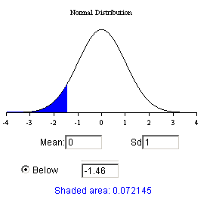
HT Example 1
H_{A}: μ<100
z = -1.46

Slide 15
HT Example 2
H_{A}: μ>35
z = 1.60

Slide 16
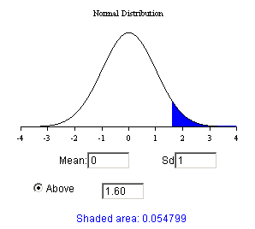
HT Example 2
H_{A}: μ>35
z = 1.60

Slide 17
HT Example 2: ≠ Version
H_{A}: μ ≠ 35
z = 1.60

Slide 18
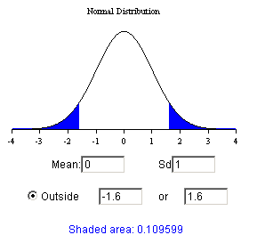
HT Example 2: ≠ Version
H_{A}: μ ≠ 35
z = 1.60

