Slide 1
STAT 515 Lecture 16 October 17, 2019
Originally prepared by Brian Habing
Department of Statistics
University of South Carolina
Redistribution of these slides without permission is a violation of copyright law.

Slide 2
Outline for Today
Hypothesis Tests (Sections 8.4-8.6)
Homework 6 is due Thursday, October 24

Slide 3
For each of the following, what is the corresponding distribution, what are the assumptions, and what can we say about the robustness (if applicable)?

Slide 5
Example 3
The Australian Journal of Zoology (1995) reported the weight of dry seed in the crop of sixteen spinifex pigeons from the Western Australian desert. Test the alternative hypothesis that the population mean is not equal to one at an α=0.10 level.
Data:
0.457 3.751 0.238 2.967 2.509 1.384 1.454 0.818
0.335 1.436 1.603 1.309 0.201 0.530 2.144 0.834

Slide 7
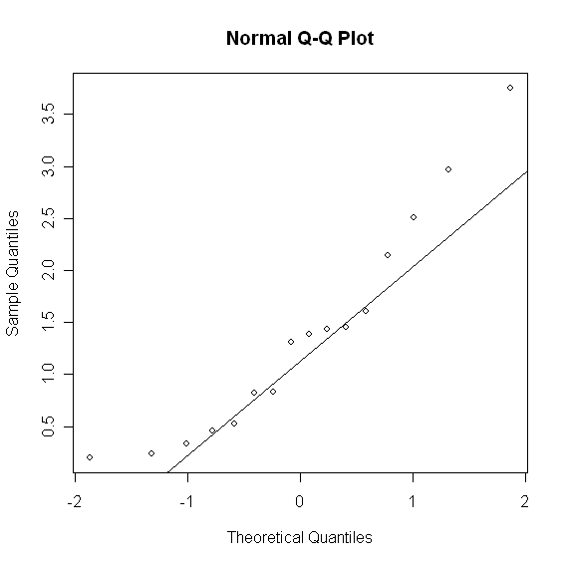
Descriptive Statistics for This Data

Slide 8
HT Example 3

Slide 9
HT Example 3

Slide 10
HT Example 3 -Variance

Slide 11
Example 4
A manufacturer claims that its products has a 4% defective rate. A major user of their product thinks it is higher and takes a simple random sample of size 500 from the last ten shipments they received to test that hypothesis at the α=0.05 level. They observe 26 defectives in their sample.

Slide 12
HT Example 4

Slide 13
HT Example 4

Slide 14
HT Example 4

Slide 15
HT Example 5
The deviation intelligence quotients for 10 specifically language impaired (SLI) children and 10 younger, normally developing children are gathered. Test the hypothesis that the SLI group has a larger variance at α=0.05.
Data:
SLI: 86, 87, 84, 94, 86, 107, 89, 98, 95, 110
YND: 110, 90, 105, 92, 92, 96, 86, 100, 92, 90
Journal of Communication Disorders, March 1995

Slide 16
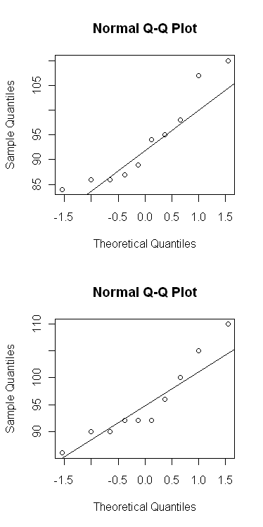
Descriptive Statistics for This Data

Slide 17
HT Example 5

Slide 18
HT Example 5

Slide 19
HT Example 5

