Slide 1
STAT 515 Lecture 17 October 22, 2019
Originally prepared by Brian Habing
Department of Statistics
University of South Carolina
Redistribution of these slides without permission is a violation of copyright law.

Slide 2
Outline for Today
Homework 6 is due Thursday, October 24
Some Practice
Tests of Hypotheses Continued
Should Read Sections 9.1-9.3 and 9.6

Slide 5
1) A random sample of size 20 is taken from a continuous population with mean 50 and standard deviation 5.
a) Give the central limit theorem based approximate probability that the sample mean will be less than or equal to 45 in terms of a standard normal distribution. (e.g. P(Z≥1.5), P(Z<0), etc…)

Slide 6
1) A random sample of size 20 is taken from a continuous population with mean 50 and standard deviation 5.
b) Why is the central limit theorem generally useless for making confidence intervals or hypothesis tests about the population mean?

Slide 7
Questions 2-5 concern the following situation. A manufacturer of home glucose meters (for diabetics) claims that they are accurate enough that with minimal training the standard deviation of the readings is 5 mg/dL or less. A medical group is concerned that the manufacturer’s claim is false and is seeking evidence that the standard deviation is higher. They recruit 20 diabetic patients from their practice and have each of them do a reading on a standardized blood sample.

Slide 8
2) State the appropriate null and alternate hypotheses for this problem, including identifying any of the parameters used in terms of the problem.

Slide 9
3) Identify which formula you could use to test this hypothesis including the distribution and degrees of freedom (if needed). (If more than one formula could work, you need only give one.)

Slide 10
4) State the assumptions required for the formula you chose in 3. Comment on the robustness of the procedure.

Slide 11
5a) State the definition of the p-value
b) Say the p-value in this case is 0.46. State the conclusion you would make, in terms of the problem, if you used an α=0.01 level.

Slide 12
Questions 6-8 concern the following situation. In Salmonella outbreaks, an average level of Salmonella bacteria above 0.3 MPN/g Is considered to be extremely dangerous. After a recent outbreak in ice-cream, epidemiologists sampled 9 randomly chosen cartons from recent contaminated production runs by the company seeking evidence that the ice cream meets this danger threshold (which would likely trigger large fines and even worse publicity).

Slide 13
6) State the appropriate null and alternate hypotheses for this problem, including identifying any of the parameters used in terms of the problem.

Slide 14
7) Identify which formula you could use to test this hypothesis including the distribution and degrees of freedom (if needed). (If more than one formula could work, you need only give one.)

Slide 15
8a) Sketch a picture of the distribution corresponding to this test, and indicate on it what at α=0.05 level would be and how it would relate to the rejection region.
b) What would a Type I error be in the context of this problem?

Slide 16
9) The confidence interval found is (5, 14). In a few sentences, explain why we say “We are 95% confident the parameter value is between 5 and 14” instead of “There is a 95% probability the parameter value is between 5 and 14”.

Slide 17
Hypothesis Tests versus Confidence Intervals

Slide 18
Hypothesis Tests versus Confidence Intervals

Slide 19
Hypothesis Tests versus Confidence Intervals

Slide 20
Sampling Distribution for the Difference of Two Means

Slide 21
Sampling Distribution for the Difference of Two Means

Slide 22
Sampling Distribution for the Difference of Two Means
Given two iid samples from normal populations that are independent of each other:
This relationship also holds approximately for large n by the CLT.

Slide 23
Sampling Distribution for the Difference of Two Means

Slide 24
Sampling Distribution for the Difference of Two Means

Slide 25
Sampling Distribution for the Difference of Two Means
Given two iid samples from normal populations that have equal variances and are independent of each other:
where
This relationship is fairly robust to non-normality.

Slide 26
Pooled t-interval

Slide 27
Pooled t-test

Slide 28
Another Sampling Distribution for the Difference of Two Means
Given two iid samples from normal populations that are independent of each other:
with
This relationship is fairly robust to non-normality.

Slide 29
Satterthwaite’s and Welch’s Two-Sample t-interval

Slide 30
Satterthwaite’s and Welch’s Two-Sample t-test

Slide 31
HT Example 5 - Means
The deviation intelligence quotients for 10 specifically language impaired (SLI) children and 10 younger, normally developing children are gathered. Test the hypothesis that the YND group has a larger mean at α=0.05.
Data:
SLI: 86, 87, 84, 94, 86, 107, 89, 98, 95, 110
YND: 110, 90, 105, 92, 92, 96, 86, 100, 92, 90
Journal of Communication Disorders, March 1995

Slide 32
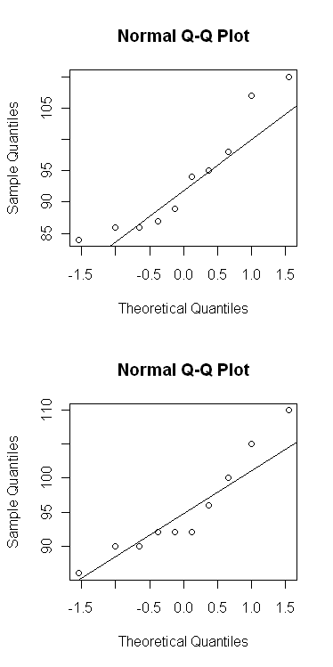
Descriptive Statistics for This Data

Slide 33
HT Example 5 - Means

Slide 34
HT Example 5 - Means

Slide 35
HT – Example 6 - Paired Data
Pair 1 2 3 4 5 6 7 8
New 77 74 82 73 87 69 66 80
Standard 72 68 76 68 84 68 61 76

Slide 36
Paired t-procedures

