Slide 1
STAT 515 Lecture 18 October 24, 2019
Originally prepared by Brian Habing
Department of Statistics
University of South Carolina
Redistribution of these slides without permission is a violation of copyright law.

Slide 2
Outline for Today
Inference for two variables
Should Read Sections 9.1-9.3 and 9.6
Homework 6 is due today
Homework 7 is due Thursday, October 31

Slide 5
Sampling Distribution for the Difference of Two Means

Slide 6
Sampling Distribution for the Difference of Two Means

Slide 7
Sampling Distribution for the Difference of Two Means
Given two iid samples from normal populations that are independent of each other:
This relationship also holds approximately for large n by the CLT.

Slide 8
Sampling Distribution for the Difference of Two Means

Slide 9
Sampling Distribution for the Difference of Two Means

Slide 10
Sampling Distribution for the Difference of Two Means
Given two iid samples from normal populations that have equal variances and are independent of each other:
where
This relationship is fairly robust to non-normality.

Slide 11
Pooled t-interval

Slide 12
Pooled t-test

Slide 13
Another Sampling Distribution for the Difference of Two Means
Given two iid samples from normal populations that are independent of each other:
with
This relationship is fairly robust to non-normality.

Slide 14
Satterthwaite’s and Welch’s Two-Sample t-interval

Slide 15
Satterthwaite’s and Welch’s Two-Sample t-test

Slide 16
HT Example 5 - Means
The deviation intelligence quotients for 10 specifically language impaired (SLI) children and 10 younger, normally developing children are gathered. Test the hypothesis that the YND group has a larger mean at α=0.05.
Data:
SLI: 86, 87, 84, 94, 86, 107, 89, 98, 95, 110
YND: 110, 90, 105, 92, 92, 96, 86, 100, 92, 90
Journal of Communication Disorders, March 1995

Slide 17
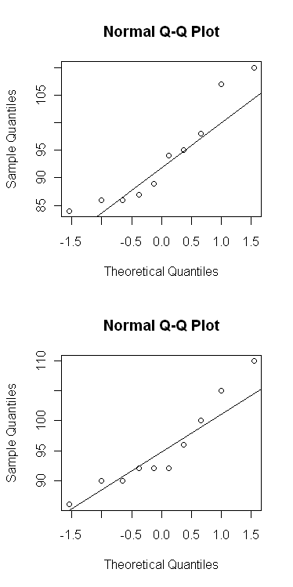
Descriptive Statistics for This Data

Slide 18
HT Example 5 - Means

Slide 19
HT Example 5 - Means

Slide 20
Another two-sample example
Eight pairs of students are selected so that each pair have been matched in terms of gender, course grades for the previous year, and temperament (based on teacher opinion). One of each pair is randomly selected to be taught using a new teaching method, while the other is taught using the standard method. It is desired to see if the new teaching method is more effective.

Slide 21
HT – Example 6 - Paired Data
Pair 1 2 3 4 5 6 7 8
New 77 74 82 73 87 69 66 80
Standard 72 68 76 68 84 68 61 76

Slide 22
Paired t-procedures

Slide 23
Sampling Distribution for Difference of Two Proportions
Let X₁ and X₂ be binomial random variables that are independent of each other with sample sizes n₁ and n₂ and probabilities p₁ and p₂. Then for large n₁ and n₂ :

Slide 26
Agresti-Caffo approximate CI for the difference of two proportions
The approximate 1-α conf. interval for p₁-p₂ is
where
Reference: Agresti and Caffo (2000, Amer. Statistician)

Slide 28
Approximate z-test for two proportions
The test statistic for testing H₀: p ₁ - p ₂ =0 is
Under H₀ it approximately follows a standard normal distribution for large samples.

