Slide 1
STAT 515 Statistical Methods I Lecture 2 August 27, 2019 Originally prepared by Brian Habing Department of Statistics University of South Carolina Redistribution of these slides without permission is a violation of copyright law.

Slide 2
Outline for Today
Introduction to Probability
You should start reading 3.1-3.6
Homework 1 is due Thursday Sept 5

Slide 3
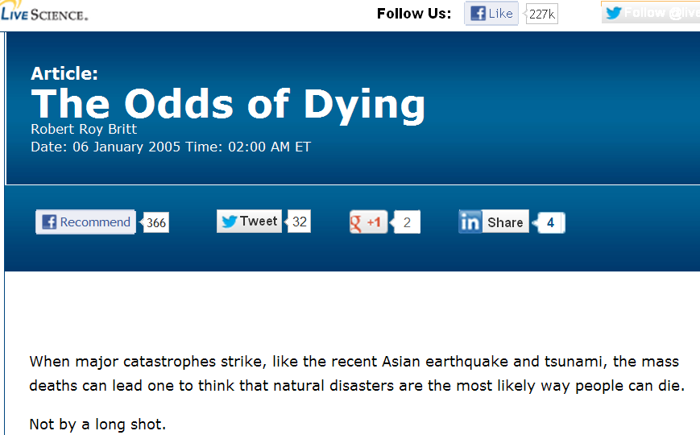
Odds in the news
http://www.livescience.com/3780-odds-dying.html

Slide 4
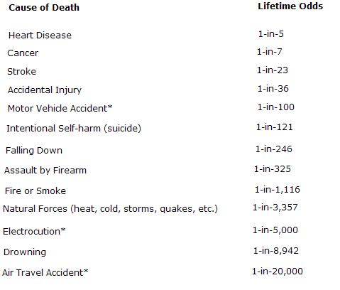
Lifetime Odds for different events

Slide 5
My Webster’s New World Dictionary defines probability as:
The quality of state of being probable, likelihood
Something that is probable
…

Slide 6
Definition of probable
Looking up probable doesn’t really seem to apply:
Supported by evidence strong enough to establish presumption but not proof
Establishing a probability
Likely to be or become true or real

Slide 7
Definition of Likelihood
So, we could check likelihood:
Probability
Clearly the dictionary won’t be too helpful here.

Slide 8
Frequentist definition of probability
One way of defining the probability of an event is:
The probability of an event is the proportion of times (relative frequency) that the event is expected to occur when an experiment is repeated a large number of times under identical conditions.

Slide 9
A probability framework
This is the “frequentist” idea that we will use to connect our theoretical probability constructions to reality.
Our goal now is to set up a mathematical foundation to allow us to apply this intuition in practice.

Slide 10
Definition of Experiment
Experiment – A procedure or process that produces results that cannot be predicted with certainty.
A fair coin is flipped twice.

Slide 11
Definition of Sample Space
Sample Space – The set W of all the possible outcomes (sample points) w of the experiment. Sample spaces can be either discrete or continuous.

Slide 12
Definition of Event
An event (usually denoted by capital letters at the beginning of the alphabet) is a set of sample points.

Slide 13
Probability Laws
A probability measure on Ω is a function, P, from (events) subsets of Ω to the real numbers (0 to 1)
satisfying the following three axioms:
1. P(Ω) = 1
2. P(A) ≥ 0 for any event A (⊂Ω)
3. If A1 and A2 mutually exclusive, then
P(A1∪ A2) = P(A1) + P(A2).
If A1,…,An,… are mutually exclusive, then P(A1∪A2∪…∪An∪…) = Σi=1 to ∞ P(Ai).

Slide 14
Assigning probabilities to outcomes
The coin flipping example is discrete, so we can define the probability measure by assigning a probability to each of the sample points so that the sum is 1.

Slide 15
Assigning probabilities to events
We would get the probability of the events A and B simply by adding the probabilities assigned to their sample points.
A={Exactly one Head} = {(HT),(TH)}
P(A) =
B={First flip was a Head} = {(HH),(HT)}
P(B) =

Slide 16
Addition Law
Addition Law
P(A∪B) = P(A) + P(B) – P(A∩B)
This is best Demonstrated Using Venn Diagrams

Slide 17
Additional Law Workspace

Slide 18
Conditional Probability
For two events A and B with P(B)>0
Define the probability of A given B as
P(A|B) = P(A∩B)
P(B)

Slide 19
Conditional Probability Workspace
A={Exactly one Head} = {(HT),(TH)}
B={First flip was a Head} = {(HH),(HT)}
P(A|B) =

Slide 20
Multiplication Rule
P(A∩B) = P(A|B) P(B)
or = P(B|A) P(A)
This is best thought about using Tree Diagrams

Slide 21
Multiplication Rule Workspace

Slide 22
Independence
Definition: Two events A and B are independent if
P(A|B)=P(A) and P(B|A)=P(B)

Slide 23
Mutual Independence
Definition: A₁, …, A_{n} are mutually independent events if and only if for every subcollection A_{i1}, …, A_{ik} of size k=2, …, n, we have
P(A_{i1}∩A_{i2} ∩ … ∩A_{ik}) = P(A_{i1}) P(A_{i2}) …P(A_{ik})

Slide 24
Mutual Independence Example
Example 1) Consider a basketball player attempting two free throws, with a 60% chance of making each one, and they are independent.

Slide 25
Mutual Independence Workspace

Slide 26
Dependent events
What if they were dependent?
Say your chance of making the first was 60%, but that your chance of making the second is 80% if you made the 1st and only 30% if you missed.

Slide 27
Workspace for dependent events

Slide 28
Independent events (Ex 2)
Example 2) Components are known to have a defective rate of 0.02 (2%) and are shipped in lots of 20.
What is the probability that the entire lot of 20 contains no defectives?

Slide 29
Dependent events Ex. 2 workspace
Now consider finding the probability of having exactly one defective out of 20.

Slide 30
Dependent events Ex 2 workspace (cont)
Now consider finding the probability of having exactly 10 defectives out of 20.

