Slide 1
STAT 515
Lecture 20
October 31, 2019
Originally prepared by Brian Habing
Department of Statistics
University of South Carolina
Redistribution of these slides without permission
is a violation of copyright law.

Slide 2
Outline for Today
Power (Section 8.7 and Supplement to 8)
Homework 7 due today
Test 2 on Thursday, November 7

Slide 3
For each of the following, what is the corresponding distribution, what are the assumptions, and what can we say about the robustness (if applicable)?

Slide 7
where

Slide 8
Before Conducting a Test
Determine that you actually want to conduct a test of hypotheses.
Determine H₀ and H_{A}.
Determine α.
Decide on how you will collect the data and how much data you will collect.
Make sure assumptions are met.

Slide 9
Power
Type II error – Failing to reject the null hypothesis when it is false.
β = P(fail to reject H₀ | H₀ is false)
power=1- β = P(reject H₀ | H₀ is false)

Slide 10
Example
Consider wanting to test the null hypothesis that σ₁=σ₂ versus the alternate that σ₁>σ₂.
Say we can afford a sample of size ten from each group and that we really want to detect anything where σ₁ is at least 20% larger than σ₂ .
If we assume the populations are normal, then we could run a simulation to see how often the test should reject.

Slide 11
Sample Simulation
Generate 10,000 samples of size ten from a normal distribution with some standard deviation (say 1, 1.2, or 2).
Generate 10,000 samples of size ten from a normal distribution with standard deviation 1.
Conduct the F test on each of these 10,000 pairs of data sets.
Determine how many of the p-values are less than or equal to your α (say 0.05).

Slide 12
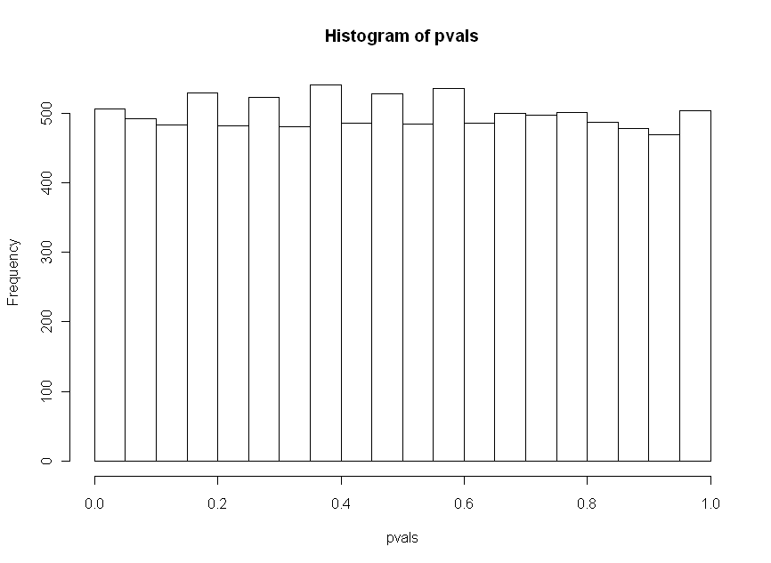
Distribution of 10,000 p-values when
H₀ is true and populations are normal (n₁= n₂ =10)
Observed percent less than 0.05 = 5.07%

Slide 13
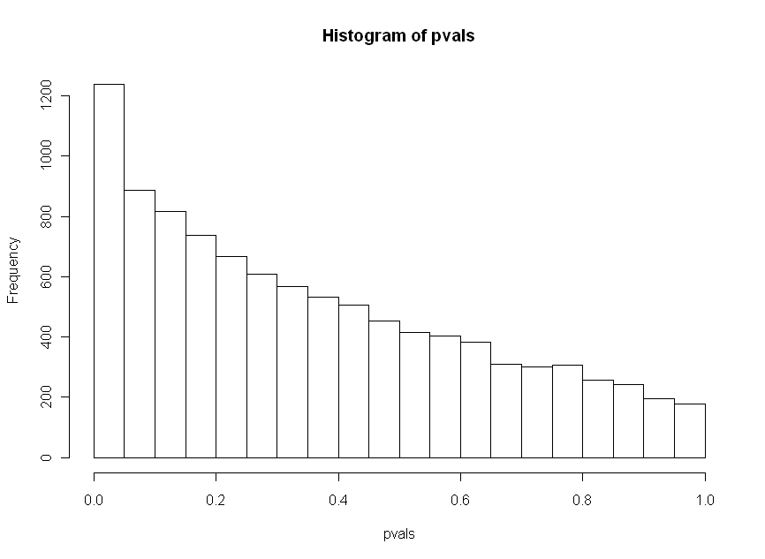
Distribution of 10,000 p-values when
H₀ is false (1st has 1.2 times the sd) and populations are normal (n₁= n₂ =10)
Observed percent less than 0.05 = 12.38%

Slide 14
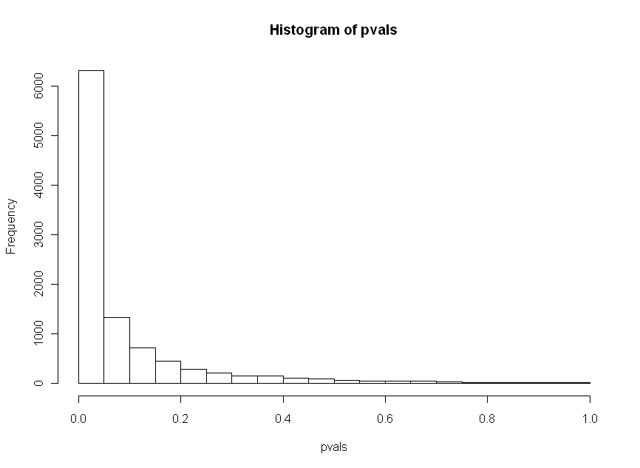
Distribution of 10,000 p-values when
H₀ is false (1st has 2 times the sd) and populations are normal (n₁= n₂ =10)
Observed percent less than 0.05 = 63.17%

Slide 15
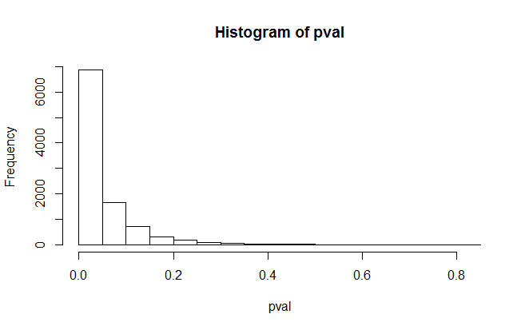
Distribution of 10,000 p-values when
H₀ is false (1st has 2 times the sd) and populations are normal (n₁= n₂ =20)
Observed percent less than 0.05 = 68.95
%

Slide 16
Combining the Results

Slide 17
Examining Robustness
We can also use simulation to examine how robust a statistical procedure is.
Simply simulate the data from the distribution you are concerned about instead of the normal distribution.

Slide 18
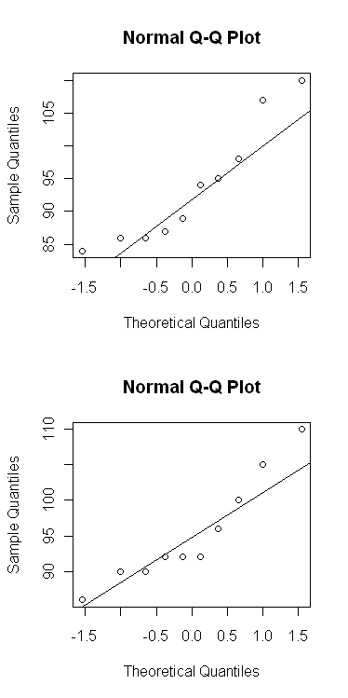
DIQ Data from Last Class

Slide 19
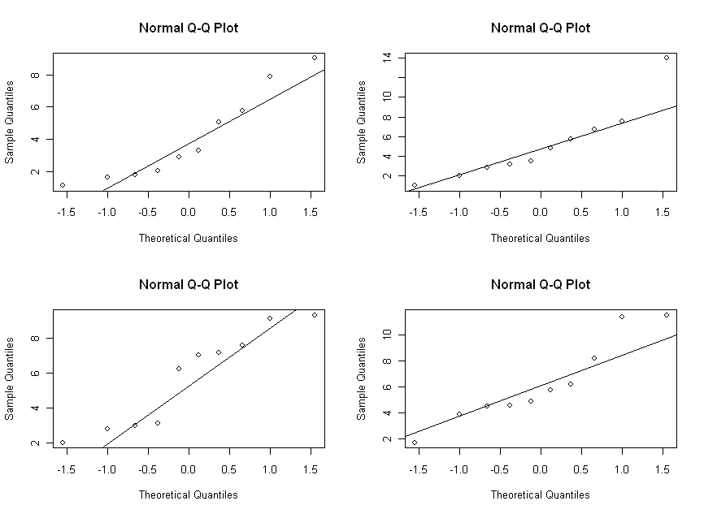
Chi-square with df=5

Slide 20
Distribution of 10,000 p-values when
H₀ is true and populations are χ² df=5
Observed percent less than 0.05 = 10.92%

Slide 21
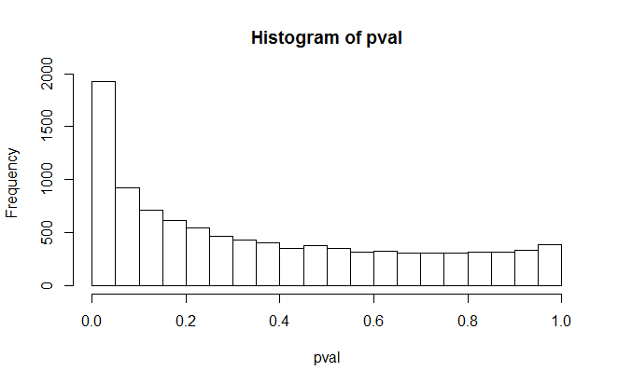
Distribution of 10,000 p-values when
H₀ is false (1st has 1.2 times the sd) and populations are χ² df=5 and χ² df=7.2
Observed percent less than 0.05 = 19.26%

Slide 22
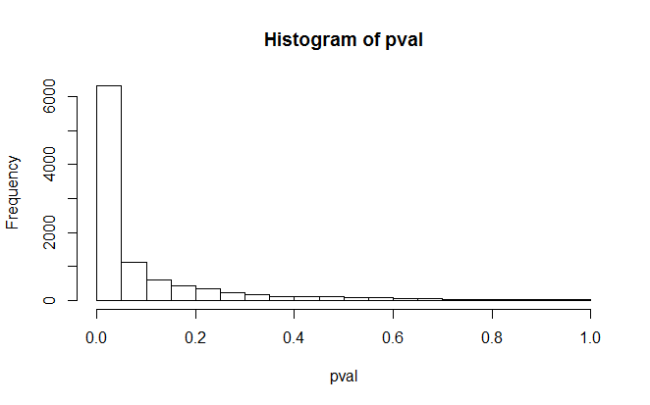
Distribution of 10,000 p-values when
H₀ is false (1st has 2 times the sd) and populations are χ² df=5 and χ² df=20
Observed percent less than 0.05 = 63.23%

Slide 23
Calculating Power Directly
Consider the easiest case, the test of H₀: μ=μ₀ vs. H_{A}: μ<μ₀ when the population is normally distributed and the standard deviation σ is known.

Slide 26
Calculating Power

Slide 29
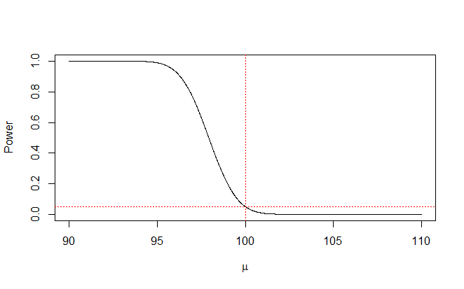
Power Curve

Slide 30
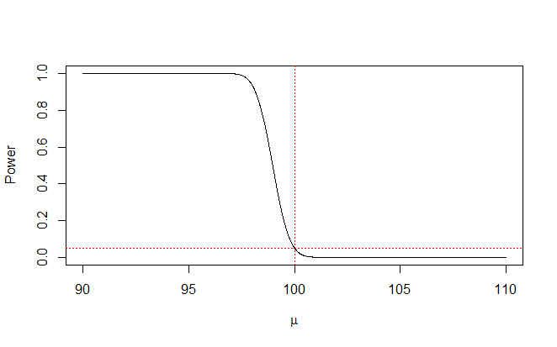
Increasing Sample Size

Slide 31

Increasing α

Slide 32
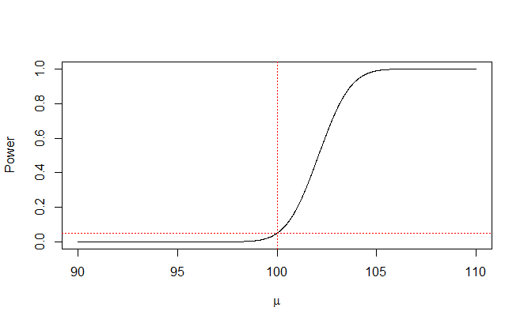
Testing >

Slide 33
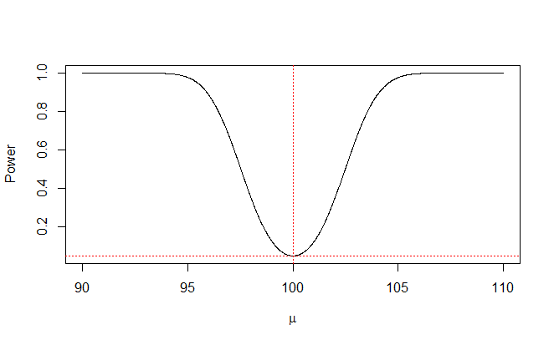
Testing ≠

