Slide 1
STAT J515 Lecture 24 November 19, 2019
Originally prepared by Brian Habing
Department of Statistics
University of South Carolina
Redistribution of these slides without permission is a violation of copyright law.

Slide 2
Outline for Today
ANOVA Continued (10.1-10.2)
Homework 9 due Thursday, November 21

Slide 3
ANOVA Example
The following data is from a master’s thesis by B. Nichols in the Department of Animal Science at the University of Arizona in 1980. It concerns how much bacteria grew on different steaks of approximately 75 grams each. The steaks were either wrapped in commercial plastic wrap; vacuum packed; sealed in a mixture of 1% CO, 40% CO2, and 59% N; or sealed in 100% C02. The steaks were randomly assigned to the different types of packaging. After being stored at 4 degrees Celsius for nine days, the logarithm of the number of psychrotrophic bacteria per square centimeter was estimated for each sample.

Slide 4
Example
Commercial 7.66 6.98 7.80
Vacuum 5.26 5.44 5.88
Mixed 7.41 7.33 7.04
CO2 3.51 2.91 3.66

Slide 5
F Distribution
Let X ² be a Chi-squared random variable with n degrees of freedom and Y ² be an independent Chi-squared random variable with m degrees of freedom
has an F distribution with n and m degrees of freedom.

Slide 6
F Distribution
Let X₁₁, X₁₂, … X_{1n1} be i.i.d. normal random variables with mean μ₁ and sd σ₂ that are independent of X₂₁, X₂₂, … X_{2n2} which are i.i.d. normal random variables with mean μ₂ and sd σ₂. Then
has an F distribution with n₁-1 and n₂-1 degrees of freedom. This relationship is not robust to non-normality.

Slide 7
Notation
Commercial 7.66 6.98 7.80
Vacuum 5.26 5.44 5.88
Mixed 7.41 7.33 7.04
CO2 3.51 2.91 3.66

Slide 8
The ANOVA Table

Slide 9
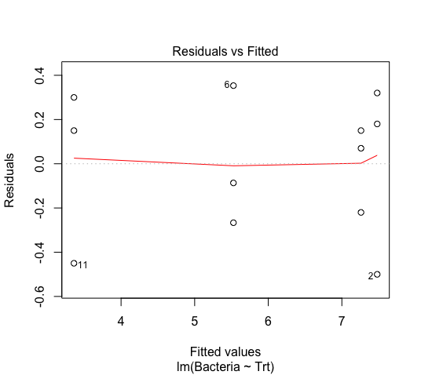
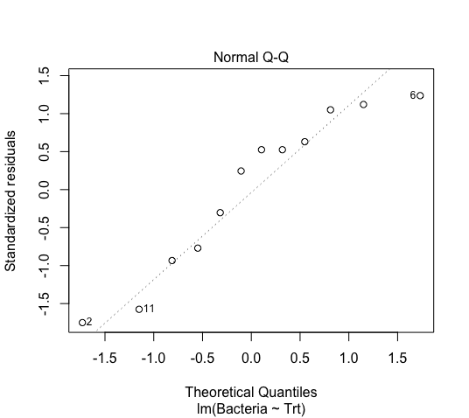
Example Continued

Slide 10
The Assumptions
The samples are independent of each other
Each sample is from a normal population
The variances of the populations are equal

Slide 11
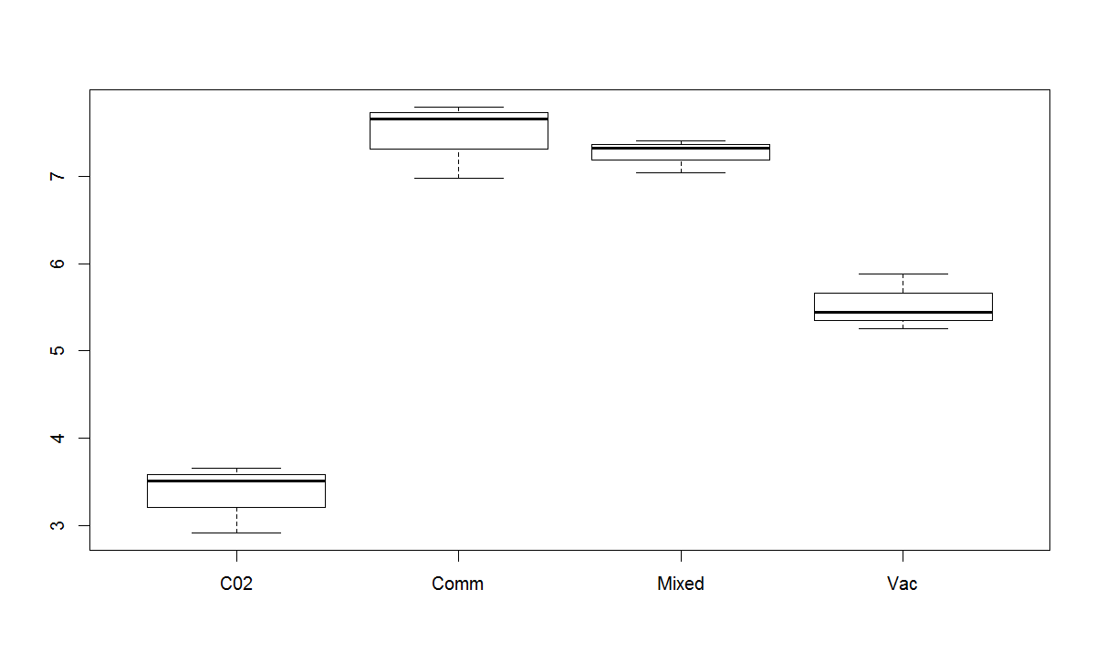
Example Continued

Slide 12
The Model Equation

Slide 13
The Assumptions, take 2
The errors are independent
The errors are normally distributed for each treatment
The errors have mean 0 for each treatment
The errors have constant variance across all treatment levels

Slide 14
The Model Equation

Slide 15
Example Continued

Slide 16
Checking Assumptions

Slide 17
Checking Assumptions

Slide 18
Checking Assumptions

Slide 19
Checking Assumptions

Slide 20
Multiple Comparisons
Many researcher find the overall ANOVA F-test to be unsatisfactory

Slide 21
Multiple Comparisons
As noted earlier, multiple pairwise tests can inflate the experimentwise error rate

Slide 22
Two procedures
Both the Bonferroni method and Tukey’s procedure are widely-used methods that control the experimentwise error rate α

Slide 23
Example-steak wrap

Slide 24
ANOVA Example
The following data is from a master’s thesis by B. Nichols in the Department of Animal Science at the University of Arizona in 1980. It concerns how much bacteria grew on different steaks of approximately 75 grams each. The steaks were either wrapped in commercial plastic wrap; vacuum packed; sealed in a mixture of 1% CO, 40% CO2, and 59% N; or sealed in 100% C02. The steaks were randomly assigned to the different types of packaging. After being stored at 4 degrees Celsius for nine days, the logarithm of the number of psychrotrophic bacteria per square centimeter was estimated for each sample.

Slide 25
Example
Commercial 7.66 6.98 7.80
Vacuum 5.26 5.44 5.88
Mixed 7.41 7.33 7.04
CO2 3.51 2.91 3.66

Slide 26
Why Did They Take the Logarithm?
par(mfrow=c(1,2))
plot(lm(exp(Count)~Trt,data=steakdf),1:2)
par(mfrow=c(1,1))

Slide 27
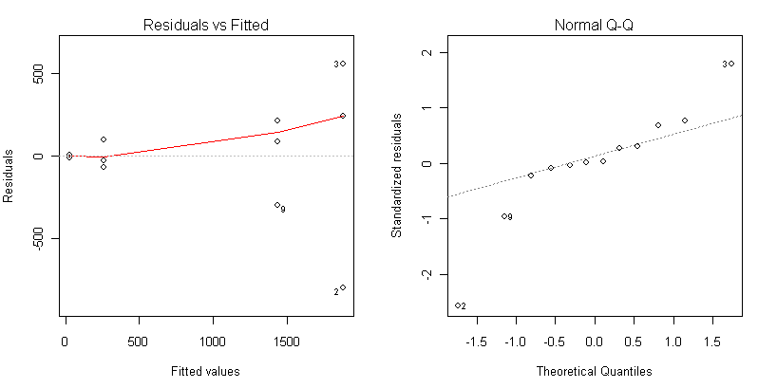

Slide 28
Log Transformation

Slide 29
Other Transformations
Square root – Not as strong as logarithm
Power and Box-Cox transformations – A very general method that includes the square root and log transformations.

Slide 30
Example 2
L=Limpets allowed
F=Large Fish Allowed
f=Small Fish Allowed
N=None Allowed
Response is % surface covered in seaweed
(Data from PhD disertation of Annette Olson at Oregon State University in 1993.)

Slide 31
DATA seaweed;
INPUT cover treat $ @@;
CARDS;
14 N 23 N 22 N 35 N 67 N 82 N
94 N 95 N 34 N 53 N 58 N 75 N
19 N 47 N 53 N 61 N 4 L 4 L
7 L 8 L 28 L 58 L 27 L 35 L
11 L 33 L 16 L 31 L 6 L 8 L
15 L 17 L 11 f 24 f 14 f 31 f
52 f 59 f 83 f 89 f 33 f 34 f
39 f 52 f 43 f 53 f 30 f 37 f
3 Lf 5 Lf 3 Lf 6 Lf 9 Lf 31 Lf
21 Lf 57 Lf 5 Lf 9 Lf 26 Lf 43 Lf
4 Lf 12 Lf 12 Lf 18 Lf 10 fF 13 fF
10 fF 15 fF 44 fF 50 fF 57 fF 73 fF
26 fF 42 fF 38 fF 42 fF 29 fF 36 fF
11 fF 40 fF 1 LfF 2 LfF 3 LfF 5 LfF
6 LfF 9 LfF 7 LfF 22 LfF 5 LfF 6 LfF
10 LfF 17 LfF 5 LfF 14 LfF 5 LfF 7 LfF
;

Slide 32
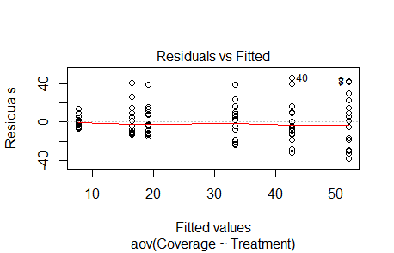
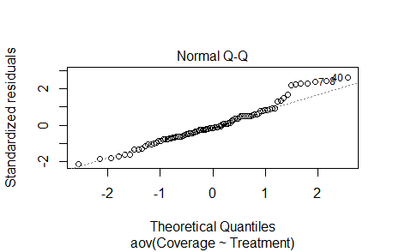

Slide 33
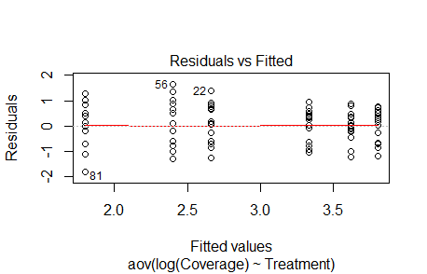
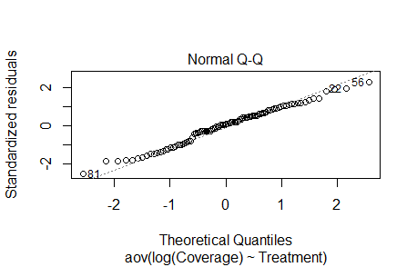
Logarithm

Slide 34
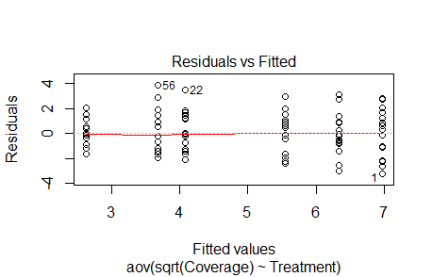
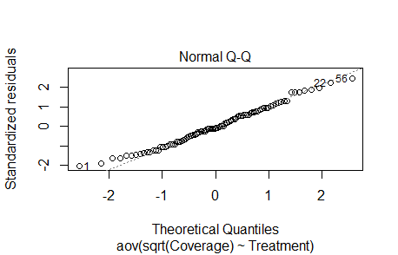
Square Root
Dependent Variable: sqrt(Coverage)
Sum of
Source DF Squares Mean Square F Value Pr > F
Model 5 225.4801794 45.0960359 16.89 <.0001
Error 90 240.3319351 2.6703548
CTotal 95 465.8121145

Slide 35
Square root
Multiple Comparisons (Tukey)
LfF Lf L fF f N

Slide 36
Going Beyond One-Way ANOVA

Slide 37
Going Beyond One-Way ANOVA

