Slide 1
STAT J515 Lecture 25 November 21, 2019
Originally prepared by Brian Habing
Department of Statistics
University of South Carolina
Redistribution of these slides without permission is a violation of copyright law.

Slide 2
Outline for Today
ANOVA Example
Introduction to Regression (11.1-11.2)
Homework 9 due today

Slide 3
ANOVA Example
The following data is from a master’s thesis by B. Nichols in the Department of Animal Science at the University of Arizona in 1980. It concerns how much bacteria grew on different steaks of approximately 75 grams each. The steaks were either wrapped in commercial plastic wrap; vacuum packed; sealed in a mixture of 1% CO, 40% CO2, and 59% N; or sealed in 100% C02. The steaks were randomly assigned to the different types of packaging. After being stored at 4 degrees Celsius for nine days, the logarithm of the number of psychrotrophic bacteria per square centimeter was estimated for each sample.

Slide 4
Example
Commercial 7.66 6.98 7.80
Vacuum 5.26 5.44 5.88
Mixed 7.41 7.33 7.04
CO2 3.51 2.91 3.66

Slide 5
Why Did They Take the Logarithm?
par(mfrow=c(1,2))
plot(lm(exp(Count)~Trt,data=steakdf),1:2)
par(mfrow=c(1,1))

Slide 6
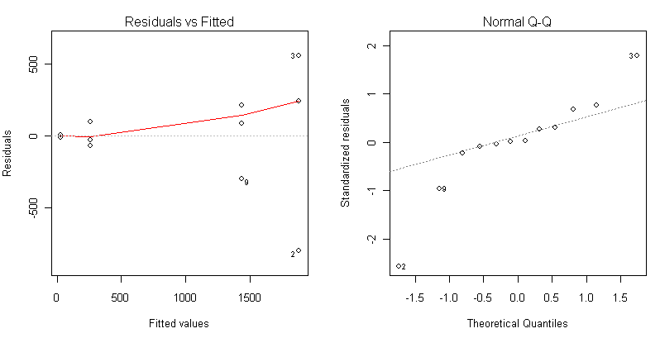

Slide 7
Log Transformation

Slide 8
Other Transformations
Square root – Not as strong as logarithm
Power and Box-Cox transformations – A very general method that includes the square root and log transformations.

Slide 9
Example 2
L=Limpets allowed
F=Large Fish Allowed
f=Small Fish Allowed
N=None Allowed
(Data from PhD disertation of Annette Olson at Oregon State University in 1993.)

Slide 10
DATA seaweed;
INPUT cover treat $ @@;
CARDS;
14 N 23 N 22 N 35 N 67 N 82 N
94 N 95 N 34 N 53 N 58 N 75 N
19 N 47 N 53 N 61 N 4 L 4 L
7 L 8 L 28 L 58 L 27 L 35 L
11 L 33 L 16 L 31 L 6 L 8 L
15 L 17 L 11 f 24 f 14 f 31 f
52 f 59 f 83 f 89 f 33 f 34 f
39 f 52 f 43 f 53 f 30 f 37 f
3 Lf 5 Lf 3 Lf 6 Lf 9 Lf 31 Lf
21 Lf 57 Lf 5 Lf 9 Lf 26 Lf 43 Lf
4 Lf 12 Lf 12 Lf 18 Lf 10 fF 13 fF
10 fF 15 fF 44 fF 50 fF 57 fF 73 fF
26 fF 42 fF 38 fF 42 fF 29 fF 36 fF
11 fF 40 fF 1 LfF 2 LfF 3 LfF 5 LfF
6 LfF 9 LfF 7 LfF 22 LfF 5 LfF 6 LfF
10 LfF 17 LfF 5 LfF 14 LfF 5 LfF 7 LfF
;

Slide 12
Logarithm

Slide 13
Square Root
Dependent Variable: scov
Sum of
Source DF Squares Mean Square F Value Pr > F
Model 5 225.4801794 45.0960359 16.89 <.0001
Error 90 240.3319351 2.6703548
CTotal 95 465.8121145

Slide 14
Going Beyond One-Way ANOVA

Slide 15
Going Beyond One-Way ANOVA

Slide 16
Regression - Example 1
The data below concerns the relationship between the prevalence of a supposed fertility harbinger and the population of Oldenburg Germany in thousands of people between 1930 and 1936.
x people
140 55.5
148 55.5
175 64.9
195 67.5
245 69.0
250 72.0
250 75.5

Slide 17
Example 1
The original data can be found in:
Ornithologische Monatsberichte, 44, No.2, Jahrgang, 1936, Berlin, and 48, No.1, Jahrgang, 1940, Berlin, and
Statistiches Jahrbuch Deutscher Gemeinden, 27-33, Jahrgang, 1932-1938, Gustav Fischer, Jena.
The actual data used is estimated from the graph in Box, Hunter, and Hunter's Statistics for Experimenters.

Slide 18
Regression

Slide 19
Regression

Slide 20
Regression

Slide 21
Regression

Slide 22
Regression

Slide 23
Least Squares Regression

Slide 24
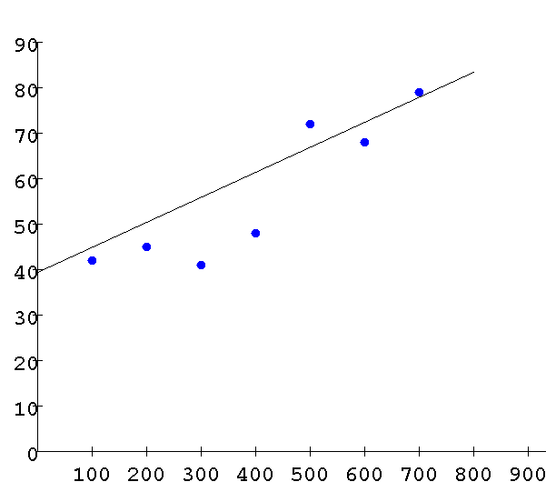
Least Squares Regression
http://hadm.sph.sc.edu/courses/J716/demos/leastsquares/leastsquaresdemo.html

Slide 25
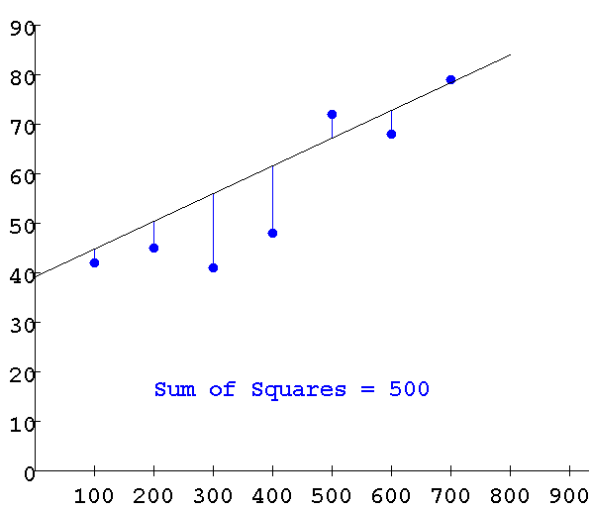
Least Squares Regression
http://hadm.sph.sc.edu/courses/J716/demos/leastsquares/leastsquaresdemo.html

Slide 26
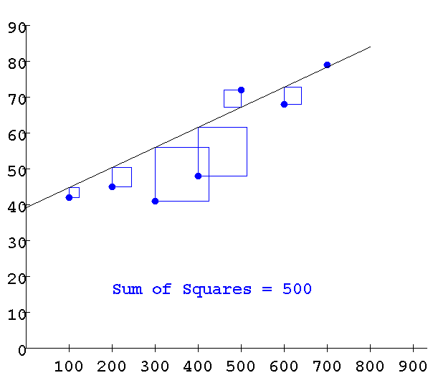
Least Squares Regression
http://sambaker.com/courses/J716/demos/LeastSquares/LeastSquaresDemo.html

Slide 27
Least Squares Regression

Slide 28
Least Squares Regression

Slide 29
Regression

Slide 30
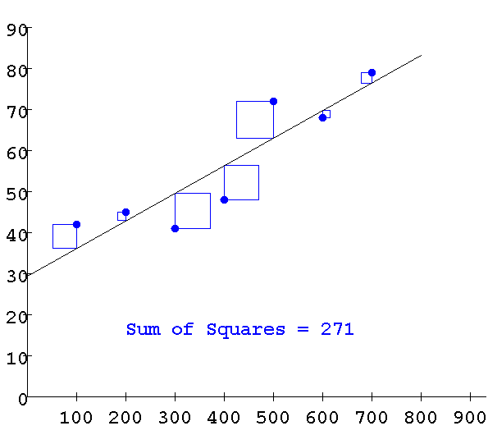
Least Squares
http://sambaker.com/courses/J716/demos/LeastSquares/LeastSquaresDemo.html

Slide 31
Example 1
x people
140 55.5
148 55.5
175 64.9
195 67.5
245 69.0
250 72.0
250 75.5
At an X level of 100, what is the best prediction for the population?

Slide 32
Example 1 Continued
x people
140 55.5
148 55.5
175 64.9
195 67.5
245 69.0
250 72.0
250 75.5
Any reason not to trust this estimate?

