Slide 1
STAT J515 Lecture 26 November 21, 2019
Originally prepared by Brian Habing
Department of Statistics
University of South Carolina
Redistribution of these slides without permission is a violation of copyright law.

Slide 2
Outline for Today
Regression Continued (11.3-11.5 and Supplements to 11.3)
Homework 10 due Tuesday, December 3rd

Slide 3
Regression - Example 1
The data below concerns the relationship between the prevalence of a supposed fertility enhancer and the population of Oldenburg Germany in thousands of people between 1930 and 1936.
x people
140 55.5
148 55.5
175 64.9
195 67.5
245 69.0
250 72.0
250 75.5

Slide 4
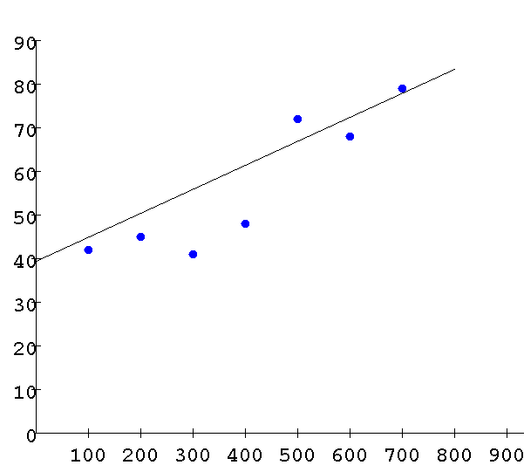
Least Squares Regression
http://hadm.sph.sc.edu/courses/J716/demos/leastsquares/leastsquaresdemo.html

Slide 5
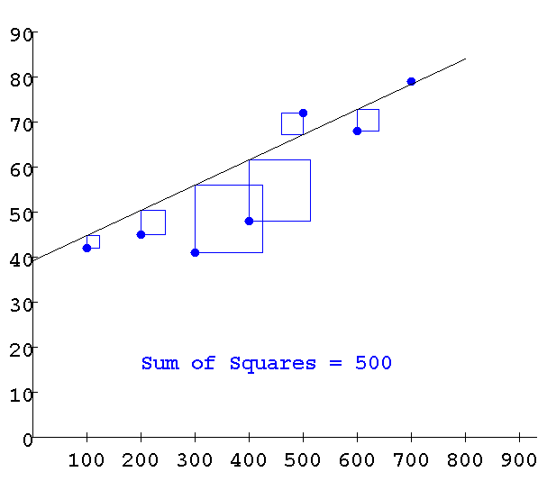
Least Squares Regression
http://hadm.sph.sc.edu/courses/J716/demos/leastsquares/leastsquaresdemo.html

Slide 6
Least Squares Regression

Slide 7
Regression

Slide 8
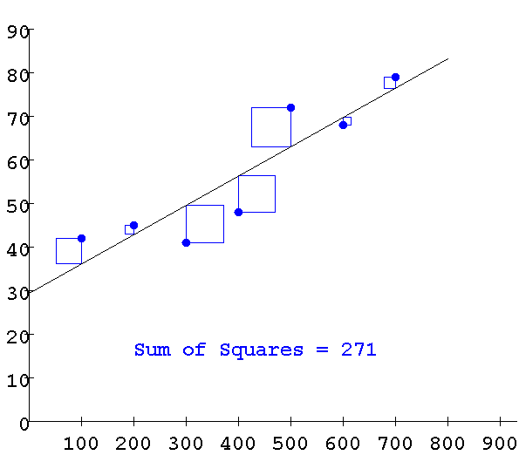
Least Squares
http://hadm.sph.sc.edu/courses/J716/demos/leastsquares/leastsquaresdemo.html

Slide 9
Example 2
The data analyzed on the next slide concerns the eruptions of the Old Faithful Geyser from August 1 to August 8, 1978 by Park Geologist Roderick A. Hutchinson (as reported in Weisberg’s “Applied Linear Regression).
Interval is the length of time until the next eruption (in minutes) and duration is the length of the last eruption (in minutes). The goal is to predict the time until the next eruption (the interval) from the length of the last eruption (the duration).

Slide 10
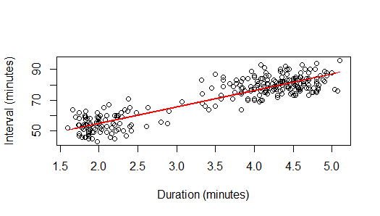
waiting=33.4744+10.7296 eruptions
For each extra minute of duration, how many more minutes do you add to your prediction of the next eruption?

Slide 11
waiting=33.4744+10.7296 eruptions
If the last eruption lasted 3 minutes, what is your best prediction of how long until the next eruption?

Slide 12
Other questions…
How far off the regression line do you expect to be?
Do you believe the regression line is “real”? (Is X really related to Y?)
How much of the change in Y can be explained by X?

Slide 13
Regression
s_{e} is the “standard error of the estimate” or the “standard deviation of the residuals” or the “root mean-squared error”

Slide 14
waiting=33.4744+10.7296 eruptions
Residual standard error: 5.914 on 270 degrees of freedom
Multiple R-squared: 0.8115, Adjusted R-squared: 0.8108

Slide 15
Regression Model

Slide 16
Assumptions

Slide 17
Assumptions
The four assumptions for linear regression are:
E(ε)=0 at each value of x
Var(ε)=σ_{ε}² at each value of x
ε are independent of each other
ε are normally distributed at each value of x

Slide 18
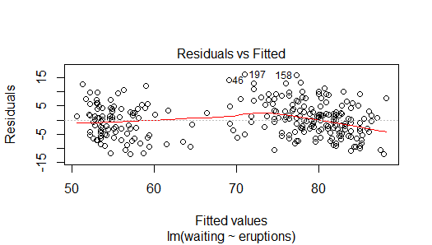
Residual vs. Predicted Plot

Slide 19
Residual vs. Predicted Plot

Slide 20
Residual vs. Predicted Plot

Slide 21
Residual vs. Predicted Plot

Slide 22
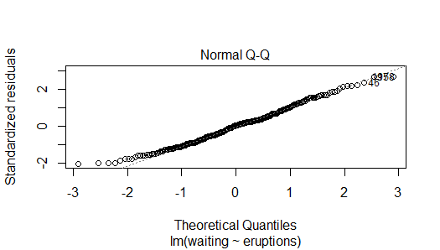
Residual Q-Q Plot

Slide 23
Residual Q-Q Plot

Slide 24
Assumptions
ε_{i} are independent of each other

Slide 25
waiting=33.4744+10.7296 eruptions
Residual standard error: 5.914 on 270 degrees of freedom
Multiple R-squared: 0.8115, Adjusted R-squared: 0.8108

Slide 26
Test about the Slope
If the regression assumptions hold, then
is the test statistic for testing H₀:β₁=β_{1Ho} and has a t distribution with n-2 degrees of freedom when H₀ is true.

Slide 27
Confidence Interval for the slope
If the regression assumptions hold, then
is the 1-α confidence interval for β₁ .

Slide 29
The ANOVA Table for Regression

Slide 30
Inference about the Slope
Source | DF | Sum of Squares | Mean Square | F Value | Pr > F
Model | 1 | 40643.73060 | 40643.73060 | 1162.06 | <.0001
Error | 270 | 9443.38705 | 34.97551
Corrected Total | 271 | 50087.11765
Coefficients:
Estimate Std. Error t value Pr(>|t|)
(Intercept) 33.4744 1.1549 28.98 <2e-16
eruptions 10.7296 0.3148 34.09 <2e-16
Confidence intervals for parameters
2.5% 97.5%
(Intercept) 31.20069 35.74810
Eruptions 10.10996 11.34932

Slide 31
Correlation Coefficient

Slide 32
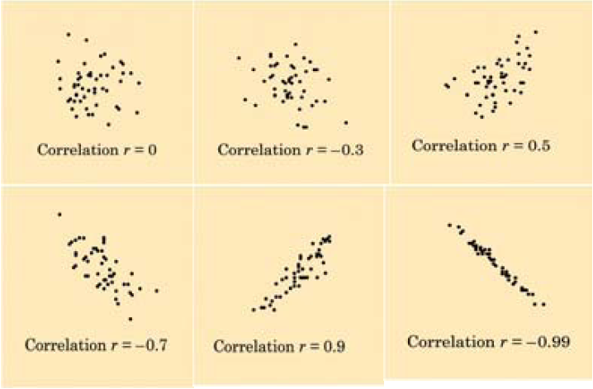

Slide 33
Correlation and Slope

Slide 34
Correlation and Slope

Slide 35
Correlation and Slope
Correlation is like the slope with the units removed.

Slide 36
Correlation and the t-test
Similar algebra shows that the t for testing β₁=0 can be written:
Correlation and sample size determine the significance of the regression line. (Hard to make a confidence interval out of this though!)

Slide 37
Another Test for Correlation
Note that the previous test for correlation is based on the four regression assumptions.
Another well-known test is “Fisher’s r-to-z transformation” that is based on the distribution being “bivariate normal” instead of a linear regression setting.

Slide 38
Correlation and Variability

Slide 39
The ANOVA Table for Regression

Slide 40
Coefficient of Determination

Slide 41
Example 2 Revisited
waiting=33.4744+10.7296 eruptions
Residual standard error: 5.914 on 270 degrees of freedom
Multiple R-squared: 0.8115, Adjusted R-squared: 0.8108

