Slide 1
STAT 515
Lecture 28
December 5, 2019
Originally prepared by Brian Habing
Department of Statistics
University of South Carolina
Redistribution of these slides without permission
is a violation of copyright law.

Slide 2
Outline for Today
Tests for Independence and Homogeneity (13.3 and Supplement)
Final is next Thursday, December 12 at 9am.

Slide 3
χ² Tests for Contingency Tables
Is asymptotically χ² when H₀ is true.
df = # cells - # fixed cells - # parameters estimated
Works well if at least 80% of the E_{i}≥5 and all are ≥1.

Slide 4
χ² Goodness of Fit Test
Consider wanting to test if a 6-sided die from a Monopoly set is fair. We roll the die 120 times and observe the number of times each side comes up:
1 2 3 4 5 6
15 21 24 20 12 28
We want to test that p₁=p₂=p₃=p₄=p₅=p₆=1/6

Slide 5
χ² test for Independence
The data below is from a 2001 issue of the Journal of the American Medical Association. It concerns a sample of 1,913 patients suffering from acute myocardial infarction. Each patient was classified according to their drinking habits and type of heart failure.
Abstain 7 or fewer 7 or more
Congestive 146 106 29
Not congestive 750 590 292
Is there a relationship between heart failure and drinking habits?

Slide 6
χ² tests for Contingency Tables
A researcher takes a random sample of 1200 subplots each of bottomland hardwood forest, cypress tupelo slough and muck swamp and recorded presence or absence of feral hog rooting activity at each subplot.
Disturbed Undisturbed
BLH 120 1080
CTS 190 1010
MS 240 960
Is there a difference in rooting activity for the three habitats at the α=0.05 level?

Slide 7
Final Practice
Question 1 is based on an experiment in which the diameter of trees toppled by Hurricane Matthew on Congaree National Park’s Weston Lake Loop Trail was measured. A sample of 10 tree diameters (in inches) appears below:
24.3 6.9 11.8 14.8 14.9 8.5 12.8 20.5 9.9 8.7
1a) Suppose we wish to test H_{o}: η=10 versus
H_{A}: η >10. Compute the signed rank test statistic T₊.

Slide 8
Final Practice
1b) The large sample Z test statistic for this problem is Z=1.58. Compute a p-value for this problem. Do you reject H_{o} at α=0.05?
1c) What assumptions did you make in conducting this test?

Slide 9
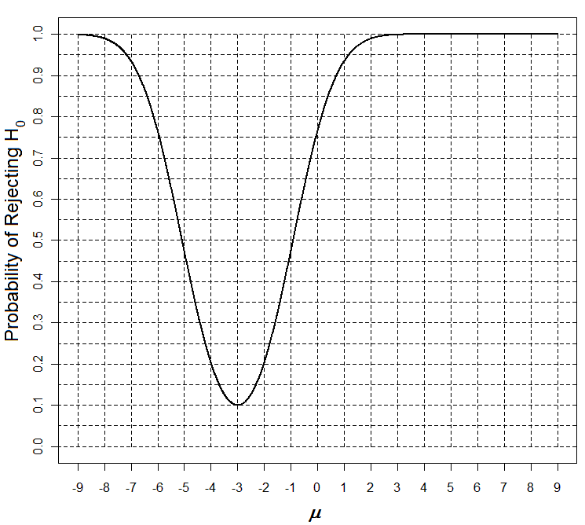
Consider the power curve below for testing H₀: μ = -3.
a) What alternate hypothesis is this power curve for?
b) What is the α-level for this test?
c) Sketch an example of what the power curve might be expected to look like if the sample size n was increased.

Slide 10
Questions 3-4 are based on the following partial ANOVA table for an experiment designed to see how student learning is affected by background noise. A group of 24 students is randomly divided into three groups of eight students. All of the students study the same reading passage for 30 minutes and then take a 10 question test over the material (the students’ test scores are the responses). The first group has background sound at a constant volume, the second has background sound that changes volume periodically, and the third group has no sound.

Slide 11
3) Complete the ANOVA table below by filling in the missing values.

Slide 12
4) State the null and alternate hypothesis for this problem, being sure to identify any symbols used, and state your conclusion in terms of the problem at an α=0.01 level.

Slide 13
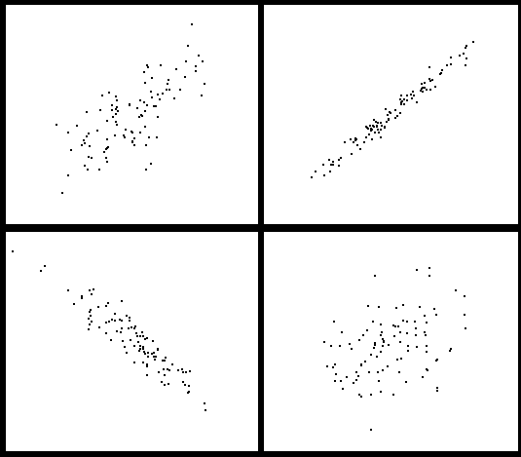
5) Identify each of the following as
having a correlation of either -0.93, 0.37, 0.73, or 0.99.

Slide 14
Questions 6-8 use the attached data set fert from a 1993 paper by Robey, et.al. in Scientific American. It was concerned with the declining fertility rate in developing countries. In particular they were looking at the effect that contraceptive use had on fertility rate. The attached pages include the R program and output for analyzing this data set (called fert).
Contprev = percentage of married women in the country using contraception
Fertrate = fertility rate for the country (average number of children born to women over their lifetime)

Slide 15
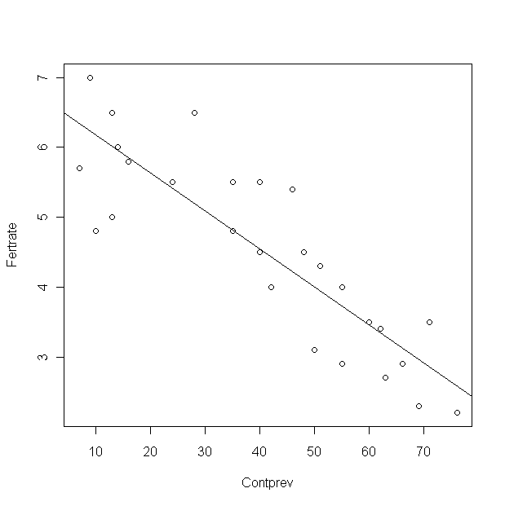
> lm(Fertrate~Contprev)
Coefficients:
(Intercept) Contprev
6.73193 -0.05461
> anova(lm(Fertrate~Contprev))
Analysis of Variance Table
Response: Fertrate
Df Sum Sq Mean Sq F value Pr(>F)
Contprev 1 35.966 35.966 74.308 5.865e-09
Residuals 25 12.100 0.484

Slide 16
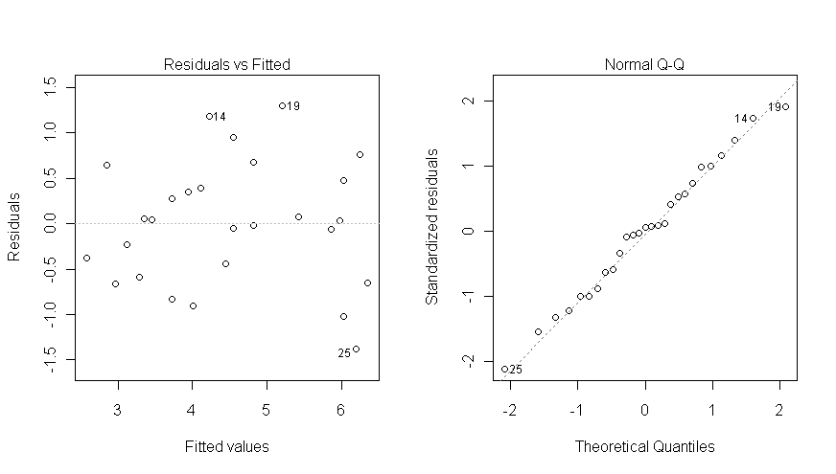

Slide 17
6) Assume the assumptions of the regression model are met.
a) Test the null hypothesis that H₀: β₁=0 against H_{A}: β₁≠0 at an α=0.05 level. Report the p-value and state your conclusion in terms of the problem.
b) What is the estimated fertility rate for a country that has a contraceptive prevalence of 50 percent?

Slide 18
7a) Give the t-statistic that you would use for testing H₀: β₁=0.05 against H_{A}: β₁≠0.05.
b) Construct a 95% confidence interval for β_{1.}

Slide 19
8) Check the regression assumption(s) that can be examined using the attached plots and say which you feel are met well enough, and which clearly aren’t, and why. Also state which assumption(s) cannot be checked.

Slide 20
Questions 9-11 concern the following study reported in The Lancet in 2005. Cardiac patients were assigned to four groups to examine the effects of “frontier medicine” (e.g. energy healing, therapeutic prayer, spiritual healing, etc…). 182 were assigned to therapeutic prayer; 185 to music, imagery, and touch therapy (MIT); 189 to both prayer and MIT, and 192 received neither prayer nor MIT. Whether they had a subsequent heart attack was observed.

Slide 21
9a) Would this data be analyzed by using a test of independence, a test of homogeneity, or a goodness of fit test? Why?
b) Give the appropriate null hypothesis and alternate hypothesis corresponding to your answer in (a). You may do it in words instead of symbols if desired.

Slide 22
10a) Give the expected values for the first row of this table.
b) Give the formula for X² for this problem (showing that you know what values to use for the first row, but only using … for the remainder. You do not need to simplify it).

Slide 23
11a) Give the degrees of freedom for this problem.
b) The chi-square statistic for this data set is found to be 1.828. Do you reject, or fail to reject, the null hypothesis at α=0.05? (Give the rejection region you used.)

