Slide 1
STAT 515 Statistical Methods I Lecture 4 September 3, 2019 Originally prepared by Brian Habing Department of Statistics University of South Carolina Redistribution of these slides without permission is a violation of copyright law.

Slide 2
Outline for Today
Finishing Probability Part I – Sections 3.1-3.9
Starting Probability Part II – Discrete Random Variables – Sections 4.1-4.4 and 4.6
Homework 3 is due Thursday the 3rd
3.70, 3.124c, 3.179b
No homework due Tuesday the 8th

Slide 3
Example 2
Components are known to have a defective rate of 0.02 (2%) and are shipped in lots of 20. Assume whether a component is defective is independent of the other components.
What is the probability that there are exactly 10 defectives out of 20??

Slide 4
Example 2-10 of 20
In order to determine the probability of having exactly 10 out of 20 defectives we would need to have some way of easily counting the number of ways this can happen.
e.g. YYYYYYYYYNNNNNNNNNN
YNYYYYYYYYNNNNNNNNN
YYNYYYYYYYNNNNNNNNN
etc…

Slide 5
Counting Rules
The fundamental tools for counting are multiplication and division:
1. If there are n_{i} possible outcomes for each of p experiments, then there are n₁xn₂x…n_{p} total possible outcomes.
The # of ordered samples of size r of n distinct object with replacement is n ^{r}
The number of distinct orders of n objects is n!=n(n-1)(n-2)… (2)(1).
2. Ordering can be removed by division.

Slide 6
Sampling r objects
Number of Samples of Size r | With Replacement | Without Replacement
Ordered | n ^{r} | n ! (n –r )! permutation
Unordered | (n -1+r )! r ! (n -1)! | n ! r !(n-r )! combination

Slide 7
Binomial Experiment
n identical trials
Each trial has only two possible outcomes (“Success” or “Failure”)
Probability of “Success” is a constant p for every trial
Trials are independent

Slide 8
Why doesn’t this work for opinion polls?

Slide 9
Hypergeometric Experiment
Population of size N
r are “successes” and N-r are “failures”
A random sample of size n is taken without replacement

Slide 10
Hypergeometric approximation to Binomial
For large populations and relatively small samples, the probabilities for a hypergeometric experiment are very close to those from a binomial experiment.
n should be the same for both experiments, and the ratio of Hypergeometric parameters r/N should be set to the binomial p

Slide 11
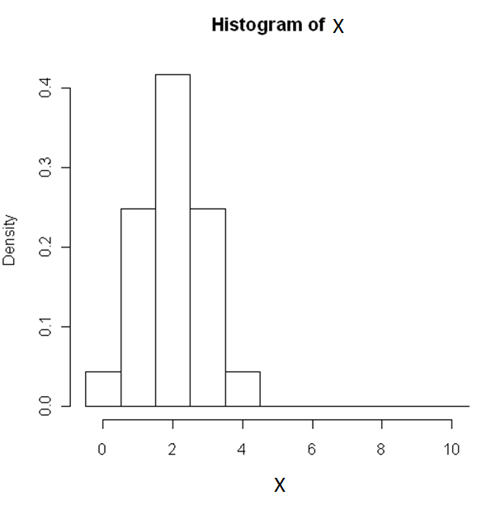
Hypergeometric with N=20, r=4, and n=10

Slide 12
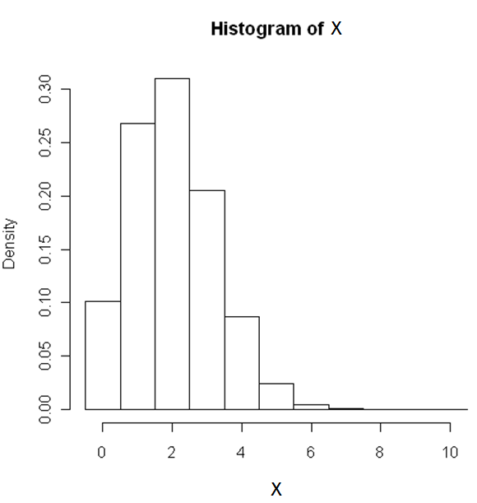
Hypergeometric with N=200, r=40, and n=10

Slide 13
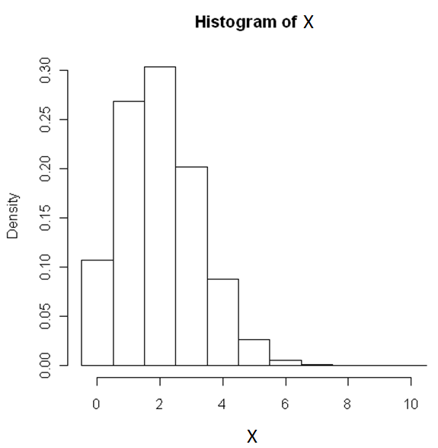
Hypergeometric with N=2000, r=400, and n=10

Slide 14
Binomial with n=10 and p=0.2

Slide 15
Epilepsy study
http://www.huffingtonpost.com/hal-herzog/pets-children-epilepsy-sudden-death_b_1791328.html

Slide 16
Summary of article
Of the 1,092 children in the study, 665 (61%) were from households with pets, and 427 (39%) lived in households with no pets.
Over 10 years, 11 children died unexplained.
Not a single child living with a companion animal died; all 11 died in households with no pets.

Slide 17
Epilepsy study hypergeometric calculation
If an urn contained 1092 marbles (427 white, 665 black), and we selected 11 marbles randomly without replacement, the probability of selecting 11 white marbles and 0 black marbles would be ~0.00003, the same as the probability o having all 11 seizure deaths in the no-pet group by chance.

Slide 18
More Probability: Law of Total Probability:
Let B₁, B₂, …, B_{n} be disjoint and
exhaustive so that ∪_{i=1 to n} B_{i} = Ω,
B_{i}∩B_{j} = ⌽ for i≠j.
Then for any A,
P(A) = P(A|B₁) P(B₁) + P(A|B₂) P(B₂) +
… + P(A|B_{n}) P(B_{n}).

Slide 19
Example 3
Machines I, II, and III produce the same product.
The rates of defectives from each are 2%, 1%, and 3% respectively.
The percent of the total product made by each are 35%, 25%, and 40% respectively.
What percent of the product are defective?

Slide 20
Example 3 Workspace

Slide 21
Bayes Rule
Let B₁,…, B_{n} be disjoint and exhaustive (∪B_{i}=Ω). Let A be any event. For any j=1, …, n
P(B_{j}|A)= P(A|B_{j}) P(B_{j})
P(A|B₁) P(B₁) +…+P(A|B_{n}) P(B_{n})

Slide 22
Example 3 revisited
What is the probability that a randomly chosen defective was produced by machine 3?

Slide 23
Probability Pt. II – Discrete Random Variables
A random variable is a function that assigns a numerical value to each sample point.

Slide 24
Probability Distribution Function
It is usually described using the probability distribution function:
p(x) = P(X=x)
Statisticians also call p(x) the probability mass function (pmf).

Slide 25
Cumulative Distribution Function
It is also often described using the cumulative distribution function (c.d.f.)
F(x) = P(X≤x)

Slide 26
Binomial Experiment Review
n identical trials
Each trial has only two possible outcomes (“Success” or “Failure”)
Probability of “Success” is a constant p for every trial
Trials are independent
Binomial Random Variable
If X is the number of successes, then

Slide 27
Hypergeometric Experiment Review
Population of size N
r are “successes” and N-r are “failures”
A random sample of size n is taken without replacement
Hypergeometric Random Variable
If X is the number of successes, then

Slide 28
Summaries of random variables
The mean or expected value of a discrete random variable X is

Slide 29
Expected Value Workspace

Slide 30
Variance of a random variable
The variance of a discrete random variable Y is

Slide 31
Variance Workspace

Slide 32
Binomial Distribution Mean and Variance

Slide 33
Binomial Distribution Mean and Variance Workspace

Slide 34
Hypergeometric Distribution

Slide 35
Properties of Distributions
Binomial Distribution
Hypergeometric Distribution

