Slide 1
STAT 515 Statistical Methods I Lecture 5 September 5, 2019 Originally prepared by Brian Habing Department of Statistics University of South Carolina Redistribution of these slides without permission is a violation of copyright law.

Slide 2
Outline for Today
Finishing Probability Part II – Discrete Random Variables – Sections 4.1-4.4 and 4.6
Starting Probability Part III – Continuous Random Variables – Sections 5.1-5.3
Homework 2 is due Thursday September 12

Slide 3
Binomial Distribution
Hypergeometric Distribution

Slide 4
Hypergeometric Distribution

Slide 5
Continuous Random Variables
Consider a random number generator that selects a real number at random from between 0 and 1.

Slide 7
The probability density function (pdf) f (x ) satisfies the following:
a) f (x ) ≥ 0 for all x.
b)
c)

Slide 10
The cdf is defined the same way as for discrete random variables:
F(X) = P(X≤x)

Slide 12
For expected values we need to change the summation into an integral:

Slide 14
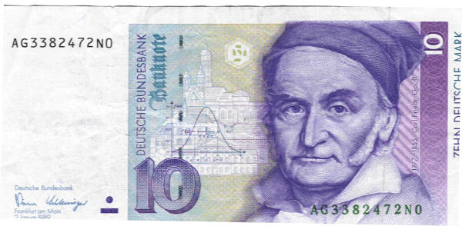
Normal Distribution

Slide 16
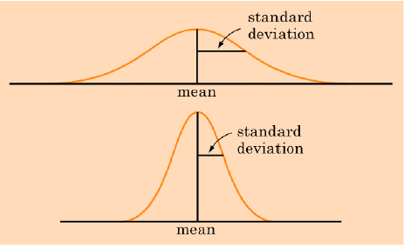

Slide 17
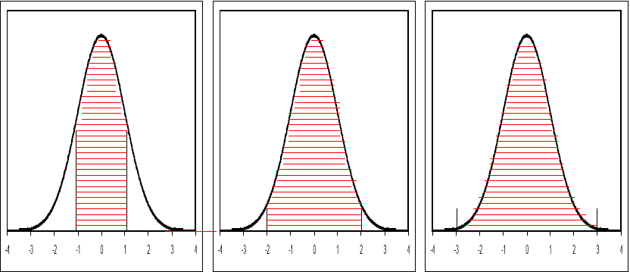
The 68-95-99.7 Rule
68% of the data falls within 1 std deviation of the mean
95% of the data falls within 2 std deviations of the mean
99.7% of the data falls within 3 std deviations of the mean

Slide 18
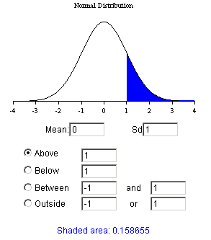
Online calculator (Probabilities)

Slide 19
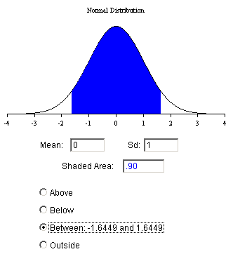
Online Calculator (Percentiles)

