Slide 1
STAT 515 Statistical Methods I Lecture 6 September 10, 2019 Originally prepared by Brian Habing Department of Statistics University of South Carolina Redistribution of these slides without permission is a violation of copyright law.

Slide 2
Outline for Today
Continuing Probability Part III – Continuous Random Variables – Sections 5.1-5.3
Homework 3 is due Thursday, September 19

Slide 3
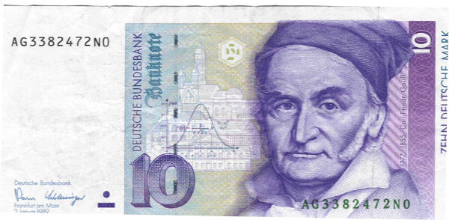
Normal Distribution

Slide 5
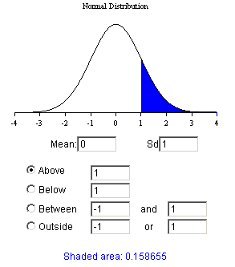
http://davidmlane.com/hyperstat/z_table.html

Slide 6
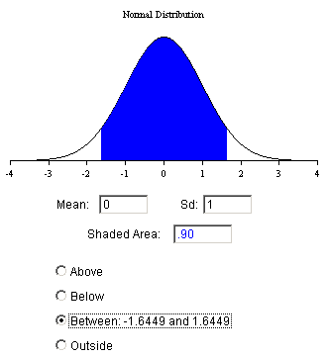
http://davidmlane.com/hyperstat/z_table.html

Slide 7
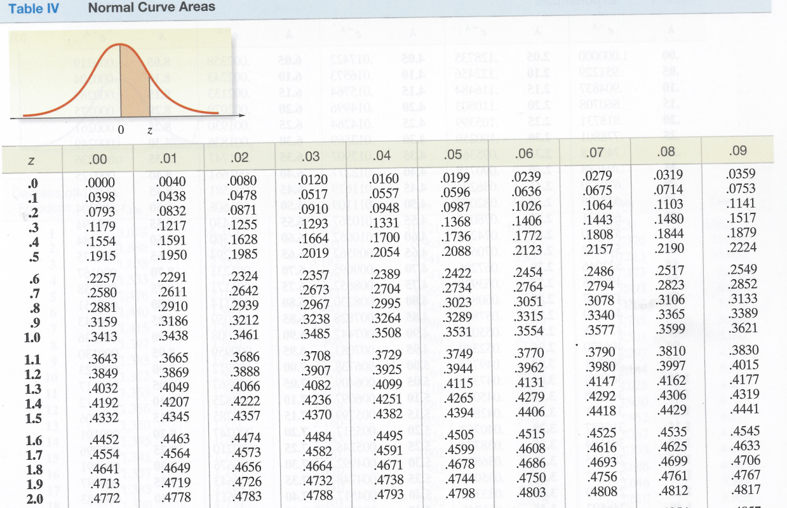

Slide 12
A “standard normal” distribution has mean μ=0 and variance σ²=1. Any normal random variable X can be transformed to standard normal by:

Slide 13
Example – IQ Scores for 12 Year Olds
IQ scores for 12 year olds follow a normal distribution with a mean of 100 and a standard deviation of 16.
What percent of 12 year olds will have an IQ higher than 132?

Slide 16
Example Continued
IQ scores for 12 year olds follow a normal distribution with a mean of 100 and a standard deviation of 16.
What IQ does a 12 year old need to be in the top 2.5%?

Slide 18
Example – Starting Salaries
Assume starting salaries in your field are approximately normally distributed with a mean of $42,000 and a standard deviation of $5,000.
a) Approximately what is the probability of earning at least $40,000 to start?
b) What salary would put you in the top 10%?

