Slide 1
STAT 515 Lecture 7 September 12, 2019
Originally prepared by Brian Habing
Department of Statistics
University of South Carolina
Redistribution of these slides without permission is a violation of copyright law.

Slide 2
Outline for Today
Continuing Probability Part III – Continuous Random Variables – Sections 5.4-5.5
Homework 2 is due today
Homework 3 is due Thursday the 19th

Slide 3
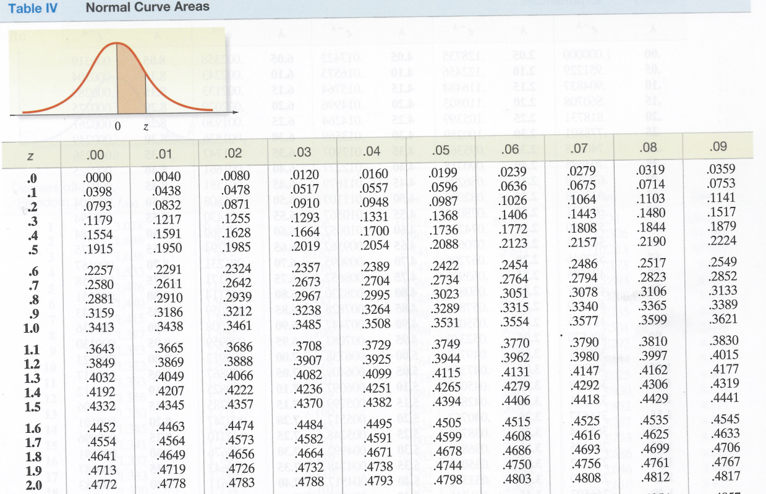

Slide 4
How can you tell if it seems like it’s from a normal distribution?
0.0008
0.0008
D
D
0.0006
e
0.0006
e
n
n
s
0.0004
s
0.0004
i
i
t
0.0002
t
0.0002
y
y
0
3800
5000
6200
0
3600
4800
6000
salary
salary
D
0.0006
e
n
0.0004
s
i
t
0.0002
y
0
3700
4300
4900
5500
6100
6700
salary

Slide 5
Normal Quantile-Quantile Plot
Plot of the data in order, against the corresponding percentiles (or quantiles) from a normal distribution.

Slide 6
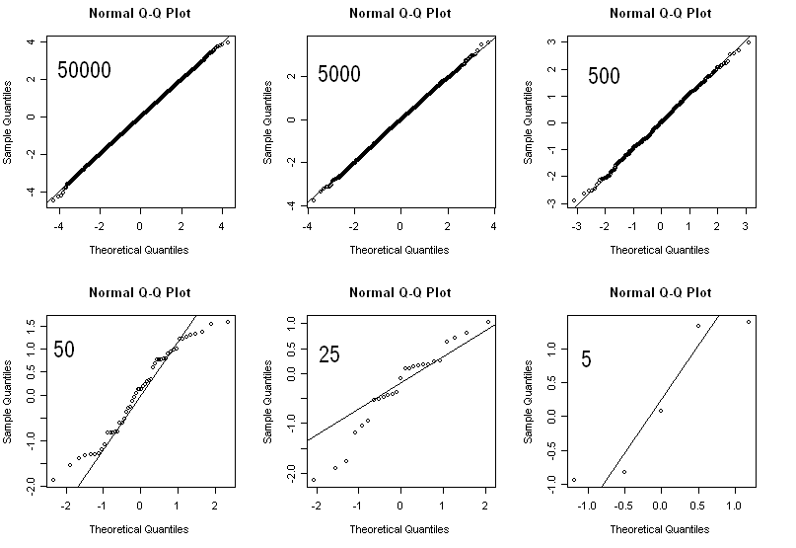
Normal Quantile-Quantile Plot

Slide 7
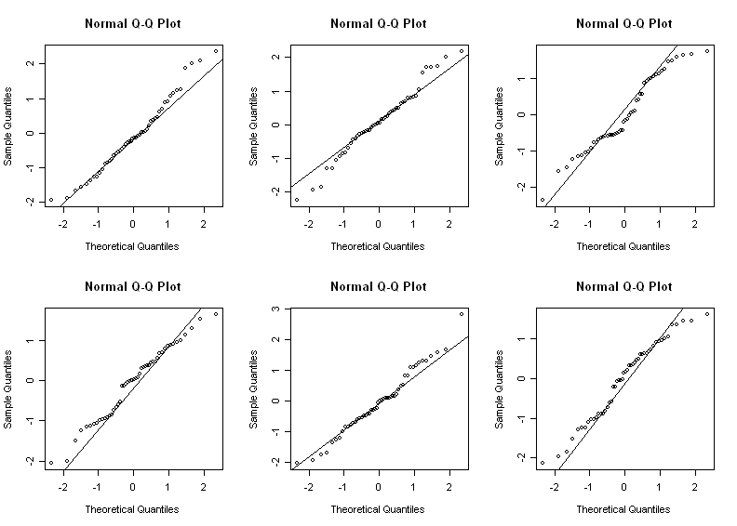
Normal n=50

Slide 8
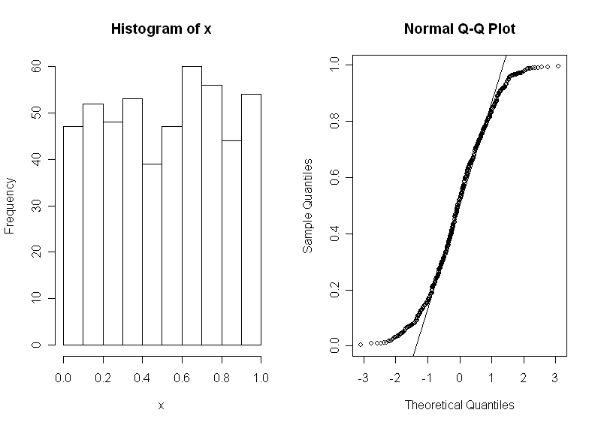
Light Tails

Slide 9
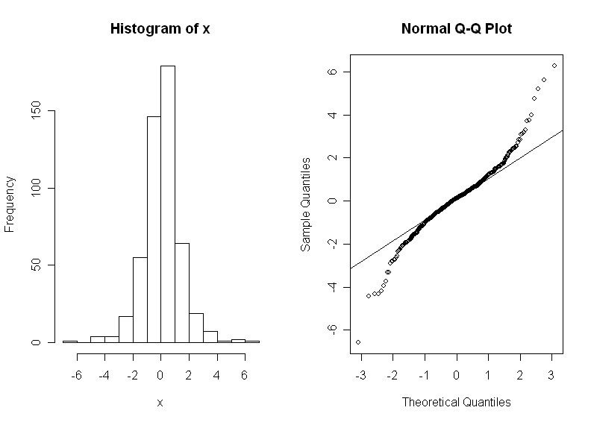
Heavy Tails

Slide 10
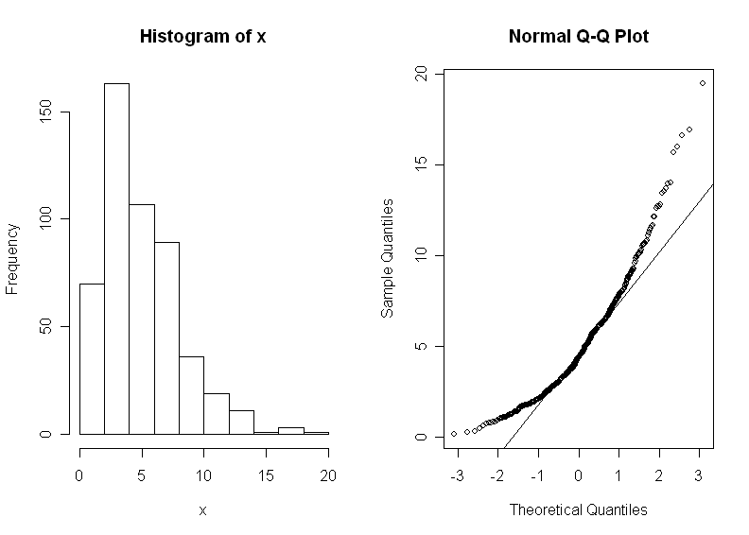
Skewed Right

Slide 11
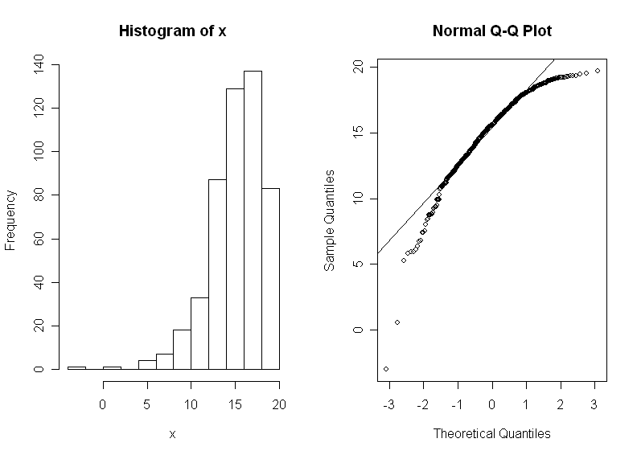
Skewed Left

Slide 12
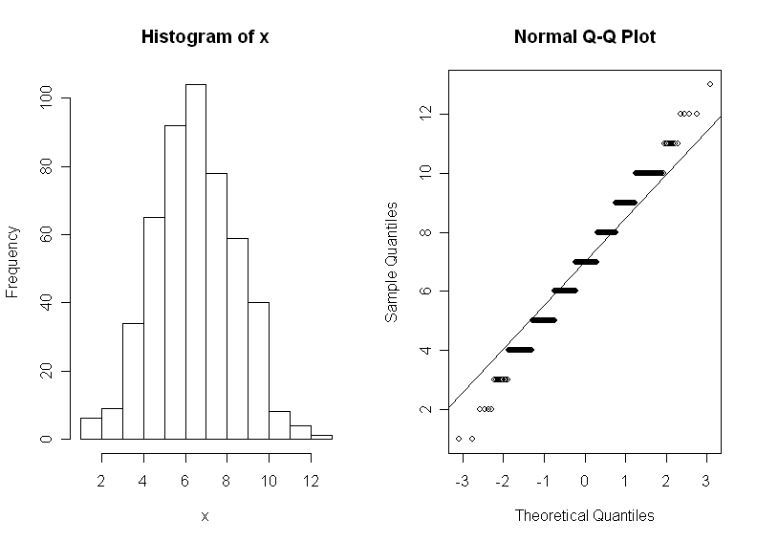
Discrete

Slide 14
Central Limit Theorem
Let X₁, X₂, … be a sequence of independent identically distributed random variables with mean μ and variance σ². Then

Slide 15
Central Limit Theorem
http://www.stat.uiuc.edu/courses/stat100/cuwu/boxmodel.html

Slide 16
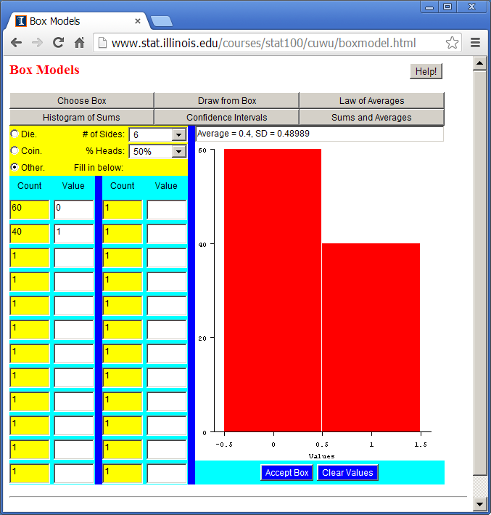

Slide 17
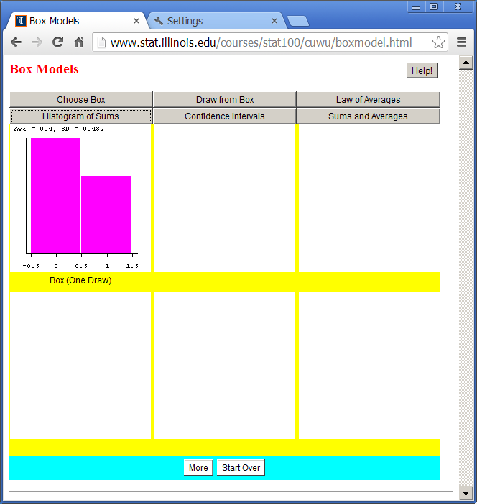

Slide 18
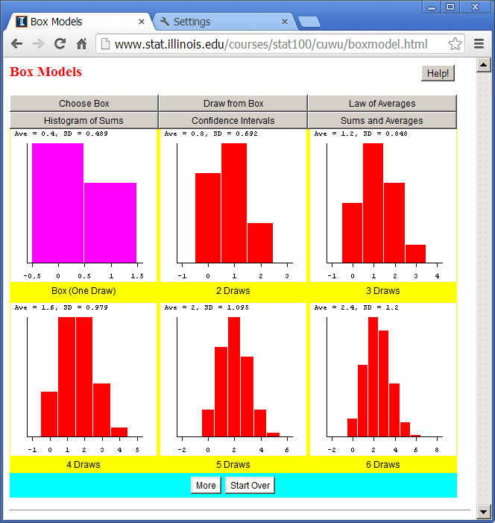

Slide 19
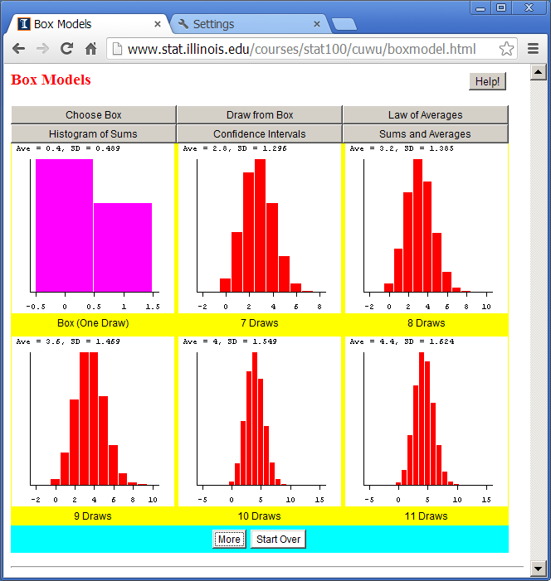

Slide 20
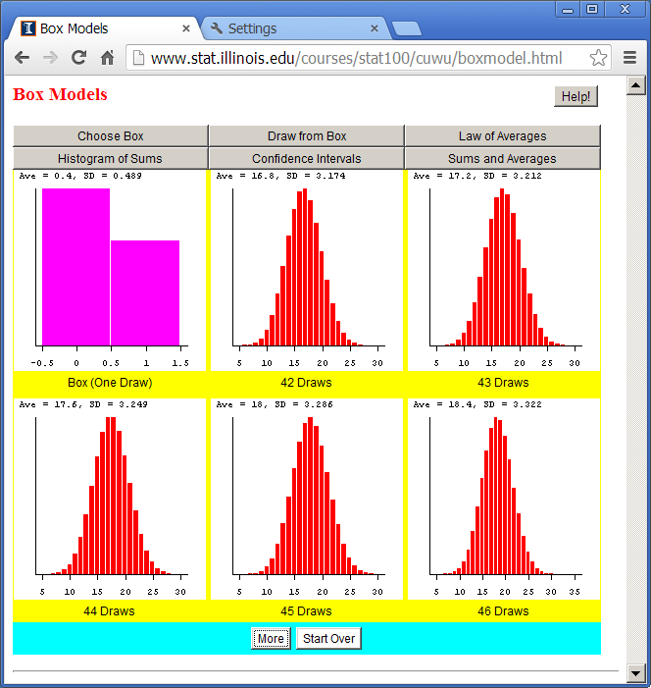

Slide 21
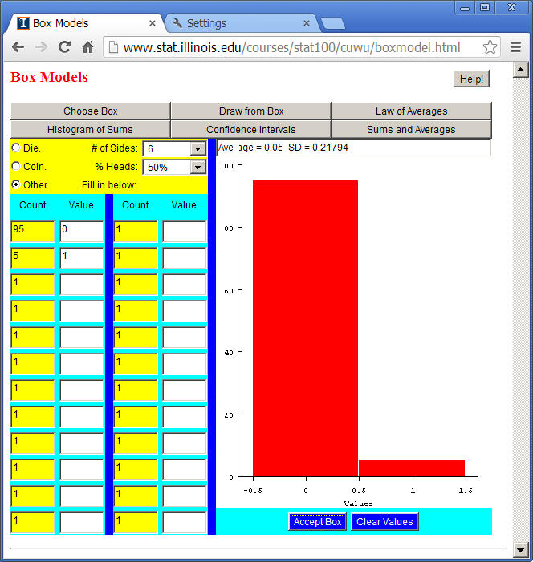

Slide 22
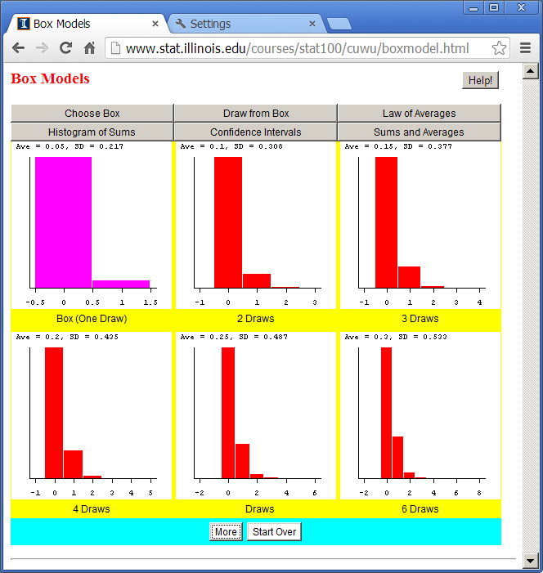

Slide 23
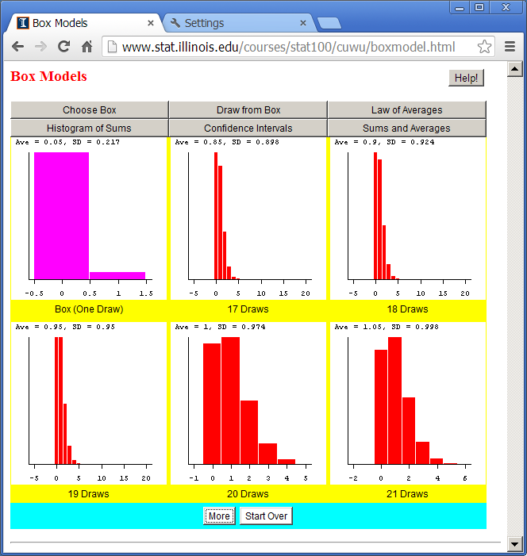

Slide 24
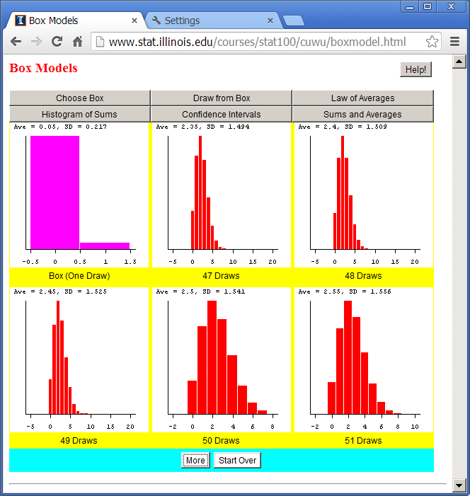

Slide 25
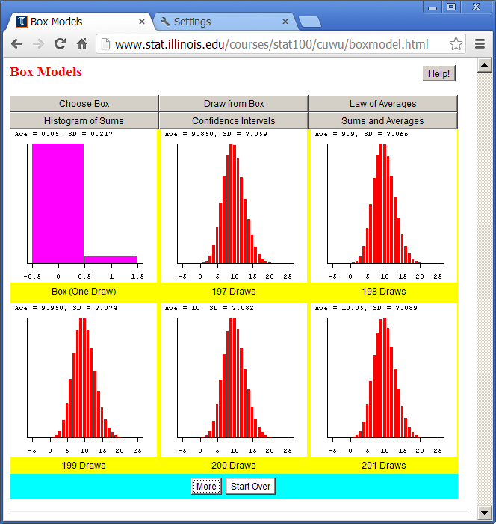

Slide 26
How Large Does n Need to be?
Always normal if the population is normal to start with
A rule of thumb is if np≥5 and n(1-p)≥5 if the population is a binomial experiment
n>30 is often suggested as being pretty good for many distributions (with seemingly little justification)

Slide 27
Example
A biased coin has a mean of 0.4 and a standard deviation of approximately 0.49 (if a head is counted as one and a tail as zero).
If it is flipped 14 times, approximately what is the chance of observing 8 heads or more?

Slide 28
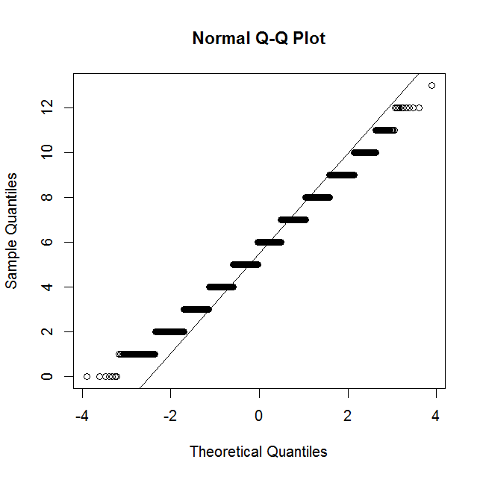
Normal Approximation to the Binomial
> x<-rbinom(10000,14,.4)
> qqnorm(x); qqline(x)

Slide 29
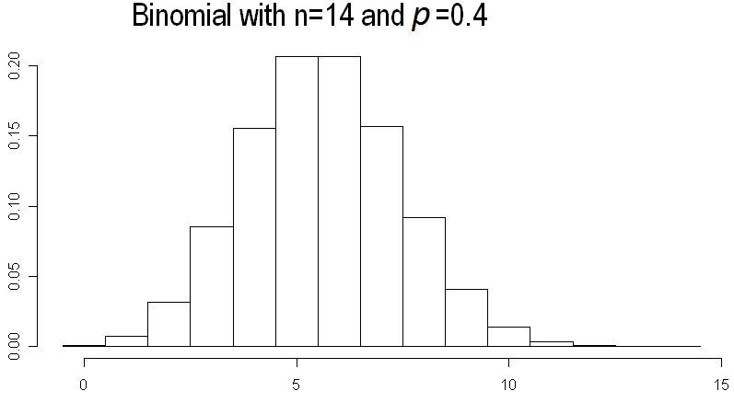
Normal Approximation to the Binomial

Slide 30
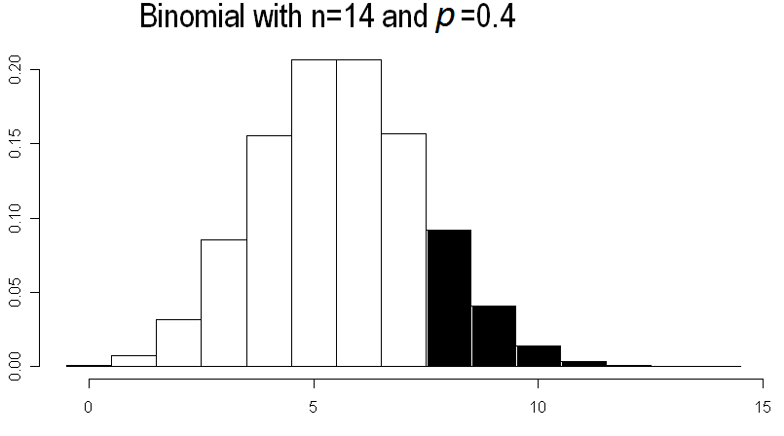
Normal Approximation to the Binomial
> 1-pbinom(7,14,.4)
[1] 0.1501401

Slide 36
Example 2
A biased coin has a mean of 0.8.
If it is flipped 4000 times, approximately what is the chance of observing 3,250 or fewer heads?

