Slide 1
STAT 515 Lecture 8 September 17, 2019
Originally prepared by Brian Habing
Department of Statistics
University of South Carolina
Redistribution of these slides without permission is a violation of copyright law.

Slide 2
Outline for Today
Continuing Probability Part IV– Poisson and Exponential Distributions – Sections 4.5 & 5.6
Homework 6 is due Thursday the 17th
Use R to construct a q-q plot for the data in 5.60 and comment on it’s shape.
5.78a Using the continuity correction
Exam is Tuesday the 22nd. Please see syllabus if you are unable to attend live.

Slide 3
Central Limit Theorem
Let X₁, X₂, … be a sequence of independent identically distributed random variables with mean μ and variance σ². Then

Slide 4
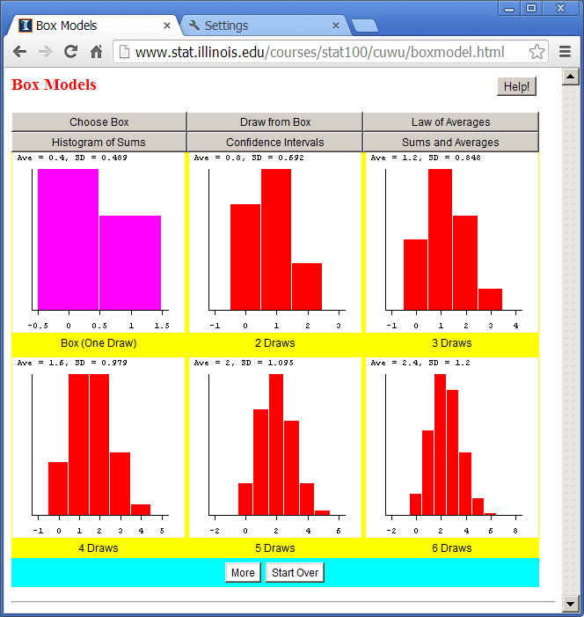

Slide 5
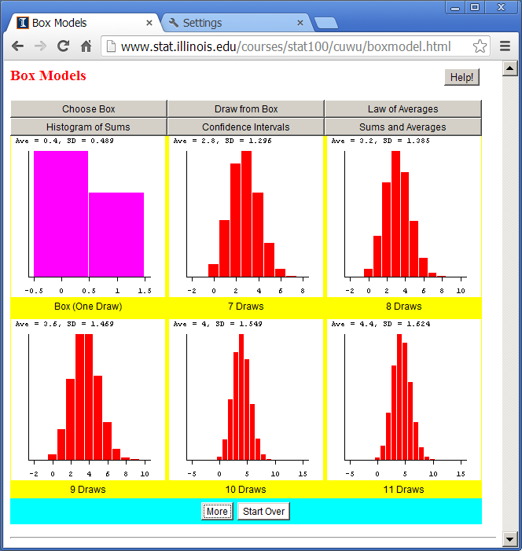

Slide 6
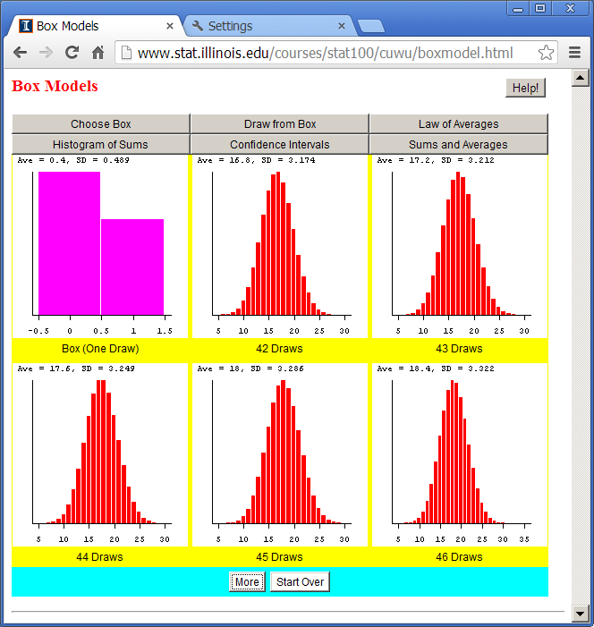

Slide 7
How Large Does n Need to be?
Is always true if the population is normal to start with
A rule of thumb is if np≥5 and n(1-p)≥5 if the population is a binomial experiment
n>30 is often suggested as being pretty good for many distributions (with seemingly little justification)

Slide 8
Binomial Approximation Example 2
A biased coin has a mean of 0.8.
If it is flipped 4000 times, approximately what is the chance of observing 3,250 or fewer heads?

Slide 9
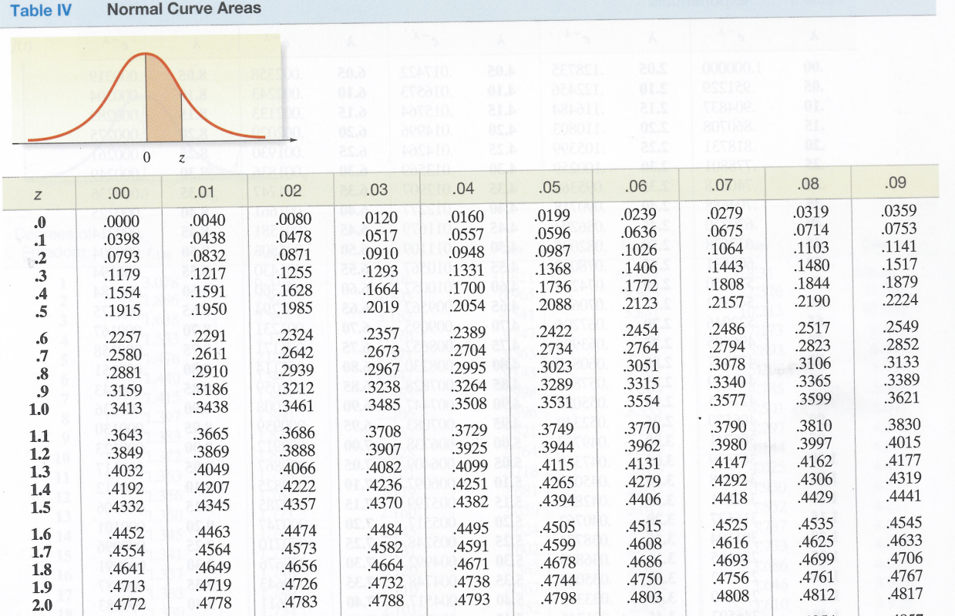

Slide 12
4.5 – The Poisson Distribution
Projector bulbs used in a classroom fail on average once every 500 hours. Consider the first 500 hours a projector is used:
What is the chance we make it through needing no replacements?
Needing one replacement?
How many replacements do we need on average?

Slide 13
Projector bulbs used in a classroom fail on average once every 500 hours. Consider the first 500 hours a projector is used

Slide 14
Imagine splitting the 500 hours in half, treating the n=2 halves independently, and giving them each a p=0.5 chance.
or n=4 parts each with p=0.25 chance…
or n=8 parts each with p=0.125 chance…
or n=16 parts each with p=0.0625 chance…
etc…

Slide 15
Y is the number of events occurring during an interval of fixed length t. Y follows a Poisson distribution if:
Only one event can occur at a particular point
Events occurring in one range are independent of events occurring in other ranges
The expected number of events during any such interval is a constant λ

Slide 16
Poisson Random Variable

Slide 17
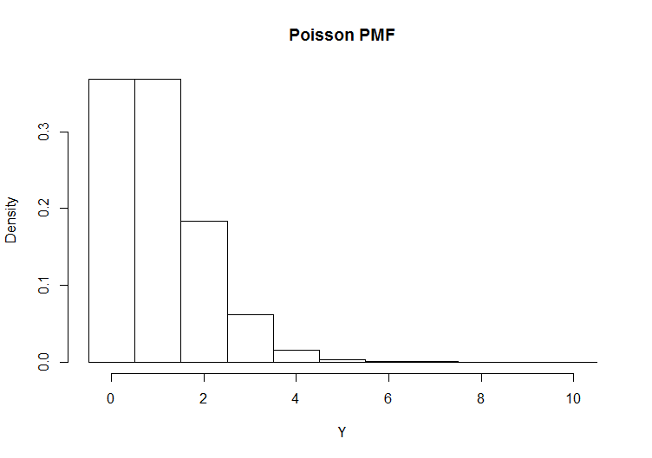
Example
Projector bulbs used in a classroom fail on average once every 500 hours. Consider the first 500 hours a projector is used

Slide 18
Example
Projector bulbs used in a classroom fail on average once every 500 hours. Consider the first 500 hours a projector is used
What is the chance we make it through needing no replacements?
Needing one replacement?
How many replacements do we need on average?

Slide 19
Example 2
The projector bulbs used in a classroom fail on average once every 500 hours. The room will get approximately 900 hours of use in the academic year.

Slide 20
Poisson Random Variable

Slide 21
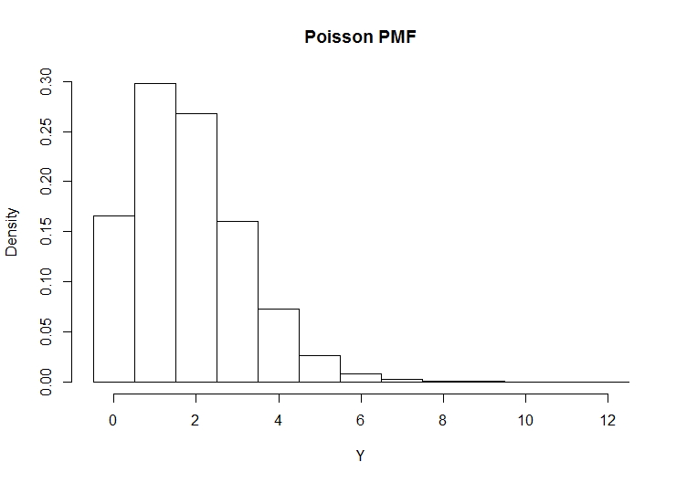
Example 2
The projector bulbs used in a classroom fail on average once every 500 hours. The room will get approximately 900 hours of use in the academic year.

Slide 22
Example 2
A projector bulbs used in a classroom fail on average once every 500 hours. The room will get approximately 900 hours of use in the academic year.
What is the chance we make it through needing no replacements?
Needing one replacement?
How many replacements do we need on average?

Slide 23
Example 3
A process for manufacturing rolls of thin copper has a noticeable imperfection an average of once every 50 meters.
What is the chance that a 20 meter segment will have no imperfections?
What are the average number of imperfections in 20 meters?

Slide 24
Exponential Distribution
Consider a “Poisson process” with parameter λ for one unit of time.
Say we are interested in the random variable: Y=time until the next occurrence

Slide 25
Lets look at the problem in terms of the cdf:

Slide 26
A bit of calculus reveals that:
pdf
mean
variance

Slide 27
Between 2am and 4am cars pass the mile marker at a rate of 10 per hour.
How long until the next car passes?
What is the probability we only need to wait 4 or fewer minutes before the next car passes?

Slide 28
