Slide 1
STAT 515 Lecture 9 September 19, 2019
Originally prepared by Brian Habing
Department of Statistics
University of South Carolina
Redistribution of these slides without permission is a violation of copyright law.

Slide 2
Outline for Today
Sampling Distributions and the Central Limit Theorem
Should Read 6.1-6.3 and Supplement to Chapter 6
Exam is Thursday live in class, or as you have already scheduled it.

Slide 3
Sampling Distributions
A sampling distribution is the probability distribution of a statistic.
In general we want a sampling distribution that is as close as possible to the corresponding parameter.

Slide 4
Example
Consider a sample of size two from a population with probability distribution:
x 0 2 8
p(x) 0.25 0.5 0.25

Slide 8
Central Limit Theorem
Let X₁, X₂, … be a sequence of independent identically distributed random variables with mean μ and variance σ². Then

Slide 10
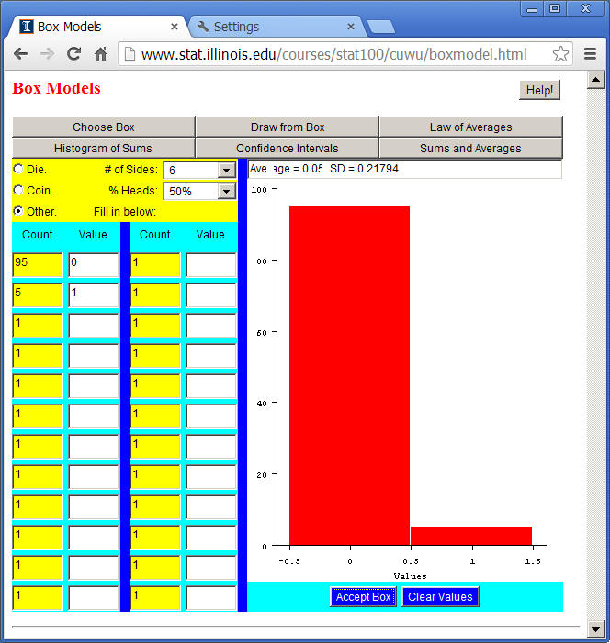

Slide 11
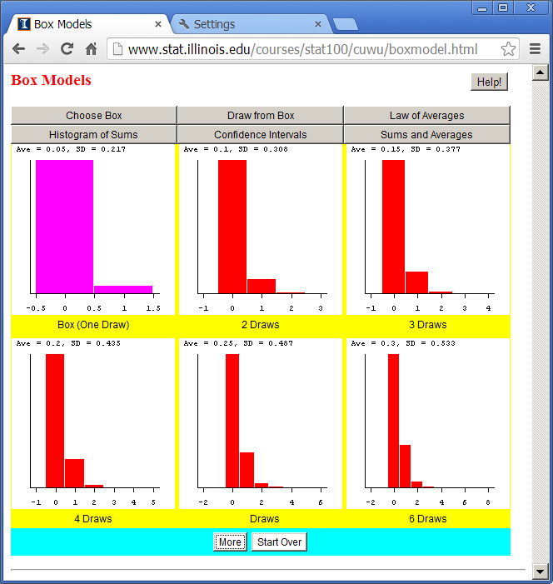

Slide 12
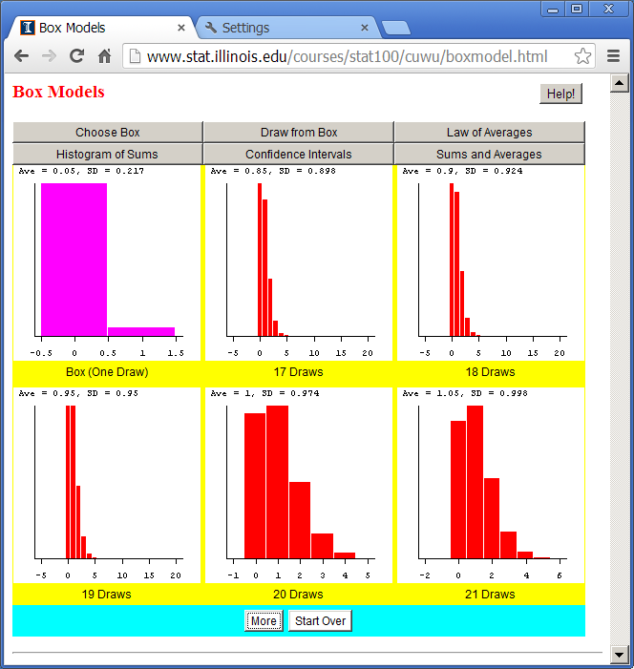

Slide 13
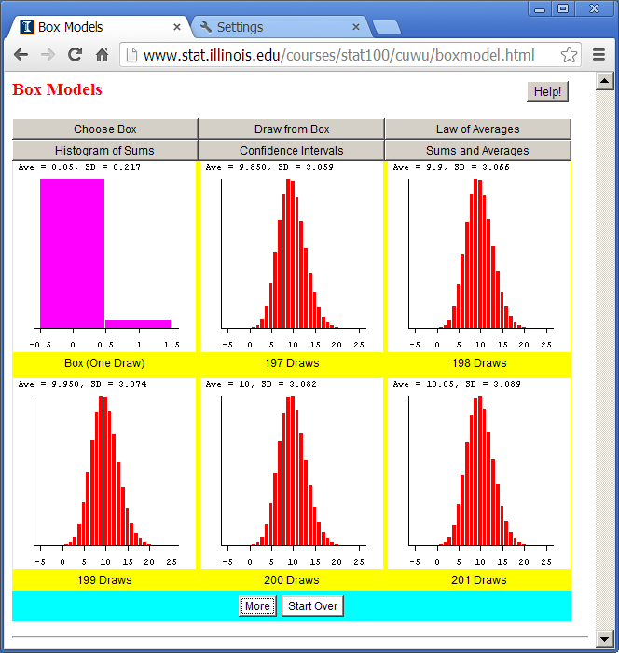

Slide 14
How Large Does n Need to be?
Is always true if the population is normal to start with
A rule of thumb is if np≥5 and n(1-p)≥5 if the population is a binomial experiment
n>30 is often suggested as being pretty good for many distributions (with seemingly little justification)

Slide 15
Example 2
The average starting income out of a program is $40,000 with a standard deviations of $4,000.
In a sample of size 16, approximately what is the probability the observed average will be $39,000 or less?

Slide 17
The average is $40,000 with an sd of $4,000.
If n=16, approximately what is the probability the observed average will be $39,000 or less?

Slide 19
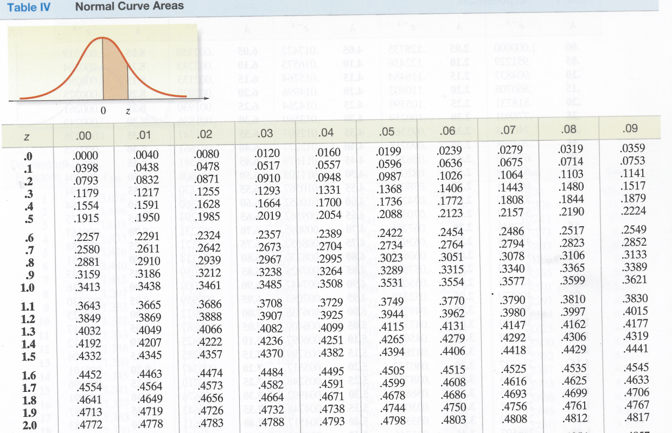

Slide 21
Chi-Squared Distribution
Let Z₁, Z₂, … Z_{n} be independent standard normal random variables. Then
has a Chi-squared distribution with n degrees of freedom.

Slide 22
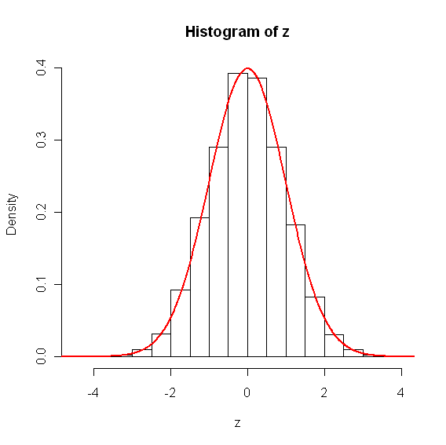
Z=rnorm(10000)
hist(z,freq=F)
vals=seq(-4,4,by-0.01)
f=dnorm(vals)
lines(vals,f,col="red",lwd=2)

Slide 23
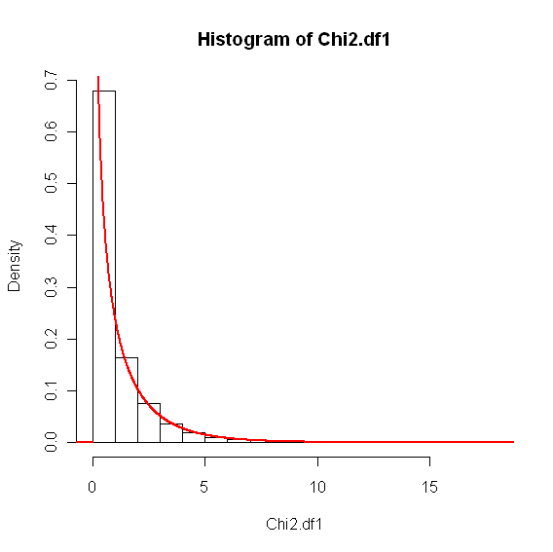
Chi2.df1<-z^2
hist(Chi2.df1,freq=F)
vals=seq(0,10,by=0.01)
f=dchisq(vals,df=1)
lines(vals,f,col="red",lwd=2)

Slide 24
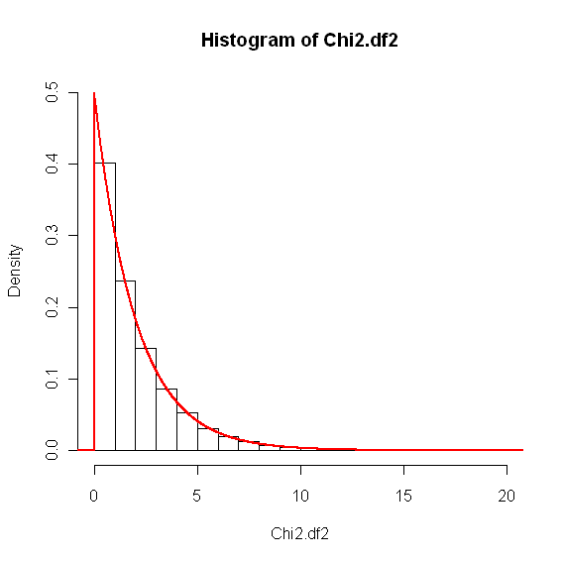
Chi2.df2=rnorm(10000)^2+rnorm(10000)^2
hist(Chi2.df2,freq=FALSE,ylim=c(0,.5))
vals=seq(0,15,by=0.01)
f=dchisq(vals,df=2)
lines(vals,f,col="red",lwd=2)

Slide 25
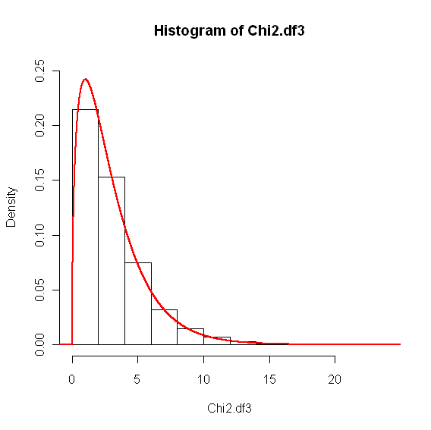
Chi2.df3=rnorm(10000)^2+rnorm(10000)^2+rnorm(10000)^2
hist(Chi2.df3,freq=FALSE,ylim=c(0,.25))
vals=seq(0,20,by=0.01)
f=dchisq(vals,df=3)
lines(vals,f,col="red",lwd=2)

Slide 26
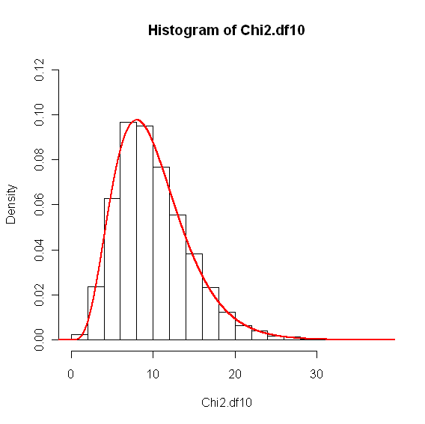
z=matrix(rnorm(10000*10),ncol=10)
Chi2.df10<-apply(z^2,1,sum)
hist(Chi2.df10,freq=F,ylim=c(0,.12))
vals=seq(0,30,by=0.01
f=dchisq(vals,df=10)
lines(vals,f,col="red",lwd=2)

Slide 27
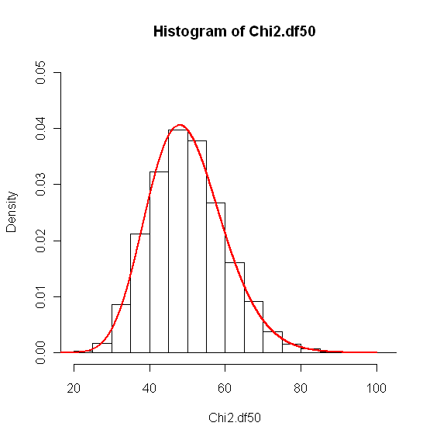
z=matrix(rnorm(10000*50),ncol=50)
Chi2.df50<-apply(z^2,1,sum)
hist(Chi2.df50,freq=FALSE,ylim=c(0,.05))
vals=seq(20,100,by=0.01)
f=dchisq(vals,df=50)
lines(vals,f,col="red",lwd=2)

Slide 28
Chi-Squared Distribution
Let X₁, X₂, … X_{n} be i.i.d. normal random variables with mean μ and sd σ:
has a Chi-squared distribution with n-1 degrees of freedom.

Slide 29
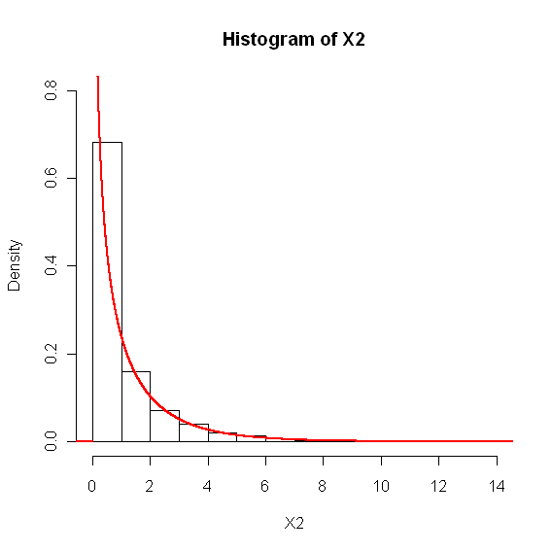
z=matrix(rnorm(10000*2),ncol=2)
sig2=1
s2=apply(z,1,var)
X2=(2-1)*s2/sig2
hist(X2,freq=FALSE,ylim=c(0,0.8))
vals=seq(0,10,by=0.01)
f=dchisq(vals,df=1)
lines(vals,f,col="red",lwd=2)

Slide 30
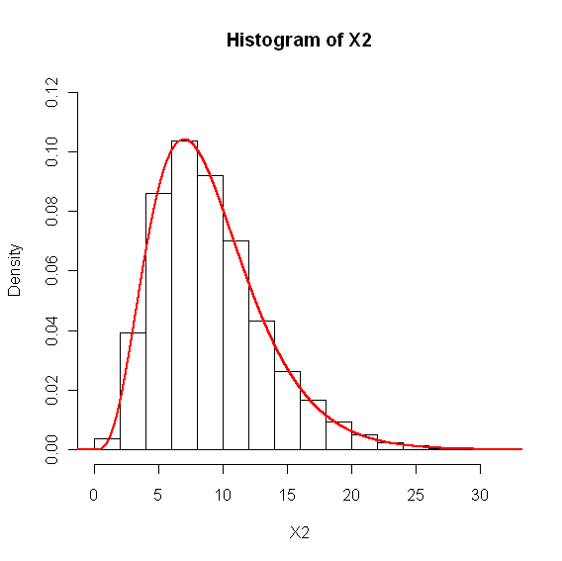
z=matrix(rnorm(10000*10),ncol=10)
sig2=1
s2=apply(z,1,var)
X2=(10-1)*s2/sig2
hist(X2,freq=FALSE,ylim=c(0,0.12))
Vals=seq(0,30,by=0.01)
f=dchisq(vals,df=9)
lines(vals,f,col="red",lwd=2)

Slide 31
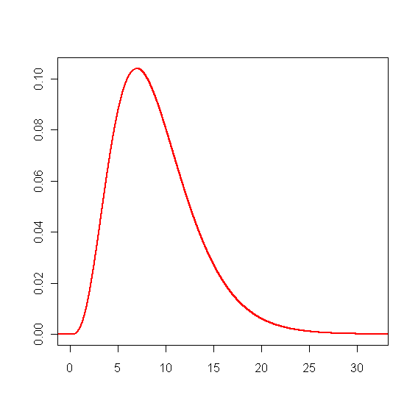
> qchisq(.025,df=9)
[1] 2.700389
> qchisq(.975,df=9)
[1] 19.02277

Slide 34
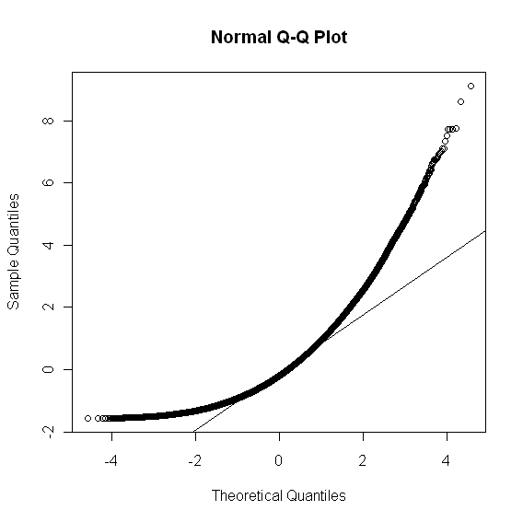
Robustness
What if the data wasn’t normal?
> z=matrix(rchisq(10000*20,df=5),ncol=20)
> z=(z-5)/sqrt(10)
> mean(c(z))
[1] 0.001372528
> sd(c(z))
[1] 1.003290
> qqnorm(c(z));qqline(c(z))

Slide 35
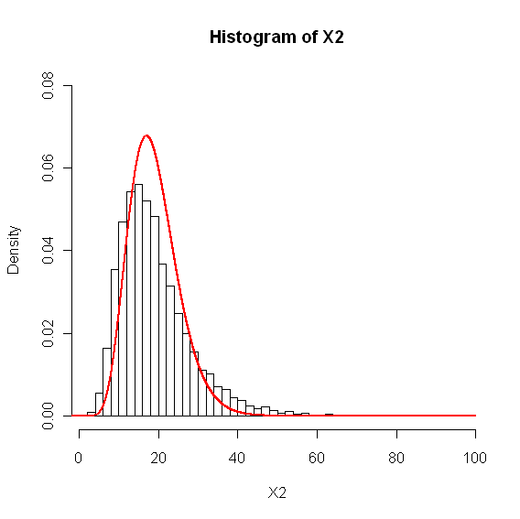
sig2=1
s2=apply(z,1,var)
X2=(20-1)*s2/sig2
hist(X2,freq=FALSE,ylim=c(0,0.08),nclass=50)
vals=seq(0,65,by=0.01)
f=dchisq(vals,df=19)
lines(vals,f,col="red",lwd=2)

