Slide 1
Completely Randomized Design Outline
Reviews for later topics
Model parameterization (estimability)
Contrasts (power analysis)
Analysis with contrasts
Orthogonal polynomial contrasts
Polynomial goodness-of-fit
Notes:
CRD Exercise—diet.sas and diet.txt; run diet.sas ahead of time

Slide 2
Completely Randomized Design
Cell means model:

Slide 3
Effects Model
Notes:
Alpha’s sum to zero implies mu_tilde is grand mean. Alpha_a set to 0 implies mu_tilde is mean of factor level a. Alpha_i is always the difference between mu_i and mu_tilde, whatever that represents.

Slide 4
GLM for Effects Model
Notes:
Write out Y_11 and Y_a1

Slide 5
CRD Contrasts
Balanced case (n_{i}=n)
-A linear combination L has the form:
-A contrast is a linear combination with the additional constraint:

Slide 6
Cotton Fiber Example
Treatment--% cotton by weight (15%, 20%, 25%, 30%, 35%)
Response--Tensile strength
Notes:
Run contrast.sas through first sgplot step. Index c by k if you want to look at more than one contrast.

Slide 7
A Simple Contrast

Slide 8
Contrast Formulas
Notes:
Run proc means and proc glm steps in contrast.sas. Show some hand calculations for L_1-hat and the sum of the c_1i-squared. Note that SS_L1 is something of a term of art.

Slide 9
Contrast Test Statistic
Under H_{o}:L₁=0,
Notes:
Run contrast in SAS, and make a note of SS_L1

Slide 10
Unbalanced CRD Contrast SS

Slide 11
Orthogonality
Contrasts are orthogonal if, for contrasts L₁ and L₂, we have

Slide 12
Orthogonality Discussion, I
The usual a-1 ANOVA contrasts are not orthogonal (though columns are linearly independent)
Orthogonality implies effect estimates are unaffected by presence/absence of other model terms
Notes:
Orthogonality is straightforward to define and check, but hard to motivate.

Slide 13
Orthogonality Discussion, II
Sums of squares for orthogonal contrasts are additive, allowing treatment sums of squares to be partitioned
Mathematically attractive, though not all contrasts will be interesting to the researcher

Slide 14
Cotton Fiber Quadratic Contrasts
Two sets of covariates (orthogonal and non-orthogonal) to test for linear and quadratic terms
Term | Orth. SS | N on-Orth SS
L | 33.6 | 33.6
L|Q | 33.6 | 364.0
Q | 343.2 | 12.8
Q|L | 343.2 | 343.2
L & Q | 376.8 | 376.8
Notes:
Refer to output again. Don’t define contrasts (this is something I used to do), but demonstrate orthogonality.

Slide 15
Cotton Fiber Example
For Orthogonal SS, L&Q=L+Q; Q=Q|L; L=L|Q
For Nonorthogonal SS, L&Q=L+Q|L=Q+L|Q
Term | Orth. SS | Non-Orth SS
L | 33.6 | 33.6
L|Q | 33.6 | 364.0
Q | 343.2 | 12.8
Q|L | 343.2 | 343.2
L & Q | 376.8 | 376.8

Slide 16
Orthogonal polynomial contrasts
Require quantitative factors
Equal spacing of factor levels (d)
Equal n_{i}
Usually, only the linear and quadratic contrasts are of interest

Slide 17
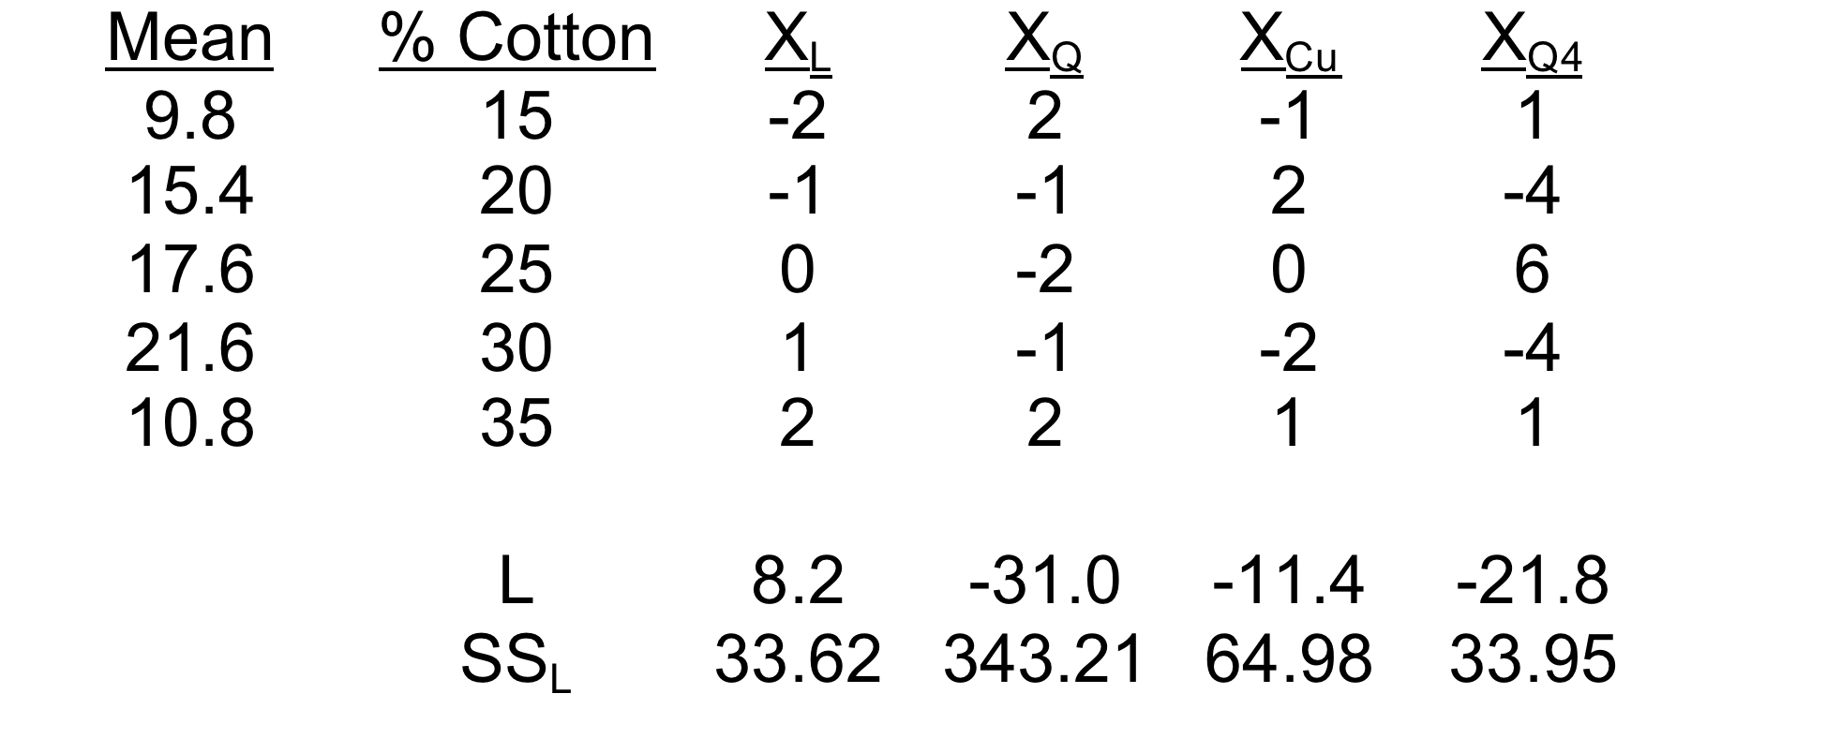
Orthogonal Polynomial Contrast Sums of Squares
Cotton Fiber Example
Notes:
Refer to output and code again.

Slide 18
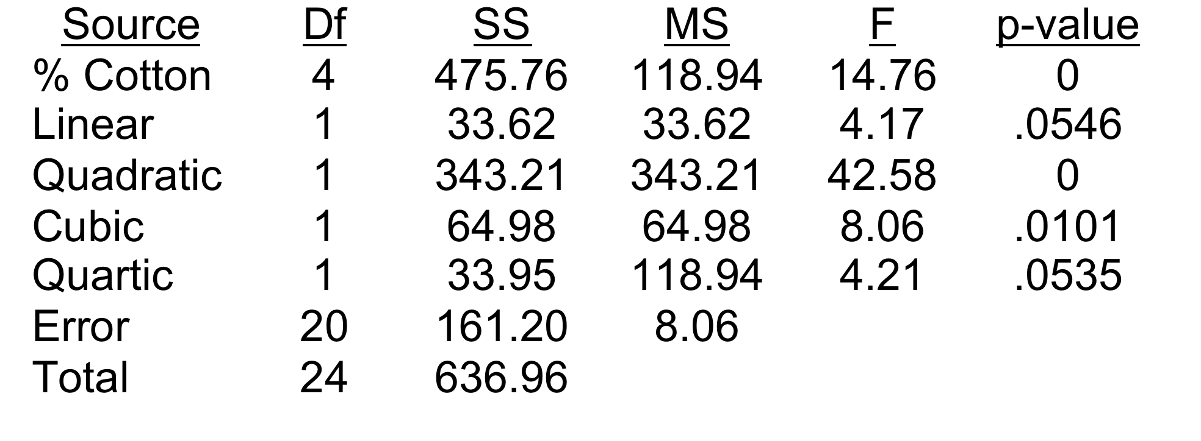
Orthogonal polynomial contrasts F tests
Cotton Fiber Example
Notes:
Sum the sums of squares in R

Slide 19
Orthogonal polynomial contrasts and goodness/lack of fit
Cotton Fiber Example
Is a L+Q model better than an intercept model?
Is a L+Q model not as good as a cell means model? (Lack of Fit test)

Slide 20
Orthogonal polynomial contrasts—another approach
Yandell has an interesting approach to reconstructing these tests
Construct the first (linear) term
Include a quadratic term that is neither orthogonal, nor a contrast
Do not construct higher-order contrasts at all
Use a Type I analysis for testing
Notes:
Run remaining code and interpret. Yandel basically fits the usual quadratic model in X.

