Slide 1
Power Analysis
Many of you have seen OCC’s
First specify test size α, σ², μ in a CRD
Compute :
Compute

Slide 2
Power Analysis-Noncentrality parameter
Compute a summary measure of H_{a}:
OCC curves will depend on α, and the numerator and denominator df
Notes:
Typical of many texts. Dividing by a standardizes phi.

Slide 3
Power Analysis—Using tables
Select the appropriate OCC curve
Find where vertical line drawn from φ on horizontal axis intersects appropriate OCC
Read β on vertical axis; compute 1−β
Notes:
Choice of the OCC table will depend on nu=a-1, alpha=0.01 or 0.05. Choice of curve within table depends on denominator df.

Slide 4
Power Analysis—Sample Size Analysis
OCC’s can be used for sample size analysis, but they are awkward
The curves are computed from the distribution of the F statistic under H_{A}
Notes:
You can work “backward” for a sample size analysis, but it’s really awkward

Slide 5
Derivation of OCC’s
Recall that

Slide 6
Properties of Mean Squares
Regardless of the true state of nature,
where
Notes:
MSE over sigma^2 is always central chi-square. Delta^2=0 implies that E(MSTR)=E(MSE)

Slide 7
Non-centrality parameter
A non-central χ² rv is often introduced as a sum of independent squared N(λ_{i},σ²) rv’s; its noncentrality parameter would be:
In our case, the normal components are not independent.
Notes:
Though components are not independent, this intuitive motivation for delta^2 still works.

Slide 8
Non-central F
We say that F has a noncentral F distribution with noncentrality parameter δ²
A non-central F rv is based on a ratio of independent non-central χ² and central χ² rv’s

Slide 9
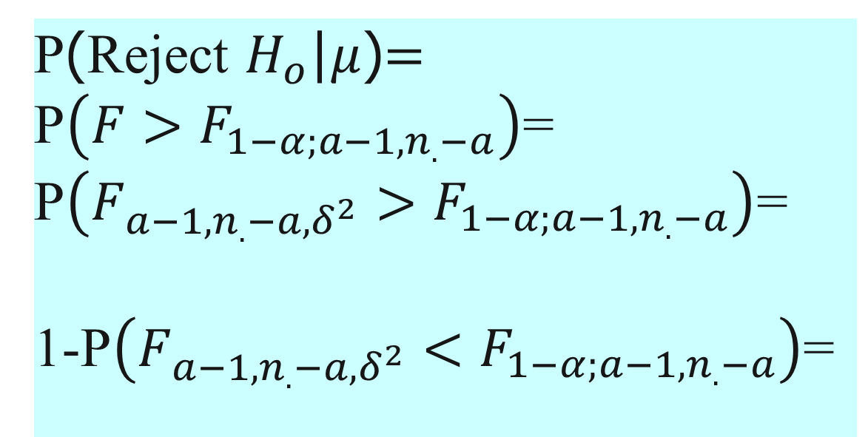
Derivation of Power
P(Reject $H_{o}$|$μ$)$=$
P$\left(F>F_{1−α;a−1,n_{.}−a}\right)$=
P$\left(F_{a−1,n_{.}−a,δ^{2}}>F_{1−α;a−1,n_{.}−a}\right)$=
1-P$\left(F_{a−1,n_{.}−a,δ^{2}}<F_{1−α;a−1,n_{.}−a}\right)$=

Slide 10
Power formulas
For the balanced case, we have:
Notes:
These equations involve the cdf’s of non-central F distributions, which are available in most computer packages.

Slide 11
Computer Code
SAS example
R code
S02<-rep(seq(1,5),each=14)
n<-rep(seq(2,15),5)
ncvec<-n*s02
Notes:
In addition to PROC GCONTOUR, the contour plots can be produced in Minitab. Run the first part of power_crd.sas. If using Minitab, open power.txt.

Slide 12
R Computer Code
Power<-1-pf(qf(.95,a-1,n*a-a),a-1,n*a-a,ncvec)
Contour(seq(2,15),seq(1,5),matrix(power,ncol=5),xlab=“Sample Size”,ylab=“Effect”)
Notes:
End of Day 4

Slide 13
Power Analysis for Contrasts
Magnitude of contrasts under H_{A} is easy for experimenters to articulate (Yandell, Edwards)
We consider one df contrasts only (Yandell focuses on specific cases; our treatment will be more general)

Slide 14
Non-central F for contrasts
We will test H_{o}:L-L_{o}=0 vs. H_{A}:L-L_{o}≠0
Typically, L_{o}=0
Regardless of the true state of nature,

Slide 15
Non-central F: balanced case
For the balanced case,

Slide 16
SAS code for contrasts
To adapt the SAS program to contrasts, note that the coefficient of n in the noncentrality parameter has changed
Loop on L (not s02) and calculate the remaining terms in the noncentrality parameter in the loop
This ensures that L is output
Remember to change numerator df
Notes:
Run remainder of power_crd.sas. Explain Class Exercise 2.

