Slide 1
STAT 541
Chapter 13 supplement: Review of Formatting Data
©Spring 2012 Imelda Go, John Grego, Jennifer Lasecki and the University of South Carolina

Slide 2
Informats
(input-related)
how to read
data values
CONVERT
[interpretation]
Formats
(output-related)
how to write data values
PRINT
[appearance]
are instructions

Slide 3
Standard
examples: 2.1 $5.
$char5. yymmdd8.
User- Defined
⬇
PROC FORMAT
Formats and Informats

Slide 4
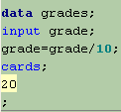
Standard Informat for Input
original values: 00 10 15 20 25 30 35 40
⬇
desired values: 0.0 1.0 1.5 2.0 2.5 3.0 3.5 4.0

Slide 5
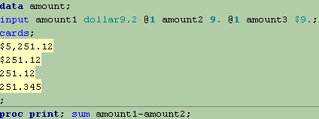
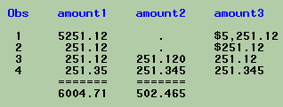
Standard Informat for Input

Slide 6
Standard Informat for Fixed-Width Input

Slide 7
Standard Informat for Delimited Input
The : argument indicates length is up to 19 characters.
with the LENGTH statement

Slide 8
Naming Conventions for User-Defined
Formats (VALUE, PICTURE) and
Informats (INVALUE) in PROC FORMAT
Character
Begins with $
INFORMAT
+ up to 30 characters
FORMAT
+ up to 31 characters
Use valid SAS names that do not end in a number.
Numeric
INFORMAT
Up to 31 characters
FORMAT
Up to 32 characters
VALID
$gender
$gender2F
INVALID
$gender2
$2gender
VALID
gender
gender2F
INVALID
gender2
2gender
In SAS code, refer to them with a period following their name, BUT do not use the period in PROC FORMAT.

Slide 9
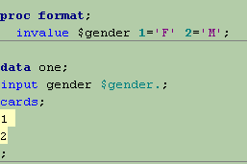
User-Defined Informat for Input

Slide 10
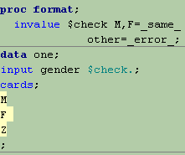
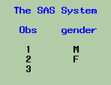
Data Validation with Informats

Slide 11
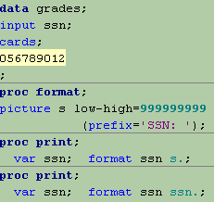
Standard and User-Defined Formats for Output
Appearance of Numbers in Output

Slide 12
Why are formats and informats useful for SAS date variables?

Slide 13
Date type ⇨ an integer equal to the number of days elapsed since Jan. 1, 1960
Date | SAS Date Value
Dec. 31, 1959 | -1
Jan. 1, 1960 | 0
Jan. 2, 1960 | 1
Jan. 10, 1960 | 9

Slide 14
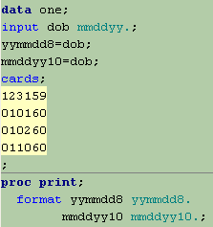
Appearance of SAS Dates (Numbers) in Output

Slide 15
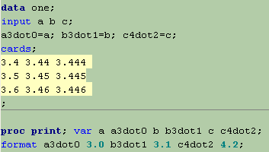
Appearance of Numbers in Output

Slide 16
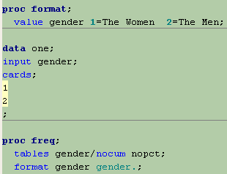
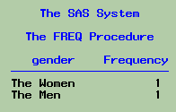
Formats for Output: Just a PROC

Slide 17
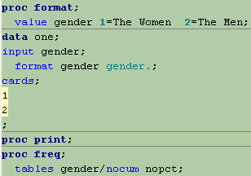
Formats for Output: Many PROCs

Slide 18
Numeric Missing Values
A numeric missing value in SAS means there is no data value.
Missing Value Type | Representation | Description
Regular Numeric | . | Single period
Special Numeric | .a .b .c . . . .x .y .z | Single period followed by a letter These are not case-sensitive. (.A is equivalent to .a).
Special Numeric | ._ | Single period followed by an underscore

Slide 19
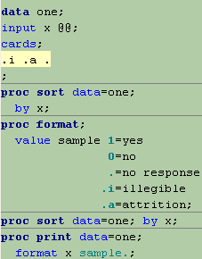
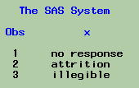
Meaning of Special Numeric Missing Values

Slide 20
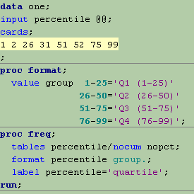
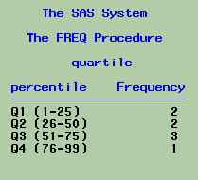
Format for Group Processing

Slide 21
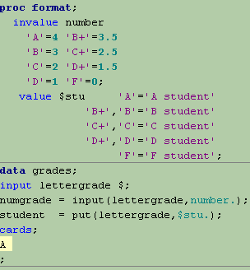
Create new variables from
existing ones
(recode)
with PUT and INPUT functions

Slide 22
PUT Function and Format
General syntax without optional arguments:
PUT(source,format)
Always returns a character value by applying a format to an expression (source)
Converts numeric to character values
The format must be of the same type as source.

Slide 23
INPUT Function and Informat
General syntax without optional arguments:
INPUT(source,informat)
Returns a value by applying an informat to an expression (source)
Informat type determines numeric or character type result.
Converts character to numeric values

Slide 24
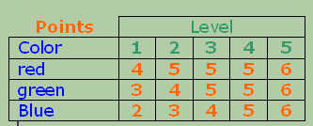
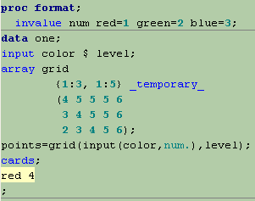
Array Index Values are Easier to Follow

Slide 25
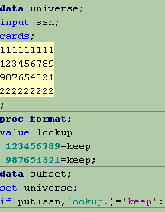
LOOKUP TABLES

Slide 26
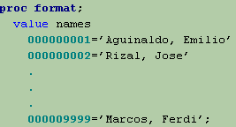
Q: What do I do if there’s A LOT to type??
A: If the information is in a data set,
you can create the format automatically.

Slide 27
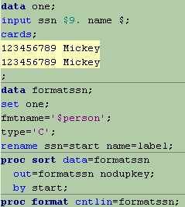
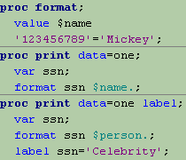
INPUT CONTROL DATA SETS (CNTLIN=)
TYPE:
C for Character FORMAT
N for Numeric FORMAT
I for Numeric INFORMAT
J for Character INFORMAT

Slide 28
OUTPUT CONTROL DATA SETS (CNTLOUT=)

Slide 29
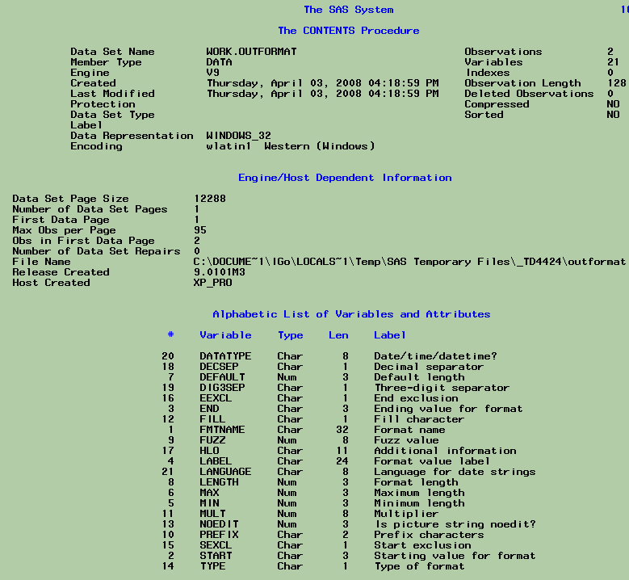
PROC CONTENTS labels describe variables in output control data sets.

Slide 30
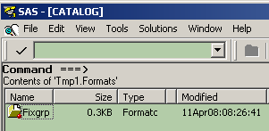
User-defined formats can be stored in format catalogs and accessed later.
PC SAS Example
Later:

Slide 31
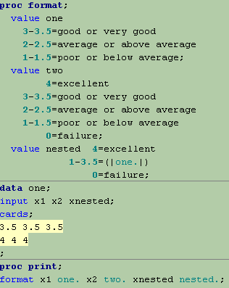
NESTED FORMATS

