Slide 1
A Brief Introduction to Bayesian Deep Learning
Towards Bayesian Deep Learning:
A Framework and Some Existing Methods
2016 December IEEE Data Engineering

Slide 2
What does “a bayesian framework” mean?
"Everything is conditional."
What the difference is between the two ideologies?
Frequentist and Bayesian statistics have different aims.You can take frequentist methods and transfer them into a Bayesian framework, you can also take Bayesian methods and consider their frequentist coverage.
Bayesian statistics concerns itself with trying to represent your beliefs in a DeFinetti consistent manner, simply put - you want a logically rigorous way of describing your initial (prior) belief and the update in your belief as you observe new data (thus creating posterior belief).
Frequentist statistics concerns itself with methods that have 'long run' guarantees. For example, if you wake up every day and perform an experiment on some new data and create a 95% confidence interval around some quantity of interest then indeed, you will correctly trap 95% of those quantities, no matter of your personal belief.
https://normaldeviate.wordpress.com/2012/11/17/what-is-bayesianfrequentist-inference/

Slide 3
Strictly speaking, the process of finding the parameters is called learning; the process of finding the latent variables given the parameters is called inference. However, given only the observed variables learning and inference are often intertwined. Usually, the learning and inference of Bayesian Network would alternate between the updates of latent variables (which correspond to inference) and the updates of the parameters (which correspond to learning).
Once the learning and inference of Bayesian Network is completed, we would have the parameters, or fix the learned , then perform inference alone to find a certain topic proportions of the new document.

Slide 4
Have a sort of idea
Update Belief
Gather Information
Model, Analyze, and Infer
Compare to the original idea

Slide 5
Visual Recognition
Text understanding
Speech Recognition
Think(Infer)
Casual Inference
Logic Deduction
Deal with Uncertainty

Slide 6
 | Deep Learning (DL) | Probabilistic Graphical Models (PGM) | Bayesian Deep Learning Framework
Casual Inference | Good | Good | Good,especially
Logic Deduction | Good | Poor | Good
Deal with Uncertainty | Poor | Good | Good, especially
Note: Deep Learning normally refers to neural networks with more than two layers.

Slide 7
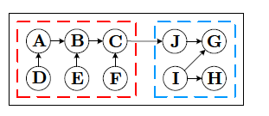
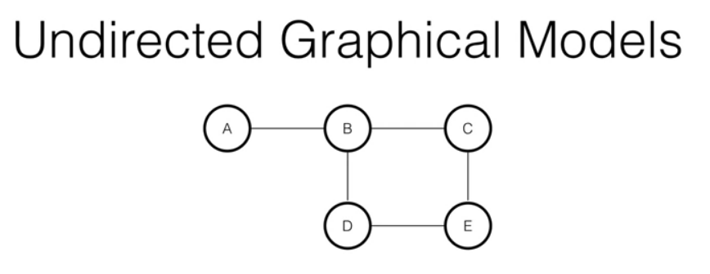
BDL Framework
ML
PGM
BDL
I.I.D. between Hinge & Perception Parts is required.

Slide 8
Difference between BDL and DL
It is difficult to model uncertainties with traditional deep learning approaches.
It is, however, important to assign level of uncertainties with the predictions; for example, in medical image diagnosis, self-driving cars etc.
Deep learning approaches have been found successful in a range of perception tasks (such as classification, segmentation, detection etc.)
However, graphical networks such as Bayesian networks are useful to model uncertainty along with causal inference and logic deduction.
In this regard, Bayesian Deep learning combines perception (deep learning) with strong probabilistic inference which can estimate uncertainty.

Slide 9
ZV
HV
LV
More Preferrable Direction

Slide 10
Further reading :
When machine learning meets complexity: why Bayesian deep learning is unavoidable

