Slide 1
Choosing Between Logistic Regression and Discriminant Analysis
Jianhuai Hu
Department of Statistics, University of South Carolina
1

Slide 2
Outline
Discriminant Analysis
Discussions
Examples
Conclusion

Slide 3
Discriminant Analysis
A researcher collected data on two external features for two (known) sub-species of an insect. She can use discriminant analysis to find linear combinations of the features that best distinguish the sub-species. The analysis can then be used to classify insects with unknown sub-species origin into one of the two sub-species based on their external features.

Slide 4
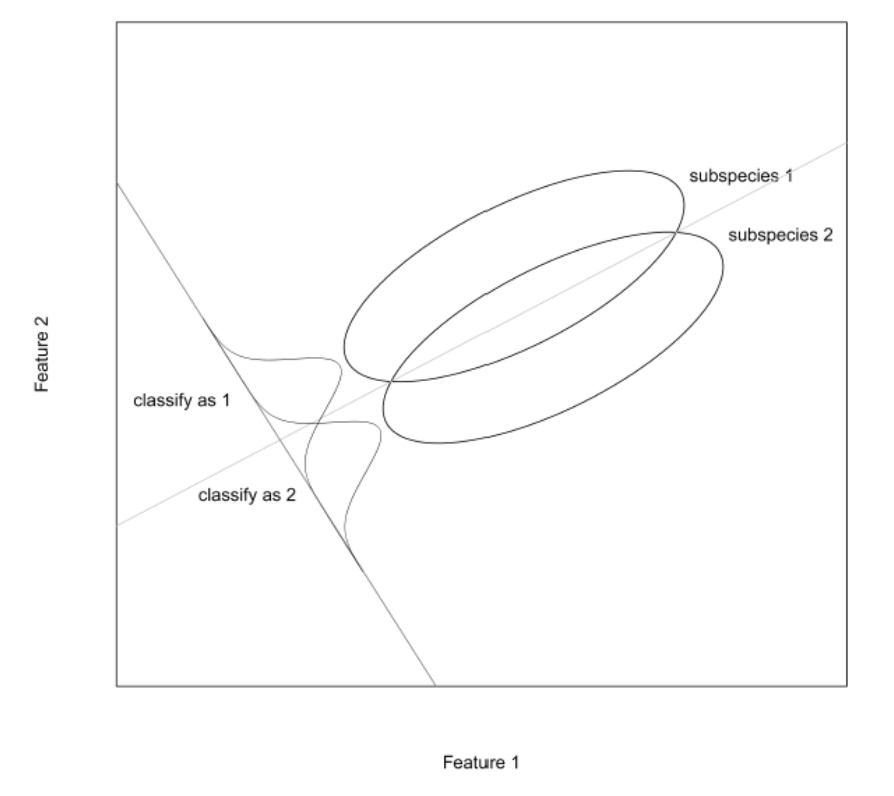
Discriminant Analysis
To see how this might be done, consider the following data plot. The line marked with green color is the linear combination of the two features that best distinguishes or discriminates the two sub-species. The value of the line could be used to classify insects into one of the two groups, as illustrated.
Two ecliptical bi-variate normal distribution
The linear combination that best separates the two subspecies
Projection of the two subspecies
Decision Boundary
Notes:
Horizontal : figure 1 Vertical : feature 2
subspecies1,2 : bi-variate normal elliptical clouds of points
Best distinguish

Slide 5
Discriminant Estimators vs. Logistic MLEs
Discriminant function estimators have often been used in logistic regression, in both theory and applications (see, for example, Truett, Cornfield, and Kannel 1967).
When such estimators were compared empirically with maximum likelihood estimators for logistic regression problems, however, they were found to be generally inferior, but not that bat. (see Halperin, Blackwelder, and Verter 1971, and D'Agostino, et al. 1978).

Slide 6
Discriminant Estimators vs. Logistic MLEs
Discriminant function estimators have often been used in logistic regression, in both theory and applications (see, for example, Truett, Cornfield, and Kannel 1967).
When such estimators were compared empirically with maximum likelihood estimators for logistic regression problems, however, they were found to be generally inferior, but not that bad. (see Halperin, Blackwelder, and Verter 1971, and D'Agostino, et al. 1978).

Slide 7
Limitations for Discriminant Analysis
When the explanatory variables don't follow a multivariate normal distribution with equal covariance matrices for each state of the dependent variables, discriminant function estimators of the slope coefficients in the logistic regression will not be consistent.
Discriminant function estimation can give misleading results regarding significance of the logistic regression coefficients when the normality condition is violated.
Under non-normal conditions, "the maximum likelihood method usually gives slightly better fits to the model, as evaluated from observed and expected numbers of cases per decile of risk."

Slide 8
Limitations for Discriminant Analysis
When the explanatory variables don't follow a multivariate normal distribution with equal covariance matrices for each state of the dependent variables, discriminant function estimators of the slope coefficients in the logistic regression will not be consistent.
Discriminant function estimation can give misleading results regarding significance of the logistic regression coefficients when the normality condition is violated.
Under non-normal conditions, "the maximum likelihood method usually gives slightly better fits to the model, as evaluated from observed and expected numbers of cases per decile of risk."

Slide 9
Limitations for Discriminant Analysis
When the explanatory variables don't follow a multivariate normal distribution with equal covariance matrices for each state of the dependent variables, discriminant function estimators of the slope coefficients in the logistic regression will not be consistent.
Discriminant function estimation can give misleading results regarding significance of the logistic regression coefficients when the normality condition is violated.
Under non-normal conditions, "the maximum likelihood method usually gives slightly better fits to the model, as evaluated from observed and expected numbers of cases per decile of risk."

Slide 10
Limitations for Discriminant Analysis
Use of discriminant function estimators tends to mask the troublesome cases by not providing danger signals.
The logistic regression model is well-known to have sufficient statistics associated with it (see, for instance, Press 1972, p. 267). Still remember Rao-Blackwell?
Maximum likelihood estimation of the logistic regression model forces the expected number of cases to equal the observed number of cases.

Slide 11
Limitations for Discriminant Analysis
Use of discriminant function estimators tends to mask the troublesome cases by not providing danger signals.
The logistic regression model is well-known to have sufficient statistics associated with it (see, for instance, Press 1972, p. 267). Still remember Rao-Blackwell?
Maximum likelihood estimation of the logistic regression model forces the expected number of cases to equal the observed number of cases.

Slide 12
Limitations for Discriminant Analysis
Use of discriminant function estimators tends to mask the troublesome cases by not providing danger signals.
The logistic regression model is well-known to have sufficient statistics associated with it (see, for instance, Press 1972, p. 267). Still remember Rao-Blackwell?
Maximum likelihood estimation of the logistic regression model forces the expected number of cases to equal the observed number of cases.

Slide 13
Female Breast Cancer Study
Certain breast cancer patients initially treated at the British
Columbia Cancer Institute between 1955 and 1963. A
study (Wilson 1977) was undertaken in 1976 to classify
the patients by extent of nodal metastases from clinical
and historical evidence.

Slide 14
Female Breast Cancer Study
The individuals who were observed were 173 of the female breast cancer patients for whom no data were missing and whose nodal status had been determined by a surgical procedure. Data was randomly divided, cross validation used.
The binary grouping variable was defined to be 0 if the lymph nodes were not involved with metastatic carcinoma, and 1 if the nodes were involved. The attribute (independent) variables were number of births, a history of hysterectomy (0-l), a history of benign breast disease during lactation (0-1), presence of nipple changes as the first disease symptom (0-1), and duration of symptoms in months.
Notes:
Lymph 淋巴 /linph/
metastatic carcinoma 转移性癌症
Hysterectomy 子宫切除（术）
lactation 哺乳

Slide 15
Female Breast Cancer Study
The individuals who were observed were 173 of the female breast cancer patients for whom no data were missing and whose nodal status had been determined by a surgical procedure. Data was randomly divided, cross validation used.
The binary grouping variable was defined to be 0 if the lymph nodes were not involved with metastatic carcinoma, and 1 if the nodes were involved. The attribute (independent) variables were number of births, a history of hysterectomy (0-l), a history of benign breast disease during lactation (0-1), presence of nipple changes as the first disease symptom (0-1), and duration of symptoms in months.
Notes:
Lymph 淋巴 /linph/
metastatic carcinoma 转移性癌症
Hysterectomy 子宫切除（术）
lactation 哺乳

Slide 16
Results
Estimated function for Logistic Model:
$$Y\left(X\right)=0.058 −0.233X_{1} −1.096X_{2}+0.713X_{3}−0.028X_{4}+0.095X_{5}$$
Estimated function for discriminant analysis:
U$\left(X\right)$
$=0.362 −0.251X_{1} −1.245X_{2}+1.104X_{3}−0.036X_{4}+ 2.114X_{5}$
where X₁ is number of births, X₂ is hysterectomy, X₃ is
benign breast disease, X₄ is duration of symptoms, and
X₅ is nipple change symptom.
Notes:
Lymph 淋巴 /linph/
metastatic carcinoma 转移性癌症
Hysterectomy 子宫切除（术）
lactation 哺乳

Slide 17
Results

Slide 18
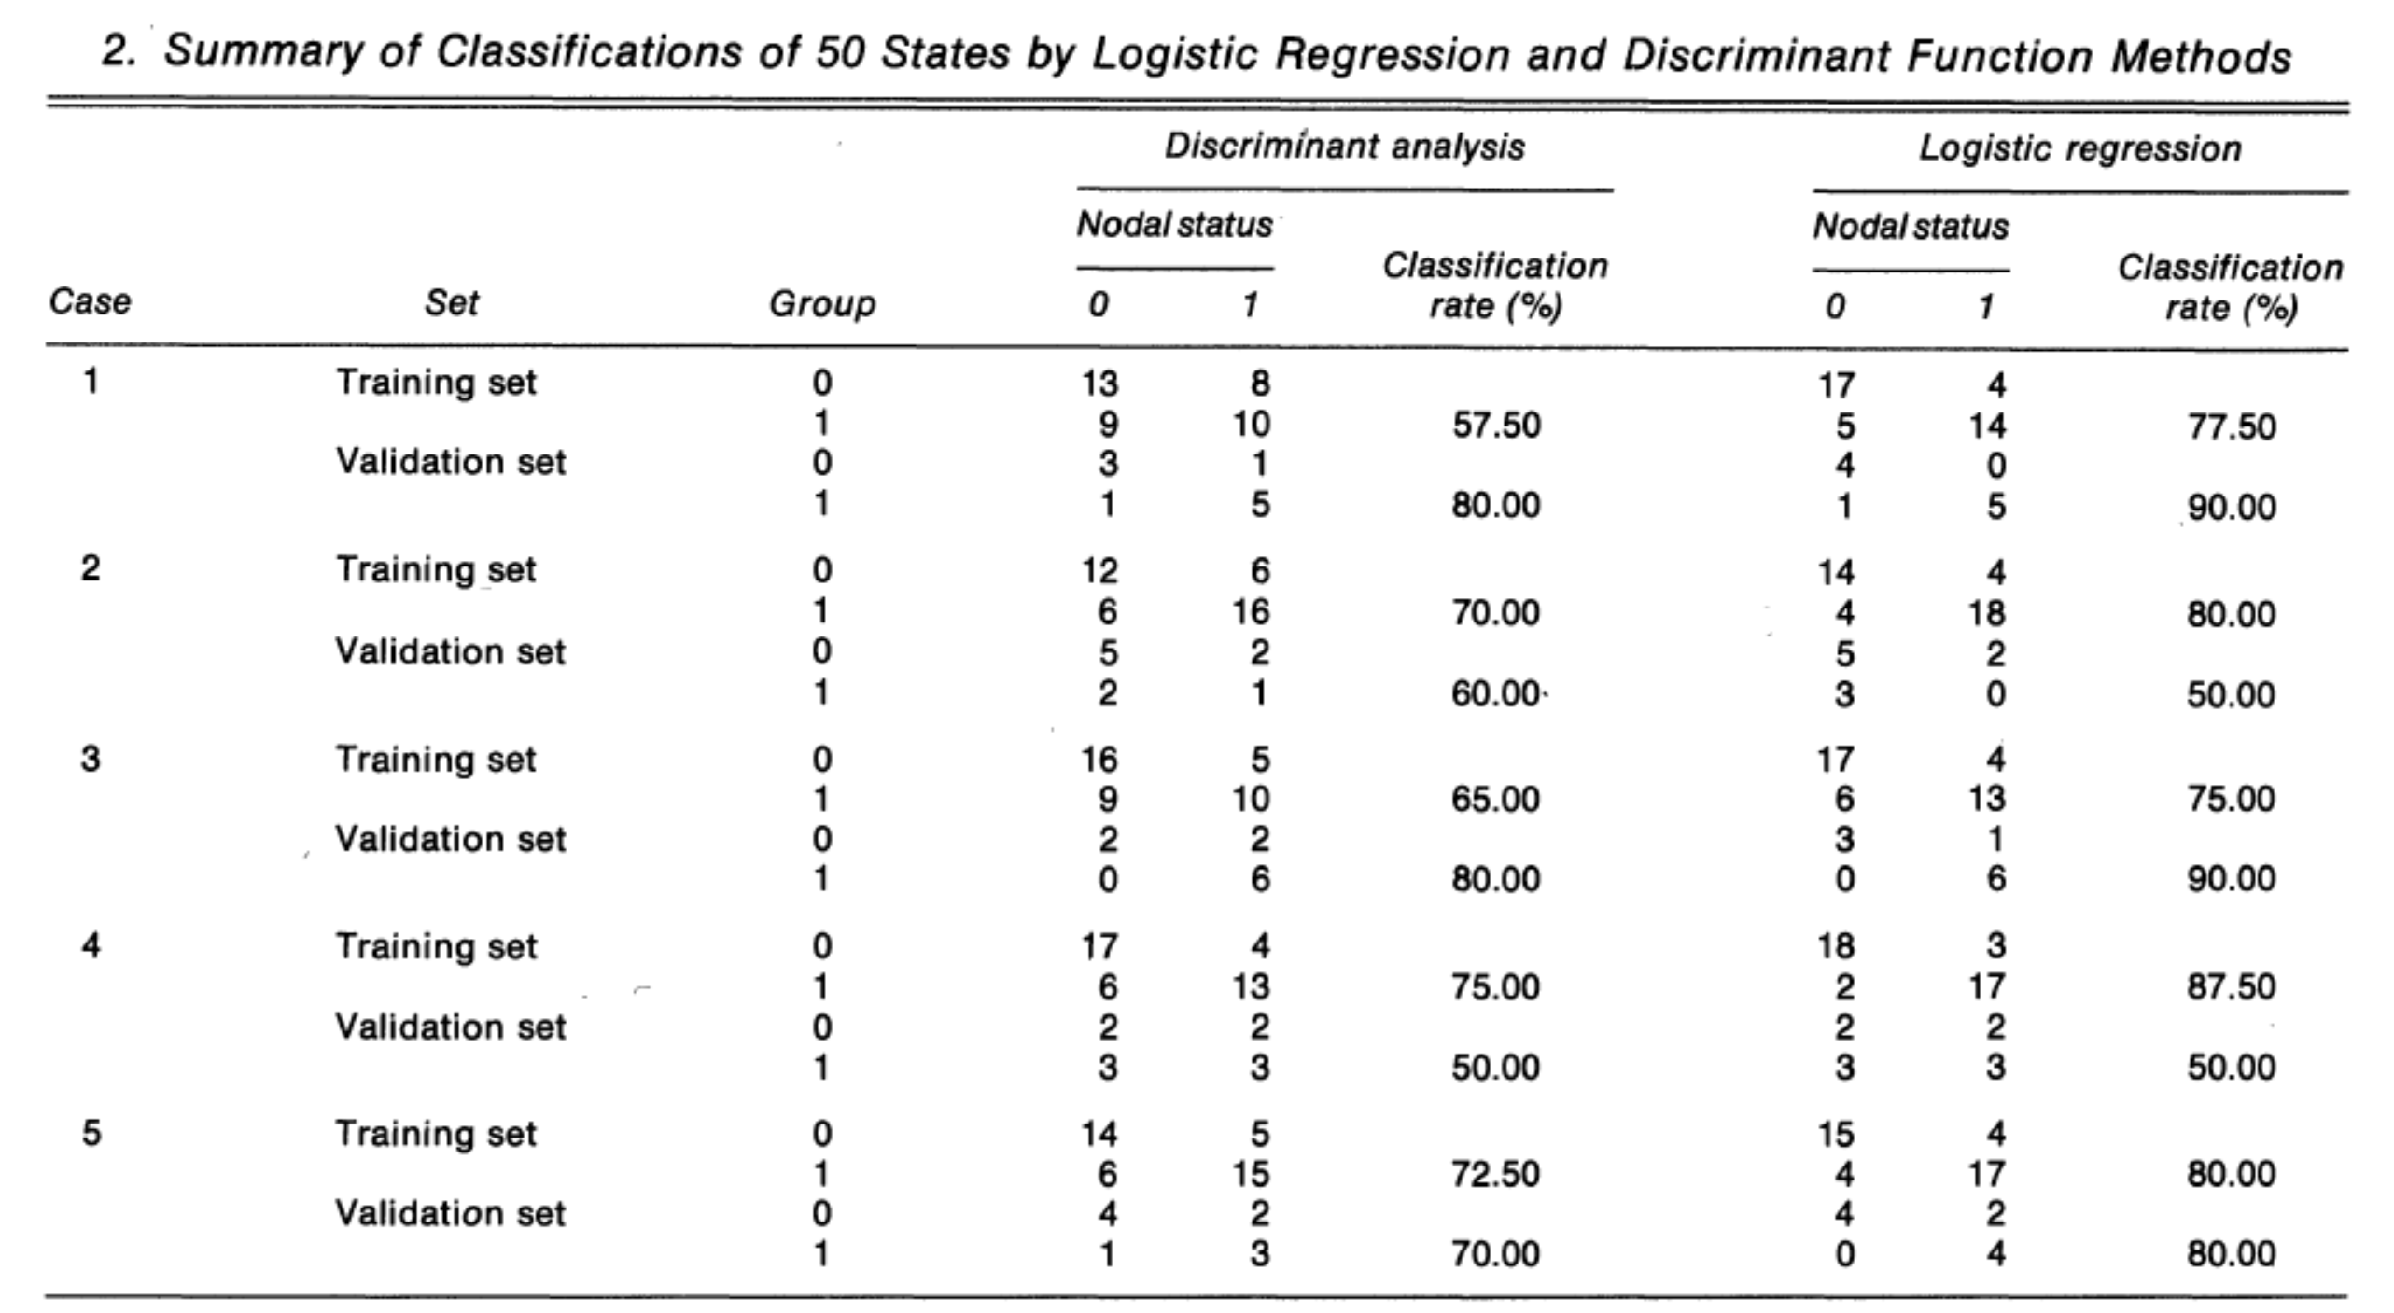
Results

Slide 19
Results
The logistic regression classified 82 (65 + 17) of the 115 patients in the training set correctly, for a 71.30 percent classification rate (see Table 1). In the validation set, 36 (25 + 11) of the 58 patients were correctly classified, for a 62.07 percent correct classification rate. The discriminant analysis correctly classified 77 of the 115 patients in the training set, for a 66.96 percent correct classification rate. In the validation set only 34 of the 58 patients were correctly classified, for a 58.62 percent correct classification
rate.

Slide 20
Summary and Conclusions
Logistic regression with MLE outperforming classical linear discriminant analysis in both cases (supporting the results of Halperin, Blackwelder, and Verter 1971), but not by a large
amount. It is unlikely that the two methods will give markedly different results, or yield substantially different linear functions unless there is a large proportion of observations whose x-values lie in regions of the factor space with linear logistic response near zero or one.

Slide 21
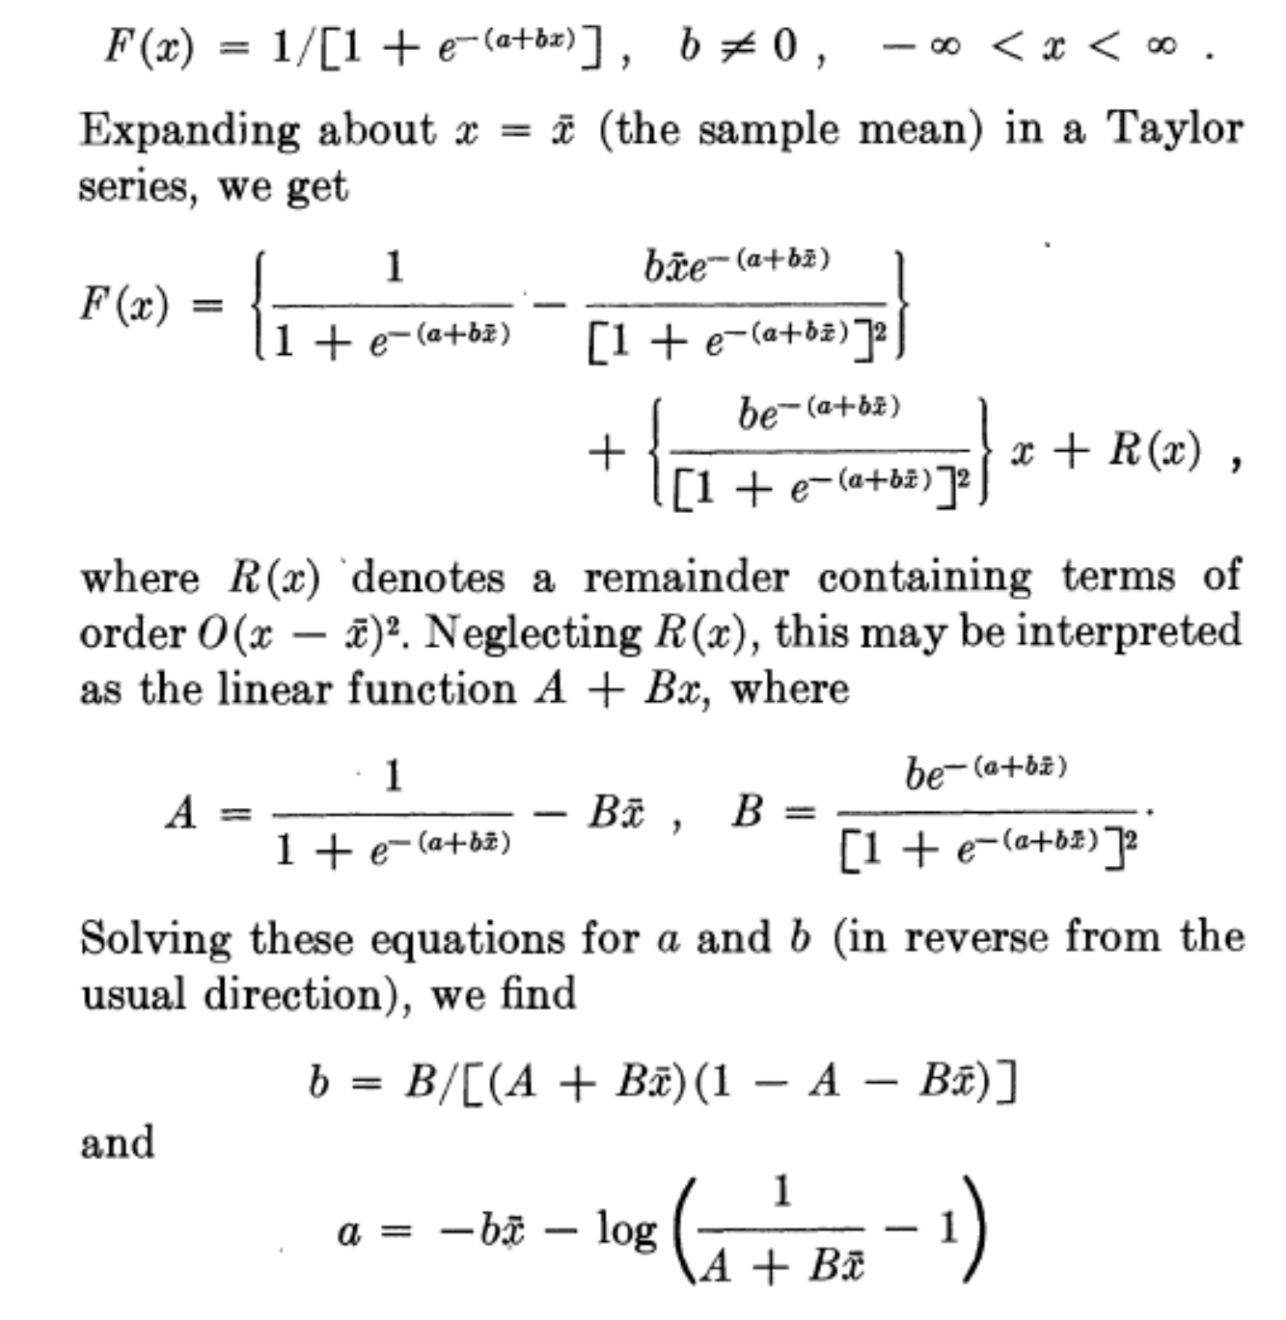
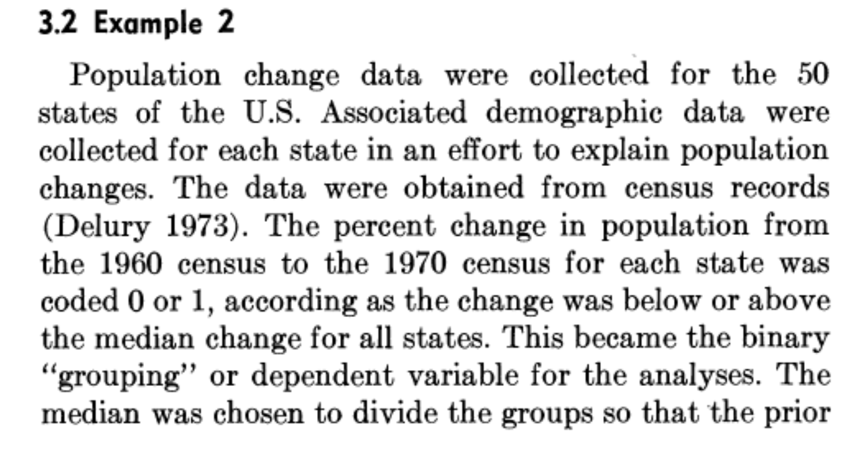
What I left out?
Due to the limitation of time and my own deficiency in statistical knowledge, many interesting things were left out, including a selection for initiation of the iterative algorithm for MLEs, some detailed explanations of the limitations for using discriminant analysis estimators, and another example.

Slide 22
Done!!!
This is the end!
Thanks for your attention.
Many thanks to Dr. Ho’s effort
Wish all of you good luck with the finals and qualification exam
Congratulations, we survived for the 1st year graduate life in statistic

