Slide 1
Zero-Inflated Generalized Poisson
Regression Model with an Application to Domestic Violence Data
Yang He
Department of Statistics
University of South Carolina
4/26/2019

Slide 2
1. Introduction
In 1989, the Portland Police Bureau in collaboration with the Family Violence Intervention Steering Committee of Multnomah County in Oregon developed a plan to reduce domestic violence in Portland.
A special police unit called Domestic Violence Reduction Unit was created for accomplishing two goals:
(i) Increasing the sanctions for batterers;
(ii) Empowering victims.
Notes:
3 min; 2 page

Slide 3
2. Design of Study and Data
To achieve these two goals, the researchers collected data from official records on batterers and from surveys on victims for 1996-1997.
For more details : Annette et al1. (1998), ICPSR 3353.
Sample size: 214 cases.
Based on these data, different models are utilized to explore the relationship between the number of violent behavior of batterer towards victim and some variables.
Notes:
2 minutes; 1 page

Slide 4
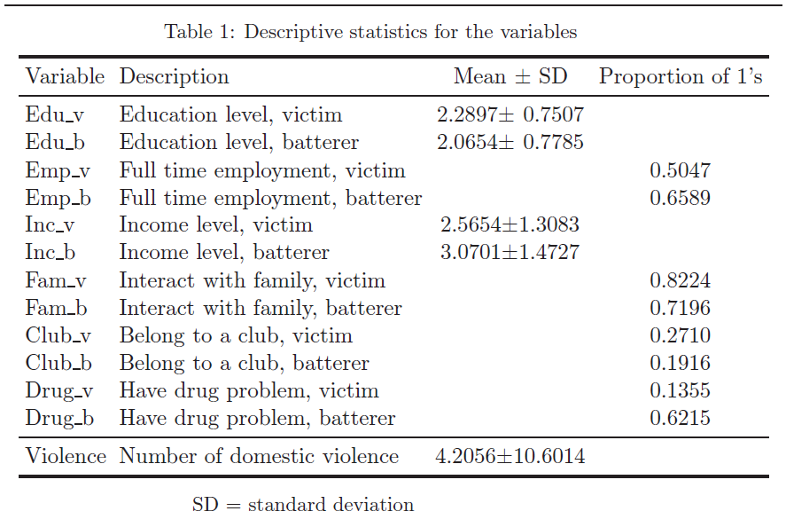
Data Preprocessing
Dependent variable:
Violence: # of violent behavior of batterer towards victim.
Independent variables:
level of education: ordinal 1,2,3
employment status: 1(yes), 0 (no)
level of income: ordinal 1-5
having family interaction: 1(yes), 0 (no)
belonging to a club: 1(yes), 0 (no)
having drug problem: 1(yes), 0 (no)
Each variable was measured for both victim and batterer.

Slide 5

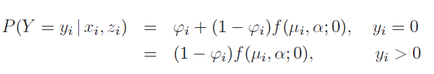



4. Statistical Models
Generalized Poisson Regression Model (GP)
Zero-Inflated Generalized Poisson Regression Model (ZIGP)​
Notes:
3 min; 2 page

Slide 6
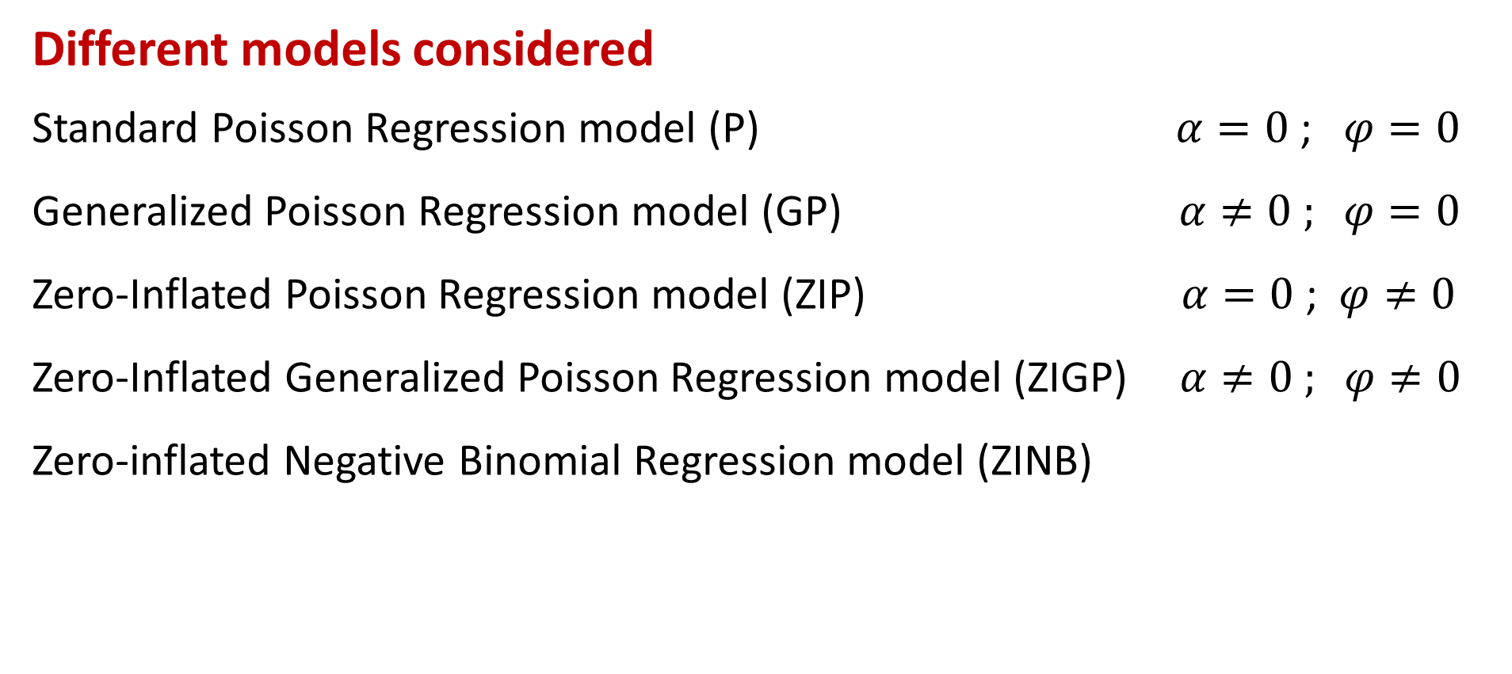
Different models considered
Standard Poisson Regression model (P) $α=0$ ;$φ=0$
Generalized Poisson Regression model (GP) $α≠0 ; φ=0$
Zero-Inflated Poisson Regression model (ZIP) $α=0$ ; $φ≠0$
​Zero-Inflated Generalized Poisson Regression model (ZIGP) $α≠0 ; φ≠0$
Zero-inflated Negative Binomial Regression model (ZINB)

Slide 7
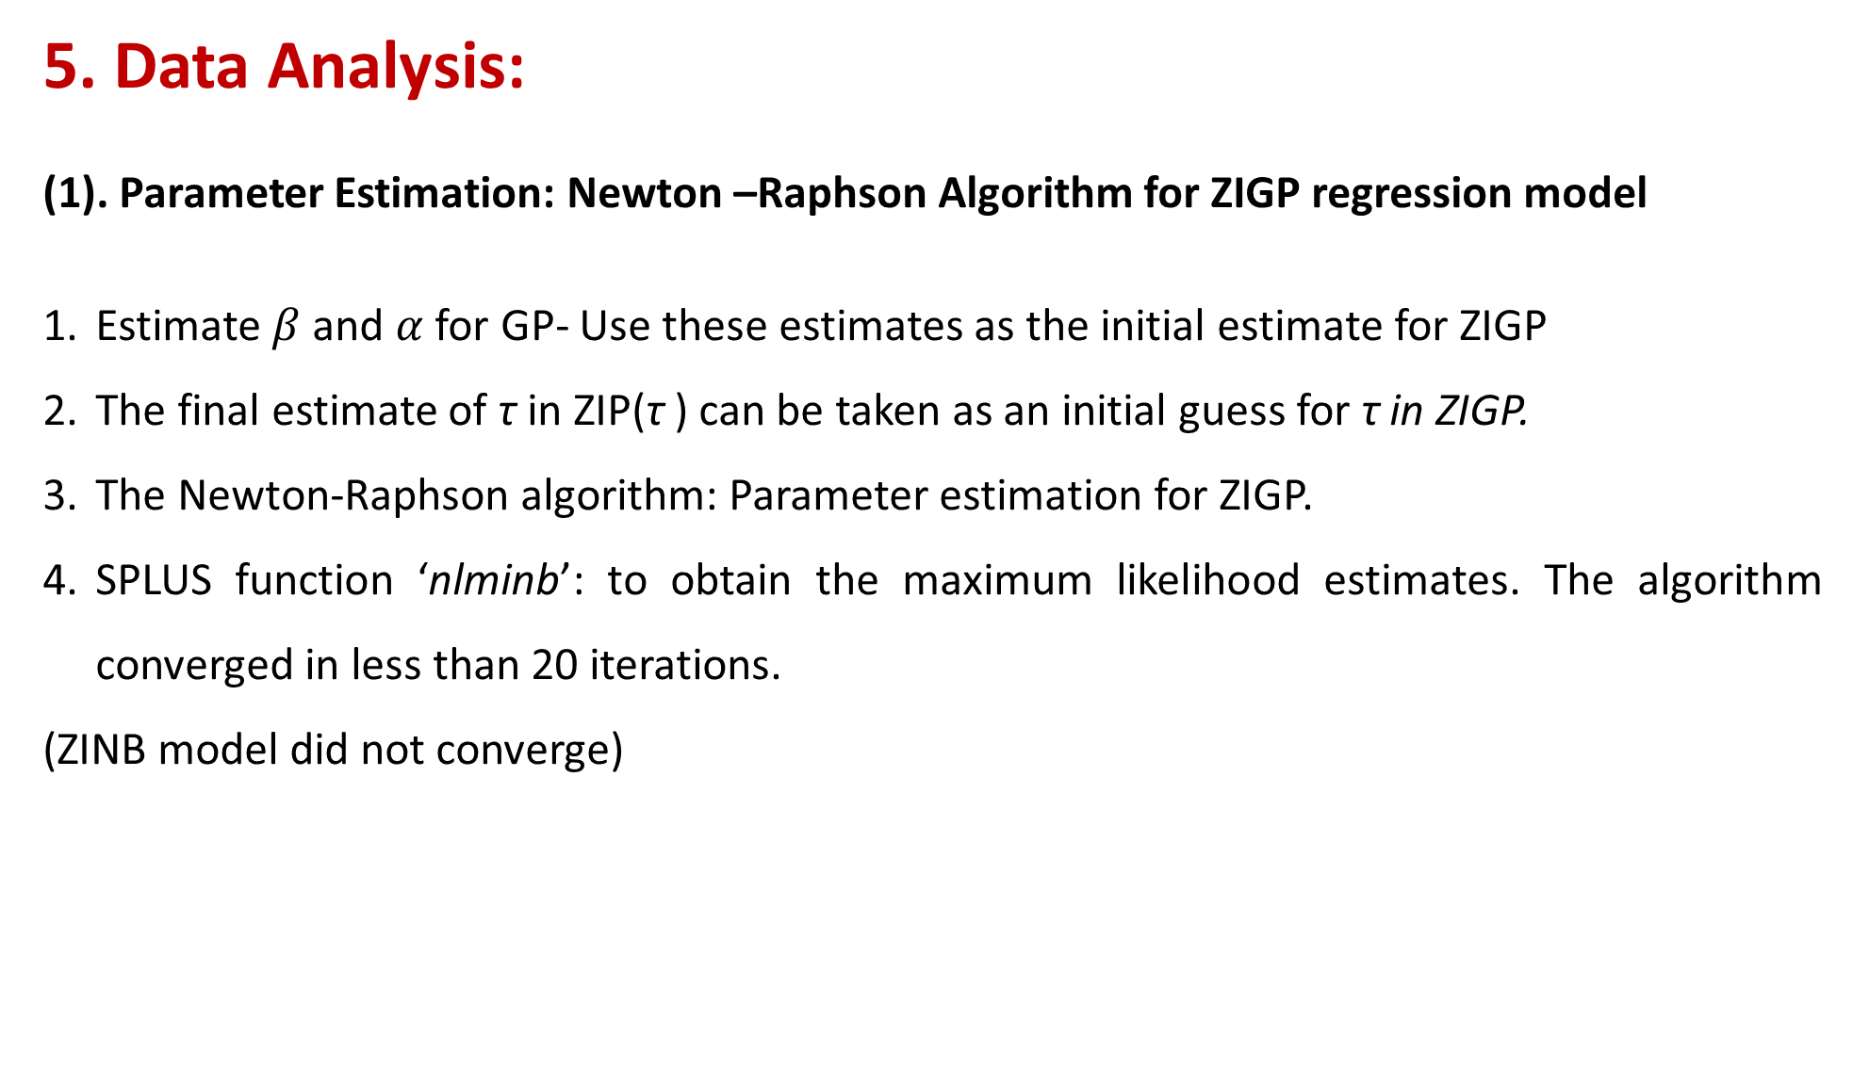
5. Data Analysis:
(1). Parameter Estimation: Newton –Raphson Algorithm for ZIGP regression model
Estimate $β$ and $α$ for GP- Use these estimates as the initial estimate for ZIGP
The final estimate of τ in ZIP(τ ) can be taken as an initial guess for τ in ZIGP.
The Newton-Raphson algorithm: Parameter estimation for ZIGP.
SPLUS function ‘nlminb’: to obtain the maximum likelihood estimates. The algorithm converged in less than 20 iterations.
(ZINB model did not converge)
Notes:
3 min; 3 pages

Slide 8
Education level
The victim’s education is negatively related to the level of violence.
The batterer’s education level is not significant.
Income
Significant negative relationship between the victim’s income and the level of violence. Thus, victims with high income tend to receive lower number of violence.
Only the ZIP model, but not the ZIGP model gave a similar conclusion for the batterer’s income.
Employment status of neither victim nor batterer is significant.
Having family interaction
Family interaction for victim is not significant in both models.
Batters having family interaction tend to be less violent in ZIP model.

Slide 9
Belonging to a club
Significant positive relationship between the victim’s belonging to a club and the level of violence. However, it is a significant negative relationship for the batterer.
Drug problem
Negative and significant relationship between the victim having drug problem and the level of violence in both models.
Significant positive relationship for batterer. This indicates that more drug problems the batterer has, more violent the batterer becomes.
Overall, all six independent variables are significant at 1% level under the ZIP model whereas only three are significant at 1% level under the ZIGP model.

Slide 10
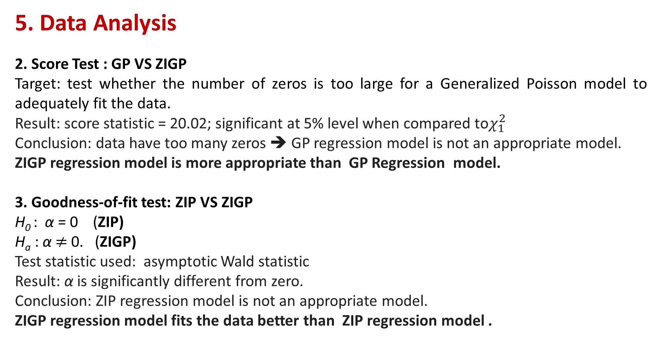
5. Data Analysis
2. Score Test : GP VS ZIGP
Target: test whether the number of zeros is too large for a Generalized Poisson model to adequately fit the data.
Result: score statistic = 20.02; significant at 5% level when compared to$χ_{1}^{2}$
Conclusion: data have too many zeros ➔ GP regression model is not an appropriate model.
ZIGP regression model is more appropriate than GP Regression model.
3. Goodness-of-fit test: ZIP VS ZIGP
H₀ : α = 0 (ZIP)
H_{a} : α $≠$0. (ZIGP)
Test statistic used: asymptotic Wald statistic
Result: α is significantly different from zero.
Conclusion: ZIP regression model is not an appropriate model.
ZIGP regression model fits the data better than ZIP regression model .

Slide 11
6. Conclusion
The application of the ZIGP regression model to the domestic violence data illustrates the usefulness of the model.
Iterative technique to estimate the parameters of ZINB regression model did not converge.
Even though the ZIGPR model is a good competitor of ZINB regression model, we do not know under what conditions, if any, which one will be better.
Notes:
2 min; 1 page

Slide 12
Thank you!

