Slide 1
Obstructive Sleep Apnea Syndrome as a risk factor for Hypertension : Population study
Peretz Lavie, professor, Paula Herer, statistician, Victor Hoffstein, professor of medicine
(Published 19th February 2000 in The BMJ)

Slide 2
What is Sleep Apnea?
A potentially serious sleep disorder in which breathing repeatedly stops and starts.
Symptoms include:
Loud snoring
Episodes in which you stop breathing during sleep
Gasping for air during sleep
Morning headache
Awakening with a dry mouth etc.

Slide 3
Objective of the study:
To asses whether sleep apnea is an independent risk factor for hypertension.
Data Collection:
2677 adults ( aged 20-85 years) with suspected sleep apnea.
They were referred to the St Michael's Hospital sleep clinic.
All were referred for diagnostic sleep recordings over a 10 year period.
Funding: Technion Sleep Disorders Center (SDC).

Slide 4
Measurement of variables
Apnea-hypopnea index : total number of apneic events plus hypopneic events divided by hours of sleep
Anthropometric measurements: Calculated their body mass index and waist to hip ratio.
Smoking status: Defined as never, present, or past smoker, and pack years of smoking.
Blood pressure : Analysis deals only with mean morning blood pressure readings.
Hypertension:
Taking antihypertensives
Having a systolic blood pressure reading greater than 140 mm Hg
Having a diastolic blood pressure reading greater than 90 mm Hg

Slide 5
Statistical Analysis
Univariate Analysis:
Association between sleep apnea and blood pressure, without any adjustment for confounding variables were checked.
Linear trends were verified using the Cochran-Armitage trend test for linearity for categorical data
Linear trends were verified using regression lines for parametric data.
Multiple linear regression :
To identify the variables that made an important contribution to the variability of blood pressure and to adjust for confounding variables with analysis of covariance.
Multiple logistic regression :
T o determine the odds ratios of having hypertension associated with an increase in the apnea-hypopnea index and a decrease in oxygen saturation.

Slide 6
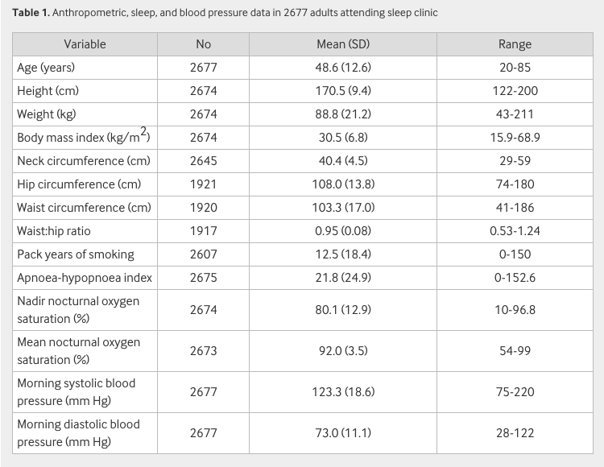
Univariate Analysis:
Summarizes the characteristics of the patient population of 1949 men and 728 women.
Patients were obese, middle aged males with mild to moderate sleep apnea
wide scatter in all variables.

Slide 7
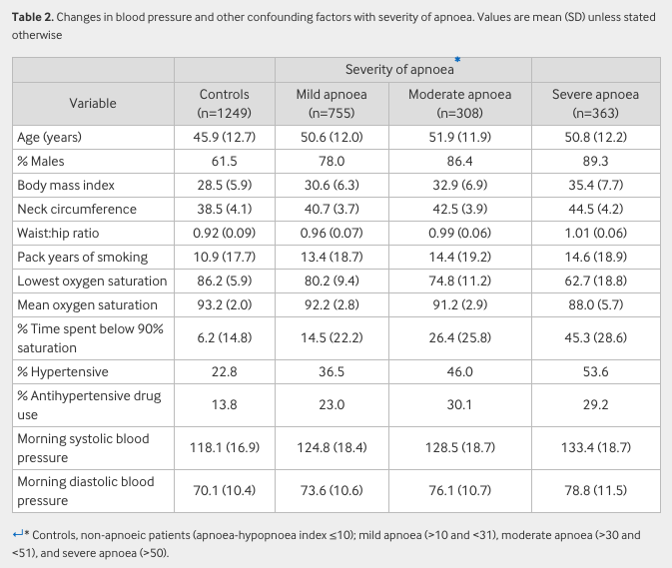
To show how blood pressure levels vary with apnea we divided our population into four groups.
Here, unadjusted systolic and diastolic blood pressures increased with the apnea-hypopnea index.
confounding factors, such as percentage of males, age, obesity and smoking history also significantly increased in trend analysis

Slide 8
Multiple regression analysis

Slide 9
Multiple logistic regression
Multiple logistic model: T=e.012apnoea-hypopnoea index+.081age+.161male+.067body mass index

Slide 10
Model: hypertension=e−.0133nadir+.081age+.265male+.072body mass index
Multiple logistic regression

Slide 11
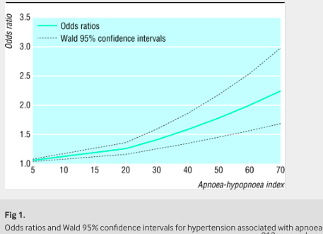
Odds Ratio and Wald 95% Confidence Interval

Slide 12
Concluding remarks:
Sleep apnea significantly contributed to hypertension independent of all relevant confounding variables.
Confirmed results by matching patients with sleep apnea.
The association of sleep apnea with hypertension warrants a more active approach in the diagnosis of it.

