Slide 1
Social Network Analysis
Shan Zhong

Slide 2
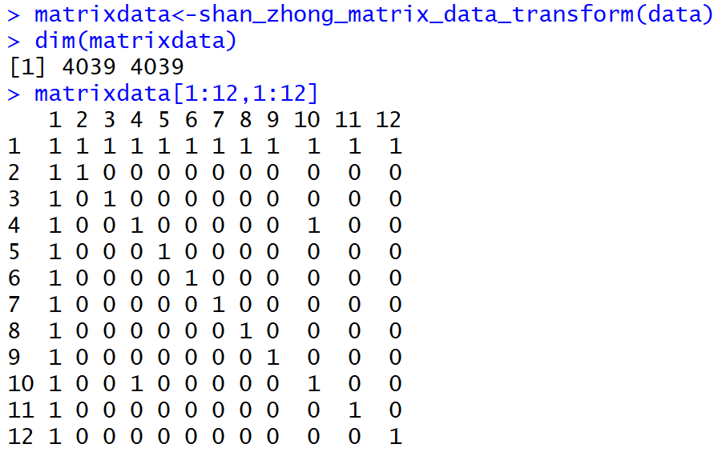
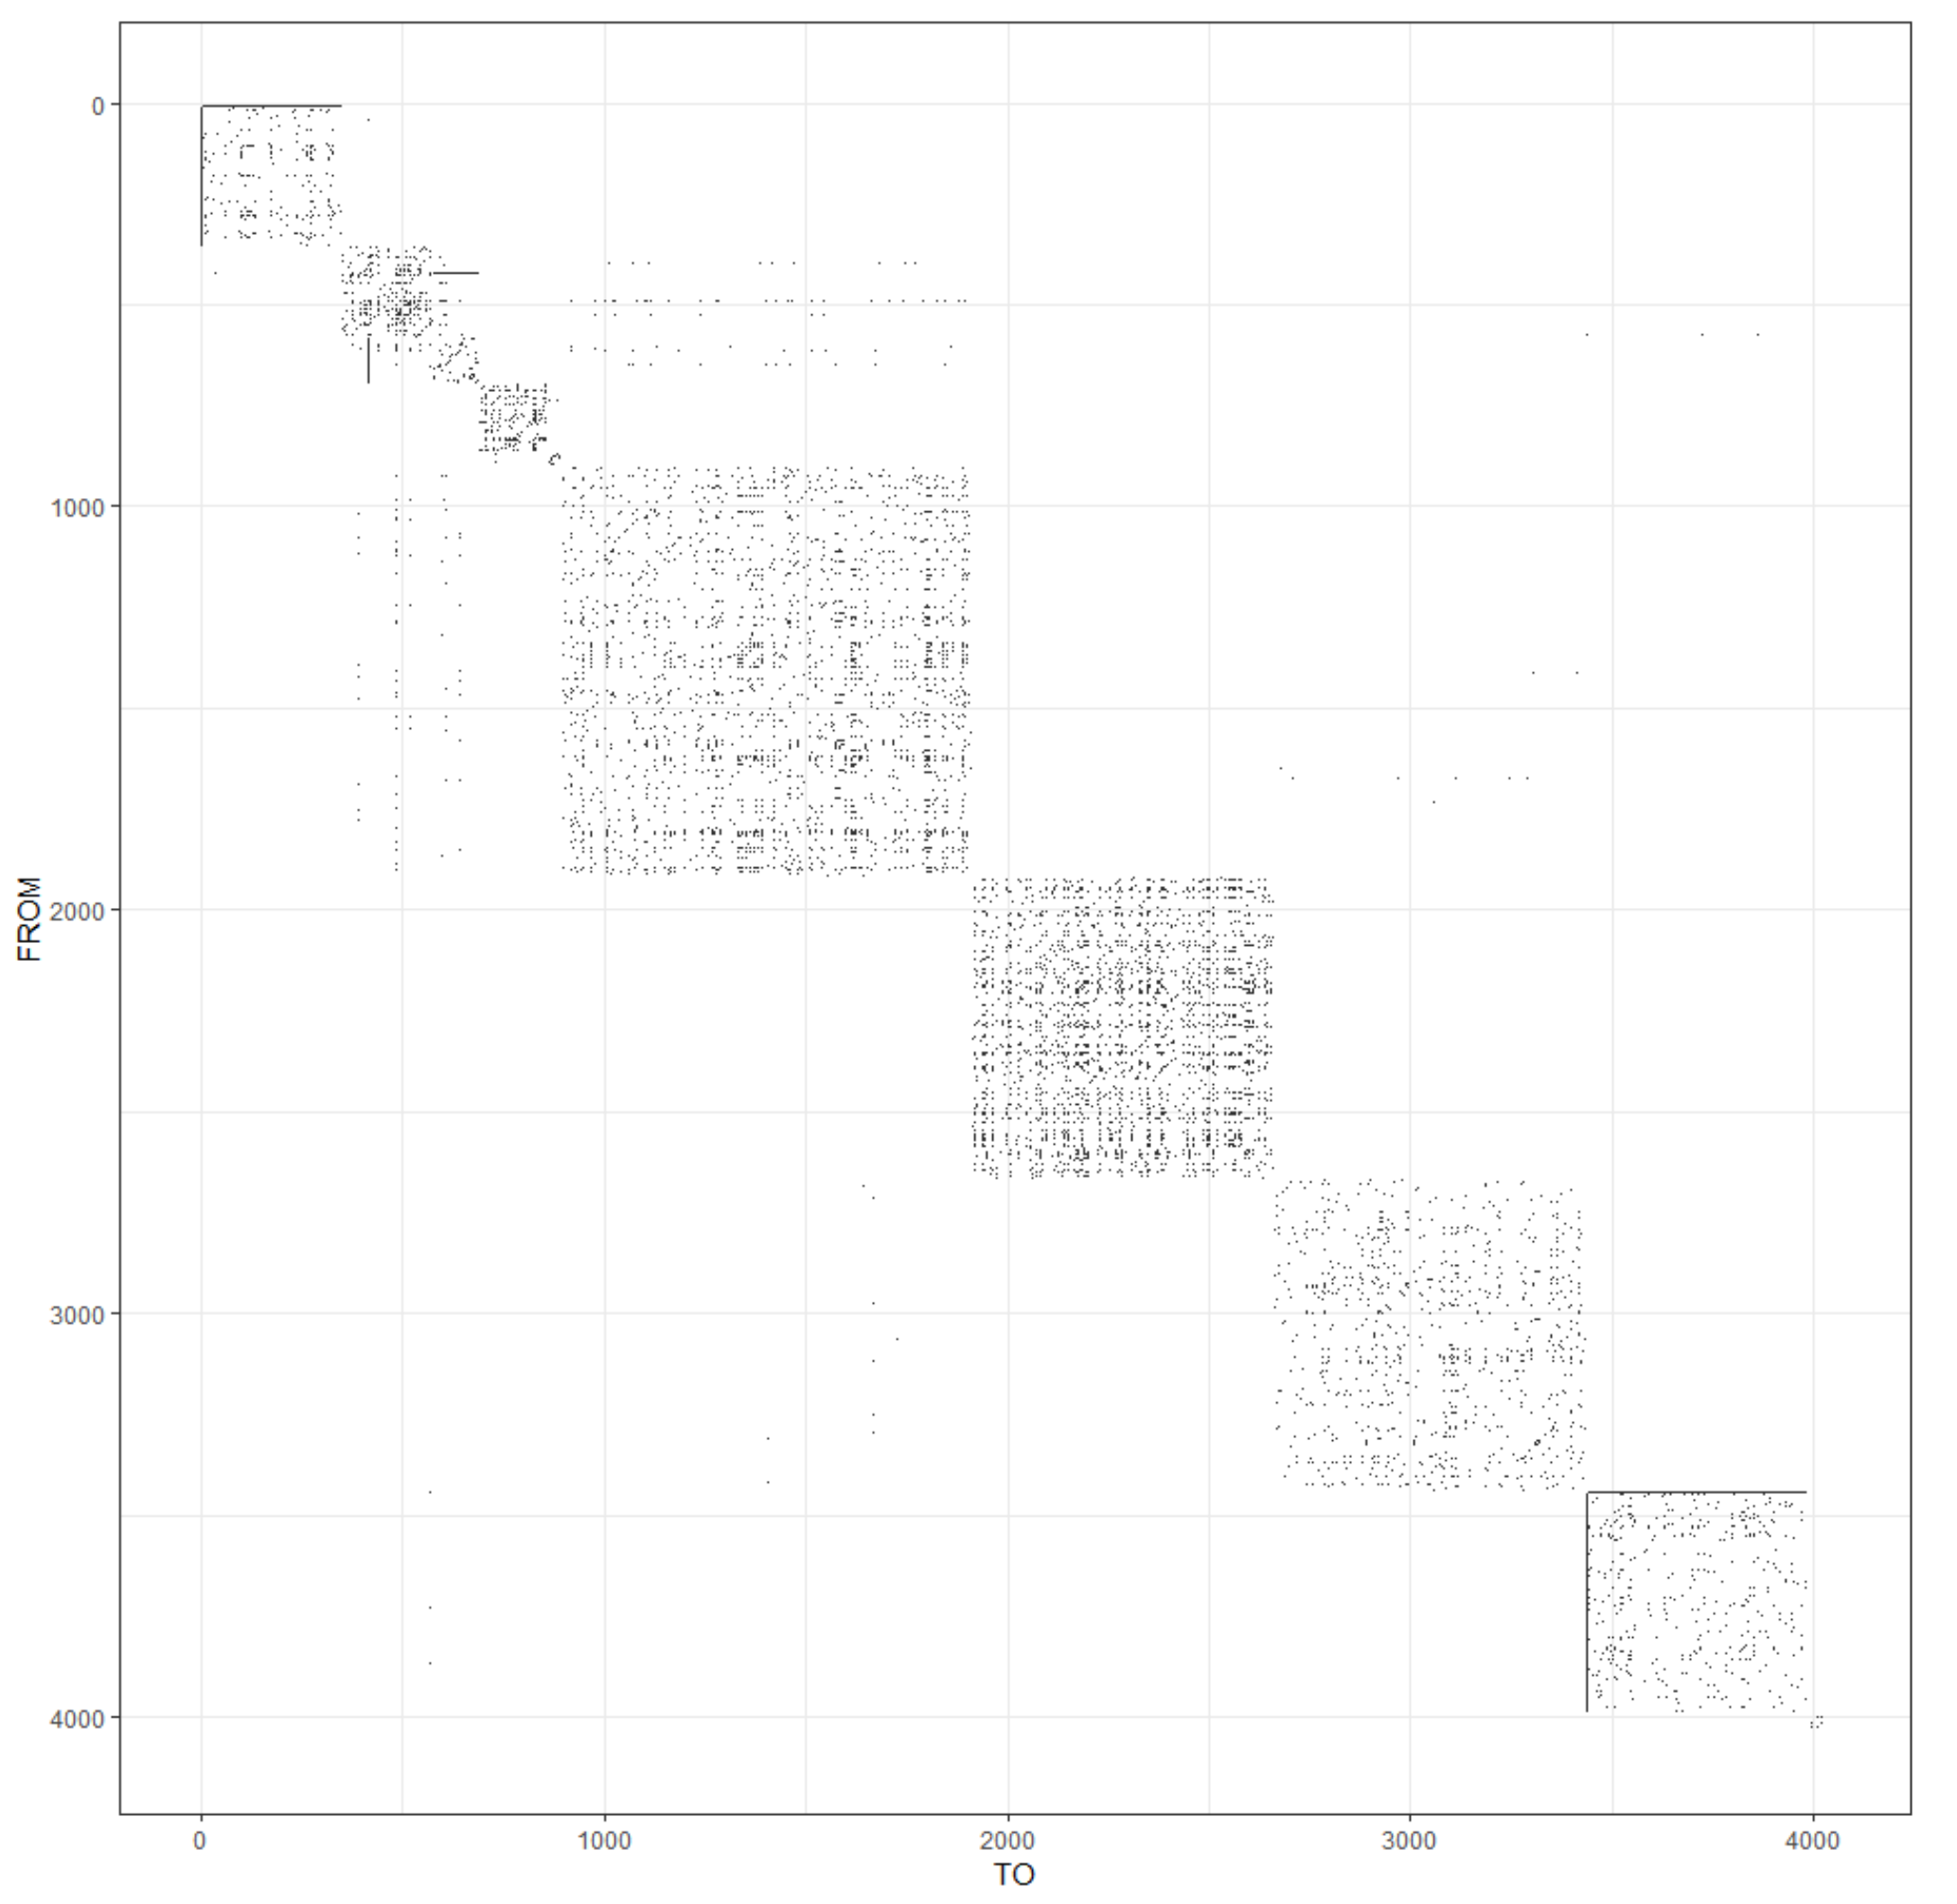
Data
10 people were asked to manually identify all the circles to which their friends belonged.
From Facebook, obtained profile and network data from 10 ego-networks, consisting of 193 circles and 4,039 users. These
Facebook data has been anonymized by replacing the Facebook-internal IDs for each user with a new value.

Slide 3
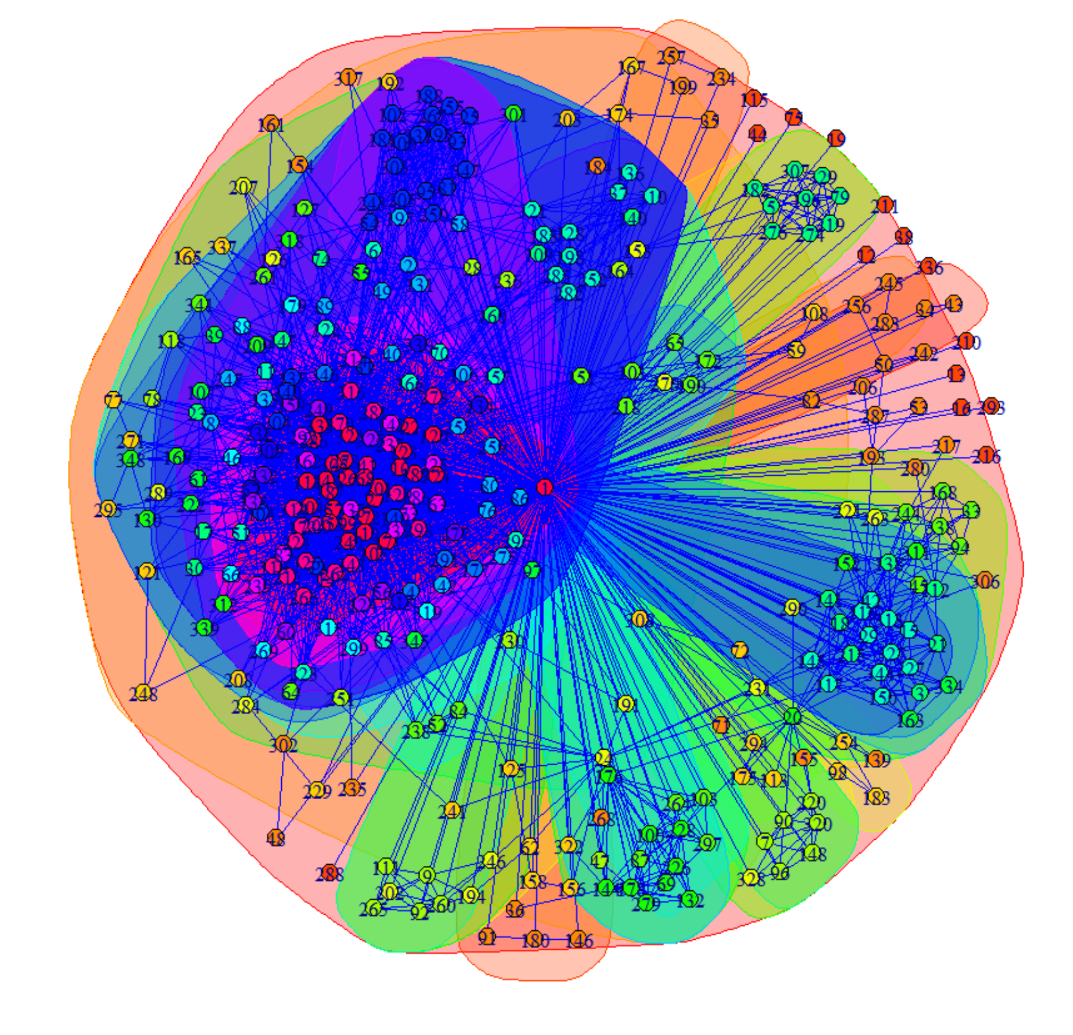
There are many model available.
Some models only consider the edge (link) between users, some only consider the profile of user, and some models are mixed.
For my models, I only consider the edge/link between users (or only consider the network of users), And we will pretend we do not have the right answer for the social circles of each user.
I tried several models and choose two to present alogirthm:
1.Baseline model:
Hierarchical clustering
Example for person 1 Using structure cohesion:
2.Mixed Membership Stochastic Blockmodels
by E.M. Airoldi, D.M. Blei, S.E. Fienberg, E.P. Xing, Journal of Machine Learning Research, 2008

Slide 4
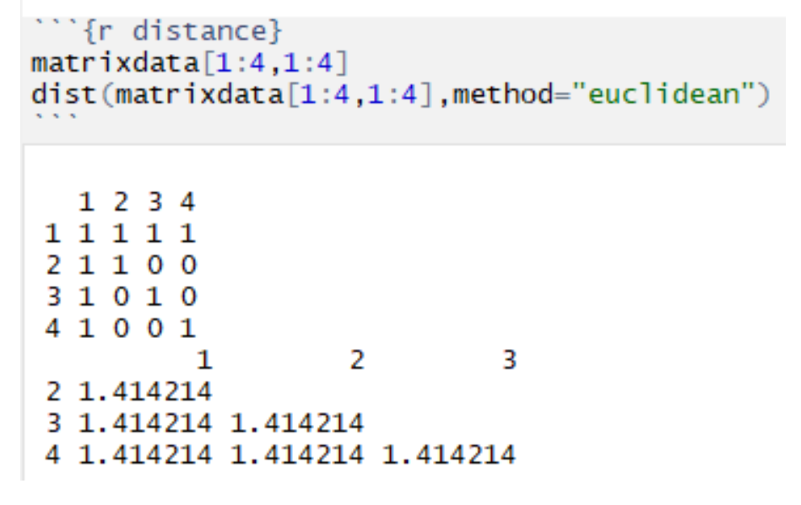
1.Hierarchical clustering with Agglomerative-Euclidean-max-linkage clustering approach:
Agglomerative:
"Bottom up" approach: each observation starts in its own cluster, and pairs of clusters are merged as one moves up the hierarchy. Hierarchical clustering seeks to build a hierarchy of clusters.
Distance metric: Euclidean distance; i.e. the "ordinary" straight line distance between two points in a Euclidean space.
Distance of each circle: Maximum over all pairs of users these two circles.
Concept is define distance between each node first, then define the distance between each circle
Then for each optimal number of circle given, there exist a smallest total circle distance.

Slide 5
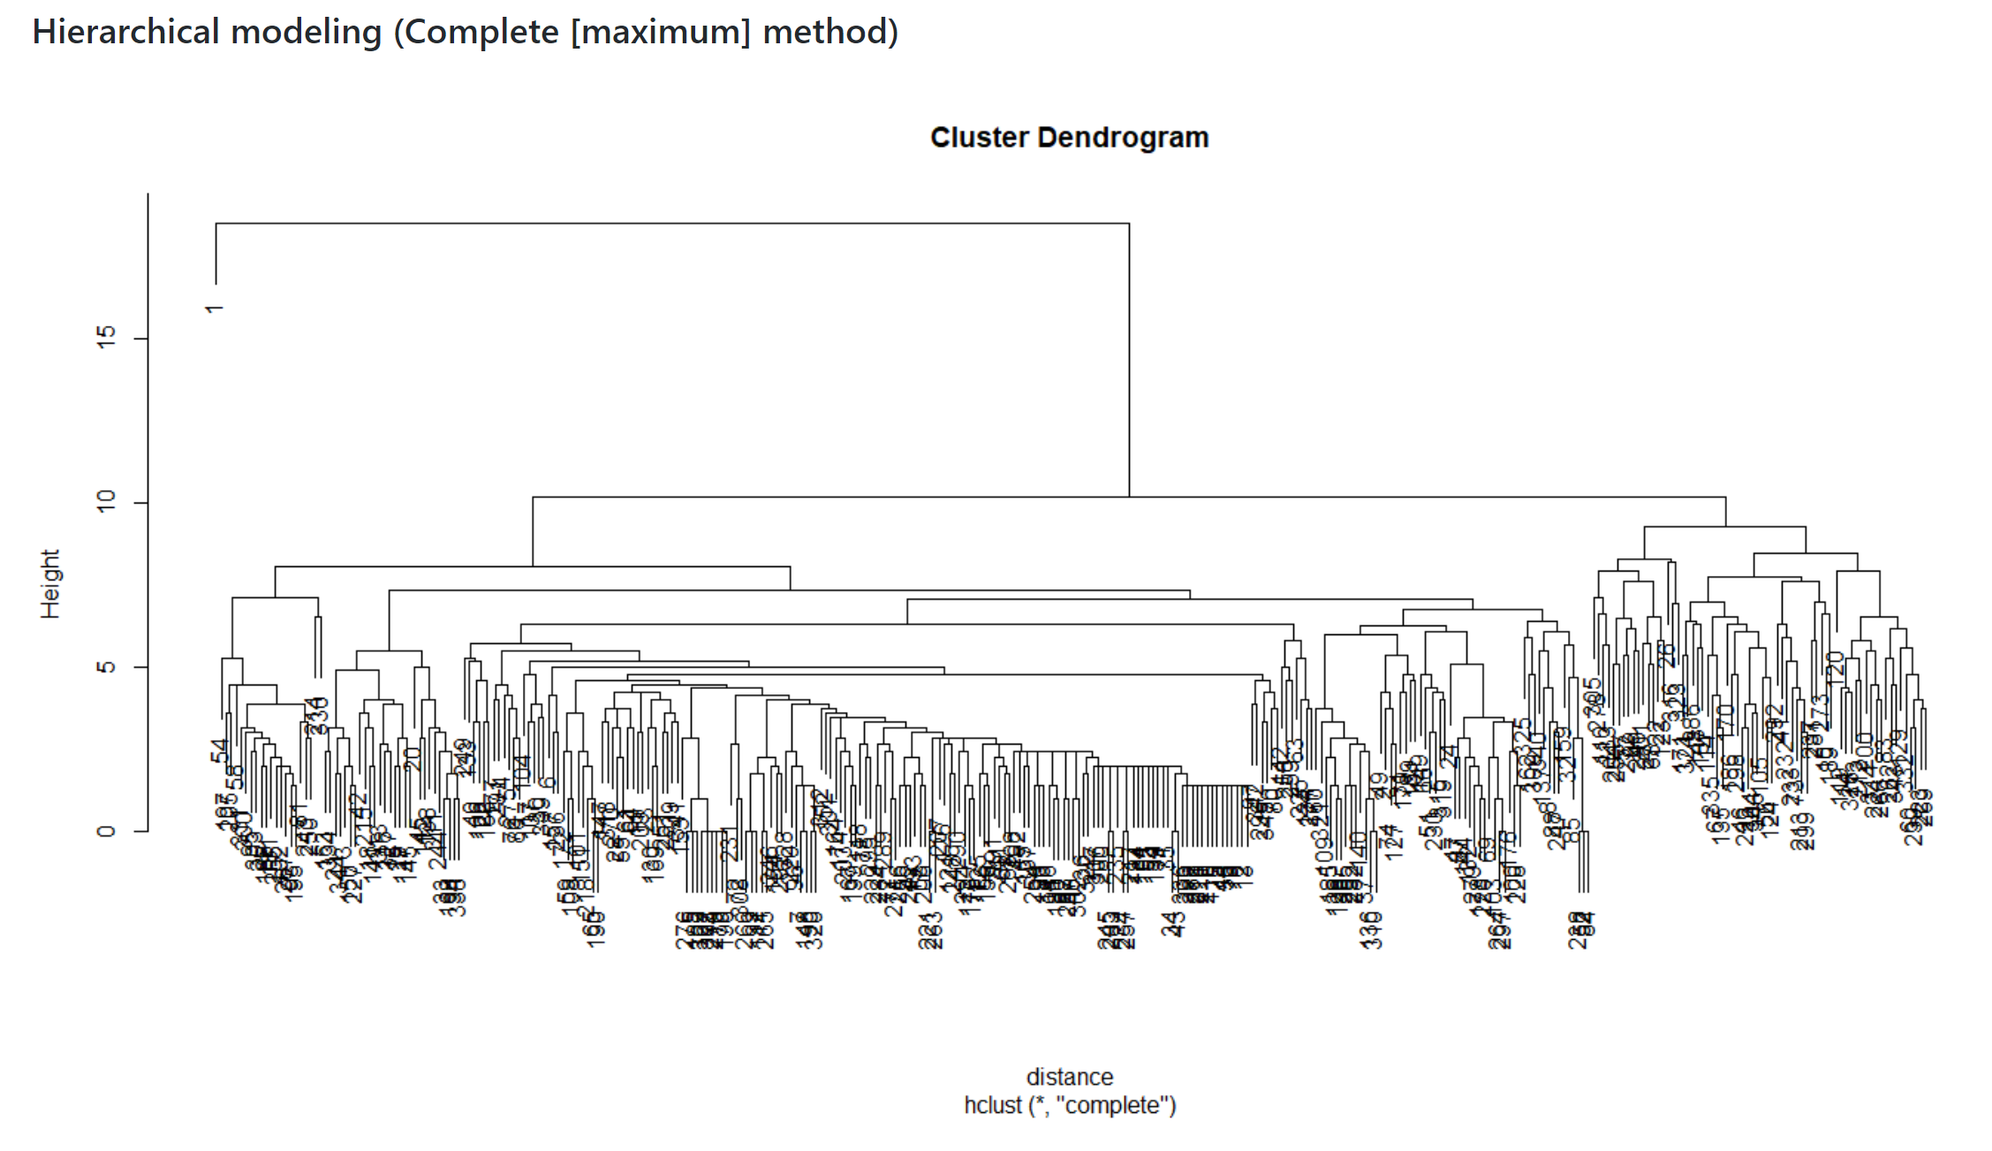
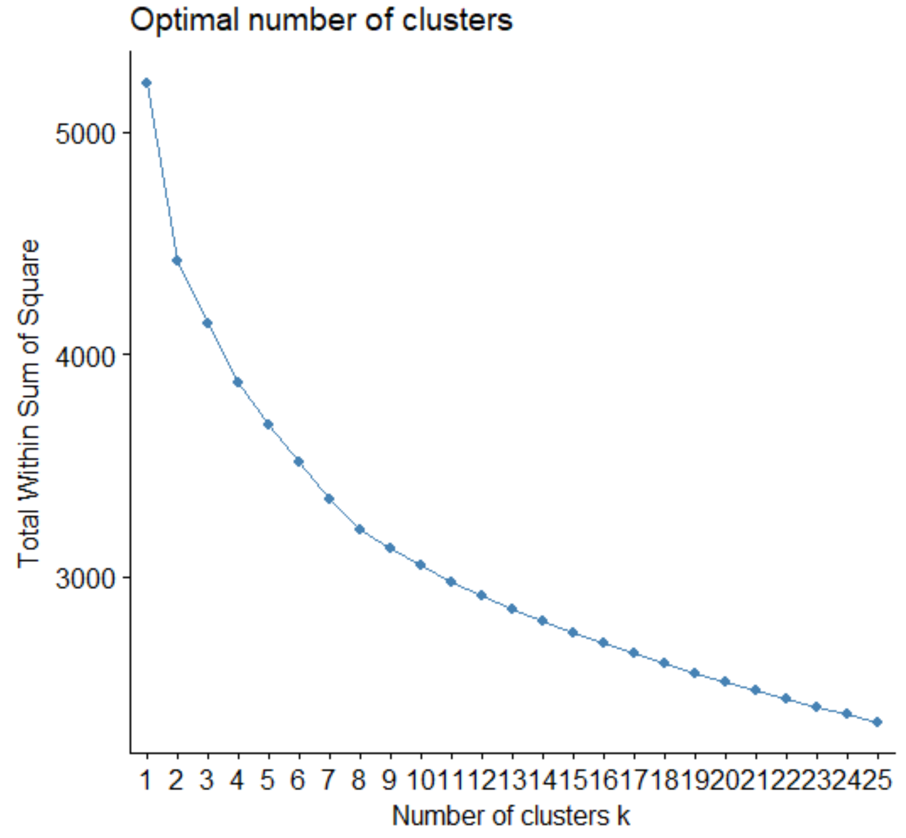
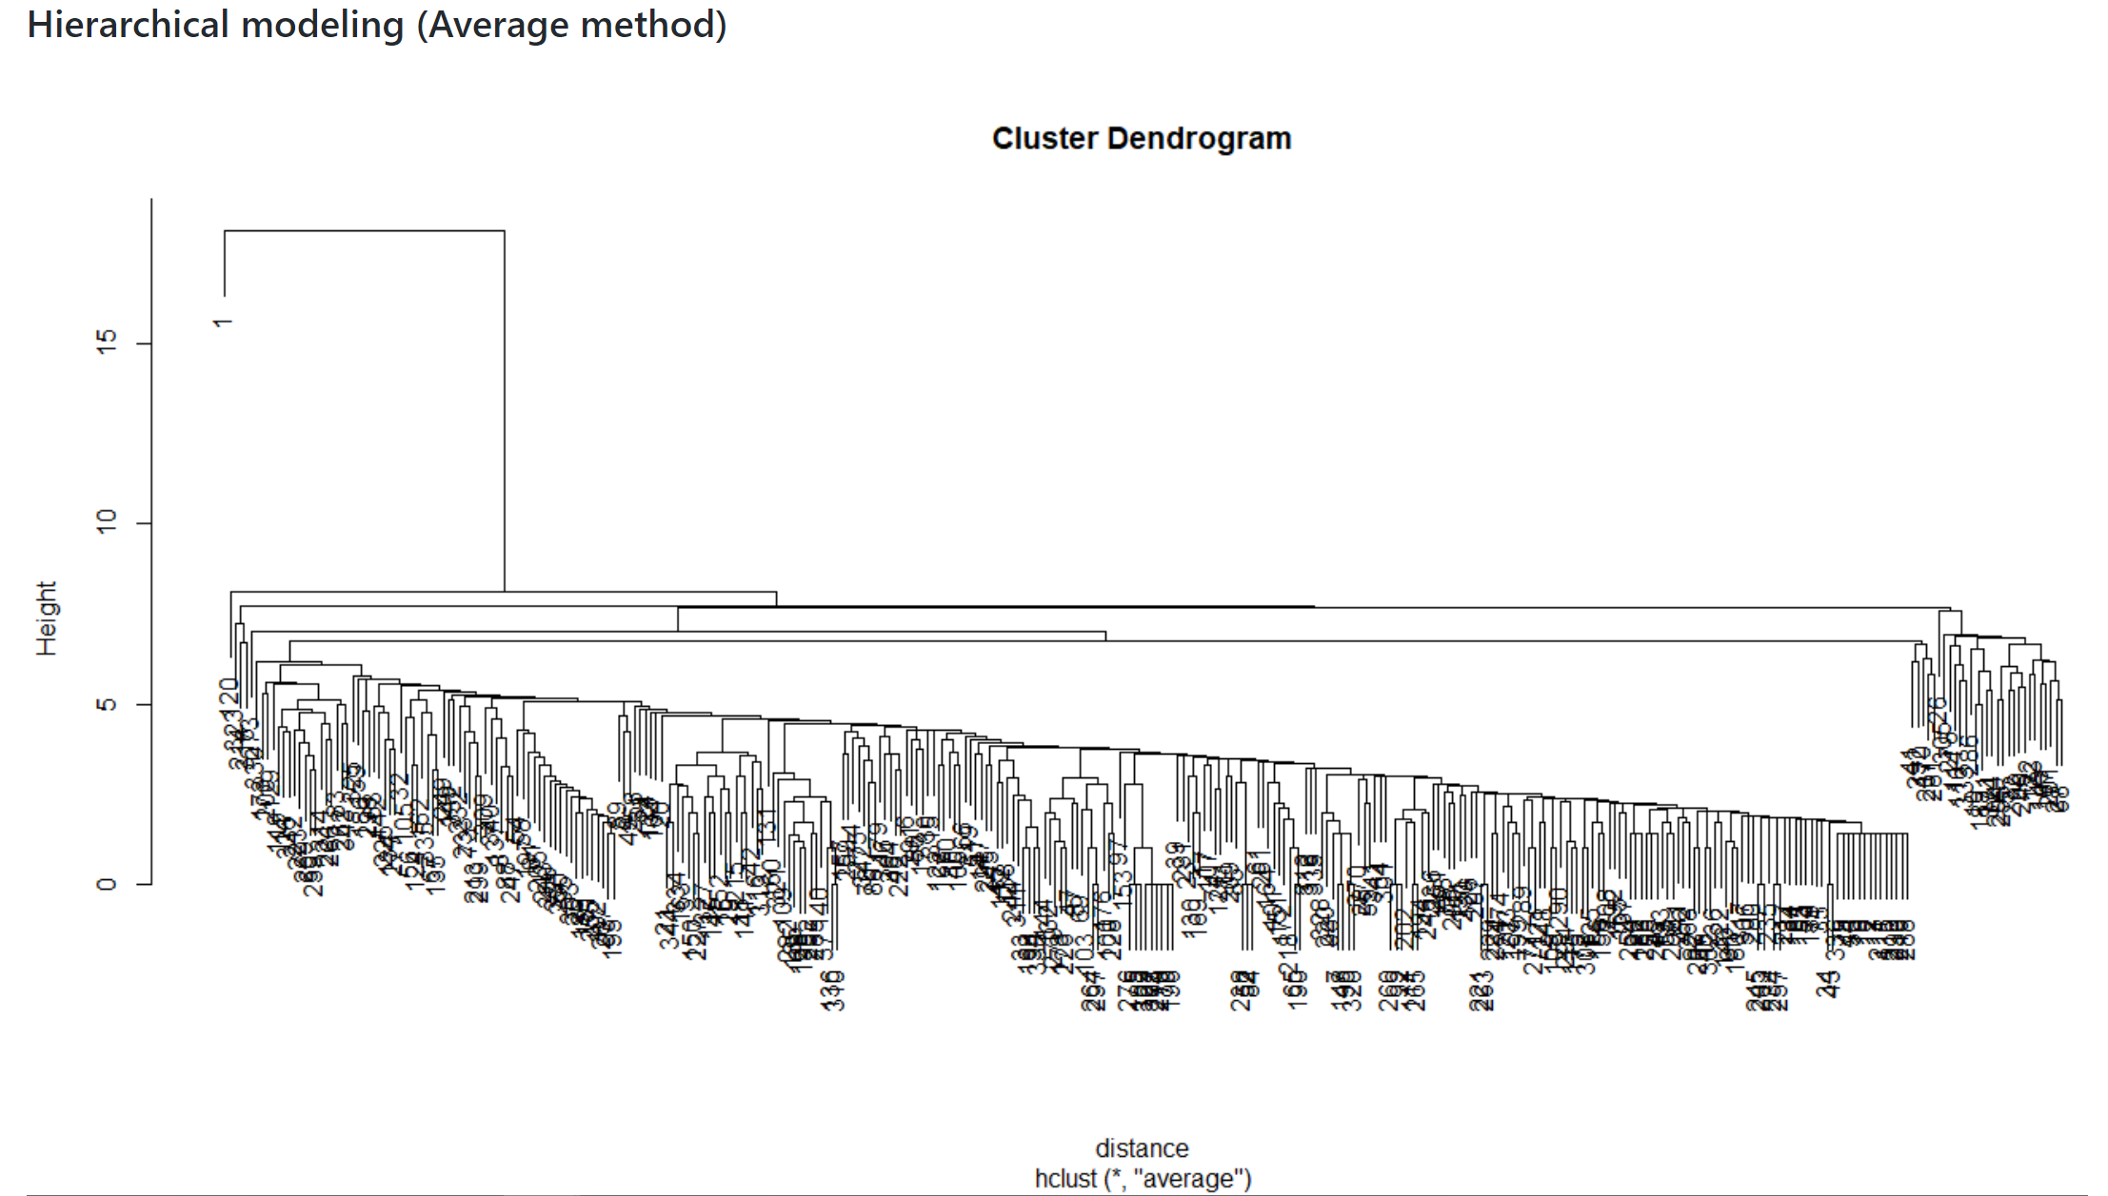
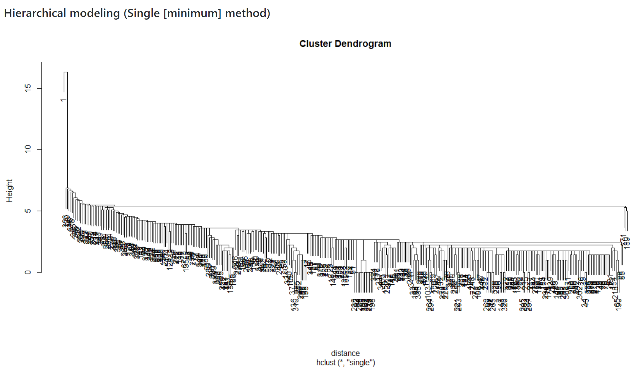
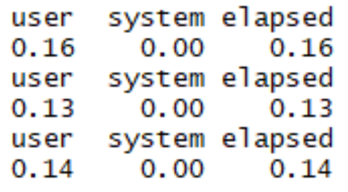
For User 1:
The computation time do not vary much for different distance defining method:

Slide 6
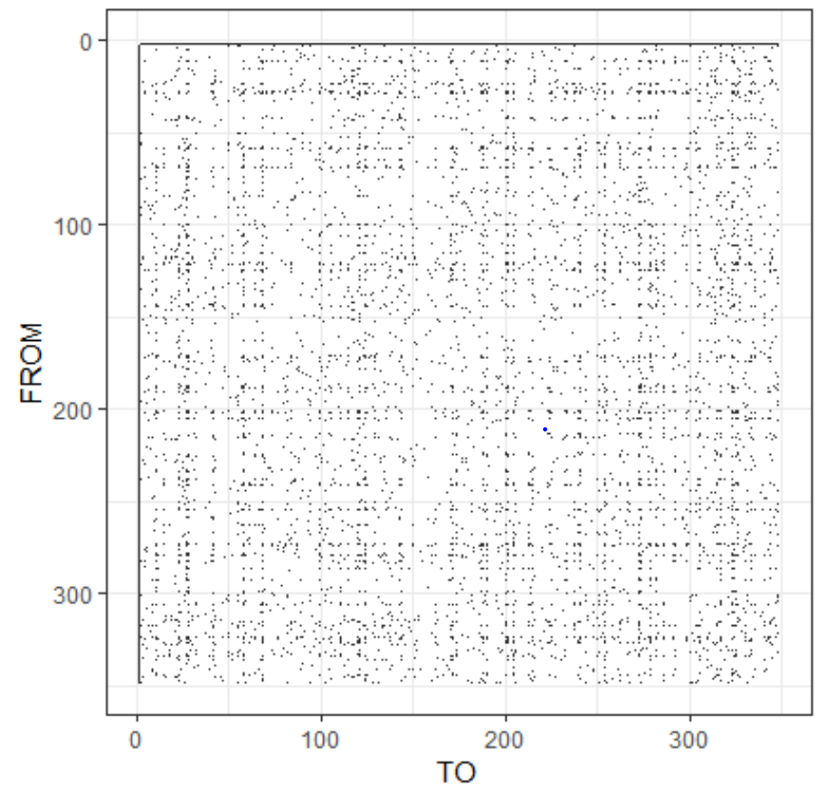
Mixed Membership Stochastic Blockmodels
Still use user 1 to explain
Randomly choose one point in the above matrix, there is a related p(row) and q(column). The p and q stands for nodes (which are the users).
Assume we have k circle(block) in total, assume each node (user) belongs to exactly one circle (block), make it a vector Zp,(or Zq) for each node(user).
Example: Zp = c(0,0,1,0) if p belongs to the third circle(block) and there are 4 circles (block) in total.
B is a k*k matrix that describes the relationship between each circle (block), and B(g,h) represents the probability of having a link(is friends) between a user from group g and a user from group h.
If p is in block g and q is in block h then the probability of observing an interaction from node p to node q is B(g,h).
Then, the relation between p and q, or Y(p,q), is Bernoulli( t(Zp)BZq )*** The t here stands for transpose. For example, if p is in block 3 and q is in block 2 then P(Y(p, q) = 1) = B(3,2).

Slide 7
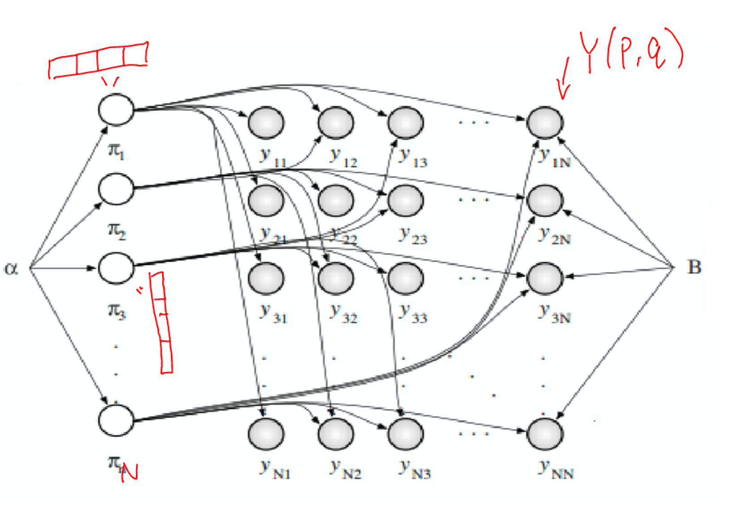
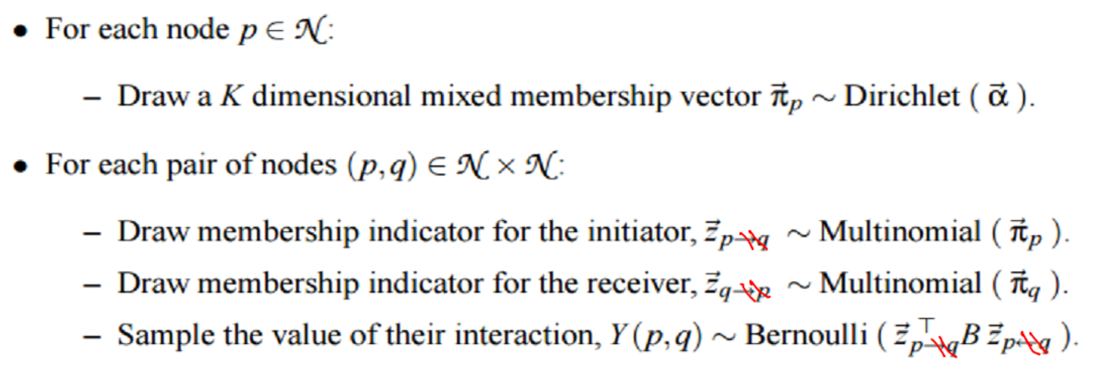
Assume there are K circles (blocks) and N users (nodes)! Y(p,q) are binary: 0 or 1
Because our data is undirected, we do not need to worry about the direction of Z

Slide 8
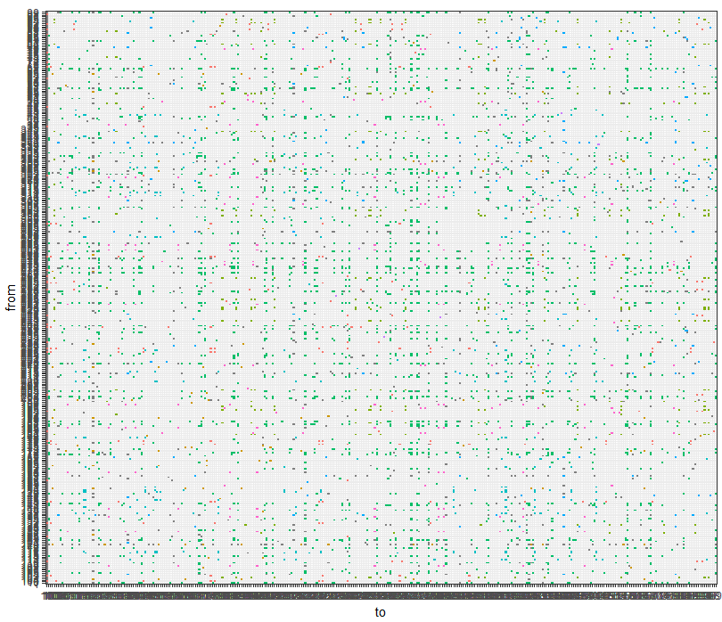
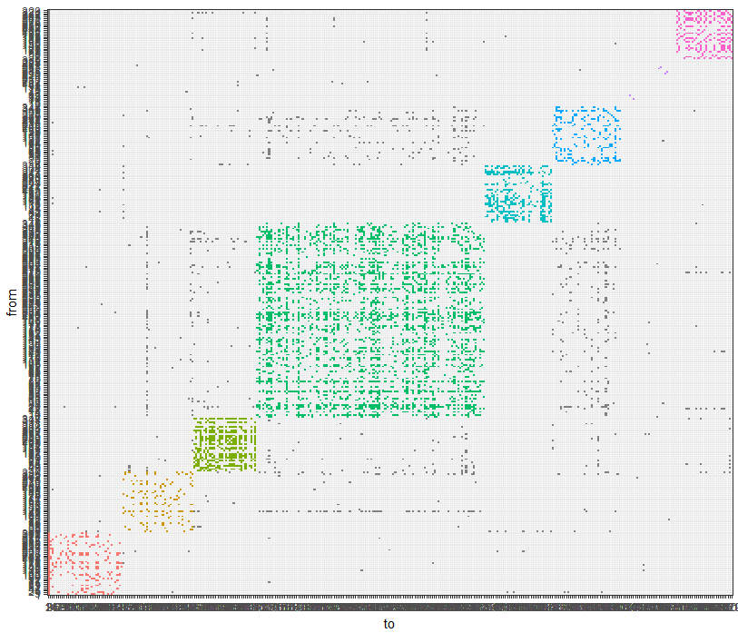
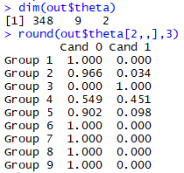
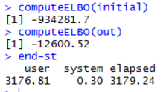
I choosed a K = 9 to reduce the computation time.
|α,B| is the number of hyper-parameters in the model, and |Y| is the number of positive relations observed.

Slide 9
Observations and thoughts
The mix membership model takes one hour to run, while baseline methods take within a second.
The mix membership model provides more information such as predicted probability of user p in block(circle) k.
These model are good enough to help users identify their friendship circle.
References:
http://www.analytictech.com/e-net/pdwhandout.pdf
https://uc-r.github.io/hc_clustering
http://i.stanford.edu/~julian/pdfs/nips2012.pdf
https://courses.washington.edu/b572/TALKS/2014/TedWestling-2.pdf
http://www.stat.cmu.edu/~brian/905-2009/all-papers/airoldi08a.pdf
https://cran.r-project.org/web/packages/mixedMem/vignettes/mixedMem.pdf
Thank you!
Shan Zhong
Aprial 24th,2019

