Slide 1
Chapter 1
Statistics, Data and Statistical Thinking

Slide 2
Chapter 1
This Chapter is filled with useful vocabulary words, which makes this chapter VERY helpful but not THAT interesting.
Bear with me statistics will be more than vocabulary words ☺

Slide 3
The Science of Statistics
Statistics is a SCIENCE (not really a Math).
Your book defines Statistics as the science of data (collecting, classifying, summarizing, organizing, analyzing, and interpreting numerical information)

Slide 4
Types of Statistical Applications
Descriptive Statistics – numerical and graphical methods to look for patterns in a data set, to summarize the information revealed in a data set, and to present the information in a convenient form
Batting averages
Daily rainfall
Graph of sample survey (like on Facebook)
Inferential Statistics – using sample data to make estimates, decisions, predictions, or other generalizations about a larger set of data
Inferring political winner from sample polling
Estimating average SAT score from sample

Slide 5
Fundamental Elements of Statistics
Experimental Unit – an object upon which we collect data
Variable – characteristic or property of an individual experimental unit
Population – a set of units that we are interested in studying
Sample – a subset of the units of a population
Census – measure a variable for every experimental unit in the population (not usually done)

Slide 6
Population vs. Sample
Population
Sample
This process can be repeated multiple times to get multiple samples

Slide 7
Population vs. Sample
Population
Parameter
Usually greek letters (α, β, ρ, μ)
Usually unknown
Sample
Statistic
Usually alphabetic letters (x, y, z, p)
Can be found from data then use to infer about population
take Random Sample
Infer About Population

Slide 8
Example – Identify the experimental units, population, variable, and sample of each of the following:
A politician who is running for the office of mayor of a city with 25,000 registered voters commissions a survey. In the survey, 48% of the 200 registered voters interviewed say they plan to vote for her.
Experimental units – each registered voter
Population – 25,000 registered voters
Variable – plans for voting for politician
Sample – 200 registered voters

Slide 9
Example – Identify the experimental units, population, variable, and sample of each of the following:
A manufacturer of computer chips claims that less than 10% of his products are defective. When 1,000 chips were drawn from a large production run, 7.5% were found to be defective.
Experimental units – each computer chip
Population – all computer chips produced by manufacturer
Variable – whether or not defective
Sample – 2,000 chips drawn

Slide 10
Four Elements of Descriptive Statistical Problems
Identify the population or sample of interest
Identify one or more variables that are to be investigated
Use Tables, graphs, or numerical summary tools (we will learn these in Chapter 2)
Identify patterns in data

Slide 11
Five Elements of Inferential Statistical Problems
Identify the population of interest
Identify one or more variables that are to be investigated
Sample population units
Make Inference about the population based on information contained in the sample (we will learn in Chapters 5, 6, and 10)
Give a measure of reliability (a statement [usually quantified] about the degree of uncertainty associated with a statistical inference) for the inference

Slide 12
Types of Data
Quantitative – measurements that are recorded on a naturally occurring numerical scale
Qualitative – measurements that cannot be measured on a natural numerical scale; they can only be classified into one of a group of categories

Slide 13
Identify the following as either qualitative or quantitative data
ACT scores
Qualitative
Quantitative
I don’t know

Slide 14
Identify the following as either qualitative or quantitative data
Number of hunting accidents in a state during deer hunting season
Qualitative
Quantitative
I don’t know

Slide 15
Identify the following as either qualitative or quantitative data
Religious affiliation
Qualitative
Quantitative
I don’t know

Slide 16
Identify the following as either qualitative or quantitative data
Time spent studying for first statistics exam
Qualitative
Quantitative
I don’t know

Slide 17
Identify the following as either qualitative or quantitative data
Lifetimes of electric light bulbs
Qualitative
Quantitative
I don’t know

Slide 18
Identify the following as either qualitative or quantitative data
Number of cars ticketed for illegal parking on campus today
Qualitative
Quantitative
I don’t know

Slide 19
Identify the following as either qualitative or quantitative data
Languages of United States
Qualitative
Quantitative
I don’t know

Slide 20
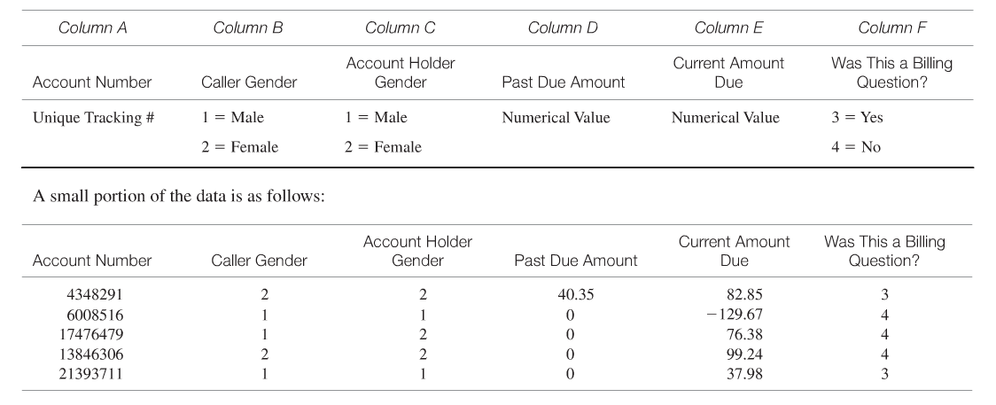
Recently the manager of the call center for a large Internet bank asked his staff to collect data on a random sample of the bank’s customers. Data on the following variables were collected and placed in a file…
Is Account Number…
Quantitative
Qualitative
I don’t know

Slide 21
Recently the manager of the call center for a large Internet bank asked his staff to collect data on a random sample of the bank’s customers. Data on the following variables were collected and placed in a file…
Is Caller Gender …
Quantitative
Qualitative
I don’t know

Slide 22
Recently the manager of the call center for a large Internet bank asked his staff to collect data on a random sample of the bank’s customers. Data on the following variables were collected and placed in a file…
Is Account Holder Gender…
Quantitative
Qualitative
I don’t know

Slide 23
Recently the manager of the call center for a large Internet bank asked his staff to collect data on a random sample of the bank’s customers. Data on the following variables were collected and placed in a file…
Is Past Due Amount…
Quantitative
Qualitative
I don’t know

Slide 24
Recently the manager of the call center for a large Internet bank asked his staff to collect data on a random sample of the bank’s customers. Data on the following variables were collected and placed in a file…
Is Current Amount Due…
Quantitative
Qualitative
I don’t know

Slide 25
Recently the manager of the call center for a large Internet bank asked his staff to collect data on a random sample of the bank’s customers. Data on the following variables were collected and placed in a file…
Is “Was This a Billing Question?”…
Quantitative
Qualitative
I don’t know

Slide 26
Collecting Data
Published Sources
Census of US
Online Collections of Data (GSS, Sports information)
Newspapers
Designed Experiments
Medical study on a particular drug
Which is the best fertilizer
Taste tests (Pepsi vs. Coke)
Survey
Polling
Online surveys (see next slide)
Nielson surveys
Observational Study
Closing stock prices
Profit trends

Slide 27
Collecting Data (Caution)
When collecting data it is important that you make sure the data was collected from a representative sample, that is a sample that is typical of the population of interest.
In particular online data or polling can be unreliable data because it is limited to those with access to a computer and usually with volunteer responses you only get people participating that feel strongly about the topic at hand.

Slide 28
Representative Sample
One way to obtain this representative sample is to take a random sample
Random Sample – is a sample selected from the population in such a way that every different sample of size n has an equal chance of selection (we will learn how to do this in Chapter 3)
Note: This is equivalent to putting all names in a hat and drawing n number of names out to be in the sample.

Slide 29
The Role of Statistics in Managerial Decision Making
When a collection of data is not a representative sample it is often the result of selection bias
Selection Bias- when a subset of the experimental units in the population is excluded so that these units have no chance of being selected for the sample (Ex. Online polls , is a selection bias against those people without computers)

Slide 30
The Role of Statistics in Managerial Decision Making
When conducting a survey it is often times the case that people will not respond. If a large number of people (relative to the number of people asked) do not respond to the survey, this is known as nonresponse bias.
Nonresponse bias- when the researchers conducting a survey or study are unable to obtain data on all experimental units selected for the sample

Slide 31
The Role of Statistics in Managerial Decision Making
It is important when preparing a survey that the questions not be leading (encouraging an answer in particular direction) or misleading (confusing), this would result in measurement error.
Measurement error- inaccuracies in the values of the data recorded.

Slide 32
A bank with branches in a large metropolitan area is considering opening its offices on Saturday, but it is uncertain whether customers will prefer (1) having walk-in hours on Saturday or (2) having extended branch hours during the week. Listed below are some of the ideas proposed for gathering data. For each, indicate what (if any) biases may result.
Put a big ad in the newspaper asking people to log their opinions on the bank’s Web site.
Non-response Bias
Selection Bias
Both
Neither

Slide 33
A bank with branches in a large metropolitan area is considering opening its offices on Saturday, but it is uncertain whether customers will prefer (1) having walk-in hours on Saturday or (2) having extended branch hours during the week. Listed below are some of the ideas proposed for gathering data. For each, indicate what (if any) biases may result.
Randomly select one of the branches and contact every customer at that bank by phone.
Non-response Bias
Selection Bias
Both
Neither

Slide 34
A bank with branches in a large metropolitan area is considering opening its offices on Saturday, but it is uncertain whether customers will prefer (1) having walk-in hours on Saturday or (2) having extended branch hours during the week. Listed below are some of the ideas proposed for gathering data. For each, indicate what (if any) biases may result.
Send a survey to every customer’s home, and ask the customer to fill it out and return it.
Non-response Bias
Selection Bias
Both
Neither

Slide 35
A bank with branches in a large metropolitan area is considering opening its offices on Saturday, but it is uncertain whether customers will prefer (1) having walk-in hours on Saturday or (2) having extended branch hours during the week. Listed below are some of the ideas proposed for gathering data. For each, indicate what (if any) biases may result.
Randomly select 20 customers from each branch. Send each a survey, and follow up with a phone call if he or she does not return the survey within a week.
Non-response Bias
Selection Bias
Both
Neither

Slide 36
Next Stop
This concludes the vocabulary of Chapter 1
Next we will visit Chapter 2 to learn the basics of descriptive statistics – how to describe data.

