Slide 1
Chapter 4
Random Variables and Probability Distributions

Slide 2
Two Types of random variables
Section 4.1

Slide 3
What is a Random Variable?
Random variables –
a variable that assumes numerical values associated with the random outcomes of an experiment, where one (and only one) numerical value is assigned to each sample point.

Slide 4
EXAMPLE
Recall on the sample space for tossing 3 coins…
{HHH, HHT, HTH, THH, TTH, THT, HTT, TTT}
What if we called the sample space…
{flipping 3 heads, flipping 2 heads, flipping 1 head, flipping 0 heads}?
Is this still a sample space?

Slide 5
EXAMPLE
Let X = # of heads when tossing 3 coins
X is then a random variable

Slide 6
Two Types of Random Variables
DISCRETE – r.v. takes on a countable # of outcomes (finite or infinite)
{# of light bulbs that burn out, # of hits to a website, # of free throw attempts before first shot is made}
CONTINUOUS – r.v. takes on any points in one ore more intervals (uncountable)
{time it takes to fly to NYC, weight of a t-bone steak, amount of rain in Seattle during April}

Slide 7
Probability distributions for discrete random variables
Section 4.2

Slide 8
Requirements for the Probability Distribution of a Discrete R.V., x
p(x) ≥ 0 for all values of x
2. ∑p(x) = 1
Where the summation of p(x) is over all possible values of x

Slide 9
Ways to describe a DISCRETE Distribution
Graphs
Table
Formula

Slide 10
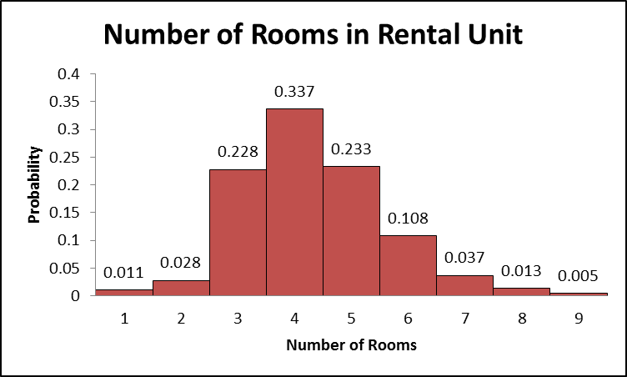
Example - The probability histogram that follows represents the number of rooms in rented housing units in 2005.

Slide 11
a. What is the probability that a randomly selected rental unit has five rooms?
Let X = the number of rooms in the rental unit

Slide 12
b. What is the probability that a randomly selected rental unit has five or six room?

Slide 13
c. What is the probability that a randomly selected rental unit has seven or more rooms?

Slide 14
Ways to describe a DISCRETE Distribution
Graphs
Table
Formula

Slide 15
Example - A Wendy’s manager performed a study to determine a probability distribution for the number of people, X, waiting in line during lunch. The results were as follows:
X | P(x)
0 | 0.011
1 | 0.035
2 | 0.089
3 | 0.150
4 | 0.186
5 | 0.172
6 | 0.132
7 | 0.098
8 | 0.063
9 | 0.035
10 | 0.019
11 | 0.002
12 | 0.006
13 | 0.001
14 | 0.001
Let X = # of people waiting in line during lunch

Slide 16
a. What is the probability that 8 people are waiting in line for lunch?
X | P(x)
0 | 0.011
1 | 0.035
2 | 0.089
3 | 0.150
4 | 0.186
5 | 0.172
6 | 0.132
7 | 0.098
8 | 0.063
9 | 0.035
10 | 0.019
11 | 0.002
12 | 0.006
13 | 0.001
14 | 0.001

Slide 17
b. What is the probability that 10 or more people are waiting in line for lunch?
X | P(x)
0 | 0.011
1 | 0.035
2 | 0.089
3 | 0.150
4 | 0.186
5 | 0.172
6 | 0.132
7 | 0.098
8 | 0.063
9 | 0.035
10 | 0.019
11 | 0.002
12 | 0.006
13 | 0.001
14 | 0.001

Slide 18
c. What is the probability that at least 3 people are waiting for lunch?
X | P(x)
0 | 0.011
1 | 0.035
2 | 0.089
3 | 0.150
4 | 0.186
5 | 0.172
6 | 0.132
7 | 0.098
8 | 0.063
9 | 0.035
10 | 0.019
11 | 0.002
12 | 0.006
13 | 0.001
14 | 0.001

Slide 19
Ways to describe a DISCRETE Distribution
Graphs
Table
Formula
We will see this in the next Section

Slide 20
Find Mean (Expected Value) of Discrete R.V.

Slide 21
Example - From our Rental Unit example – If a rental unit is randomly selected, how many rooms would you expect the unit to have?

Slide 22
Example - From our Wendy’s example – Compute and interpret the mean of the random variable X.
X | P(x)
0 | 0.011
1 | 0.035
2 | 0.089
3 | 0.150
4 | 0.186
5 | 0.172
6 | 0.132
7 | 0.098
8 | 0.063
9 | 0.035
10 | 0.019
11 | 0.002
12 | 0.006
13 | 0.001
14 | 0.001
X P(X)
0
0.035
0.178
0.45
0.744
0.86
0.792
0.686
0.504
0.315
0.19
0.022
0.072
0.013
0.014

Slide 23
Note: The Expected Value and the mean are interchangeable expression when it comes to random variables.
Expected values are not necessarily obtainable value but the average of the long run experiment where the values are weighted by their probabilities.
DO NOT ROUND!!!!!

Slide 24
Find Variance and Standard Deviation of Discrete R.V.

Slide 25
Example - From our Rental Unit problem find the variance and the standard deviation.

Slide 26
Example - From our Wendy’s example – Compute the variance and standard deviation
X | P(x)
0 | 0.011
1 | 0.035
2 | 0.089
3 | 0.150
4 | 0.186
5 | 0.172
6 | 0.132
7 | 0.098
8 | 0.063
9 | 0.035
10 | 0.019
11 | 0.002
12 | 0.006
13 | 0.001
14 | 0.001
X P(X) | X² P(X)
0 | 0
0.035 | 0.035
0.178 | 0.356
0.45 | 1.35
0.744 | 2.976
0.86 | 4.3
0.792 | 4.752
0.686 | 4.802
0.504 | 4.032
0.315 | 2.835
0.19 | 1.9
0.022 | 0.242
0.072 | 0.864
0.013 | 0.169
0.014 | 0.196

Slide 27
Note: Now that you know mean and standard deviation you can use these along with Chebyshev’s and Empirical Rule to determine approximate percentages between random variables.

Slide 28
Binomial distribution
Section 4.3

Slide 29
Characteristics of a Binomial Experiment
The experiment consists of n identical trials
There are only two possible outcomes on each trial. We will denote one outcome by S (for success) and the other by F (for failure).
The probability of S remains the same from trial to trial. This probability is denoted by p, and the probability of F is denoted by q. Note that q=1-p
The trials are independent
The binomial random variable x is the number of S’s in n trials.

Slide 30
EXAMPLES
You observe the sex of the next 50 children born at a local hospital; X is the number of girls among them.
Binomial

Slide 31
EXAMPLES
A couple decides to continue to have children until their first girl is born; X is the total number of children the couple has.
Not Binomial

Slide 32
EXAMPLES
You want to know what percent of married people believe that mothers of young children should not be employed outside the home. You plan to interview 50 people, and for the sake of convenience you decide to interview both the husband and the wife in 25 married couples. The random variable X is the number among the 50 persons interviewed who think mothers should not be employed.
Not Binomial

Slide 33
EXAMPLES
An auto manufacturer chooses one car from each hour’s production for a detailed quality inspection. One variable recorded is the count X of finish defects (dimples, ripples, etc.) in the car’s paint
Not Binomial

Slide 34
EXAMPLES
The pool of potential jurors for a murder case contains 100 persons chosen at random from the adult residents of a large city. Each person in the pool is asked whether he or she opposes the death penalty; X is the number who say “Yes”
Binomial

Slide 35
EXAMPLES
Joe buys a ticket in his state’s “Pick 3” lottery game every week; X is the number of times in a year that he wins a prize. (Assume 52 weeks in a year)
Binomial

Slide 36
How do we find probabilities?
Example: A major electronics manufacturer has determined that when one of its televisions is sold, there is 0.08 chance that the set will need service before the warranty period expires. It has also assessed a 0.05 chance that a DVD player will need service prior to the expirations of the warranty.
Suppose the retailer sells 3 DVD players on a particular Saturday. What is the probability that at least 2 of the DVD players need repair prior to warranty expiring?

Slide 37
Previous Method: Using a tree diagram…

Slide 38
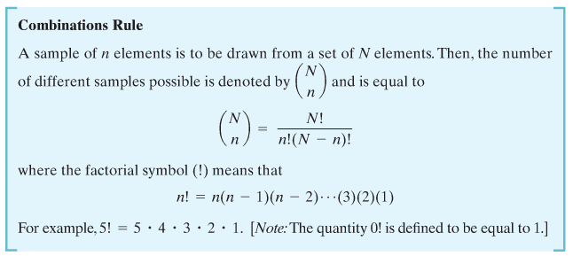
Another way to look at it….
Combinations Rule:

Slide 39
EXAMPLE
How many different ways to need two repairs?
How many different ways to need three repairs?

Slide 40
Combine together to get Probability
P(at least two DVDs needed repair)
= P(two need repair) + P(three need repair)
= 1-[P(none need repair) + P( one needs repair)]

Slide 41
Is the Example a Binomial experiment?
If I represent X as the number of DVDs that need repair, is X a binomial random variable?
There are 4 identical trials (a trial is each DVD)
There are only two possible outcomes (S=need repair and F=does not need repair) [S should always be what you are trying to find probability of]
The probabilities of S remain the same for each trial (p=.05, q=0.95)
The trials are independent. (each DVD does not affect the other)
X is the number of DVDs that need repair

Slide 42
Binomial Probability Distribution Function
Where
x=0,1,2,…,n
p=probability of success on a single trial
q = 1-p
n = number of trials
x = number of success in n trials
n-x = number of failures in n trials

Slide 43
DVD Example
Let X = # of DVDs that need repair
n=3 (DVDs)
p=0.05 (probability of needing repair)
What is the probability that at least 2 DVDs (out of 3) need repair?

Slide 44
Simple Example
n=10, p=0.4, x = 3

Slide 45
Example: Create Entire Prob. Distribution
According to the American Red Cross, 7% of people in the United States have blood type O-negative. A simple random sample of size 4 is obtained, and the number of people X with blood type O-negative is recorded. Construct a probability distribution for the random variable X.
Let X = # of people with O-negative blood
X | P(X)
0 | $${\left(\begin{matrix}4 \\ 0\end{matrix}\right){(0.07)}^{0}\left(0.93\right)}^{4}=0.74805$$
1 | $${\left(\begin{matrix}4 \\ 1\end{matrix}\right){(0.07)}^{1}\left(0.93\right)}^{3}=0.22522$$
2 | $${\left(\begin{matrix}4 \\ 2\end{matrix}\right){(0.07)}^{2}\left(0.93\right)}^{2}=0.02543$$
3 | $${\left(\begin{matrix}4 \\ 3\end{matrix}\right){(0.07)}^{3}\left(0.93\right)}^{1}=0.00128$$
4 | $${\left(\begin{matrix}4 \\ 4\end{matrix}\right){(0.07)}^{4}\left(0.93\right)}^{0}=0.000024$$

Slide 46
Example: Without finding Entire Prob. Distribution
Clarinex-D is a medication whose purpose is to reduce the symptoms associate with a variety of allergies. In clinical trials of Clarinex-D, 5% of the patients in the study experienced insomnia as a side effect. A random sample of 20 Clarinex-D users is obtained, and the number of patients who experienced insomnia is recorded.
a. Find the probability that exactly 3 experienced insomnia as a side effect.

Slide 47
Clarinex-D is a medication whose purpose is to reduce the symptoms associate with a variety of allergies. In clinical trials of Clarinex-D, 5% of the patients in the study experienced insomnia as a side effect. A random sample of 20 Clarinex-D users is obtained, and the number of patients who experienced insomnia is recorded.
b. Find the probability that 3 or fewer experiences insomnia as a side effect.

Slide 48
Clarinex-D is a medication whose purpose is to reduce the symptoms associate with a variety of allergies. In clinical trials of Clarinex-D, 5% of the patients in the study experienced insomnia as a side effect. A random sample of 20 Clarinex-D users is obtained, and the number of patients who experienced insomnia is recorded.
c. Find the probability that between 1 and 4 patients, inclusive, experienced insomnia as a side effect.

Slide 49
Mean and Standard Deviation – Using General Discrete R.V. Formula
Example: Using our O-blood type example find the expected number of people with blood type O-negative out of 4.
X | P(x) | xP(x)
0 | 0.74805
1 | 0.22522
2 | 0.02543
3 | 0.00128
4 | 0.000024
X | P(x) | xP(x)
0 | 0.74805 | 0
1 | 0.22522 | 0.22522
2 | 0.02543 | 0.05086
3 | 0.00128 | 0.00384
4 | 0.000024 | 0.000096

Slide 50
Mean and Standard Deviation of Binomial Random Variable
Mean:
Variance:
Standard Deviation:

Slide 51
For O-negative Example

Slide 52
Poisson Random Variables
Section 4.4

Slide 53
Characteristics of Poisson Random Variable
The experiment consists of counting the number of times a certain event occurs during a given unit of time or in a given area or volume (or weight, distance, or any other unit of measurement)
The probability that an event occurs in a given unit of time, area, or volume is the same for all the units.
The number of events that occur in one unit of time, area, or volume is independent of the number that occur in any other mutually exclusive unit.
The mean (or expected) number of events in each unit is denoted by the Greek letter lambda, λ

Slide 54
Examples…
Number of emergency calls in one hour
Number of hurricanes per year
Number of people at a drive thru window in one shift
The amount of toxins in a gallon of city water
The number of errors in a day shift at a factory

Slide 55
Probability Distribution of Poisson Random Variable
Where:
x = 0,1,2,…
λ = mean number of events during given unit of time, are, volume, etc.
e = 2.71828…

Slide 56
Example - According to the Statistical Abstract of the United States, traffic fatalities occur at the rate of 1.5 deaths per 100 million miles. Find the probability that, during the next 100 million vehicle miles, there will be
a. Exactly zero deaths.
Let X = # of deaths in 100 million vehicle miles

Slide 57
Example - According to the Statistical Abstract of the United States, traffic fatalities occur at the rate of 1.5 deaths per 100 million miles. Find the probability that, during the next 100 million vehicle miles, there will be
b. At least one death
X | P(X)
0
1
2
3
…
Complement of P(X=0)
Want the total of these probabilities

Slide 58
Example - According to the Statistical Abstract of the United States, traffic fatalities occur at the rate of 1.5 deaths per 100 million miles. Find the probability that, during the next 100 million vehicle miles, there will be
c. More than one death
X | P(X)
0
1
2
3
…
Complement of P(X=0) +P(X=1)
Want the total of these probabilities

Slide 59
Mean and Variance for Poisson Distribution
Again we could use the formulas for discrete random variables but this is special kind of discrete random variables and has its own shortcut.
Mean:
Variance:

