Slide 1
Probability distributions for continuous random variables
Chapter 4b: Section 4.5

Slide 2
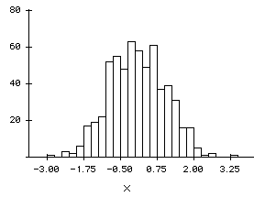
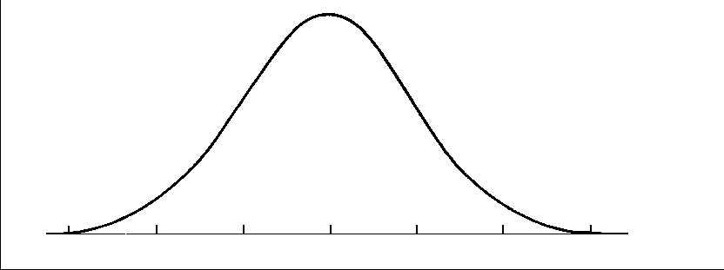
Continuous Probability Distribution
Recall what a Histogram for Bell-Shaped Continuous Random Variable Looks Like
When you smooth the curve the function that forms is represented by f(x). (This function is the probably density function)
f(x)

Slide 3
Continuous Probability Distribution Properties
The AREA under the curve corresponds to probability
The probability associated with one particular value P(X=x) = 0
Hence, P(a<x<b) = P(a≤x≤b)
The total area under a probability distribution is equal to 1

Slide 4
How do you find AREA (Probability)under curve
Don’t worry…we won’t be doing integration in this class

Slide 5
The Normal Distribution
For each normal random variable we must know the value of µ and σ.
If two normal random variables have the same mean and standard deviation then their probabilities are equivalent as well.

Slide 6
Relationship between normal R.V with different mean and standard deviation

Slide 7
Probability Density Function for Normal Random Variable (x)
Where
µ = mean of the normal random variable x
σ = standard deviation
π = 3.1415…
e = 2.71828…
This is the function you would integrate – DO NOT USE in calculations – this is what gives you the curve

Slide 8
How to find Normal Probabilities?
From Table IV in book
(Called Z-table or Standard Normal Table)
Standard Normal Random Variables have
mean = 0 and standard deviation = 1
Z~N(µ=0, σ=1)

Slide 9
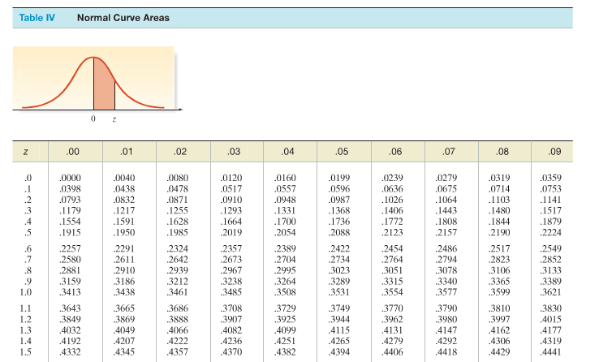

Slide 10
Example – Find the probability that the standard normal random variable z falls between 0 and 0.47. P(0 < z < 0.47)
0
0.47
z

Slide 11
Example – Find the probability that the standard normal random variable z falls between -1.2 and 0.58. P(-1.2 < z < 0.58)
-1.20
0
0.58
z

Slide 12
Example – Find the probability that the standard normal random variable z falls to the left (is less than) 0.78. P(z < 0.78)
0.2823
0.5
0
0.78
z

Slide 13
Example – Find the probability that the standard normal random variable z falls to the right (is greater than) 1.43. P(z > 1.43)
0.4236
0.0764
0
1.43
z

Slide 14
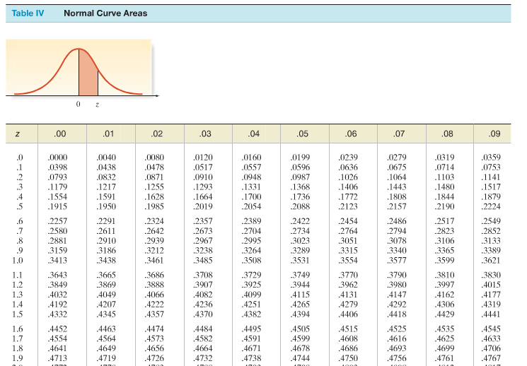
Example – Find the probability that a standard normal random variable exceeds 1.67 in absolute value. P(|z| > 1.67)
0.4525
0.4525
-1.67
0
1.67
z

Slide 15
Example – Find the probability that a standard normal random variable lies between 0.23 and 1.56. P(0.23 < z< 1.56)
0.4406
0.0910
0
0.23
1.56
z

Slide 16
Example – Suppose Z has a standard normal probability distribution IF P(Z < c) = .8554 Find c.
0.8554
0.3554
0.5
0
c
z

Slide 17
Finding Probability for Normal Random Variables (µ not 0 and/or σ not 1)
Now that we know how to find probabilities of standard normal random variables we need to know how to find probabilities of a normal random variable with any mean and standard deviation.
Note: standard normal random variables are the z-scores of normal random variables.

Slide 18
Steps for Finding a Probability Corresponding to a Normal Random Variable
Sketch the normal distribution and indicate the mean of the random variable x.
Convert the boundaries of the shaded area from x values to standard normal random variable z values using the formula
Show the z values under the corresponding x values on your sketch.
Use Table IV in Appendix B (standard normal table) to find the areas corresponding to the z values.
If necessary, use the symmetry of the normal distribution to find area corresponding to negative z values and the fact that the total area on each side of the mean equals 0.5 to convert the areas from Table IV to probabilities of the event you shaded.

Slide 19
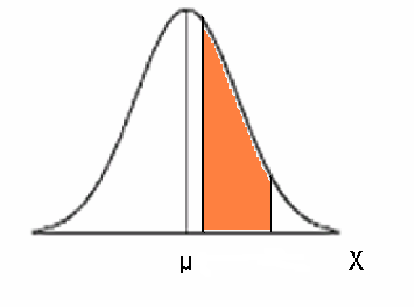
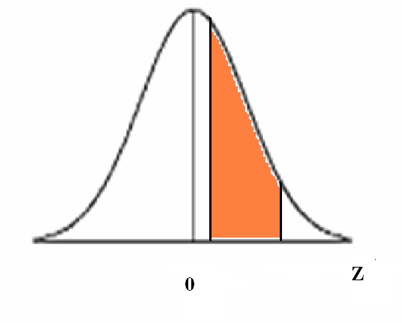
Translate X~N(µ,σ) to Z~N(0,1)
a
b
a-µ
____
σ
b-µ
____
σ

Slide 20
Example – Fast-food restaurants spend quite a bit of time studying the amount of time cars spend in their drive-thrus. Certainly, the faster get through the drive-thru, the more the opportunity for making money. In 2007, QSR Magazine studied drive-thru times for fast-food restaurants and Wendy’s had the best time, with a mean time spent in the drive-thru of 138.5 seconds. Assuming drive-thru times are normally distributed with a standard deviation of 29 seconds, answer the following.
Let X = amount of time cars spend in Wendy’s drive thru

Slide 21
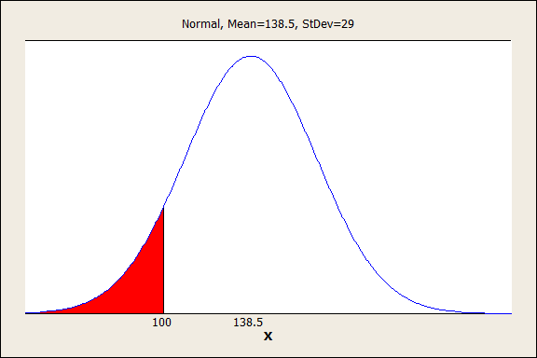
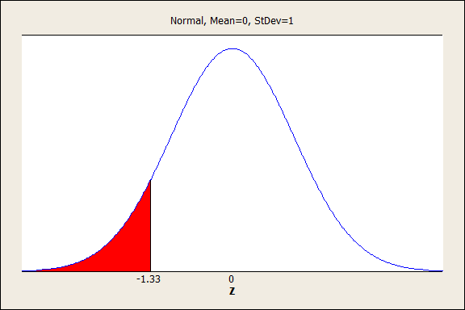
What is the probability that a randomly selected car will get through Wendy’s drive-thru in less than 100 seconds?

Slide 22
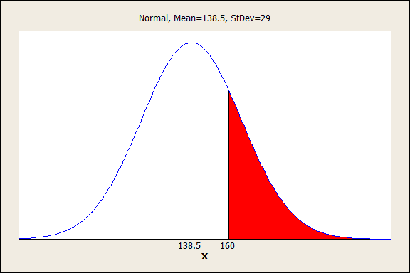
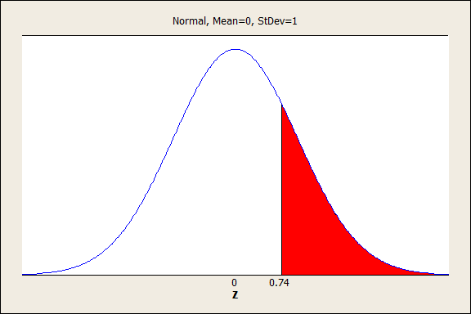
What is the probability that a randomly selected car will spend more than 160 seconds in Wendy’s drive thru?

Slide 23
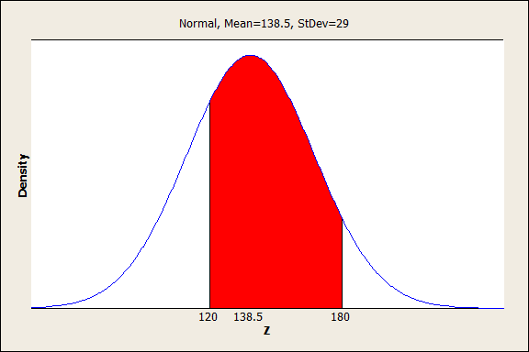
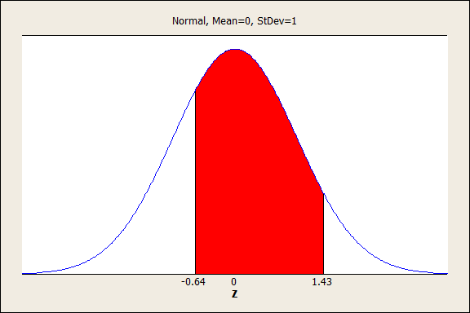
What proportion of cars spend between 2 and 3 minutes in Wendy’s drive-thru?

Slide 24
Example – General Electric manufactures a decorative Crystal Clear 60-watt light bulb that is it advertises will last 1,500 hours. Suppose that the lifetimes of the light bulbs are approximately normally distributed, with a mean of 1550 hours and a standard deviation of 57 hours.
Let X = lifetime of GE Crystal Clear 60-watt light bulbs

Slide 25
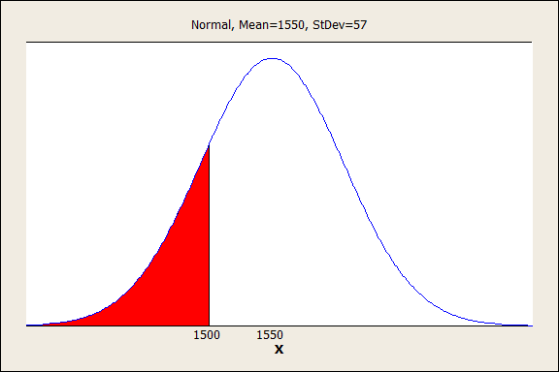
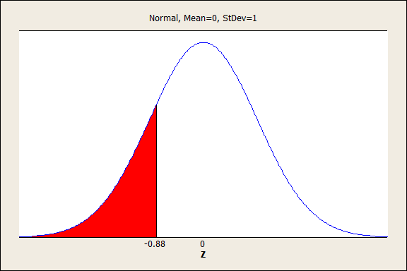
What proportion of the light bulbs will last less than the advertised time?

Slide 26
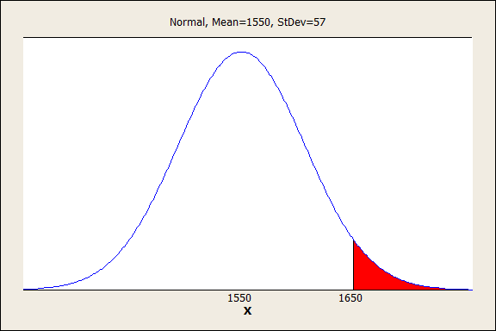
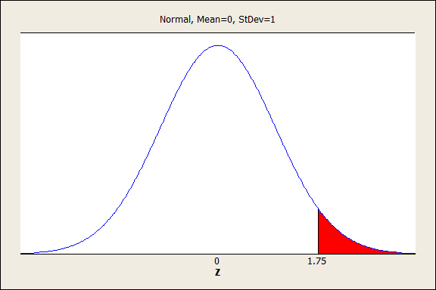
What proportion of the light bulbs will last more than 1650 hours?

Slide 27
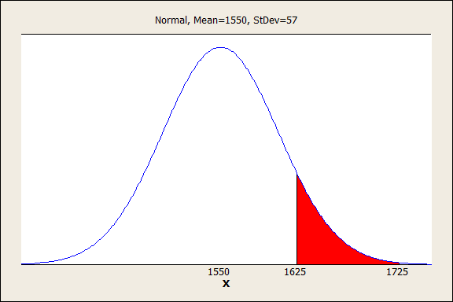
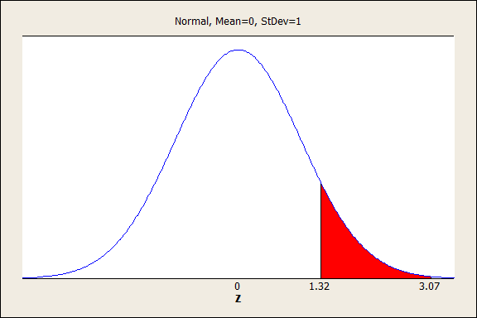
What is the probability that a randomly selected GE Crystal Clear 60-watt light bulb will last between 1625 and 1725 hours?

Slide 28
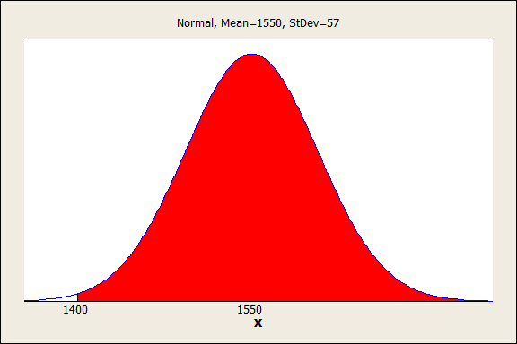
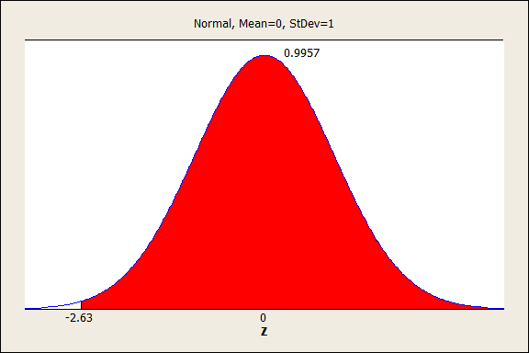
What is the probability that a randomly selected GE Crystal Clear 60-watt light bulb will last longer than 1400 hours?

Slide 29
The examples above are situations where you are trying to find the probability (or proportion).
There are occasions where you are given the probability and you want to find what z (and in turn what x) corresponds to the probability given.
In these situations you need to work backwards – looking in the table for z’s rather than probs.

Slide 30
Example – Refer to our Wendy’s example from above (mean = 138.5 seconds, standard deviation = 29 seconds). Suppose that Wendy’s wants to institute a policy at its restaurants that it will not charge any patron that must wait more than a certain amount of time for an order. Management does not want to give away free meals to more than 1% of the patrons. What time would you recommend Wendy’s advertise as the maximum wait time before a free meal is awarded?

Slide 31
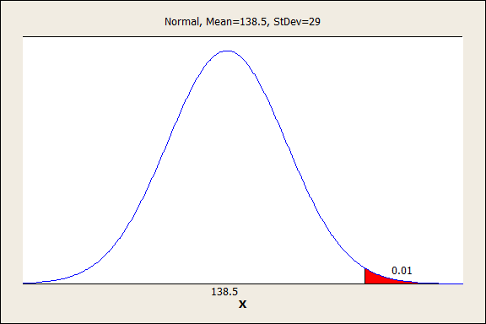
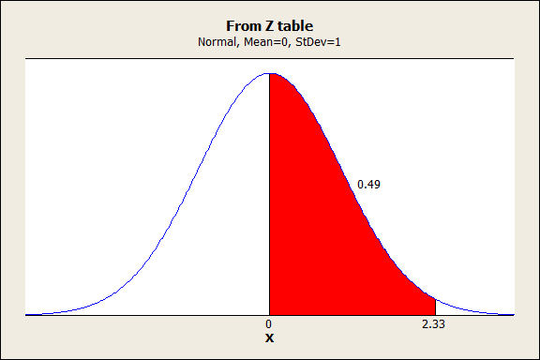
Management does not want to give away free meals to more than 1% of the patrons. What time would you recommend Wendy’s advertise as the maximum wait time before a free meal is awarded?

Slide 32
Example – The number of chocolate chips in an 18-ounce bag of Chips Ahoy! chocolate cookies is approximately normally distributed, with a mean of 1262 chips and a standard deviation of 118 chips, according to a study by cadets of the US Air Force Academy.

Slide 33
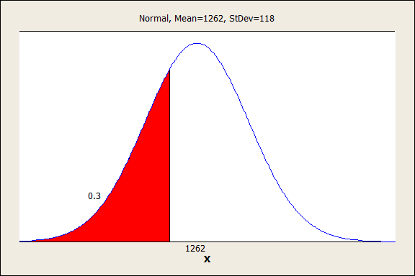
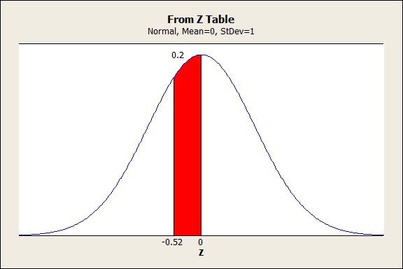
Determine the 30th percentile for the number of chocolate chips in an 8-ounce bag of Chips Ahoy! cookies

Slide 34
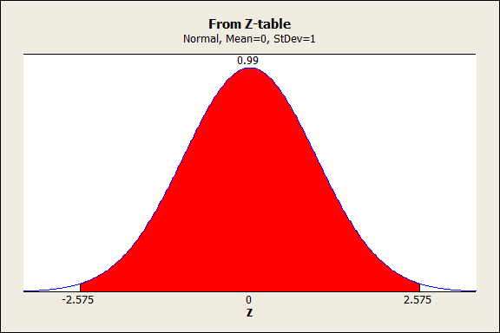
Determine the number of chocolate chips in a bag of Chips Ahoy! that make up the middle 99% of bags.

Slide 35
Descriptive measures for assessing normality
Section 4.7

Slide 36
Determining Whether the Data are from an Approximately Normal Distribution
Construct either a histogram or stem-and-leaf display for the data and note the shape of the graph. If the data are approximately normal, the shape of the histogram or stem-and-leaf display will be similar to the normal curve (mound shape and symmetric).
Compute the intervals and determine the percentage of measurements falling in each. If the data are approximately normal, the percentages will be approximately equal to 68%, 95%, and 100% respectively.
Find the interquartile range, IQR, and standard, s, for the sample, then calculate the ration IQR/s. If the data are approximately normal, then IQR/s ≈ 1.3.
Examine a normal probability plot for the data. If the data are approximately normal, the points will fall (approximately) on a straight line.

Slide 37
Recommendations
Do at least 2 of the previous checks
These checks form normality are all descriptive measures. It is possible that a set of data passes all 4 of the criteria above and the population is not actually normal (it is unlikely but possible) therefore it is important that we claim the data is approximately normal

Slide 38
Example – Wear-out failure time of electronic components is often assumed to have a normal distribution. Can the normal distribution be applied to the wear-out of used manufactured products, such as colored display panels? A lot of 50 used display panels was purchased by an outlet store. Each panel displays 12 to 18 color characters. Prior to acquisition, the panels had been used for about one-third of their expected lifetimes. The data is saved in the PANELFILE file gives the failure times (in years) of the 50 used panels. Use the techniques of this section to determine whether the used panel wear-out times are approximately normally distributed.

Slide 39
Example – To minimize the potential for gastrointestinal disease outbreaks, all passenger cruise ships arriving at US ports are subject to unannounced sanitation inspections. Ships are rated on a 100-point scale by the Centers for Disease Control and Prevention. A score of 86 or higher indicates that the ship is providing an accepted standard of sanitation. The latest sanitation scores for 183 cruise ships are saved in the SHIPSANIT file. Assess whether the sanitation scores are approximately normally distributed.

Slide 40
Other Continuous Distributions: Uniform and Exponential
Section 4.9

Slide 41
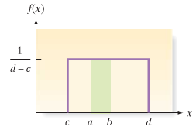
Probability Density Function: Uniform

Slide 42
How to find Uniform Probabilities?

Slide 43
Uniform: Mean & Standard Deviation

Slide 44
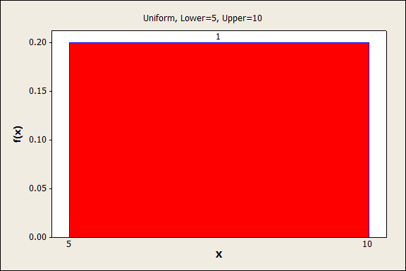
Example - The reaction time X (in minutes) of a certain chemical process follows a uniform probability distribution with 5 ≤ X ≤ 10.
a. Draw a graph of the density curve

Slide 45
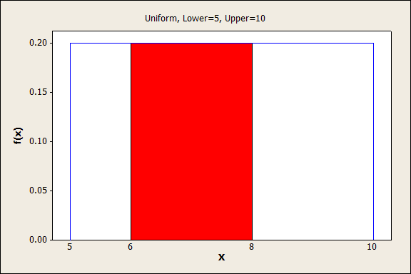
Example - The reaction time X (in minutes) of a certain chemical process follows a uniform probability distribution with 5 ≤ X ≤ 10.
b. What is the probability that the reaction time is between 6 and 8 minutes?

Slide 46
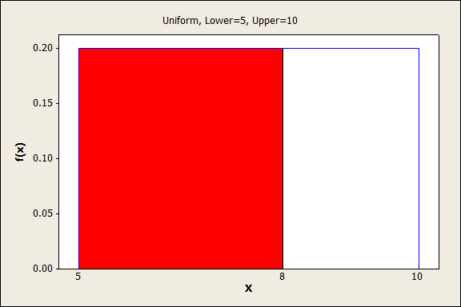
Example - The reaction time X (in minutes) of a certain chemical process follows a uniform probability distribution with 5 ≤ X ≤ 10.
c. What is the probability that the reaction time is between 5 and 8 minutes?

Slide 47
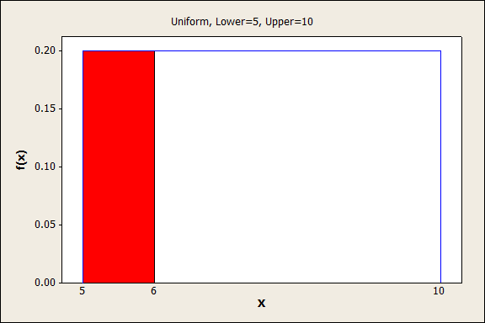
Example - The reaction time X (in minutes) of a certain chemical process follows a uniform probability distribution with 5 ≤ X ≤ 10.
d. What is the probability that the reaction time is less than 6 minutes?

Slide 48
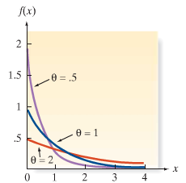
Probability Density Function: Exponential (Waiting-Time)

Slide 49
How to find Exponential Probabilities?

Slide 50
Exponential: Mean and Standard Deviation

Slide 51
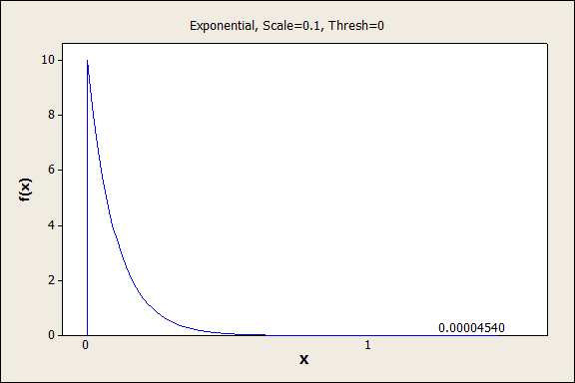
Example – In NASCAR races such as the Daytona 500, 43 drivers start the race; however, about 10% of the cars do not finish due to the failure of critical parts. University of Portland professors conducted a study of critical-part failures from 36 NASCAR races. The researchers discovered that the time (in hours) until the first critical-part failure is exponentially distributed with a mean of .10 hour.
a. Find the probability that the time until the first critical part failure is 1 hour or more

Slide 52
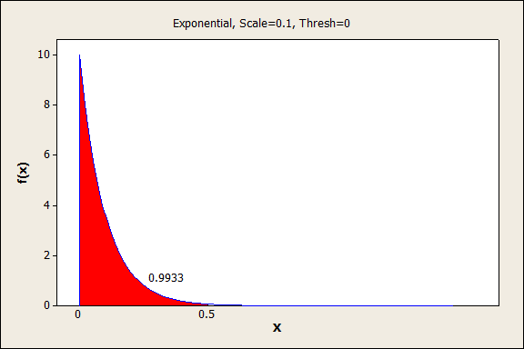
b. Find the probability that the time until the first critical part failure is less than 30 minutes.

Slide 53
Sampling Distribution
Section 4.10

Slide 54
Now to Inference….
We are now to the inferential statistics part of our course.
Before we can start inferring the values of population parameters we should ask ourselves which sample statistic am I going to use to get an estimate of my population parameter.

Slide 55
Book Example
Toss a fair die and let x equal the number of dots showing on the up face.

Slide 56
Why does this happen?
This happens because both $\overline{x}$and m are themselves random variables.
Let’s do an example using Excel…..

Slide 57
Sampling Distribution
The Sampling Distribution of a sample statistic ($\overline{x} , m, \hat{p}$) calculated from a sample of n measurements is the probability distribution of the statistic.

Slide 58
Which do we choose?
If two statistics A and B have sampling distributions as shown below which would you choose? Why?

Slide 59
Sampling Distribution of Sample Mean
Population Mean of Sample Means
Population Standard Deviation of Sample Means
Often referred to as standard error of the mean

Slide 60
What is the distribution?
1. If a random sample of n observations is selected from a population with a normal distribution, the sampling distribution of will be a normal distribution (in other words – if the population was normal the sampling distribution of is also normal)
$$X\sim Normal\left(μ_{x},σ_{x}\right)→\overline{X}\sim Normal(μ_{\overline{x}},σ_{\overline{x}})$$

Slide 61
What is the distribution?
2. If a random sample of n observations is selected from a population (any population) with mean μ and standard deviation of σ. Then, when n is sufficiently large, the sampling distribution of will be approximately a normal distribution (this is the CENTRAL LIMIT THEOREM)
$$X\sim ?\left(μ_{x},σ_{x}\right)→if n≥30→\overline{X}\sim Normal(μ_{\overline{x}},σ_{\overline{x}})$$
The larger the sample size (n) the better will be the normal approximation

Slide 62
Applet
http://media.pearsoncmg.com/ph/esm/esm_mcclave_msb11e_11/applets/sampledist.html

Slide 63
Example – The most famous geyser in the world, Old Faithful in Yellowstone National Park, has a mean time between eruptions of 85 minutes. If the interval of time between eruptions is normally distributed with standard deviation 21.25 minutes answer the following questions:
a. What is the probability that a randomly selected time interval between eruptions is longer than 95 minutes?

Slide 64
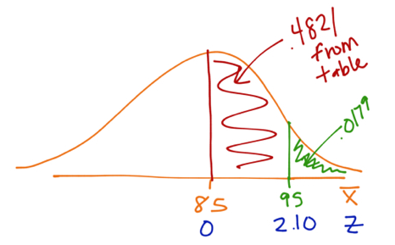
b. What is the probability that a random sample of 20 time intervals between eruptions has a mean longer than 95 minutes?

Slide 65
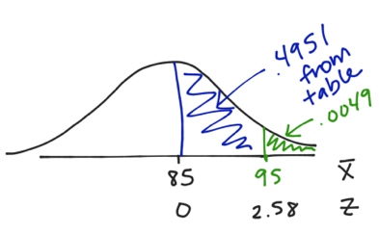
c. What is the probability that a random sample of 30 time intervals between eruptions has a mean longer than 95 minutes?

Slide 66
Old Faithful
http://www.nps.gov/features/yell/live/live4.htm

Slide 67
Example- The shape of the distribution of the time required to get an oil change at a 10-minute oil-change facility is unknown. However, records indicate that the mean time for an oil-change is 11.4 minutes and the standard deviation for oil-change time is 3.2 minutes.
a. To compute probabilities regarding the sample mean using the normal model, what size sample would be required?
n ≥ 30

Slide 68
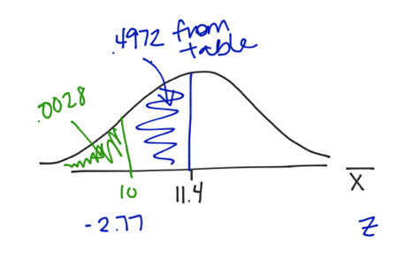
b. What is the probability that a random sample of n = 40 oil changes results in a sample mean times of less than 10 minutes?

Slide 69
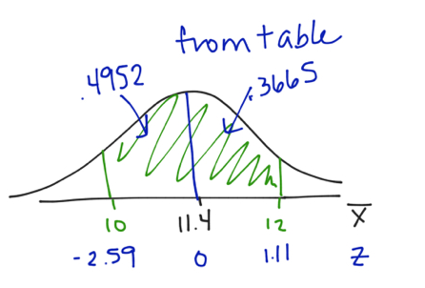
c. What is the probability that a random sample of n = 35 oil changes results in a sample mean time between 10 and 12 minutes?

