Slide 1
Chapter 10
Simple Linear Regression

Slide 2
Simple Linear Regression
Chapter 10 introduces inference about a response variable from an explanatory variable.
It is possible to perform this same type of analysis with multiple explanatory variables which you will see in Chapter 11 in MGT 310.
Rather than break down this Chapter into sections I will break down the Chapter into steps to perfrom a simple linear regression.

Slide 3
TWO Quantitative Variables
When you have two quantitative variables often you would like to know if how these two variables are related or associated.
If you determine that the two quantitative variables are linearly associated it is appropriate to fit a line to the data.
Once a line has been fit you can then plug in any value of the explanatory variable to predict what the response variable will be.

Slide 4
For Example: A nation job placement company is interested in developing a model that might be used to explain the variation in starting salaries for college graduates based on the college GPA. The following data were collected through a random sample of the clients with which this company has been associated.
GPA | Starting Salary
3.20 | $35,000
3.40 | $29,500
2.90 | $30,000
3.60 | $36,400
2.80 | $31,500
2.50 | $29,000
3.00 | $33,200
3.60 | $37,600
2.90 | $32,000
3.50 | $36,000

Slide 5
Other Examples
Example: College GPA and high school GPA
Example: Test 3 Score and Test 4 Score
Example: Mother’s heights and daughter’s heights

Slide 6
Before we begin looking a simple linear regression let’s review from your previous math courses what the equation for a line looks like.
Recall:
Where m is the slope and b is the y-intercept
The concept covered in this Chapter fits a line to data with one response and one explanatory variable, then uses hypothesis testing to determine if the fit line can be used to predict values of the response variable.
$$y=mx+b$$

Slide 8
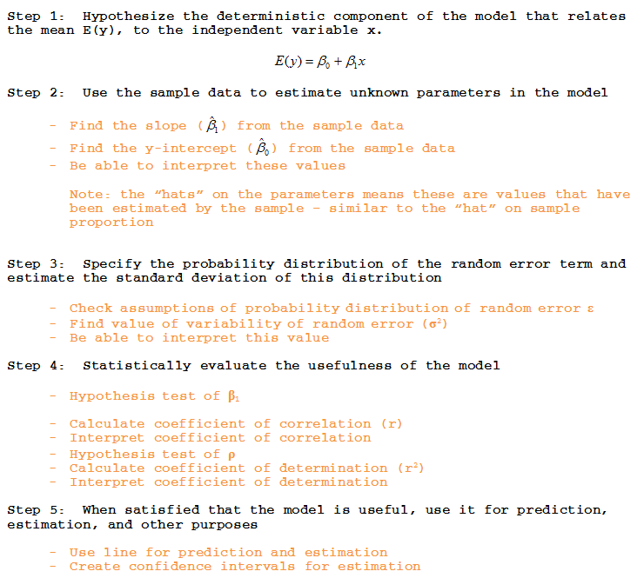
Step-by-Step Process

Slide 9
EXAMPLE: For simplicity purposes we are going to use an example without any units
x | 3 | 1 | 3 | 5
y | 5 | 8 | 6 | 4

Slide 10
Step 1: Hypothesize the deterministic component of the model that relates the mean E(y), to the independent variable x.
We are considering only straight lines with one explanatory variable therefore the model in this Chapter will always be…

Slide 11
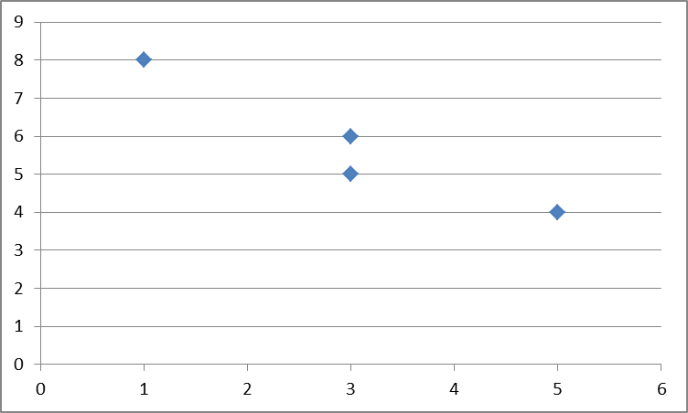
Step 2: Use the sample data to estimate unknown parameters in the model
1. Plot the data to a scattergram (or scatterplot)
Determine whether fitting a line to the data seems appropriate based on the graph. (Note: not all data points will fall EXACTLY on line – it is an approximation)

Slide 12
Step 2: Use the sample data to estimate unknown parameters in the model
Errors of prediction (ε) – deviations from the fitted prediction line
GOAL: To fit a line that minimizes the errors of prediction

Slide 13
Step 2: Use the sample data to estimate unknown parameters in the model
The line that minimizes these errors is called:
Least squares line
Least squares regression line
Regression line
Least square prediction line
The methodology used to obtain this line is called the method of least squares.

Slide 14
Step 2: Use the sample data to estimate unknown parameters in the model
Recall – We are finding the EQUATION for the line that best fits the sample data (to estimate the line for the population)
2. Find the slope $\hat{β_{1}}$ from the sample data

Slide 15
Step 2: Use the sample data to estimate unknown parameters in the model
x | y | $$x_{i}−\overline{x}$$ | $$y_{i}−\overline{y}$$ | $$\left(x_{i}−\overline{x}\right)\left(y_{i}−\overline{y}\right)$$ | $${\left(x_{i}−\overline{x}\right)}^{2}$$ | $$xy$$ | $$x^{2}$$ | $$y^{2}$$
3 | 5
1 | 8
3 | 6
5 | 4
x | y | $$x_{i}−\overline{x}$$ | $$y_{i}−\overline{y}$$ | $$\left(x_{i}−\overline{x}\right)\left(y_{i}−\overline{y}\right)$$ | $${\left(x_{i}−\overline{x}\right)}^{2}$$ | $$xy$$ | $$x^{2}$$ | $$y^{2}$$
3 | 5 | 0 | -0.75 | 0 | 0 | 15 | 9 | 25
1 | 8 | -2 | 2.25 | -4.5 | 4 | 8 | 1 | 64
3 | 6 | 0 | 0.25 | 0 | 0 | 18 | 9 | 36
5 | 4 | 2 | -1.75 | -3.5 | 4 | 20 | 25 | 16
12 | 23 | 0 | 0 | -8 | 8 | 61 | 44 | 141

Slide 16
Step 2: Use the sample data to estimate unknown parameters in the model
3. Find the y – intercept $\left({\hat{β}}_{0}\right)$ from the sample
x | y | $$xy$$ | $$x^{2}$$ | $$y^{2}$$
3 | 5 | 15 | 9 | 25
1 | 8 | 8 | 1 | 64
3 | 6 | 18 | 9 | 36
5 | 4 | 20 | 25 | 16
12 | 23 | 61 | 44 | 141

Slide 17
Step 2: Use the sample data to estimate unknown parameters in the model
4. Be able to interpret these values
y-intercept: the line crosses the y-axis at 8.75
Slope: For every 1 unit increase in x there is a 1 unit decrease in y

Slide 18
Step 3: Specify the probability distribution of the random error term and estimate the standard deviation of this distribution
Know the assumptions needed for the probability distribution of the random error ε
Assumption 1: The mean of the probability distribution of ε is 0
– that is, the average of the values of ε over an infinitely long series of experiments is 0 for each setting of the independent variable x. This assumption implies that the mean value of y, E(y), for a given value of x is

Slide 19
Step 3: Specify the probability distribution of the random error term and estimate the standard deviation of this distribution
Know the assumptions needed for the probability distribution of the random error ε
Assumption 2: The variance of the probability distribution of ε is constant for all setting of the independent variable x.
For our straight line model, this assumption means that the variance of ε is equal to a constant, say σ², for all values of x. (We will estimate this by s²)

Slide 20
Step 3: Specify the probability distribution of the random error term and estimate the standard deviation of this distribution
Know the assumptions needed for the probability distribution of the random error ε
Assumption 3: The probability distribution of ε is normal.

Slide 21
Step 3: Specify the probability distribution of the random error term and estimate the standard deviation of this distribution
Know the assumptions needed for the probability distribution of the random error ε
Assumption 4: The values of ε associated with any two observed values of y are independent
– that is, the value of ε associated with one value of y has no effect on the values of ε associated with other y values.

Slide 22
Step 3: Specify the probability distribution of the random error term and estimate the standard deviation of this distribution
Recall Assumption 3 – that ε’s have a constant variance – know how to estimate this value with s² (variability of random error term)

Slide 23
Step 3: Specify the probability distribution of the random error term and estimate the standard deviation of this distribution
$$s=\sqrt{s^{2}}=\sqrt{\frac{SSE}{n−2}}$$
$$SSE= {SS}_{yy}−{\hat{β}}_{1}{SS}_{xy}$$
x | y | $$xy$$ | $$x^{2}$$ | $$y^{2}$$
3 | 5 | 15 | 9 | 25
1 | 8 | 8 | 1 | 64
3 | 6 | 18 | 9 | 36
5 | 4 | 20 | 25 | 16
12 | 23 | 61 | 44 | 141

Slide 24
Step 3: Specify the probability distribution of the random error term and estimate the standard deviation of this distribution
Be able to interpret this estimation of the standard deviation of the random error (in context of the problem)
We expect approximately 95% of the observed values of y to lie within 2(0.6124) = 1.2247 of their respective least squares predicted values of, $\hat{y}$.

Slide 25
Step 4: Assess Model Adequacy
Evaluate Statistical Usefulness of Model
Hypothesis Test of $β_{1}$

Slide 26
Step 4: Assess Model Adequacy
Hypotheses:
One Tailed Test:
Two Tailed Test:

Slide 27
Step 4: Assess Model Adequacy
Assumptions: (same for assumptions as Step 3)
ε’s have mean of 0
ε’s have constant variance
ε’s are normally distributed
ε’s are independent

Slide 28
Step 4: Assess Model Adequacy
Test Statistic:

Slide 29
Step 4: Assess Model Adequacy
Rejection Region:
One-tailed:
t<-t_{α} when (or t>t_{α} when )
Two-tailed:
|t| > t_{α/2}
t_{α} and t_{α/2} based on (n-2) degrees of freedom

Slide 30
Step 4: Assess Model Adequacy
Summary:
If test statistic falls in rejection region OR p-value < α
At the ___% significance level, my test statistic (t = ___) falls in the rejection region (or my p-value (_____) < α) therefore, I reject my null hypothesis. The data provides sufficient evidence to support that the slope of the line is (greater than, less than or different from) 0.
If test statistic does not fall in rejection region OR p-value > α
At the ___% significance level, my test statistic (t = ___) does not fall in the rejection region (or my p-value (______) > α) therefore, I do not reject my null hypothesis. The data provides insufficient evidence to support that the slope of the line is (greater than, less than or different from) 0.

Slide 31
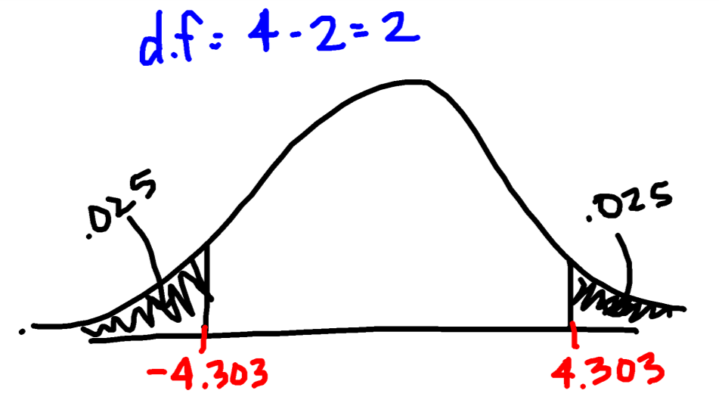
Perform a two-tailed Hypothesis test for slope (using α = 0.05)
H₀: β₁ = 0
H_{A}: β₁ ≠ 0
Where β₁ is the slope of the least squares regression equation for the population of x and y
Assumptions
ε’s have a mean of 0
ε’s have constant variance
ε’s are normally distributed
ε’s are independent
Rejection Region:
Test Statistic:

Slide 32
At the 5% significance level the test statistic (t = -4.619) falls in the rejection region therefore, I reject the null hypothesis.
There is sufficient evidence to support the slope of the population data is different from 0.

Slide 33
Step 4: Assess Model Adequacy
Calculate coefficient of correlation (r)
x | y | $$xy$$ | $$x^{2}$$ | $$y^{2}$$
3 | 5 | 15 | 9 | 25
1 | 8 | 8 | 1 | 64
3 | 6 | 18 | 9 | 36
5 | 4 | 20 | 25 | 16
12 | 23 | 61 | 44 | 141

Slide 34
Step 4: Assess Model Adequacy
Interpret coefficient of correlation
There is a strong negative linear relationship between x and y

Slide 35
Step 4: Assess Model Adequacy
Calculate coefficient of determination (r²)

Slide 36
Step 4: Assess Model Adequacy
Interpret coefficient of determination (r²)

Slide 37
Step 4: Assess Model Adequacy
Interpret coefficient of determination (r²)
About 91.43% of the variation in the sample of y can be explained by using x to predict y in our model

Slide 38
Step 5: When satisfied that model is useful, use it for prediction, estimation, and other purposes.
How do we know model is useful?
Statistically Useful if:
Reject H₀ in hypothesis test for slope
Practically Useful if:
2s is “small” (relative to values of y)
r² is “large”

Slide 39
Step 5: When satisfied that model is useful, use it for prediction, estimation, and other purposes.
Use line for prediction and estimation
Plug in value of x into equation to predict y at that level
(Note: it is only appropriate to plug in value that are x-values used in the scope of the problem)
Example – What is the predicted value of y when x is 4

Slide 40
Step 5: When satisfied that model is useful, use it for prediction, estimation, and other purposes.
Create and interpret confidence intervals for estimation

Slide 41
Step 5: When satisfied that model is useful, use it for prediction, estimation, and other purposes.
Example – Create a confidence interval for the prediction at x = 4

Slide 42
Now On DDXL
Simple Linear Regression

