Slide 1
Chapter 2b

Slide 2
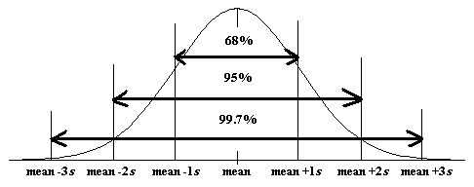
Empirical Rule
IF HISTOGRAM IS BELL SHAPED
Approximately 68% of all observations fall within one standard deviation of the mean.
Approximately 95% of all observations fall within two standard deviations of the mean
Approximately 99.7% of all observations fall within three standard deviations of the mean

Slide 3
The height of male students at Clemson is approximately normally distributed (bell shaped) with a mean of 71 inches and standard deviation of 2.5 inches.
a) What percent of the male students are shorter than 66 inches?
b) Taller than 73.5 inches?
c) Between 66 & 73.5 inches?

Slide 4
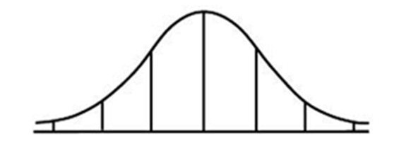
The height of male students at Clemson is approximately normally distributed (bell shaped) with a mean of 71 inches and standard deviation of 2.5 inches.
a) What percent of the male students are shorter than 66 inches?
95%
2.5%
2.5%
66
71
66 is 2 standard deviations below 71

Slide 5
The height of male students at Clemson is approximately normally distributed (bell shaped) with a mean of 71 inches and standard deviation of 2.5 inches.
b) Taller than 73.5 inches?
68%
16%
71
73.5
73.5 is 1 standard deviation above 71

Slide 6
The height of male students at Clemson is approximately normally distributed (bell shaped) with a mean of 71 inches and standard deviation of 2.5 inches.
c) Between 66 & 73.5 inches?
95%
68%
34%
34%
47.5%
47.5%
66
71
73.5

Slide 7
Example
Given a data set comprised of 4037 measurements that is bell-shaped with a mean of 256. If 99.7% of the data lies between -26 and 538 then what is the standard deviation?

Slide 8
Given a data set comprised of 4037 measurements that is bell-shaped with a mean of 256. If 99.7% of the data lies between -26 and 538 then what is the standard deviation?
26
256
538

Slide 9
ChebyShev’s Rule
Applies to data of ANY shape (including bell shaped and symmetric)
No useful information is provided on the fraction of measurements that fall within 1 standard deviation of the mean
Generally, for any number of k (>1), at least
of the measurements will fall within k standard deviations of the of the mean

Slide 10
Example
For any data set, what percentage of the data should lie within 2 standard deviations of the mean?

Slide 11
Example
Consider the sample data:
41 44 45 47 48 51 53 58 66
What exact percentage of this data lies within 2 standard deviations of the mean?
Consider the sample data:
41 44 45 47 48 51 53 58 66
What exact percentage of this data lies within 2 standard deviations of the mean?
Note: Right skewed

Slide 12
Example
Consider the sample data:
20 37 48 48 49 50 53 61 64 70
What exact percentage of this data lies within 2 standard deviations of the mean?
Consider the sample data:
20 37 48 48 49 50 53 61 64 70
What exact percentage of this data lies within 2 standard deviations of the mean?
Note: Left skewed

Slide 13
Example
For any data set, what percentage of the data should lie within 3 standard deviations of the mean?

Slide 14
Example
Consider the data:
41 44 45 47 48 51 53 58 66
What percentage of the data lies within 3 standard deviations of the mean?

Slide 15
Example
Consider the data:
20 37 48 48 49 50 53 61 64 70
What percentage of the data lies within 3 standard deviations of the mean?

Slide 16
Note:
We know from both the Empirical and Chebyshev’s rules that most of the measurements from a data set will be within 2 standard deviations from the mean and that most all of the measurements from a data set will be within 3 standard deviations from the mean. Consequently, we would expect the range of the measurements to be between 4 and 6 standard deviations in length.
(sometimes in exercises and examples your book uses range/4 as a crude approximation for s.)

Slide 17
Approximation for sample St. Dev.
Min
Mean
Max
Approx. 2 standard devs.
Approx. 2 standard devs.

Slide 18
Measures of Position

Slide 19
Measures of Position
Percentiles
Quartiles
Z-scores

Slide 20
Percentiles
The pth percentile is the value such that p percent of the observations fall below or at that value
3 5 6 8 9 9 10 13 15 18 23 23 27 28 29 32 34 36 36 37
20%
80%
8 = 20th percentile
n = 20

Slide 21
Quartiles
Splits data into quarters (fourths)
First quartile = 25th percentile
Second quartile = 50th percentile
Third quartile = 75th percentile

Slide 22
Finding Quartiles
Arrange data in order
Consider the median (the midpoint). That is the second quartile, Q2
Consider the lower half of the observations. The median of these observations is the first quartile, Q1.
Consider the upper half of observations. Their median is the third quartile, Q3
Note: When using technology, different devices use different methods for finding quartiles.

Slide 23
Simple Example
Suppose a personnel manager has hired 10 new employees. The ages of each of these employees sorted from low to high is listed as follows:
23 25 25 34 35 45 46 47 52 54
Q1 = 25
Median = 40
Q3 = 47
n = 10
Median = average of 35 and 45 = 40
Median of all value less than 40 = 25 = Q1 or 25th percentile
Median of all value greater than 40 = 47 = Q3 or 75th percentile

Slide 24
Interquartile Range
IQR = Q3 – Q1
Measure of spread
Resistant statistic

Slide 25
Five Number Summary
Min
Q1
Median
Q3
Max

Slide 26
A report from the U.S. Department of Justice gave the following percent increase in federal prison populations in 20 northeastern & mid-western states in 1999.
5.9 1.3 5.0 5.9 4.5 5.6 4.1 6.3 4.8 6.9
4.5 3.5 7.2 6.4 5.5 5.3 8.0 4.4 7.2 3.2
Find the Five Number Summary.
Min = 1.3 Q1 = 4.45 Med = 5.4 Q3 = 6.35 Max = 8

Slide 27
Boxplots
Why use them?
ease of construction
convenient handling of outliers
construction is not subjective (like histograms)
Used with medium or large size data sets (n > 10)
useful for comparative displays

Slide 28
Disadvantage of boxplots
does not retain the individual observations
should not be used with small data sets (n < 10)

Slide 29
How to construct
find five-number summary
  Min Q1 Med Q3 Max
draw box from Q1 to Q3
draw median as center line in the box
Calculate Fences
whiskers extend to largest (smallest) data value inside the fence
Mark outliers with an asterisk

Slide 30
Fences (or bounds)
Interquartile Range (IQR) – is the range (length) of the box
Q3 - Q1
Q1 – 1.5IQR
Q3 + 1.5IQR
Any observation outside this fence is an outlier! Put a dot for the potential outliers.

Slide 31
Boxplot . . .
Draw the “whisker” from the quartiles to the observation that is within the fence!

Slide 32
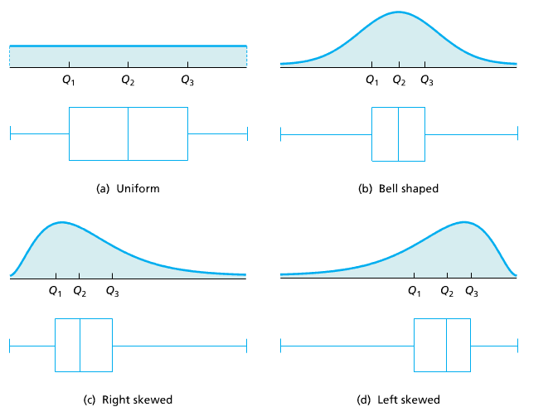
Shape of Boxplots

Slide 33
A report from the U.S. Department of Justice gave the following percent increase in federal prison populations in 20 northeastern & mid-western states in 1999.
5.9 1.3 5.0 5.9 4.5 5.6 4.1 6.3 4.8 6.9
4.5 3.5 7.2 6.4 5.5 5.3 8.0 4.4 7.2 3.2
Create a boxplot. Describe the distribution.
Step 1: Order observations and find 5 number summary:
1.3 3.2 3.5 4.1 4.4 4.5 4.5 4.8 5 5.3
5.5 5.6 5.9 5.9 6.3 6.4 6.9 7.2 7.2 8
Minimum = 1.3
Q1 = 4.45
Median = 5.4
Q3 = 6.35
Maximum = 8

Slide 34
A report from the U.S. Department of Justice gave the following percent increase in federal prison populations in 20 northeastern & mid-western states in 1999.
1.3 3.2 3.5 4.1 4.4 4.5 4.5 4.8 5 5.3
5.5 5.6 5.9 5.9 6.3 6.4 6.9 7.2 7.2 8
Step 2: draw box from Q1 to Q3
Step 3: draw median as center line in the box
Minimum = 1.3
Q1 = 4.45
Median = 5.4
Q3 = 6.35
Maximum = 8
1
2
3
4
5
6
7
8
9

Slide 35
A report from the U.S. Department of Justice gave the following percent increase in federal prison populations in 20 northeastern & mid-western states in 1999.
1.3 3.2 3.5 4.1 4.4 4.5 4.5 4.8 5 5.3
5.5 5.6 5.9 5.9 6.3 6.4 6.9 7.2 7.2 8
Step 4: Calculate Fences
Minimum = 1.3
Q1 = 4.45
Median = 5.4
Q3 = 6.35
Maximum = 8
Lower Fence = Q1 – 1.5(IQR) = 4.45 – 1.5(1.9) = 1.6
Upper Fence = Q3 + 1.5(IQR) = 6.35 + 1.5(1.9) = 9.2
1
2
3
4
5
6
7
8
9

Slide 36
A report from the U.S. Department of Justice gave the following percent increase in federal prison populations in 20 northeastern & mid-western states in 1999.
1.3 3.2 3.5 4.1 4.4 4.5 4.5 4.8 5 5.3
5.5 5.6 5.9 5.9 6.3 6.4 6.9 7.2 7.2 8
Step 5: whiskers extend to largest (smallest) data value inside the fence
Step 6: Mark outliers with an asterisk
Minimum = 1.3
Q1 = 4.45
Median = 5.4
Q3 = 6.35
Maximum = 8
Notice the Lower and Upper Fences
DO NOT appear on Boxplot Graph
Lower Fence = 1.6
Upper Fence = 9.2
*
1
2
3
4
5
6
7
8
9

Slide 37
When describing graphs
Center
Shape
Spread

Slide 38
Cancer
No Cancer
100
200
Radon
The median radon concentration for the no cancer group is lower than the median for the cancer group. The range of the cancer group is larger than the range for the no cancer group. Both distributions are skewed right. The cancer group has outliers at 39, 45, 57, and 210. The no cancer group has outliers at 55 and 85.

Slide 39
Z-score
In a bell shaped distribution a potential outlier is more than 3 standard deviations from the mean.
Z-score measures the number of standard deviations from the mean

Slide 40
Example
If and inches, what is the z-score for the observation of 19.4?
19.4 is 3.4 standard deviations above the mean

Slide 41
Example
Ellen is taking Math and English. On her first test in English she scored a 78. The mean of her English class was 74 and the standard deviation was 5. On her first test in Math she scored a 91. The mean of her Math class was 89 and the standard deviation was 6.
What is the z-score for her English score?

Slide 42
Example
Ellen is taking Math and English. On her first test in English she scored a 78. The mean of her English class was 74 and the standard deviation was 5. On her first test in Math she scored a 91. The mean of her Math class was 89 and the standard deviation was 6.
What is the z-score for her Math score?

Slide 43
Example
Ellen is taking Math and English. On her first test in English she scored a 78. The mean of her English class was 74 and the standard deviation was 5. On her first test in Math she scored a 91. The mean of her Math class was 89 and the standard deviation was 6.
Which class is she doing better in relative to the rest of her class?

Slide 44
Graphical misuses

Slide 45
Guidelines for Constructing Effective Graphs
Label both axes and provide a heading
The vertical axis should start at 0.
Be cautious in using figures
Be cautious of comparing more than one group on a single graph

Slide 46
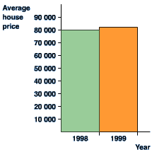
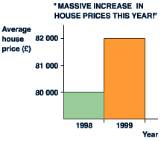
Beware of tricky graphs
What it should look like…
Y-axis does not start at zero

Slide 47
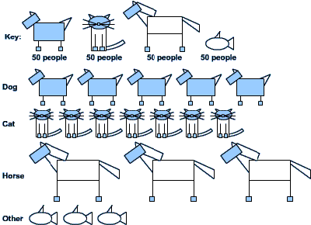
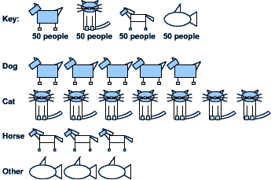
Beware of Tricky Graphs
Incorrect graph
What the graph should be…

Slide 48
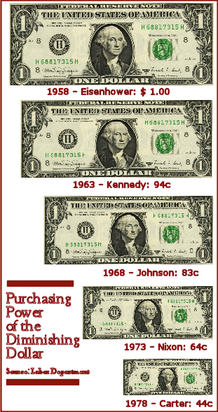
Beware of Tricky Graphs
Can you tell what is wrong with this graph?
The dollars were reduced in both dimensions making the 1978 dollar look 1/6 the size of the 1958 dollar when that is not the case….

Slide 49
Time Plots
Data collected over time is called a time series
Use a time plot to display time series data
Look for trends (rise, fall, etc.)
Example: DOW Jones Industrial Average (1900-Present Monthly)

Slide 50
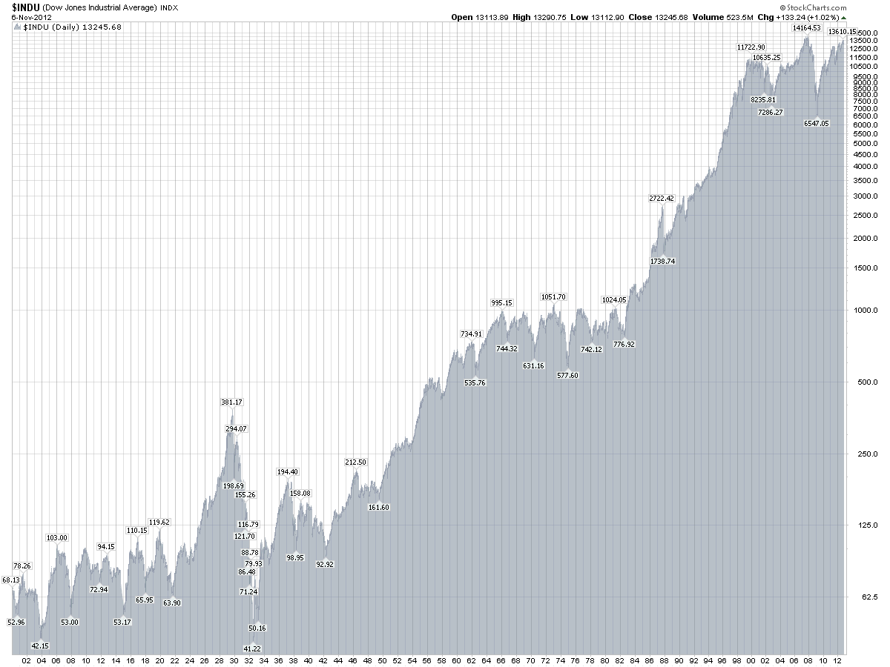
Time Plots
http://stockcharts.com/freecharts/historical/djia1900.html

