Slide 1
Chapter 3
Probability

Slide 2
Experiment
An act or process of observation that leads to a single outcome that cannot be predicted with certainty
OR
The process that produces outcomes
For business this can range from
an investment decision to
a personnel decision to
a choice of a warehouse

Slide 3
Examples of Experiments
Observe the up face on a coin
Draw two marbles at random from a bag of black and red marbles
Invest a stock
Select an individual at random and observe their shoe size
Shoot 5 free throws

Slide 4
Sample Point
The most basic outcome of an experiment
Examples: (each individual outcome is a sample point)
Observe the up face on a coin
Head, tail
Draw two marbles at random
Red/Red, Red/Black, Black/Black
Invest a stock
Stock increases, stock decreases, stock remains same
Select an individual at random and observe their shoe size
…5,6,7,8,9,10,11,12,13,14,….
Shoot 5 free throws (M = made it, X = missed it)
MXXXX, XMXXX, MMXXX, XXMXX, …

Slide 5
Sample Space
The Collection of all sample points of an experiment
Examples: (entire collection of each is sample space)
Observe the up face on a coin
Head, tail
Draw two marbles at random
Red/Red, Red/Black, Black/Black
Invest a stock
Stock increases, stock decreases, stock remains same
Select an individual at random and observe their shoe size
…5,6,7,8,9,10,11,12,13,14,….
Shoot 5 free throws (M = made it, X = missed it)
MXXXX, XMXXX, MMXXX, XXMXX, …

Slide 6
Probability Rules for Sample Points
Let p_{i} represent the probability of sample point i.
All sample point probabilities must lie between 0 and 1 (0 ≤ p_{i} ≤ 1)
The probabilites of all sample points within a sample space must sum to 1 ( ).

Slide 7
Events
Event - A specific collection of sample points.
Simple Event - on a single sample point
Compound Event – collection of two or more sample points

Slide 8
Examples
Observe the up face on a coin
A = coin comes up head (Simple Event)
Draw two marbles at random from a bag of black and red marbles
B = both marbles are red (Simple Event)
C = at least one marble is black (Compound Event)
Invest a stock
D = stock does not decrease (Compound Event)
Select an individual at random and observe their shoe size
E = shoe size larger than 12 (Compound Event)
Shoot 5 free throws
F = makes at least 3 free throws (Compound Event)
G = makes only 1 of the 5 free throws (Compound Event)
H = make only the first free throw (Simple Event)

Slide 9
Probability of an Event

Slide 10
Example: Olympic Medals
Country | Count
United States (U) | 104
China (C) | 88
Russia (R) | 82
Great Britain (GB) | 65
Other (O) | 623
TOTAL | 962
What is the probability a randomly selected medal is from United States?

Slide 11
Example: Olympic Medals
Country | Count
United States (U) | 104
China (C) | 88
Russia (R) | 82
Great Britain (GB) | 65
Other (O) | 623
TOTAL | 962
What is probability a randomly selected medal is from Russia or Great Britain?

Slide 12
Example: Olympic Medals
 | Gold (G) | Silver (S) | Bronze (B) | Total
United States (U) | 46 | 29 | 29 | 104
China (C) | 38 | 27 | 23 | 88
Russia (R) | 24 | 26 | 32 | 82
Great Britain (GB) | 29 | 17 | 19 | 65
Other (O) | 165 | 366 | 253 | 623
TOTAL | 302 | 304 | 356 | 962
What is the probability a randomly selected medal is gold?

Slide 13
Example: Olympic Medals
 | Gold (G) | Silver (S) | Bronze (B) | Total
United States (U) | 46 | 29 | 29 | 104
China (C) | 38 | 27 | 23 | 88
Russia (R) | 24 | 26 | 32 | 82
Great Britain (GB) | 29 | 17 | 19 | 65
Other (O) | 165 | 366 | 253 | 623
TOTAL | 302 | 304 | 356 | 962
What is the probability a randomly selected medal is won by Russia?

Slide 14
Example: Olympic Medals
 | Gold (G) | Silver (S) | Bronze (B) | Total
United States (U) | 46 | 29 | 29 | 104
China (C) | 38 | 27 | 23 | 88
Russia (R) | 24 | 26 | 32 | 82
Great Britain (GB) | 29 | 17 | 19 | 65
Other (O) | 165 | 366 | 253 | 623
TOTAL | 302 | 304 | 356 | 962
What is the probability a randomly selected was silver AND won by the United States

Slide 15
Example: Olympic Medals
 | Gold (G) | Silver (S) | Bronze (B) | Total
United States (U) | 46 | 29 | 29 | 104
China (C) | 38 | 27 | 23 | 88
Russia (R) | 24 | 26 | 32 | 82
Great Britain (GB) | 29 | 17 | 19 | 65
Other (O) | 165 | 366 | 253 | 623
TOTAL | 302 | 304 | 356 | 962
What is the probability a randomly selected medal is bronze or won by China?

Slide 16
Union
If either A or B or both occurs on a single performance of the experiment
 | Gold (G) | Silver (S) | Bronze (B) | Total
United States (U) | 46 | 29 | 29 | 104
China (C) | 38 | 27 | 23 | 88
Russia (R) | 24 | 26 | 32 | 82
Great Britain (GB) | 29 | 17 | 19 | 65
Other (O) | 165 | 366 | 253 | 623
TOTAL | 302 | 304 | 356 | 962
What is probability a randomly selected medal is from Russia or Great Britain?
What is the probability a randomly selected medal is bronze or won by China?

Slide 17
Intersection
If both events A and B occur on a single performance of the experiment
 | Gold (G) | Silver (S) | Bronze (B) | Total
United States (U) | 46 | 29 | 29 | 104
China (C) | 38 | 27 | 23 | 88
Russia (R) | 24 | 26 | 32 | 82
Great Britain (GB) | 29 | 17 | 19 | 65
Other (O) | 165 | 366 | 253 | 623
TOTAL | 302 | 304 | 356 | 962
What is the probability a randomly selected was silver AND won by the United States

Slide 18
Additive Rule of Probability
What is the probability a randomly selected medal is bronze or won by China?
Previous Method
 | Gold (G) | Silver (S) | Bronze (B) | Total
United States (U) | 46 | 29 | 29 | 104
China (C) | 38 | 27 | 23 | 88
Russia (R) | 24 | 26 | 32 | 82
Great Britain (GB) | 29 | 17 | 19 | 65
Other (O) | 165 | 366 | 253 | 623
TOTAL | 302 | 304 | 356 | 962
Additive Rule

Slide 19
Mutually Exclusive
If A∩B contains no sample points – that is A and B have no points in common
 | Gold (G) | Silver (S) | Bronze (B) | Total
United States (U) | 46 | 29 | 29 | 104
China (C) | 38 | 27 | 23 | 88
Russia (R) | 24 | 26 | 32 | 82
Great Britain (GB) | 29 | 17 | 19 | 65
Other (O) | 165 | 366 | 253 | 623
TOTAL | 302 | 304 | 356 | 962
Are the following pairs mutually exclusive events?
U and G
C and R
G and GB
G and S
O and U
No
Yes
No
Yes
Yes

Slide 20
Additive Rule for Mutually Exclusive Events
IF A and B are mutually exclusive THEN…
THEREFORE….
BECOMES…

Slide 21
Complement
The complement of an event A is the event that A does not occur – that is, the event consisting of all sample points that are not in event A.
Notation:
Example:
G = gold medal G^{C} = silver or bronze medal
U = won by US U^{C} = all other countries {China, Russia, Great Britain, and Other}

Slide 22
Complement Rule
If A is the complement of A^{c} then…

Slide 23
New Example
The table below shows the results of a survey of online video viewing by age.
 | Type of Videos Preferred
Viewer Age | User Created | TV
18-34 | 39 | 30 | 69
35-54 | 10 | 10 | 20
55+ | 3 | 8 | 11
 | 52 | 48 | 100
What is the probability that a viewer is aged 18-34?

Slide 24
New Example
The table below shows the results of a survey of online video viewing by age.
 | Type of Videos Preferred
Viewer Age | User Created | TV
18-34 | 39 | 30 | 69
35-54 | 10 | 10 | 20
55+ | 3 | 8 | 11
 | 52 | 48 | 100
What is the probability that a viewer prefers watching TV videos?

Slide 25
New Example
The table below shows the results of a survey of online video viewing by age.
 | Type of Videos Preferred
Viewer Age | User Created | TV
18-34 | 39 | 30 | 69
35-54 | 10 | 10 | 20
55+ | 3 | 8 | 11
 | 52 | 48 | 100
What is the probability of viewers who are 18-34 and prefer watching user-created videos?

Slide 26
New Example
The table below shows the results of a survey of online video viewing by age.
 | Type of Videos Preferred
Viewer Age | User Created | TV
18-34 | 39 | 30 | 69
35-54 | 10 | 10 | 20
55+ | 3 | 8 | 11
 | 52 | 48 | 100
What is the probability of viewers who are 35-54 or prefer user created videos (use addition rule)?

Slide 27
New Example
The table below shows the results of a survey of online video viewing by age.
 | Type of Videos Preferred
Viewer Age | User Created | TV
18-34 | 39 | 30 | 69
35-54 | 10 | 10 | 20
55+ | 3 | 8 | 11
 | 52 | 48 | 100
Are the following pairs of events mutually exclusive?
18-34 and 55+
User Created and 35-54
Below 54 and 55+
18-34 and Below 54
YES
YES
YES
NO

Slide 28
New Example
The table below shows the results of a survey of online video viewing by age.
 | Type of Videos Preferred
Viewer Age | User Created | TV
18-34 | 39 | 30 | 69
35-54 | 10 | 10 | 20
55+ | 3 | 8 | 11
 | 52 | 48 | 100
What is the complement of the following events?
A = User Created
B = 35 or older
C = 55+
D = User Created and Younger than 55
A^{c} = TV
B^{c} = 18-34
C^{c} = 54 or below
D^{c} = TV or (User Created and 55+)

Slide 29
Conditional Probability
Probability of an event B given information about another event A.
Read as “Probability of B given A”

Slide 30
Conditional Probability Formula

Slide 31
Olympic Example
 | Gold (G) | Silver (S) | Bronze (B) | Total
United States (U) | 46 | 29 | 29 | 104
China (C) | 38 | 27 | 23 | 88
Russia (R) | 24 | 26 | 32 | 82
Great Britain (GB) | 29 | 17 | 19 | 65
Other (O) | 165 | 366 | 253 | 623
TOTAL | 302 | 304 | 356 | 962
Given a randomly selected medal is Gold what is the probability that the medal was won by the US?

Slide 32
Olympic Example
 | Gold (G) | Silver (S) | Bronze (B) | Total
United States (U) | 46 | 29 | 29 | 104
China (C) | 38 | 27 | 23 | 88
Russia (R) | 24 | 26 | 32 | 82
Great Britain (GB) | 29 | 17 | 19 | 65
Other (O) | 165 | 366 | 253 | 623
TOTAL | 302 | 304 | 356 | 962
What is the probability that a medal won by China is Bronze?

Slide 33
Video Example
 | Type of Videos Preferred
Viewer Age | User Created | TV
18-34 | 39 | 30 | 69
35-54 | 10 | 10 | 20
55+ | 3 | 8 | 11
 | 52 | 48 | 100
Given that a randomly chosen viewer prefers to watch TV, what is the probability that the viewer is 55+?

Slide 34
Video Example
 | Type of Videos Preferred
Viewer Age | User Created | TV
18-34 | 39 | 30 | 69
35-54 | 10 | 10 | 20
55+ | 3 | 8 | 11
 | 52 | 48 | 100
What is the percentage of viewers aged 18-34 who prefer watching user created videos?

Slide 35
Independent Events
Events A and B are independent events if the occurrence of B does not alter the probability that A has occurred.
If events are not independent they are dependent.

Slide 36
Olympic Example
 | Gold (G) | Silver (S) | Bronze (B) | Total
United States (U) | 46 | 29 | 29 | 104
China (C) | 38 | 27 | 23 | 88
Russia (R) | 24 | 26 | 32 | 82
Great Britain (GB) | 29 | 17 | 19 | 65
Other (O) | 165 | 366 | 253 | 623
TOTAL | 302 | 304 | 356 | 962
Are the events G and U independent?
Since P(G) ≠ P(G|U) G and U are dependent.
(Think of this as the probability a randomly selected medal is gold changes dependent on whether the medal is won by the United States)

Slide 37
Video Example
 | Type of Videos Preferred
Viewer Age | User Created | TV
18-34 | 39 | 30 | 69
35-54 | 10 | 10 | 20
55+ | 3 | 8 | 11
 | 52 | 48 | 100
Are the events User Created and 55+ independent?
Since P(User Created) ≠ P(User Created|55+) User Created and 55+ are dependent.

Slide 38
Multiplication Rule
In table form it is easy to find
when randomly selecting one unit at a time. However, when we do not have data set up in a nice table the formula for conditional probability can be rearranged to become…

Slide 39
Multiplication Rule If A and B are independent
IF A and B are independent THEN…
THEREFORE…
BECOMES…

Slide 40
Probability Rules
Addition Rule
Complement Rule
Conditional Rule
Multiplication Rule

Slide 41
Sequential Events
When trying to find the probability of sequential events the probability rules that you have learned can be useful…
For Example:
 | Gold (G) | Silver (S) | Bronze (B) | Total
United States (U) | 46 | 29 | 29 | 104
China (C) | 38 | 27 | 23 | 88
Russia (R) | 24 | 26 | 32 | 82
Great Britain (GB) | 29 | 17 | 19 | 65
Other (O) | 165 | 366 | 253 | 623
TOTAL | 302 | 304 | 356 | 962
1. If two medals are randomly selected what is the probability that the 1st selected is gold and the 2nd selected is silver?
2. If two medals are randomly selected what is the probability one is gold and one is silver?

Slide 42
Multiplication Rule for Sequential Events
 | Gold (G) | Silver (S) | Bronze (B) | Total
United States (U) | 46 | 29 | 29 | 104
China (C) | 38 | 27 | 23 | 88
Russia (R) | 24 | 26 | 32 | 82
Great Britain (GB) | 29 | 17 | 19 | 65
Other (O) | 165 | 366 | 253 | 623
TOTAL | 302 | 304 | 356 | 962
If two medals are randomly selected what is the probability that the 1st selected is gold and the 2nd selected is silver?
Select two medals randomly – what is the sample space?
G₁G₂, G₁S₂, G₁B₂, S₁G₂, S₁S₂, S₁B₂, B₁G₂, ₁B₂,
Which simple points are included in the question of interest?
G₁S₂
What is the proper equation for the question of interest?
What is probability that the 1st is gold and 2nd is silver?

Slide 43
Multiplication Rule for Sequential Events
 | Gold (G) | Silver (S) | Bronze (B) | Total
United States (U) | 46 | 29 | 29 | 104
China (C) | 38 | 27 | 23 | 88
Russia (R) | 24 | 26 | 32 | 82
Great Britain (GB) | 29 | 17 | 19 | 65
Other (O) | 165 | 366 | 253 | 623
TOTAL | 302 | 304 | 356 | 962
If two medals are randomly selected what is the probability one is gold and one is silver?
Select two medals randomly – what is the sample space?
G₁G₂, G₁S₂, G₁B₂, S₁G₂, S₁S₂, S₁B₂, B₁G₂, ₁B₂,
Which simple points are included in the question of interest?
G₁S₂, S₁G₂,
What is the proper equation for the question of interest?
$$\begin{matrix}\left.P(G_{1}S_{2}{ \text{or} \text{S}}_{1}G_{2})=P(G_{1} \text{and} S_{2}) \text{or} P(S_{1}{ \text{and} \text{G}}_{2}\right) \\ =P(G_{1})P(S_{2}|G_{1})+P(S_{1})P(G_{2}|S_{1})−0\end{matrix}$$
What is probability that the one is gold and one is silver?
$$P(G_{1}S_{2} \text{or} S_{1}G_{2})=\left(\frac{302}{962}\right)\left(\frac{304}{961}\right)+\left(\frac{304}{962}\right)\left(\frac{302}{961}\right)=0.1986$$

Slide 44
Probabilities from Word Problems
In a bag of peanut M&M’s, there are 80 M&M’s, with 11 red ones, 12 orange ones, 20 blue ones, 11 green ones, 18 yellow ones, and 8 brown ones. They are mixed up so that each candy piece is equally likely to be selected if we pick one.
If we select one at random, what is the probability that it is red?
If we select one at random, what is the probability that it is not blue?
If we select on at random, what is the probability that it is red or orange?
If we select one at random, then put it back mix them up well and select another one, what is the probability that both the first and second ones are blue?
If we select one, keep it and then select a second one, what is the probability that the first one is red and the second one is green?

Slide 45
Probabilities from Word Problems
In a bag of peanut M&M’s, there are 80 M&M’s, with 11 red ones, 12 orange ones, 20 blue ones, 11 green ones, 18 yellow ones, and 8 brown ones. They are mixed up so that each candy piece is equally likely to be selected if we pick one.
Write down what you know…
P(red) = 11/80
P(orange) = 12/80
P(blue) = 20/80
P(green) = 11/80
P(yellow) = 18/80
P(brown) = 8/80
If we select one at random, what is the probability that it is red?

Slide 46
Probabilities from Word Problems
In a bag of peanut M&M’s, there are 80 M&M’s, with 11 red ones, 12 orange ones, 20 blue ones, 11 green ones, 18 yellow ones, and 8 brown ones. They are mixed up so that each candy piece is equally likely to be selected if we pick one.
b. If we select one at random, what is the probability that it is not blue?
c. If we select on at random, what is the probability that it is red or orange?

Slide 47
Probabilities from Word Problems
In a bag of peanut M&M’s, there are 80 M&M’s, with 11 red ones, 12 orange ones, 20 blue ones, 11 green ones, 18 yellow ones, and 8 brown ones. They are mixed up so that each candy piece is equally likely to be selected if we pick one.
d. If we select one at random, then put it back mix them up well and select another one, what is the probability that both the first and second ones are blue?
e. If we select one, keep it and then select a second one, what is the probability that the first one is red and the second one is green?

Slide 48
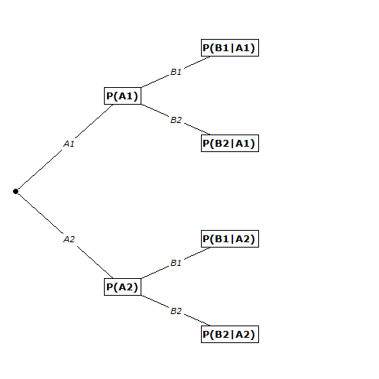
Tree Diagrams
Sometimes it is useful to use a tree diagram in order to fully see the sample space…
To create a tree diagram:
Each level represents the outcomes for each event
There are multiple branches per level which represent the potential outcomes for each
The sum of the probabilities from each node should add to 1.
Level 1
Level 2

Slide 49
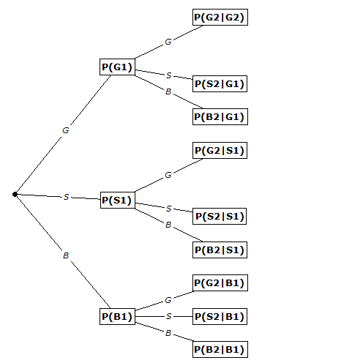
Olympic Example
1st medal selected
2nd medal selected
G₁G₂
G₁S₂
G₁B₂
S₁G₂
S₁S₂
S₁B₂
B₁G₂
B₁S₂
B₁B₂

Slide 50
Example
Men have a reputation for not wanting to ask for directions. A Harris study conducted for Lincoln Mercury indicated that 42% of men and 61% of women would stop and ask for directions. The US Census Bureau’s 2007 population estimate was that for individuals 18 or over, 48.2% were men and 51.8% were women. This exercise addresses this age group.
Create a tree diagram for this example.

Slide 51
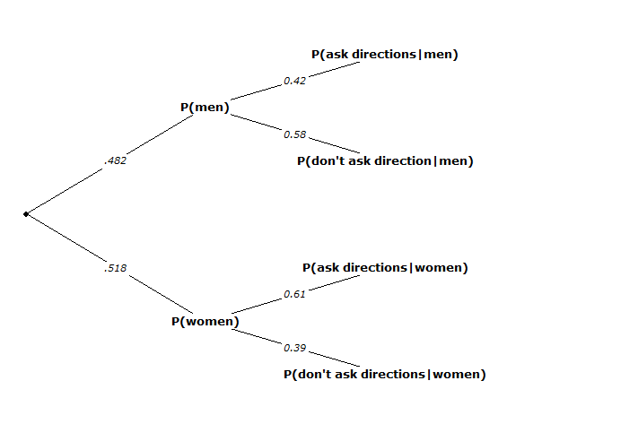
Example

