Slide 1
Random Sampling and Combinations

Slide 2
Simple Random Sample
Simple random sample – sample of n subjects from a population in which each possible sample of that size has the same chance of being selected
How do we select a simple random sample?
Random number table
Random number applet
Random number generator on internet
Random number generator on calculator
Draw out of hat

Slide 3
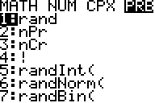
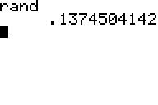
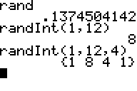
Random Number Generator on Calculator
Step 1: Hit “MATH”
Arrow over to “PRB”
Choice 1: rand – gives a random number between 0 and 1
Choice 5: randInt( - gives a random integer betweeen two specified bounds (randInt(lb,ub)) [keep hitting enter for more #s]
If add randInt(lb,ub,#) it will gives # random numbers between lb and ub

Slide 4
After have Random numbers how do we get a random sample?
Number the subjects in sampling frame, using numbers of the same length (number of digits)
Select random numbers
Include in the sample those subjects having numbers equal to the random numbers selected.

Slide 5
Example:
A designed experiment in the medical field involving human subjects is referred to as a clinical trial. One recent clinical trial was designed to determine the potential of using aspirin in preventing heart attacks. Volunteer physicians were randomly divided into two groups – the treatment group and the control group. Each physician in the treatment group took on aspirin tablet a day for one year, while the physicians in the control group took and aspirin free placebo made to look identical to an aspirin tablet. Because the physicians did not known which group, treatment or control, they were assigned to, the clinical trial is called a blind study. Assume 20 physicians volunteered for the study. Use a random number generator to randomly assign half of the physicians to the treatment group and half to the control group.

Slide 6
Make sure
Explanation Can Be Repeated
Be a specific as possible
It is your job to clearly communicate your understanding of how to perform experiment

Slide 7
Solution
Essentially we want to select a random sample of 10 physicians from the 20.
Number the physicians from 1 to 20
Using a random number generator – generate integers ranging from 1 to 20
The first 10 unique random numbers generated (ignore duplicates) will be the numbers associated with the 10 doctors to be assigned to the treatment group
The remaining 10 will be assigned to the control group

Slide 8
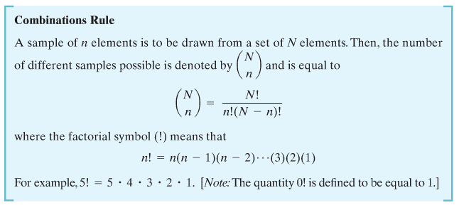
Combination Rule
For classical probability assessment it is often useful to determine the total number of possible outcomes. There is a simple rule for finding the number of these different outcomes.

Slide 9
Example
You have the capital to invest in two of four ventures, each of which requires approximately the same amount of investment capital. Unknown to you, two of the investments will eventually fail and two will be successful. If you selected two ventures at random, what are the points that make up the sample space?
Denote the two successful enterprises as S1 and S2, and the two failing enterprises as F1 and F2.
Using the Combinations Rule how many different outcomes make up the sample space?

Slide 10
What are those outcomes?
Outcome | First Venture | Second Venture
1 | S1 | S2
2 | S1 | F1
3 | S1 | F2
4 | S2 | F1
5 | S2 | F2
6 | F1 | F2

Slide 11
Example
Suppose you plan to invest equal amounts of money in each of five business ventures. If you have 20 ventures from which to make the selection, how many different samples of 5 that can be selected from the 20 ventures is

