Slide 1
Prepare Students to Participate in Class

Slide 2
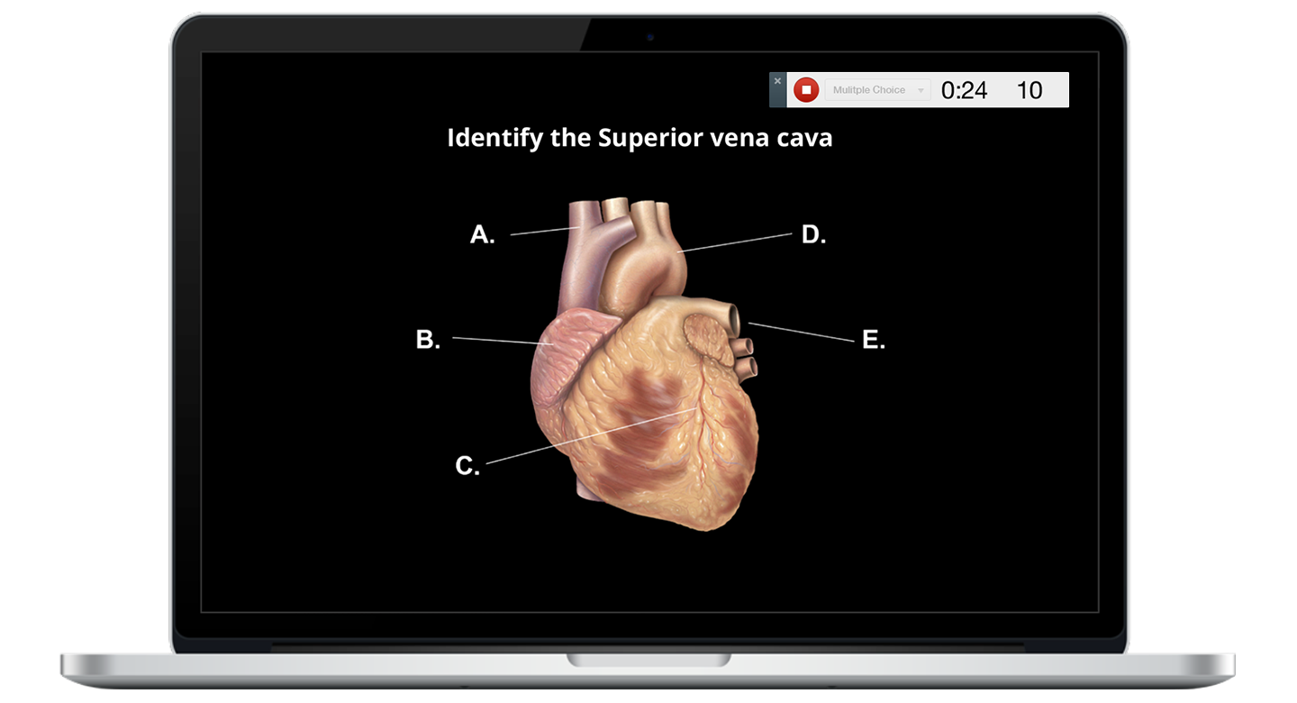
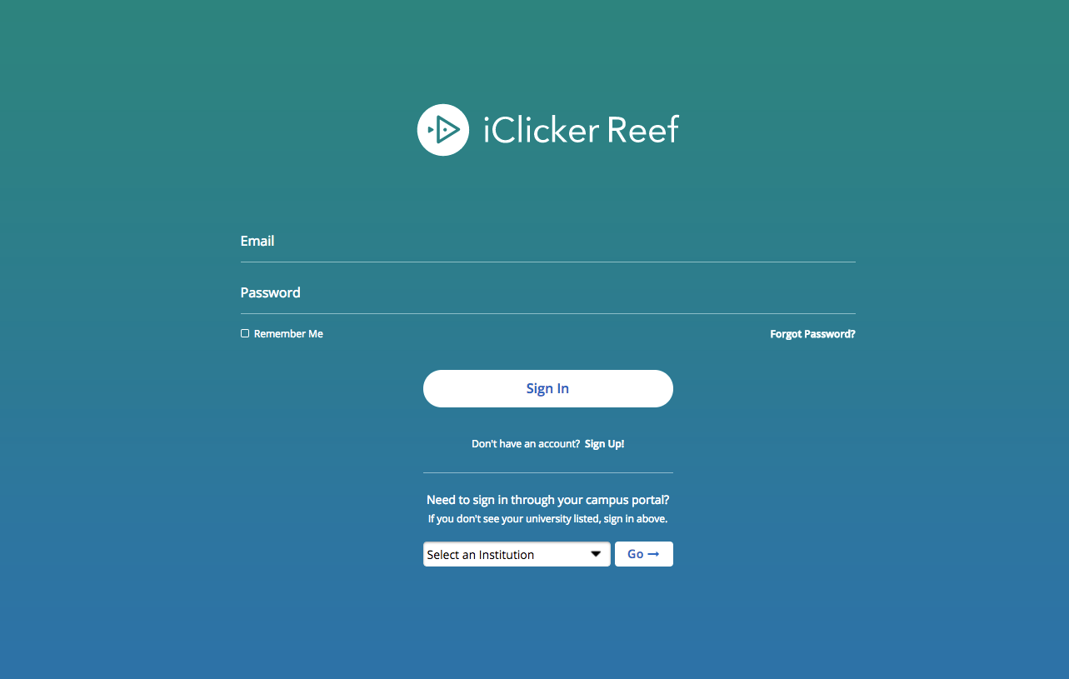
Reef Student Web Application
Go to www.app.reef-education.com.
If you've used Reef before, login.
If you are new to Reef, click on the "Sign Up" link.
Select:
University of South Carolina Dept of Statistics
Important: Only create and use a single Reef student account. Creating multiple accounts may result in the loss of grade points.

Slide 3
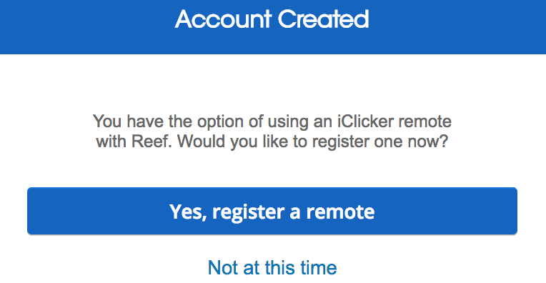
If you are using an iClicker Remote...
If you plan to use an iClicker remote, you must register your remote in your Reef account.

Slide 4
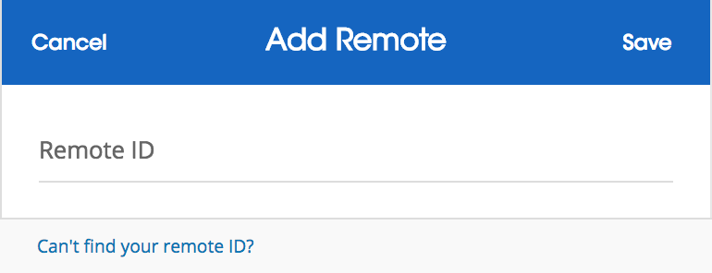
If you are using an iClicker Remote...
Enter the barcode ID number found on the back of your clicker. If you do not have your clicker, you can register it later in your Reef profile.

Slide 5
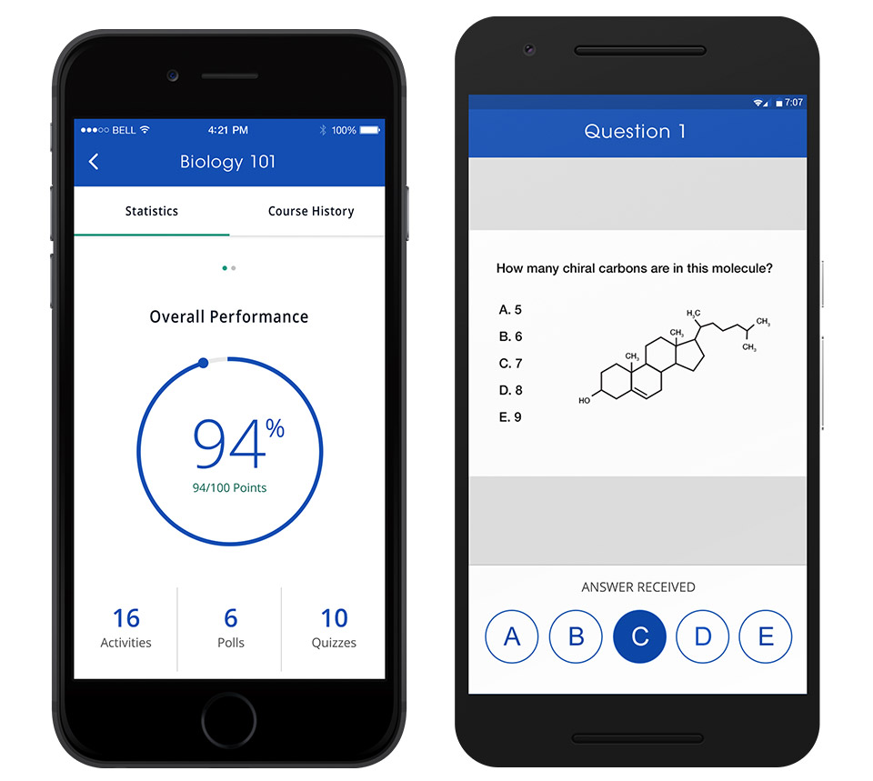
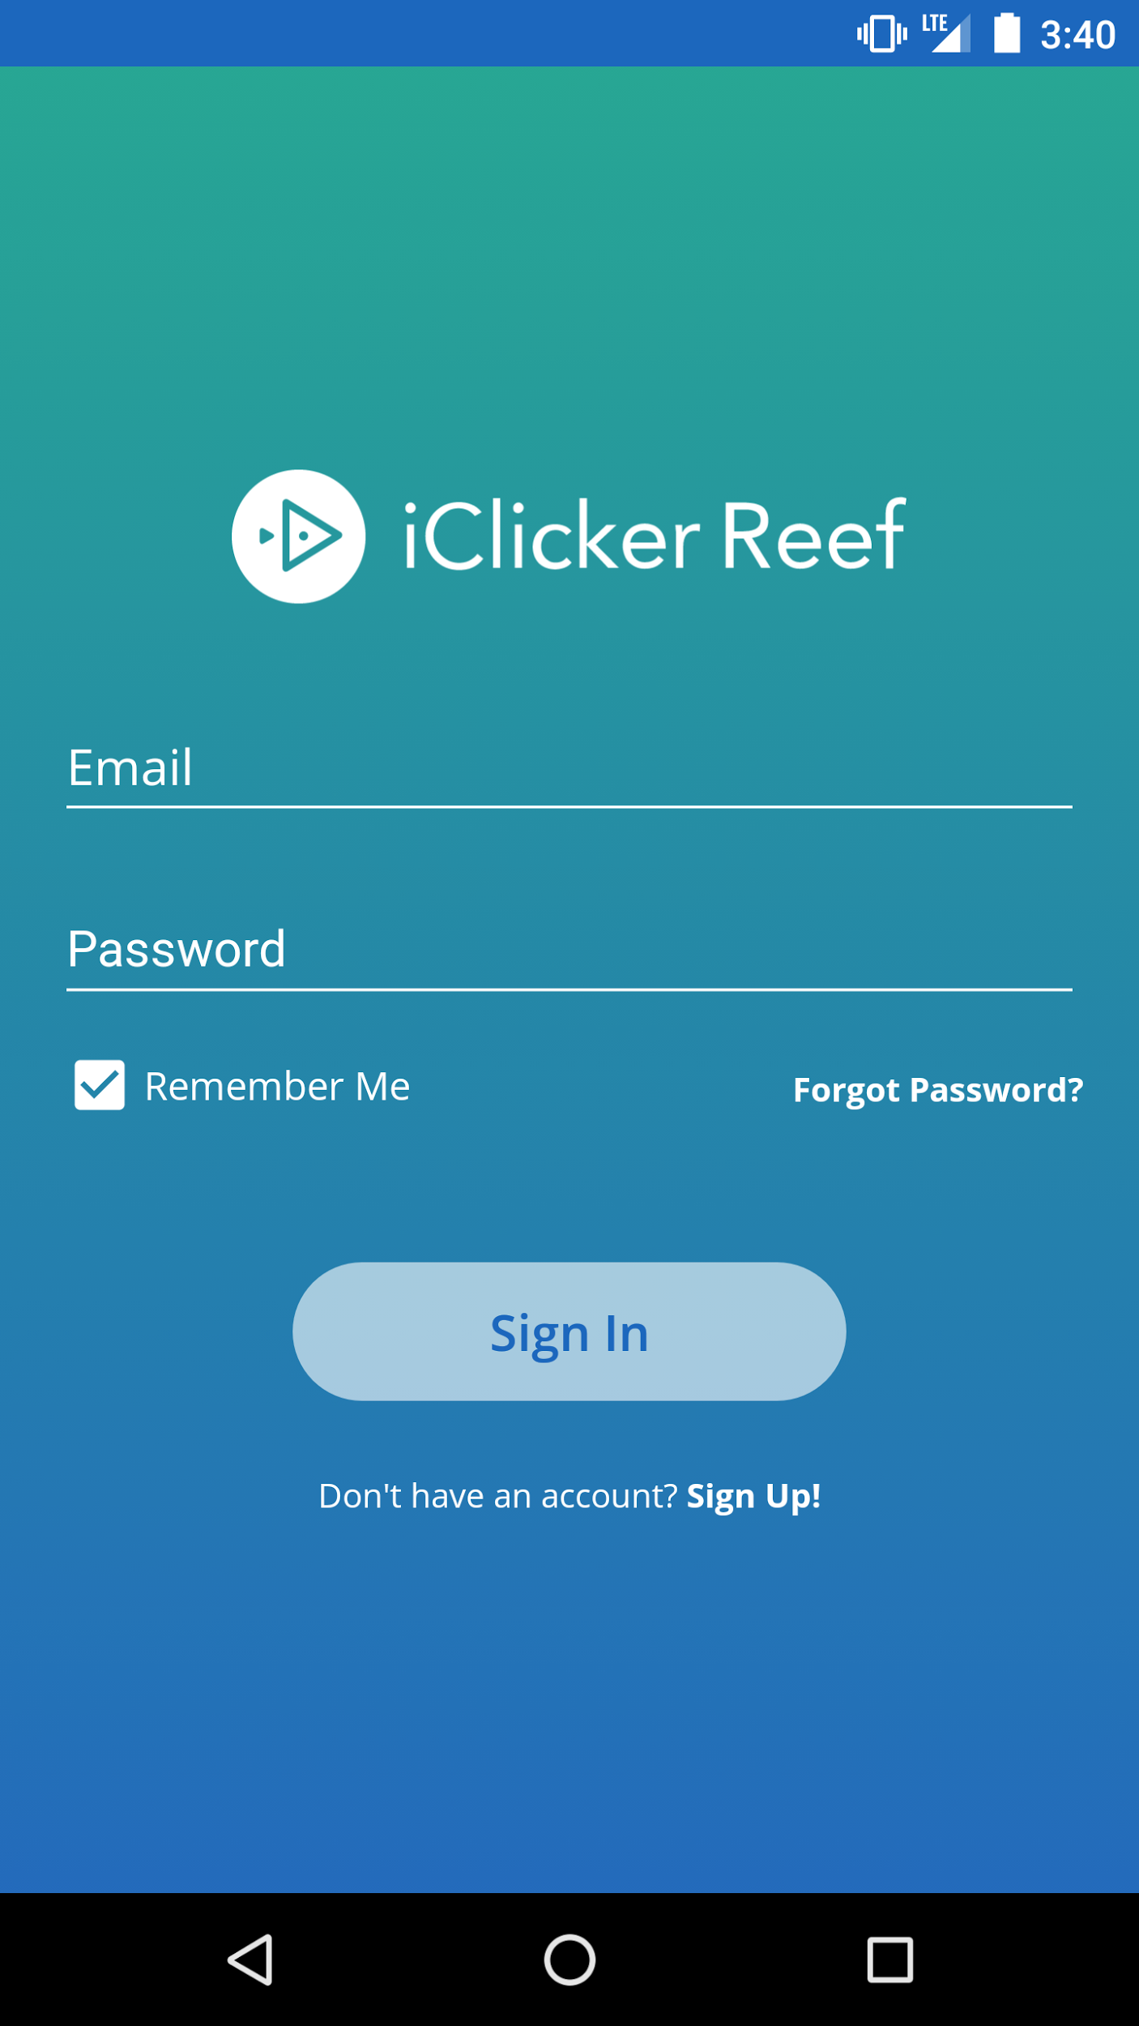
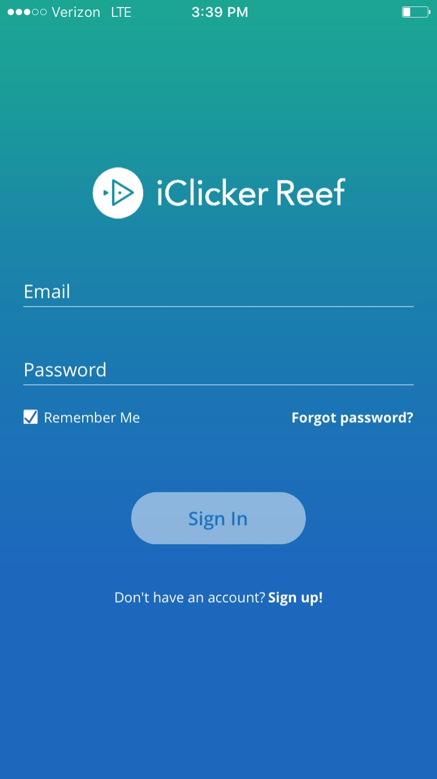
Reef Student Mobile App
If you want to use your mobile device to vote, you can download the mobile app from the Apple or Google app stores.

Slide 6
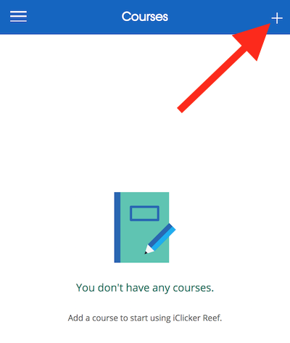
Add This Course
Go to the courses list and click the + button.
Search and select University of South Carolina Dept of Statistics
Search and select Ward-Besser Select your section: STAT 206 (1:10) _OR_ STAT 206 (2:20)
Confirm this course by clicking "Add this Course."

Slide 7
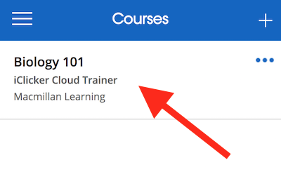
Check Your Courses List
You should see the course added to your Courses list.

Slide 8
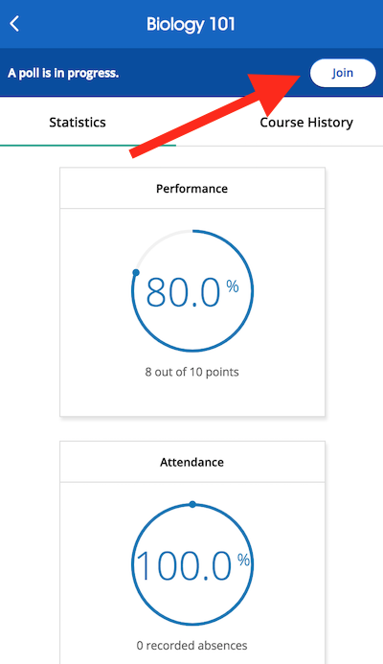
Join a Session
I will be running Attendance, Polling, and Quizzing (mostly Polling) sessions in class.
When I start a session, you will see a “Join” button appear on your screen.
Hit the Join button to participate in a poll or participate in a quiz.

Slide 9
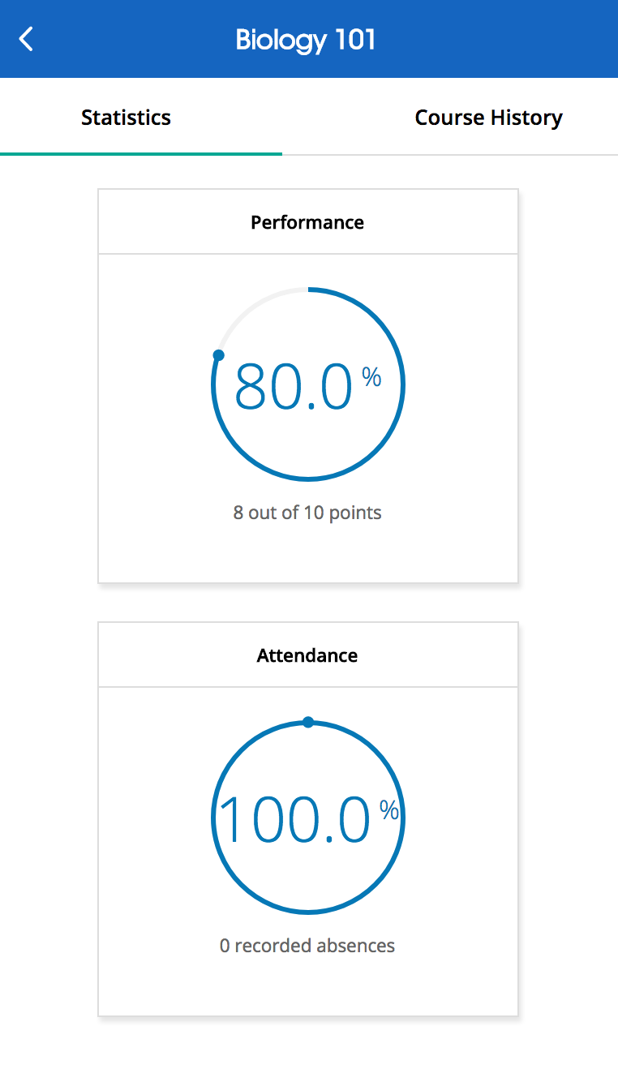
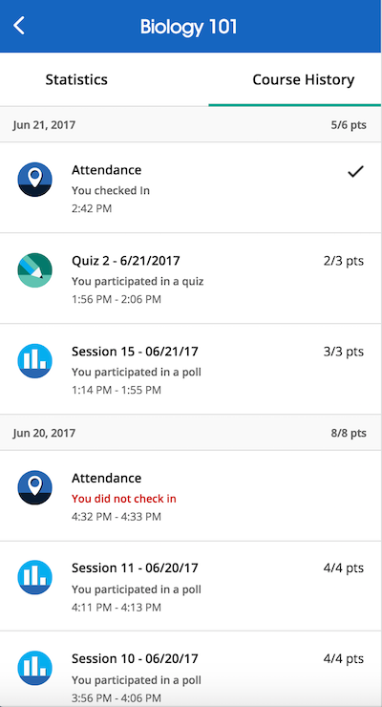
Viewing Course Statistics and Course History
The main screen of Reef shows your Course Statistics. Here you will see an overview of your course performance for points earned in polls and/or quizzes. You will also see an overview of your attendance performance.
The Course History view shows you a detailed view of your individual session results, by date. You can select an individual session to view more details, [including results and images of polling questions to use as a study guide].

Slide 10
Questions? support@iclicker.com 1-866-209-5698 9am-11pm EST Monday-Thursday 9am-9pm EST Friday

