Slide 1
ANNOUNCEMENTS
STAT 206 (Elementary Statistics for Business)
  Instructor: Chendi Jiang
  TA: Dongho Shin
Register in Pearson MySTATLab to have access to STAT 206 notes, assignments, grades and communication
Your Course name:
STAT 206 – Elementary Statistics for Business
Your course ID: jiang61044
REMEMBER! If you’re waiting for financial aid, click Get temporary access without payment for 14 days. (Click Yes when a message appears asking if you are sure you want temporary access.)
iClicker Reef app – FREE! instructions available
When emailing me, please indicate the course and section (time) you are attending

Slide 2
STAT 206 (007) Teaching Assistant (TA) Dongho Shin
  Email: dongho@email.sc.edu
  Office: 200D
  Office hours: MW 2:00-4:00

Slide 3
Things to Learn First…
You CANNOT escape data.
  Are you on “Facebook”? “Instagram”? “Twitter”?
  You CREATE data every time you “Check in,” “Like,” “Comment,” “Search.”
Think of STATISTICS as a way of thinking to help you (or someone…) make better decisions
DEFINITIONS before we start:
  VARIABLE – characteristic of an item or individual
  DATA – set of individual values associated with a variable
  STATISTICS – includes methods to help transform data into useful information for decision makers
    Used “personal” statistics your ENTIRE life!
      Route to work…
      What is weather like?
      Crossing the street…
    EXAMPLE: A recent newspaper article concluded that smoking marijuana at least three times a week resulted in lower grades in college.
      How do you think the researchers came to this conclusion?
      Do you believe it?
      Is there a more seasonable conclusion?
    From The State newspaper:
      “S.C. road deaths linked to non-use of seat belts, statistics say”

Slide 4
Chapter 1
Defining and Collecting Data

Slide 5
1.1 Defining Data / 1.2 Measurement Scales
Operational definition – a universally accepted meaning that is clear to all associated with the analysis
Types of Variables
Categorical (Category)
  Nominal – Name of a Category
    Ex.
  Ordinal – Has a natural ordering
    Ex.
Numerical / Quantitative (Quantity)
  Discrete – distinct cutoffs between values
    Ex.
  Continuous – on a continuum
    Ex.
Gender (female/male), hair color (blonde, brunette, red , gray…)
economic status, with three categories (low, medium and high)
educational experience (with values such as elementary school graduate,
high school graduate, some college and college graduate)
Number of friends, number of children, number of courses
Height, weight, time

Slide 6
Questions:
How long did it take to download the update for your newest mobile app?
  Categorical nominal
  Categorical ordinal
  Numerical discrete
  Numerical continuous
Do you have a Facebook profile? Yes or No?
  Categorical nominal
  Categorical ordinal
  Numerical discrete
  Numerical continuous
How many text messages have you sent in the past three days?
  Categorical nominal
  Categorical ordinal
  Numerical discrete
  Numerical continuous

Slide 7
1.3 Collecting Data
After defining variables, you proceed with data collection:
  Identify data SOURCES
  POPULATION or SAMPLE
  CLEANING/RECODING your data (if necessary. Yes, it almost always is…)
POPULATION –
SAMPLE –
all items/individuals about which you want to reach conclusions (described by PARAMETERS)
items/individuals (from the population) which are selected for analysis (items/individuals about which you collect data) (described by STATISTICS)
Why sample?
  Less time consuming
  Less costly
  Less cumbersome and more practical
BUT… even when we sample correctly, we introduce CHANCE (RANDOMNESS)!

Slide 8
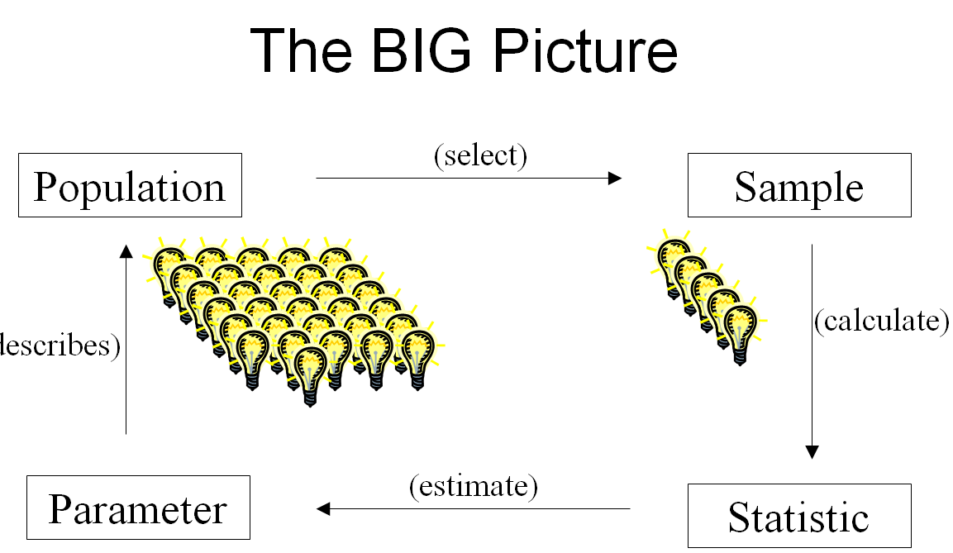

Slide 9
Data Cleansing
  Cleansing (for Outliers and Missing Values)
    Outliers –
    Missing Values –
Values that seem excessively different from most of the data values
Values that were not collected
(➔ not available to the analysis)
Recoding/cleansing data requires MUTUALLY EXCLUSIVE and
COLLECTIVELY EXHAUSTIVE definitions
  Mutually Exclusive –
  Collectively Exhaustive –
Each data value is place in one and only one category
ALL data values must be recoded in the categories created

Slide 10
Questions:
Radio talk show host is interested in the percentage of Philadelphia voters who are registered Republicans. Voter registration records show that 18% of all voters in Philadelphia are registered as Republicans. However, a radio talk show host in Philadelphia found that of 20 local residents who called the show recently, 60% were registered Republicans.
Population?
Parameter?
Sample?
Statistic?
All voters in Philadelphia
Percent of all voters in Philadelphia who are registered Republicans (18%)
20 voters in Philadelphia who called in
Percent of all voters in Philadelphia who called in
who are registered Republicans (60%)
Is this a good way to sample?

Slide 11
1.4 Types of Sampling Methods
listing of items/individuals/units from the population used to select the sample
Sampling Frame –
Probability Sample –
Non-Probability Sample –
select items/individuals/units for the sample based on known probabilities (GOOD!)
➔ Results can be generalized
to the POPULATION
select items/individuals/units for the sample without knowing their probabilities of selection (BAD!)
➔ Creates BIAS. Cannot be used for statistical inference (i.e. results cannot be generalized
to the population)

Slide 12
Sampling Methods – bad and good
Samples should be REPRESENTATIVE of the population. That is, the sample should be “like” the population to the greatest degree possible. Let’s consider some possibilities:
  Judgment – collect a sample that an “expert” thinks is representative of the population
    PROs: hmmmm…
    CONs:
      Who/what is an expert? Who gets to make the decision?
      E.g., Pre-Columbus, experts believed the world was flat…
      Outcome is biased toward beliefs of the “expert”
BAD

Slide 13
Sampling Methods – bad and good
Sample should be REPRESENTATIVE of the population. That is, the sample should be “like” the population to the greatest degree possible.
  Convenience – collect the sample that is easiest to access
    PROs: “easiest to access”
    CONs:
      E.g., Consider trying to identify the percentage of Gamecock fans in Columbia, SC by interviewing people leaving Williams Brice Stadium after a huge football victory
      E.g., Consider trying to determine the percentage of students satisfied with student parking by interviewing people leaving a dormitory in the morning
      Outcome is biased since choosing the “easiest to access” may miss entire segments of the population
  Volunteer – subjects choose to participate in the study
    PROs: volunteers do the work for you (self-selection)
    CONs:
      Who responds by choice? Those with very POSITIVE reactions or very NEGATIVE reactions
      Outcome is biased since mostly seeing responses for those with strong feelings – not the “middle of the road,” often in the majority
BAD

Slide 14
Sampling Methods – bad and good
Sample should be REPRESENTATIVE of the population. That is, the sample should be “like” the population to the greatest degree possible.
  Census – (attempt to) collect data from every individual in the population
    PROs: “like” the population because it IS the population
    CONs:
      Time
      Money
      Can be destructive
      E.g., think about trying to collect ALL mosquitoes in SC to study West Nile virus…
Good, if It’s possible

Slide 15
Sampling Methods – bad and good
Sample should be REPRESENTATIVE of the population. That is, the sample should be “like” the population to the greatest degree possible.
  Simple Random Sample (SRS) – sample is chose in such a way that every subject is equally likely to be selected for the study
    PROs:
      Most basic form of random sampling
      Random sampling is the most likely way to achieve a sample that is representative of the population
    CONs:
      Not always feasible
      Can require really LARGE samples
      May require most complex sample designs
      (lots of other types of random sampling: stratified random sampling,
      random cluster sampling, etc. Take more statistics classes to learn…)
Good

Slide 16
Sampling Methods – bad and good
Sample should be REPRESENTATIVE of the population. That is, the sample should be “like” the population to the greatest degree possible.
  Stratified – divide frame into groups (strata). Take a simple random sample from each strata
    PROs:
      Individual estimates for each stratum
      Variable measured gives more consistent values within each of the strata than the population as a whole
      If strata are geographically separated, may be cheaper
      Perhaps use different interviewers for each of the strata
    CONs:
      Requires determination of variables on which to base stratification
      Can be expensive to implement
Good

Slide 17
Sampling Methods – bad and good
Sample should be REPRESENTATIVE of the population. That is, the sample should be “like” the population to the greatest degree possible.
  Systematic – uses a systematic method k=N/n (i.e. n groups
  of k items such as, every 10th person) to select the sample
    PROs:
      Easily executed and easily understood
      If population is not fixed (always growing), it may be the only way…
    CONs:
      If same starting point is used, it draws the same sample over and over again
      Can be biased if ignoring the same parts of the population over and over again
Good, if…

Slide 18
Sampling Methods – bad and good
Sample should be REPRESENTATIVE of the population. That is, the sample should be “like” the population to the greatest degree possible.
  Cluster – divide N items in the frame into clusters and take a random sample of the clusters. Study all items in the cluster
    PROs:
      Clusters may be naturally occurring
      Cost effective if population spread over a wide geographic region
    CONs:
      May require a larger sample size
Good

Slide 19
Questions:
Back to previous example: Radio talk show host is interested in the percentage of Philadelphia voters who are registered Republicans. Voter registration records show that 18% of all voters in Philadelphia are registered as Republicans. However, a radio talk show host in Philadelphia found that of 20 local residents who called the show recently, 60% were registered Republicans.
What type of sample is this?
Is this a good way to sample?
Convenience / Voluntary Response
NO! Biased because one group is more likely to respond than other groups

Slide 20
Questions:
A student at the university is conducting a survey to find the opinion of her fellow students on the availability of student parking on campus. She stands outside of a dorm and polls fellow students as they leave the dorm.
Which sampling method is this?
Convenience sample
Problem:
  Not random
  By survey people living in the dorm, she MISSED the major group of people impacted by student parking
  – COMMUTING STUDENTS!

Slide 21
Questions:
Want to find the opinions of US adults, but want to save on time and money by randomly selecting residences. All adults residing in a sampled residence will be interviewed.
A. Stratified B. Cluster C. Both
Want to find the opinions of US adults and need to make sure that 3 specific religious groups are represented. You sample 100 Christians, 100 Jewish, and 100 Muslims.
A. Stratified B. Cluster C. Both
Want to find the opinions of city dwelling US adults and need to make sure that the east and west coasts are represented. You send 5 interviewers to the east coast and 5 to the west coast. 5 City blocks are chosen at random. Everyone living in a chosen city block is interviewed. (similarly for the east coast)
A. Stratified B. Cluster C. Both

Slide 22
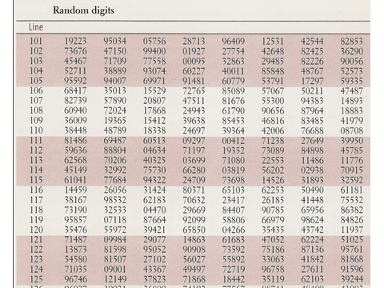
If you are using a table of random digits…
Population labels must each contain the same number of digits
Spaces in the random digits table have no meaning (they are just place holders)
You can start anywhere you like in the table (across rows, up a column, down a column,…)
Some people start their population labels at 0 and some start them at 1 (be aware)
Skip repeated codes and those outside the range of labels

Slide 23
Example 4 – Take a random sample of 3 people
Step 1: Label your “population” elements
Since we are using the pesky table of random digits, be sure each label (code) has the same number of digits!
Step 2: Obtain the sample
Using the following selection from a random digits table. (Note: In practice you would choose any selection you want, but in class we will use the same selection to learn how to use the table.)
38167 98532 62183 70632 23417

Slide 24
1.5 Types of Survey Errors
Coverage Error – certain groups are excluded from the sampling frame
➔ Results in selection bias
Non-Response Error – failure to collect data on all items in the sample
➔ Results in nonresponse bias
Sampling Error – reflects the “chance differences”
➔ Caused by the act of taking a sample and make the results from a sample different from those of a census (Margin of Error)
Measurement Error – Error NOT related to the act of selecting a sample (processing errors, poorly worded questions, deliberate inaccuracies in responses, etc.)

Slide 25
Questions:
A survey indicates that the vast majority of college students own their own personal computers. What information would you want to know before you accepted the results of this survey?
  Who funded the survey? Why was it conducted?
  Sample design? Sample size?
  What was the population from which the sample was selected?
  Mode of response? (Personal interview? Telephone interview? Mail survey? Etc.)
  What is the operating definition of “vast majority”?
  What were the questions? Were they field-tested? Clear accurate, unbiased, valid?
  Response rate?

Slide 26
Questions: Identify the error
The subject lies about past drug use
A. Coverage Error
B. Non-Response Error
C. Sampling Error
D. Measurement Error
A typing error is made in recording the data
A. Coverage Error
B. Non-Response Error
C. Sampling Error
D. Measurement Error
Two large random samples are taken and the results/statistics differ slightly
A. Coverage Error
B. Non-Response Error
C. Sampling Error
D. Measurement Error
The subject cannot be contacted after five calls
A. Coverage Error
B. Non-Response Error
C. Sampling Error
D. Measurement Error
Interviewers choose people on the street to interview
A. Coverage Error
B. Non-Response Error
C. Sampling Error
D. Measurement Error

Slide 27
end

Slide 28
ANNOUNCEMENTS
Register in Pearson MySTATLab to have access to STAT 206 notes, assignments, grades and communication
STAT 206 – Elementary Statistics for Business
(course ID: jiang61044)
Get temporary access without payment for 14 days
  Zero on homework assignments if not registered
iClicker Reef app – FREE! Instructions available
STAT 206 Teaching Assistant (TA) Dongho Shin
  Email: dongho@email.sc.edu
  Office: 200D
  Office hours: MW 2:00-4:00

Slide 29
Questions:
A sociologist wants to know the opinions of employed adult women about government funding for day care. She obtains a list of the 580 members of a women’s club and mails a questionnaire to 100 of these women selected at random. Only 41 questionnaires are returned.
What is the Population?
  All women
  All employed adult women
  580 members of a women’s club on the list
  100 women to whom questionnaires are sent
What is the Sample?
  100 randomly selected women to whom questionnaires were sent
  580 members of a women’s club on the list
  41 women who returned the survey

Slide 30
Review:
Using Table of Random Digits for sampling:
  Population labels must each contain the same number of digits
  To sample WITHOUT REPLACEMENT, Skip repeated codes and those outside the range of labels
  To sample WITH REPLACEMENT, do NOT skip repeated codes
Types of errors in sampling:
  Coverage Error – certain groups are excluded from the sampling frame
  ➔ Results in selection bias
  Non-Response Error – failure to collect data on all items in the sample
  ➔ Results in nonresponse bias
  Sampling Error – reflects the “chance differences”
  ➔ Caused by the act of taking a sample and make the results from a sample different from those of a census (Margin of Error)
  Measurement Error – Error NOT related to the act of selecting a sample (processing errors, poorly worded questions, deliberate inaccuracies in responses, etc.)

Slide 31
Questions:
A Wall Street Journal poll asked 2,150 adults in the U.S. a series of questions to find out their view on the U.S. economy.
The possible responses to the question
"How satisfied are you with the U.S. economy today?” of
“very satisfied”, “moderately satisfied”, “neutral”, “moderately dissatisfied” and “very dissatisfied”
are values from which of the following?
  categorical nominal variable
  categorical ordinal variable
  discrete numerical variable
  continuous numerical variable
The population of interest for this survey is
  all the males living in the U.S. when the poll was taken
  all the females living in the U.S. when the poll was taken
  all the people living in the U.S. when the poll was taken
  all the adults living in the U.S. when the poll was taken

Slide 32
Review:
CATEGORICAL variables (Category)
  Nominal – Name of a Category
  Ordinal – Has a natural ordering
NUMERICAL / QUANTITATIVE variables (Quantity)
  Discrete – distinct cutoffs between values
  Continuous – on a continuum
POPULATION – all items/individuals about which you want to reach conclusions (described by PARAMETERS)
SAMPLE – items/individuals
(from the population) which are
selected for analysis
(items/individuals about which
you collect data)
(described by STATISTICS)

Slide 33
Questions:
To obtain a sample of 10 books in the store, the manager walked to the first shelf next to the cash register to pick the first 10 books on that shelf. This is an example of a
  stratified sample
  systematic sample
  convenience sample
  simple random sample
Is this a PROBABILITY sample or a NON-PROBABILITY sample or NEITHER?
  PROBABILITY sample
  NON-PROBABILITY sample
  NEITHER

Slide 34
Review:
MUTUALLY EXCLUSIVE – Each data value is place in one and only one category
COLLECTIVELY EXHAUSTIVE – ALL data values must be recoded in the categories created
PROBABILITY SAMPLE – select items/individuals/units for the sample based on known probabilities (GOOD!)
➔ Results can be generalized to the POPULATION
NON-PROBABILITY SAMPLE – select items/individuals/units for the sample without knowing their probabilities of selection (BAD!) ➔ Creates BIAS.
Cannot be used for statistical inference (i.e. results cannot be generalized to the population)
BAD (i.e., non-probability) sampling methods:
  Judgment – collect a sample that an “expert” thinks is representative of the population
  Convenience – collect the sample that is easiest to access
  Voluntary Response – subjects choose to participate in the study
GOOD (i.e. probability) sampling methods:
  Simple Random Sample – every sample has equal chance of being chosen
  Stratified Random Sample – stratify first, randomly sample within strata
  Systematic Sample – choose random starting point, then choose every n^{th} record
  Random Cluster Sample – (efficiency) randomly choose clusters, evaluate all individuals within cluster

