Slide 1
STAT 206: Chapter 10
Fundamentals of Hypothesis Testing: Two-Sample Tests

Slide 2
Ideas in Chapter 10
How to use hypothesis testing for comparing the difference between
The means of two related populations
The means of two independent populations
The proportions of two independent populations

Slide 3
What we know about one (1) sample confidence intervals for population mean…
10.2 Comparing Means of Two Related (Dependent) Populations
CI = point estimate ± margin of error
Central Limit Theorem says that the sampling distribution for a mean or proportion is bell-shaped if the sample size is big enough
We know how to calculate the confidence interval (CI) for population mean:
“t-score” is based on the t-distribution
Determined from level of confidence and
Degrees of freedom (df = n-1)
To use this method, you need:
Data obtained by randomization
Approximately normal data population distribution
Margin
of Error
Standard
Error

Slide 4
Confidence Interval for Mean Difference in Two Populations (DEPENDENT Samples)
Want to compare two groups that are related to one another, for example:
Has “customer service” training made a difference in the number of customer complaints?
Ages of husbands and wives (i.e., couples ➔ ages probably NOT independent)
Before and after treatment of measurements of some medical test (i.e., same subjects/patients with before/after measurements ➔ “pair” is the same subject ➔ not independent)
Effectiveness of sunscreen in a left-arm / right-arm experiment (i.e., same subjects/individuals ➔ “pair” is the same subject ➔ not independent)
Braking distance for cars in wet / dry conditions (i.e., same cars, but conditions change ➔ not independent)
Braking distance for cars tire brand 1/ tire brand 2 (i.e., same cars, but tires change ➔ not independent)

Slide 5
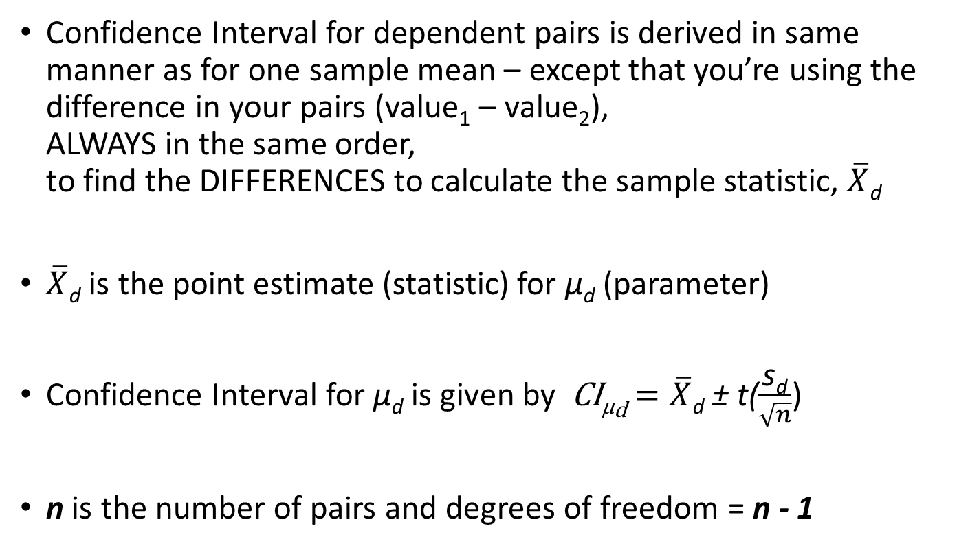
Confidence Interval for Population Mean Difference (DEPENDENT)
Confidence Interval for dependent pairs is derived in same manner as for one sample mean – except that you’re using the difference in your pairs (value₁ – value₂), ALWAYS in the same order, to find the DIFFERENCES to calculate the sample statistic, $\overline{X}$_{d}
$\overline{X}$_{d} is the point estimate (statistic) for µ_{d} (parameter)
Confidence Interval for µ_{d} is given by CI_{µd} $=\overline{X}$_{d} ± t($\frac{\text{s}\text{d}}{\sqrt{n}}$)
n is the number of pairs and degrees of freedom = n - 1

Slide 6
Interpretation of confidence intervals for two samples mean differences (i.e., DEPENDENT)
Let LL = lower limit and UL = upper limit of a confidence interval for (group A – group B). That is, CI (μ_{d}) = CI(μ_{A} – μ_{B}) = (LL , UL)
If LL and UL are both greater than 0, this suggests that group A has the greater mean
Interpretation: We are x%* confident that the population mean for group A is at least LL and at most UL units greater than the population mean for group B.

Slide 7
Interpretation of confidence intervals for two samples mean differences (i.e., DEPENDENT)
Let LL = lower limit and UL = upper limit of a confidence interval for (group A – group B). That is, CI (μ_{d}) = CI(μ_{A} – μ_{B}) = (LL , UL)
If LL and UL are both less than 0, this suggests that group B has the greater mean
Interpretation: We are x%* confident that the population mean for group B is at least |LL| and at most |UL| units greater than the population mean for group A.

Slide 8
Interpretation of confidence intervals for two samples mean differences (i.e., DEPENDENT)
Let LL = lower limit and UL = upper limit of a confidence interval for (group A – group B). That is, CI (μ_{d}) = CI(μ_{A} – μ_{B}) = (LL , UL)
If LL is less than 0 and UL is greater than 0, then neither group clearly has a greater mean
Interpretation: With x% confidence, it is unclear whether group A or group B has the greater population mean. If group A has the greater population mean, it is by at most UL units and if group B has the greater population mean, it is by at most |LL| units.

Slide 9
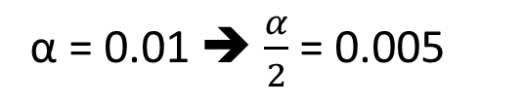
Paired Difference: Example
Assume you send your salespeople to a “customer service” training workshop. Has the training made a difference in the number of complaints? You collect the following data:
Σ
D_{i}
Salesperson | # complaints BEFORE | # complaints AFTER | AFTER - BEFORE Difference
C.B | 6 | 4 | -2
T.F | 20 | 6 | -14
M.H. | 3 | 2 | -1
R.K. | 0 | 0 | 0
M.O. | 4 | 0 | -4
 |  |  | -21 | sum
X_{d} =
= -4.2
n
α = 0.01 ➔ $\frac{α}{2}$ = 0.005
df = n – 1 = 5 – 1 = 4
t = 4.604
We are 99% confident that the difference in customer complaints, AFTER and BEFORE training is at least -15.87 and at most 7.47. Because the CI covers 0, we cannot be 99% confident that µ_{D} is not equal to 0 (i.e., no difference).

Slide 10

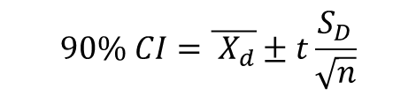
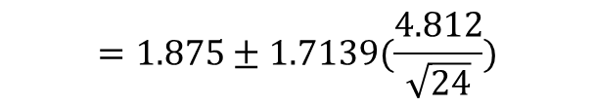



Example: We are interested in whether there is a difference in the mean age at which men marry and the age at which women marry. The following data was collected from a random sample of 24 couples. Compute and interpret a 90% confidence interval on the mean difference between husbands’ and wives’ age at marriage. Assume that ages at marriage follow a normal distribution.
couple | husband | wife | husband-wife
1 | 25 | 22 | 3
2 | 25 | 32 | -7
3 | 51 | 50 | 1
4 | 25 | 25 | 0
5 | 38 | 33 | 5
6 | 30 | 27 | 3
7 | 60 | 45 | 15
8 | 54 | 47 | 7
9 | 31 | 30 | 1
10 | 54 | 44 | 10
11 | 23 | 23 | 0
12 | 34 | 39 | -5
13 | 25 | 24 | 1
14 | 23 | 22 | 1
15 | 19 | 16 | 3
16 | 71 | 73 | -2
17 | 26 | 27 | -1
18 | 31 | 36 | -5
19 | 26 | 24 | 2
20 | 62 | 60 | 2
21 | 29 | 26 | 3
22 | 31 | 23 | 8
23 | 29 | 28 | 1
24 | 35 | 36 | -1
couple | husband | wife
1 | 25 | 22
2 | 25 | 32
3 | 51 | 50
4 | 25 | 25
5 | 38 | 33
6 | 30 | 27
7 | 60 | 45
8 | 54 | 47
9 | 31 | 30
10 | 54 | 44
11 | 23 | 23
12 | 34 | 39
13 | 25 | 24
14 | 23 | 22
15 | 19 | 16
16 | 71 | 73
17 | 26 | 27
18 | 31 | 36
19 | 26 | 24
20 | 62 | 60
21 | 29 | 26
22 | 31 | 23
23 | 29 | 28
24 | 35 | 36
90% confidence interval results: μ₁ - μ₂ : mean of the paired difference between husband and wife
$$\overline{X_{d}}=1.875$$
$$S_{D}=4.812$$
α = 0.10 ➔ $\frac{α}{2}$ = 0.05
$$90\% CI=\overline{{ X}_{d}}±t\frac{S_{D}}{\sqrt{n}}$$
df = n – 1 = 24 – 1 = 23
$$=1.875±1.7139(\frac{4.812}{\sqrt{24}})$$
t = 1.7139
$=(0.19148 ,$3.55852)
Interpretation: We are 90% confident that the mean age at which men marry is at least 0.19 and at most 3.5 years greater than the mean age at which women marry. That is, we are 90% confident that the average age at which men marry is higher than the average age at which women marry.

Slide 11
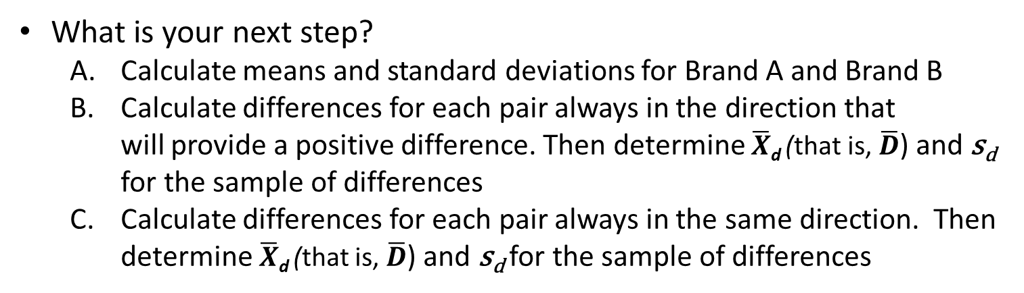
Question:
Nine experts rated two brand of Colombian coffee in a taste-testing experiment. A rating on a 7-point scale (1 = extremely unpleasing ➔ 7 = extremely pleasing) is given for each of four characteristics: taste, aroma, richness and acidity. The table at the right contains the rating accumulated over all four characteristics:
Is the assumption that the populations are dependent or independent?
Dependent / related
Independent / not related
 | Brand
Expert | A | B
C.C. | 24 | 26
S.E. | 27 | 27
E.G. | 19 | 22
B.L. | 24 | 27
C.M. | 22 | 25
C.N. | 26 | 27
G.N. | 27 | 26
R.M. | 25 | 27
P.V. | 22 | 23
What is your next step?
Calculate means and standard deviations for Brand A and Brand B
Calculate differences for each pair always in the direction that will provide a positive difference. Then determine $\overline{X}$_{d} (that is, $\overline{D}$) and s_{d} for the sample of differences
Calculate differences for each pair always in the same direction. Then determine $\overline{X}$_{d} (that is, $\overline{D}$) and s_{d} for the sample of differences

Slide 12
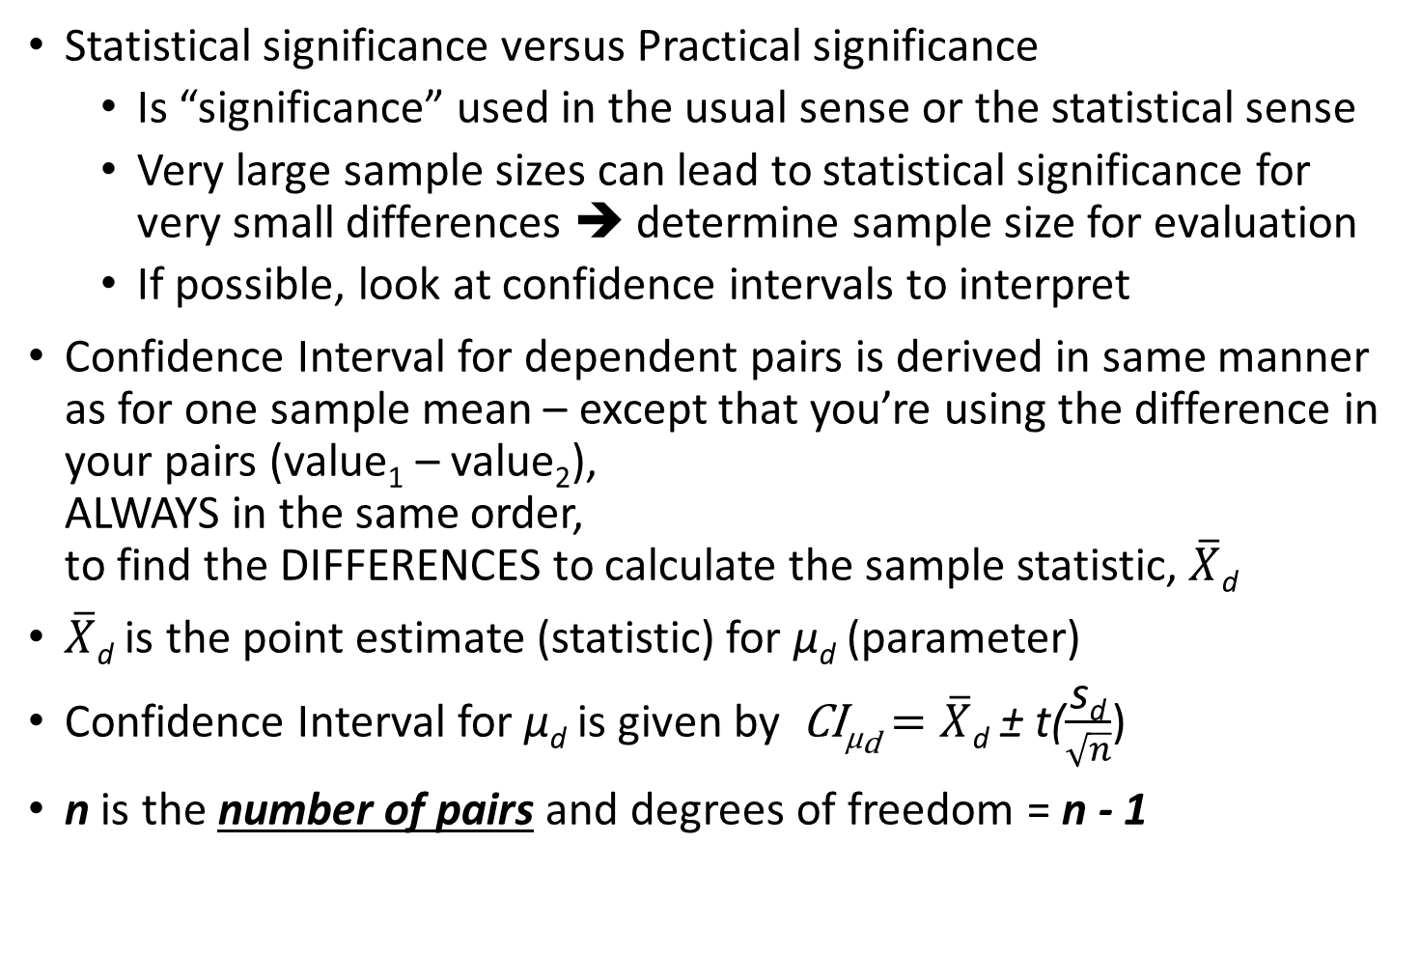
Review:
Statistical significance versus Practical significance
Is “significance” used in the usual sense or the statistical sense
Very large sample sizes can lead to statistical significance for very small differences ➔ determine sample size for evaluation
If possible, look at confidence intervals to interpret
Confidence Interval for dependent pairs is derived in same manner as for one sample mean – except that you’re using the difference in your pairs (value₁ – value₂), ALWAYS in the same order, to find the DIFFERENCES to calculate the sample statistic, $\overline{X}$_{d}
$\overline{X}$_{d} is the point estimate (statistic) for µ_{d} (parameter)
Confidence Interval for µ_{d} is given by CI_{µd} $=\overline{X}$_{d} ± t($\frac{\text{s}\text{d}}{\sqrt{n}}$)
n is the number of pairs and degrees of freedom = n - 1

Slide 13
Hypothesis Tests for Population Mean Difference (DEPENDENT)
Steps for a Hypothesis Test:
Check assumptions
Sample of difference scores is a random sample from a population of such difference scores
Difference scores have a population distribution that is approximately normal. This is important for small samples (less than about 30). If the sample size is small, make a graphical display and check for extreme outliers or skew
Set up hypotheses:
H_{o}: μ_{d} = μ₁– μ₂ ≥, ≤, or = 0
H_{a}: μ_{d} = μ₁– μ₂ <, > or ≠ 0
Calculate test statistic. (Use software, and/or it will be given in output.)

Slide 14
Hypothesis Tests for Population Mean Difference (DEPENDENT)
Steps for a Hypothesis Test:
Calculate p-value (Use software. It will be given in output)
If using the > alternative, p-value = P(T > t)
If using the < alternative, p-value = P(T < t)
If using the ≠ alternative, p-value = 2 * P(T < -|t|) if using E.3
Draw conclusion and interpret the results
If p-value ≤ α (or if p-value is less than .01 when no α is given), ➔ reject H₀ (With p-value = _______, we have sufficient evidence that (state H_{A} in problem context)
If p-value > α (or if p-value is greater than .10 when no α is given), ➔ do not reject H₀ (With p-value = _______, we do not have sufficient evidence that (state H_{A} in problem context)
RECALL: Smaller p-values give stronger evidence against the null, H₀

Slide 15
Paired Difference Test: Solution
Has the training made a difference in the number of complaints (at the 0.01 level)?
H₀: μ_{D} = μ_{after}-μ_{before}= 0
H₁: μ_{D} = μ_{after}-μ_{before} ≠ 0
Reject
Reject
α/2
α/2
α = .01
X_{d} =
- - 4.2
- 4.604 4.604
- 1.66
t_{0.005} = ± 4.604 d.f. = n - 1 = 4
Decision: Do not reject H₀
(t_{stat} is not in the reject region)
Test Statistic:
Conclusion: There is not a significant change in the number of complaints.

Slide 16
Back to our Previous Example: We are interested in whether there is a difference in the mean age at which men marry and the age at which women marry. The following data was collected from a random sample of 24 couples. Assume that ages at marriage follow a normal distribution. Test whether there is a difference in ages at which men and women marry using α = .10.
couple | husband | wife | husband-wife
1 | 25 | 22 | 3
2 | 25 | 32 | -7
3 | 51 | 50 | 1
4 | 25 | 25 | 0
5 | 38 | 33 | 5
6 | 30 | 27 | 3
7 | 60 | 45 | 15
8 | 54 | 47 | 7
9 | 31 | 30 | 1
10 | 54 | 44 | 10
11 | 23 | 23 | 0
12 | 34 | 39 | -5
13 | 25 | 24 | 1
14 | 23 | 22 | 1
15 | 19 | 16 | 3
16 | 71 | 73 | -2
17 | 26 | 27 | -1
18 | 31 | 36 | -5
19 | 26 | 24 | 2
20 | 62 | 60 | 2
21 | 29 | 26 | 3
22 | 31 | 23 | 8
23 | 29 | 28 | 1
24 | 35 | 36 | -1
Hypothesis test results: μ_{H} - μ_{W} : mean of the paired difference between husband and wife
H₀ : μ_{D} = μ_{H} - μ_{W} = 0 H_{A} : μ_{D} = μ_{H} - μ_{W} ≠ 0
Difference | Sample Diff. | Std. Err. | DF | T-Stat | P-value
husband - wife | 1.875 | 0.9822934 | 23 | 1.9087983 | 0.0688
With P-value = 0.0688 and α = 0.10, there is sufficient evidence that the mean age at which men marry differs from the mean age at which women marry.

Slide 17
Example: (Salt Free Diet) Salt-free diets are often prescribed for people with high blood pressure. The following data are from an experiment designed to estimate the reduction in diastolic blood pressure (in units called millimeters of mercury (mm Hg)) as a result of following such a diet for 2 weeks. Assume diastolic readings follow a normal distribution.
Before | 93 | 106 | 87 | 92 | 102 | 95 | 88 | 110
After | 92 | 102 | 89 | 92 | 101 | 96 | 88 | 105
Difference: (After – Before) | -1 | -4 | 2 | 0 | -1 | 1 | 0 | -5
Find and interpret a 99% confidence interval for the true mean reduction in blood pressure.
99% confidence interval results: μ_{After} - μ_{Before} : mean of the paired difference between After and Before
Difference | Sample Diff. | Std. Err. | DF | L. Limit | U. Limit
After – Before | -1 | 0.8451542 | 7 | -3.9576032 | 1.9576032
With 99% confidence it is unclear whether mean diastolic blood pressure is reduced (or increased) by a salt free diet. If it is reduced, it by at most 3.957 mm Hg. If it is increased it is by at most 1.957 mm Hg.

Slide 18
Example: (Salt Free Diet) Salt-free diets are often prescribed for people with high blood pressure. The following data are from an experiment designed to estimate the reduction in diastolic blood pressure (in units called millimeters of mercury (mm Hg)) as a result of following such a diet for 2 weeks. Assume diastolic readings follow a normal distribution.
Before | 93 | 106 | 87 | 92 | 102 | 95 | 88 | 110
After | 92 | 102 | 89 | 92 | 101 | 96 | 88 | 105
Difference: (After – Before) | -1 | -4 | 2 | 0 | -1 | 1 | 0 | -5
Test whether there is a reduction in diastolic blood pressure as a result of following a salt-free diet for 2 weeks.
Hypothesis test results: μ₁ - μ₂ : mean of the paired difference between After and Before
H₀ : μ₁ - μ₂ ≥ 0 H_{A} : μ₁ - μ₂ < 0
Difference | Sample Diff. | Std. Err. | DF | T-Stat | P-value
After - Before | -1 | 0.8451542 | 7 | -1.183216 | 0.1377
With P-value = 0.1377, there is not sufficient evidence that mean diastolic blood pressure is reduced by following a salt-free diet for 2 weeks.

Slide 19
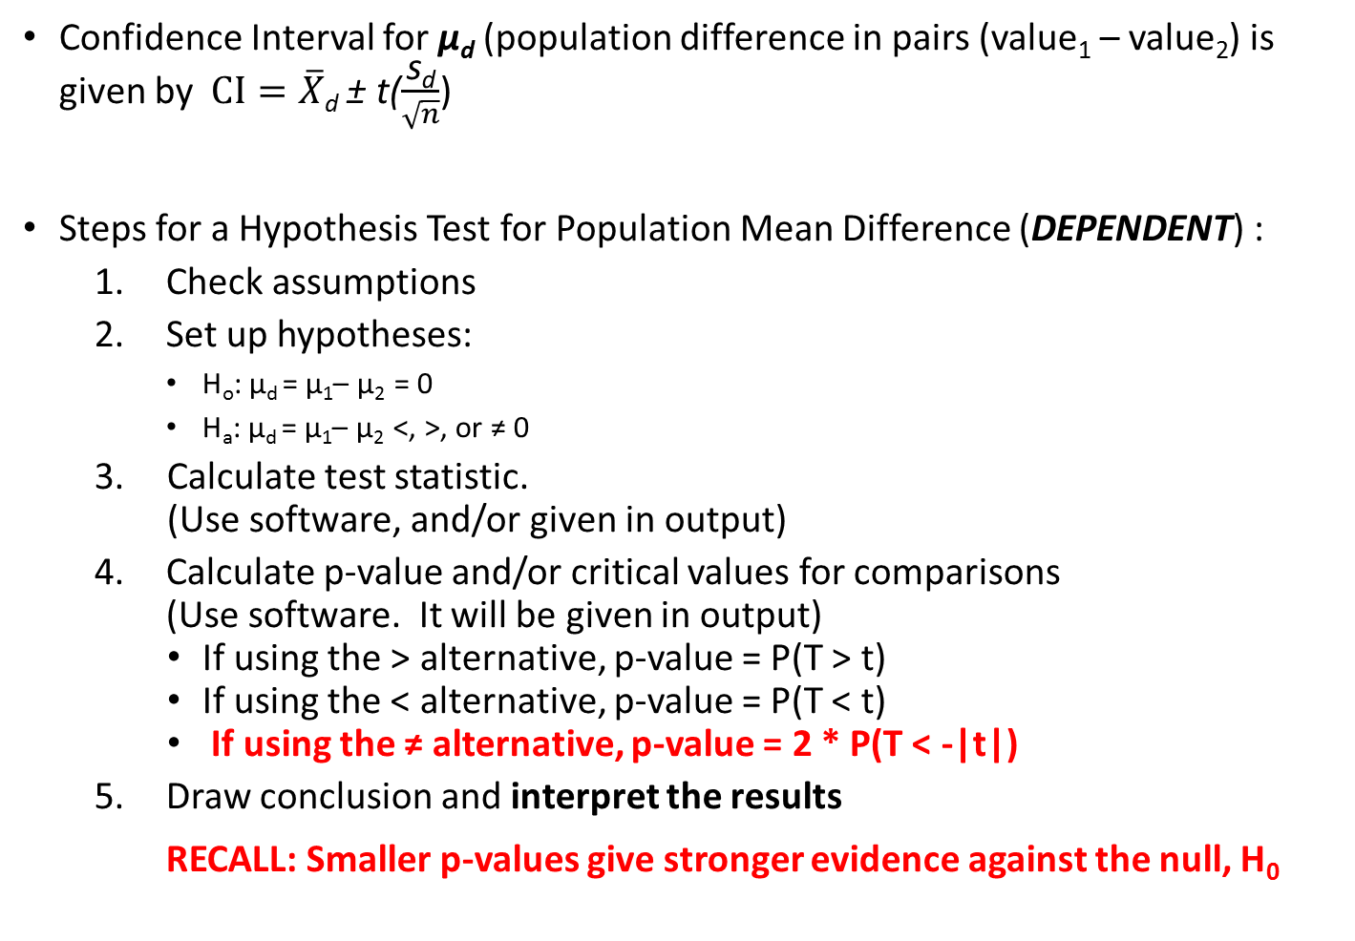
REVIEW Population Mean Difference (DEPENDENT):
Confidence Interval for µ_{d} (population difference in pairs (value₁ – value₂) is given by $CI=\overline{X}$_{d} ± t($\frac{\text{s}\text{d}}{\sqrt{n}}$)
Steps for a Hypothesis Test for Population Mean Difference (DEPENDENT) :
Check assumptions
Set up hypotheses:
H_{o}: μ_{d} = μ₁– μ₂ = 0
H_{a}: μ_{d} = μ₁– μ₂ <, >, or ≠ 0
Calculate test statistic. (Use software, and/or given in output)
Calculate p-value and/or critical values for comparisons (Use software. It will be given in output)
If using the > alternative, p-value = P(T > t)
If using the < alternative, p-value = P(T < t)
If using the ≠ alternative, p-value = 2 * P(T < -|t|)
Draw conclusion and interpret the results
RECALL: Smaller p-values give stronger evidence against the null, H₀

Slide 20
Question:
A recent study found that 51 children who watched a commercial for Walker Crisps (potato chips) featuring a well-known celebrity endorser ate a mean of 36 grams of Walker Crisps, but 41 children who watched a commercial for an alternative food snack ate a mean of 25 grams of Walker Crisps.
Is the assumption that the populations are dependent or independent?
Dependent
Independent

Slide 21
But what if your populations are NOT dependent?
10.4 F-Test for the Ratio of Two Variances (sort of…)
Two populations ➔ Two means and two variances…
We must have a method to combine the variances in order to calculate our test statistics

Slide 22
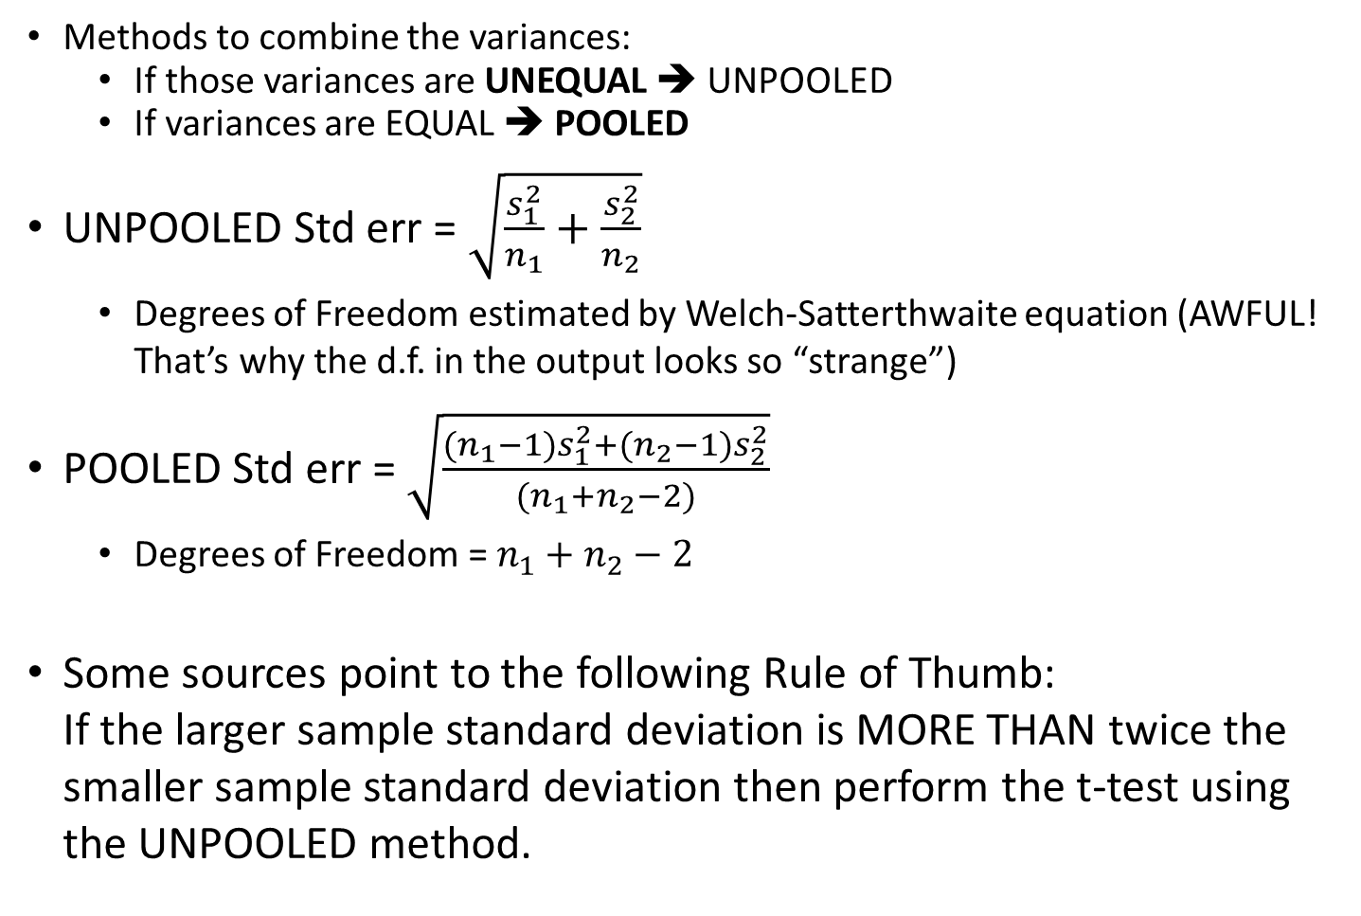
Two populations ➔ Two variances
Methods to combine the variances:
If those variances are UNEQUAL ➔ UNPOOLED
If variances are EQUAL ➔ POOLED
UNPOOLED Std err = $\sqrt{\frac{s_{1}^{2}}{n_{1}}+\frac{s_{2}^{2}}{n_{2}}}$
Degrees of Freedom estimated by Welch-Satterthwaite equation (AWFUL! That’s why the d.f. in the output looks so “strange”)
POOLED Std err = $\sqrt{\frac{{{(n}_{1}−1)s}_{1}^{2}{{+(n}_{2}−1)s}_{2}^{2}}{(n_{1}+n_{2}−2)}}$
Degrees of Freedom = $n_{1}+n_{2}−2$
Some sources point to the following Rule of Thumb: If the larger sample standard deviation is MORE THAN twice the smaller sample standard deviation then perform the t-test using the UNPOOLED method.

Slide 23
Comparing Two Means: INDEPENDENT
10.1 Comparing Means of Two Related Independent Populations
Two INDEPENDENT samples (unlike our paired sample experiments)
Examples:
Randomized experiments that randomly allocate subjects to two treatments
Single blind (subject doesn’t know treatment but administrator does)
Double blind (neither subject nor administrator know treatment)
Observational study separates subjects into groups according to their value for an explanatory variable
Same steps as previous hypothesis tests:
Check assumptions
Set up hypotheses
Calculate test statistic
Calculate p-value
Draw conclusion and interpret results

Slide 24
Steps of a Hypothesis Test for Comparing Means of Two INDEPENDENT Samples
Step 5: Draw Conclusion and Interpret Results
We summarize the test by reporting and interpreting the P-value
Smaller p-values give stronger evidence against the null hypothesis
If p-value ≤ α ➔ REJECT H₀
If p-value > α ➔ FAIL to reject H₀
With p-value = _______, we <have / do not have> sufficient evidence that <state Ha in the context of the problem>

Slide 25
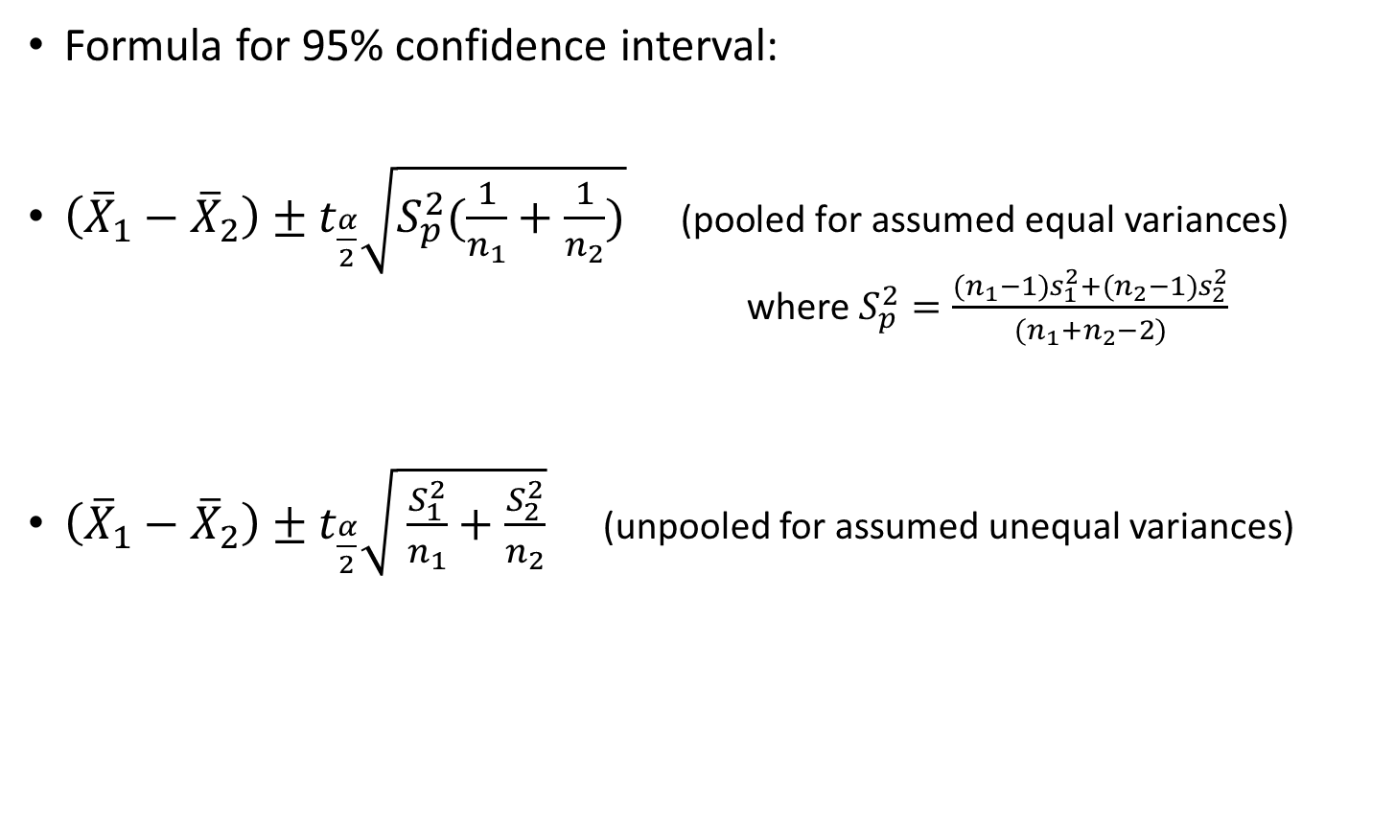
Confidence Intervals for comparing two means using independent samples
Formula for 95% confidence interval:
$\left({\overline{X}}_{1}−{\overline{X}}_{2}\right)±t_{\frac{α}{2}}\sqrt{S_{p}^{2}(\frac{1}{n_{1}}+\frac{1}{n_{2}})}\text{ (}\text{pooled} \text{for} \text{assumed} \text{equal} \text{variances}\text{)}$ where $S_{p}^{2}=\frac{{{(n}_{1}−1)s}_{1}^{2}{{+(n}_{2}−1)s}_{2}^{2}}{(n_{1}+n_{2}−2)}$
$\left({\overline{X}}_{1}−{\overline{X}}_{2}\right)±t_{\frac{α}{2}}\sqrt{ \frac{S_{1}^{2}}{n_{1}}+\frac{S_{2}^{2}}{n_{2}}}$ (unpooled for assumed unequal variances)
(t-score and/or Confidence Interval LL/UL
given on output if using software)

Slide 26
Interpretation of Confidence Intervals for comparing two means using independent samples
Let LL = lower limit and UL = upper limit of a confidence interval for (group A – group B). That is, μ_{A} – μ_{B}= (LL , UL)
If LL and UL are both greater than 0, this suggests that group A has the greater mean.
Interpretation: We can be 95 %* confident that the population mean for group A is at least LL and at most UL units greater than the population mean for group B.
If LL and UL are both less than 0, this suggests that group B has the greater mean.
Interpretation: We can be 95 %* confident that the population mean for group B is at least |UL| and at most |LL| units greater than the population mean for group A.
If LL is less than 0, and UL is greater than 0, neither group clearly has the greater mean.
Interpretation: With 95 %* confidence, it is unclear whether group A or group B has the greater population mean. If group A has the greater population mean, it is by at most UL units and if group B has the greater population mean, it is by at most |LL| units.
*Use correct Level of Confidence

Slide 27
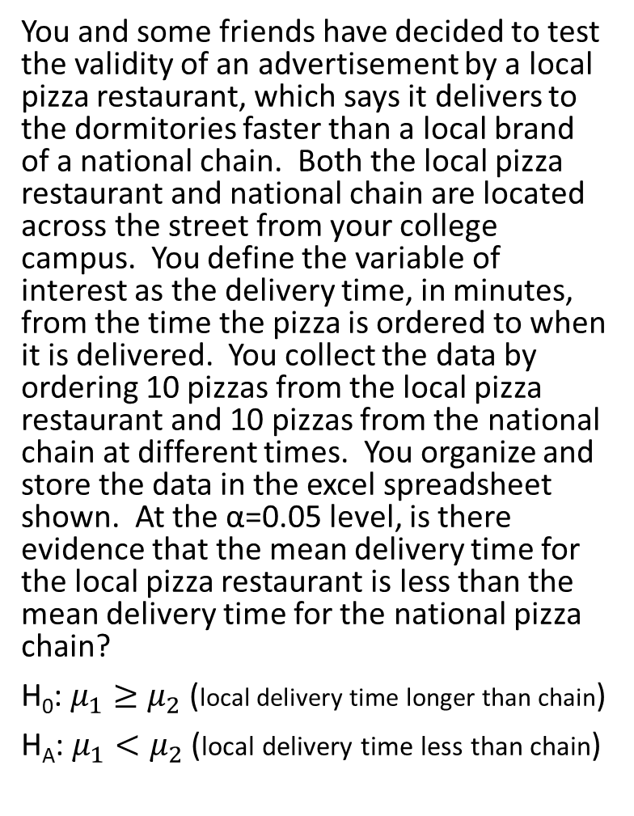
Example: (variances assumed equal)
You and some friends have decided to test the validity of an advertisement by a local pizza restaurant, which says it delivers to the dormitories faster than a local brand of a national chain. Both the local pizza restaurant and national chain are located across the street from your college campus. You define the variable of interest as the delivery time, in minutes, from the time the pizza is ordered to when it is delivered. You collect the data by ordering 10 pizzas from the local pizza restaurant and 10 pizzas from the national chain at different times. You organize and store the data in the excel spreadsheet shown. At the α=0.05 level, is there evidence that the mean delivery time for the local pizza restaurant is less than the mean delivery time for the national pizza chain?
H₀: $μ_{1}≥μ_{2}$ (local delivery time longer than chain)
H_{A}: $μ_{1}<μ_{2}$ (local delivery time less than chain)
Local | Chain
16.8 | 22.0
11.7 | 15.2
15.6 | 18.7
16.7 | 15.6
17.5 | 20.8
18.1 | 19.5
14.1 | 17.0
21.8 | 19.5
13.9 | 16.5
20.8 | 24.0
n1= | n2=
10 | 10
Are the populations of delivery times for local and national pizzerias independent or dependent?
Independent
Dependent

Slide 28
Example: (variances assumed equal)
You and some friends have decided to test the validity of an advertisement by a local pizza restaurant, which says it delivers to the dormitories faster than a local brand of a national chain. Both the local pizza restaurant and national chain are located across the street from your college campus. You define the variable of interest as the delivery time, in minutes, from the time the pizza is ordered to when it is delivered. You collect the data by ordering 10 pizzas from the local pizza restaurant and 10 pizzas from the national chain at different times. You organize and store the data in the excel spreadsheet shown. At the α=0.05 level, is there evidence that the mean delivery time for the local pizza restaurant is less than the mean delivery time for the national pizza chain?
H₀: $μ_{1}≥μ_{2}$ (local delivery time longer than chain)
H_{A}: $μ_{1}<μ_{2}$ (local delivery time less than chain)

Slide 29
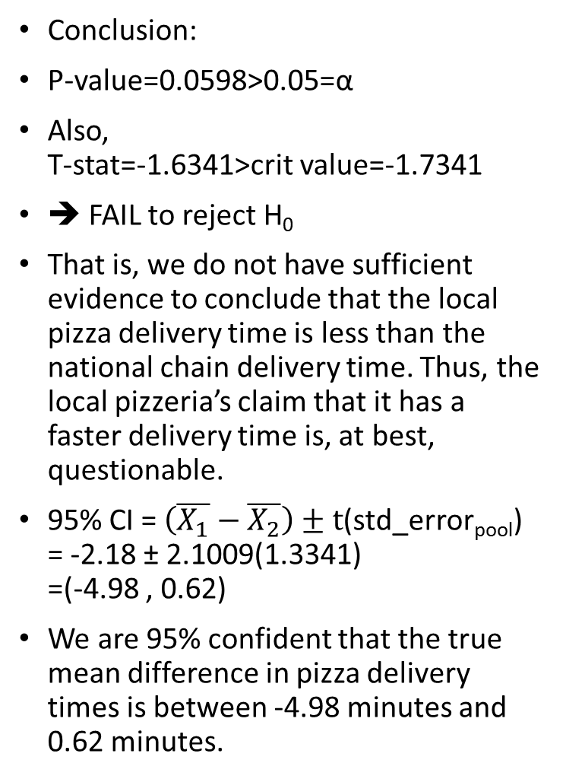
Example: (variances assumed equal)
You and some friends have decided to test the validity of an advertisement by a local pizza restaurant, which says it delivers to the dormitories faster than a local brand of a national chain. Both the local pizza restaurant and national chain are located across the street from your college campus. You define the variable of interest as the delivery time, in minutes, from the time the pizza is ordered to when it is delivered. You collect the data by ordering 10 pizzas from the local pizza restaurant and 10 pizzas from the national chain at different times. You organize and store the data in the excel spreadsheet shown. At the α=0.05 level, is there evidence that the mean delivery time for the local pizza restaurant is less than the mean delivery time for the national pizza chain?
H₀: $μ_{1}≥μ_{2}$ (local delivery time longer than chain)
H_{A}: $μ_{1}<μ_{2}$ (local delivery time less than chain)
Conclusion:
P-value=0.0598>0.05=α
Also, T-stat=-1.6341>crit value=-1.7341
➔ FAIL to reject H₀
That is, we do not have sufficient evidence to conclude that the local pizza delivery time is less than the national chain delivery time. Thus, the local pizzeria’s claim that it has a faster delivery time is, at best, questionable.
95% CI = $\left(\overline{X_{1}}−\overline{X_{2}}\right)±t$(std_error_{pool}) = -2.18 ± 2.1009(1.3341) =(-4.98 , 0.62)
We are 95% confident that the true mean difference in pizza delivery times is between -4.98 minutes and 0.62 minutes.

Slide 30
Example 1 – Ebay Sales: Recall Example 7 from Chapter 7 which compared the Ebay selling prices of the Palm M515 PDA. Some were sold using the Buy it Now option and some were sold using through the bidding option. The table shows data for both options. (The data was obtained from May 2003.)
Is there evidence, at the .05 level of significance, that there is a difference in the mean selling price of the two methods?
Find and interpret a 95% confidence interval for the difference in the mean selling price of the two methods.
Buy-It-Now | Bidding
235 | 250
225 | 249
225 | 255
240 | 200
250 | 199
250 | 240
210 | 228
 | 255
 | 232
 | 246
 | 210
 | 178
 | 246
 | 240
 | 245
 | 225
 | 246
 | 225
Summary statistics:
Column | n | Mean | Variance | Std. Dev. | Std. Err. | Median | Range | Min | Max | Q1 | Q3
Buy-It-Now | 7 | 233.57143 | 214.28572 | 14.638501 | 5.5328336 | 235 | 40 | 210 | 250 | 225 | 250
Bidding | 18 | 231.61111 | 481.1928 | 21.936108 | 5.17039 | 240 | 77 | 178 | 255 | 225 | 246

Slide 31
Example 1 – Ebay Sales: Recall Example 7 from Chapter 7 which compared the Ebay selling prices of the Palm M515 PDA. Some were sold using the Buy it Now option and some were sold using through the bidding option. The table shows data for both options. (The data was obtained from May 2003.)
Is there evidence, at the .05 level of significance, that there is a difference in the mean selling price of the two methods?
Buy-It-Now | Bidding
235 | 250
225 | 249
225 | 255
240 | 200
250 | 199
250 | 240
210 | 228
 | 255
 | 232
 | 246
 | 210
 | 178
 | 246
 | 240
 | 245
 | 225
 | 246
 | 225
Hypothesis test results: μ₁ : mean of Buy-It-Now μ₂ : mean of Bidding μ₁ - μ₂ : mean difference H₀ : μ₁ - μ₂ = 0 H_{A} : μ₁ - μ₂ ≠ 0 (without pooled variances)
Difference | Sample Mean | Std. Err. | DF | T-Stat | P-value
μ₁ - μ₂ | 1.9603175 | 7.57266 | 16.589735 | 0.25886774 | 0.7989
With p-value = 0.7989 > α = 0.05, we do not have sufficient evidence that there is a difference the average selling price of the two methods of purchase on Ebay.

Slide 32
If we are testing for the difference between the means of 2 independent populations presuming equal variances with samples of n₁ = 20 and n₂ = 20, the test and the number of degrees of freedom are equal to:
t-distribution with 19 degrees of freedom
t-distribution with 38 degrees of freedom
t-distribution with 18 degrees of freedom
z-distribution with 40 degrees of freedom
df = (n₁-1) + (n₂-1) = n₁+n₂ - 2 = 20+20 - 2 = 38

Slide 33
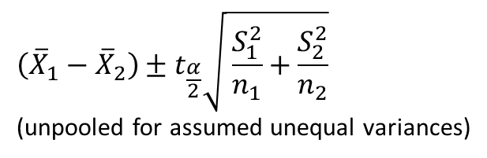

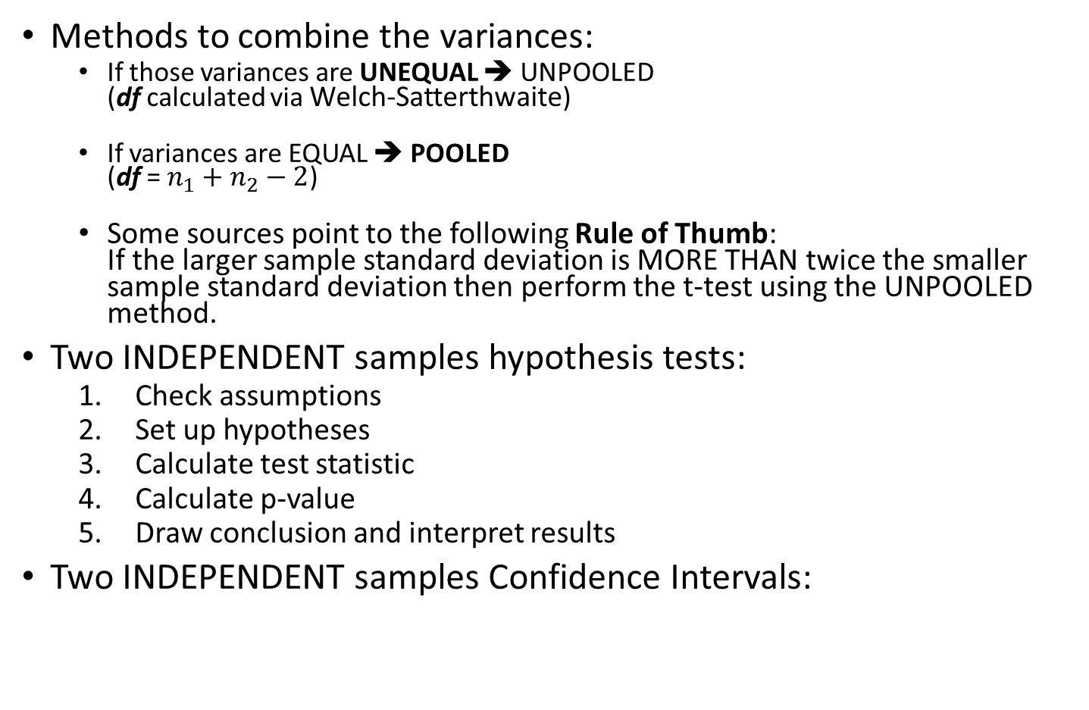
Review
Methods to combine the variances:
If those variances are UNEQUAL ➔ UNPOOLED (df calculated via Welch-Satterthwaite)
If variances are EQUAL ➔ POOLED (df = $n_{1}+n_{2}−2$)
Some sources point to the following Rule of Thumb: If the larger sample standard deviation is MORE THAN twice the smaller sample standard deviation then perform the t-test using the UNPOOLED method.
Two INDEPENDENT samples hypothesis tests:
Check assumptions
Set up hypotheses
Calculate test statistic
Calculate p-value
Draw conclusion and interpret results
Two INDEPENDENT samples Confidence Intervals:
$$\left({\overline{X}}_{1}−{\overline{X}}_{2}\right)±t_{\frac{α}{2}}\sqrt{S_{p}^{2}(\frac{1}{n_{1}}+\frac{1}{n_{2}})} \\ \text{(}\text{pooled} \text{for} \text{assumed} \text{equal} \text{variances}\text{)}$$
$$\left({\overline{X}}_{1}−{\overline{X}}_{2}\right)±t_{\frac{α}{2}}\sqrt{ \frac{S_{1}^{2}}{n_{1}}+\frac{S_{2}^{2}}{n_{2}}}$$ (unpooled for assumed unequal variances)

Slide 34
Comparing two proportions…
10.3 Comparing Proportions of Two Related Independent Populations
Same steps as previous hypothesis tests:
Check assumptions
Set up hypotheses
Calculate test statistic
Calculate p-value
Draw conclusion and interpret results

Slide 35
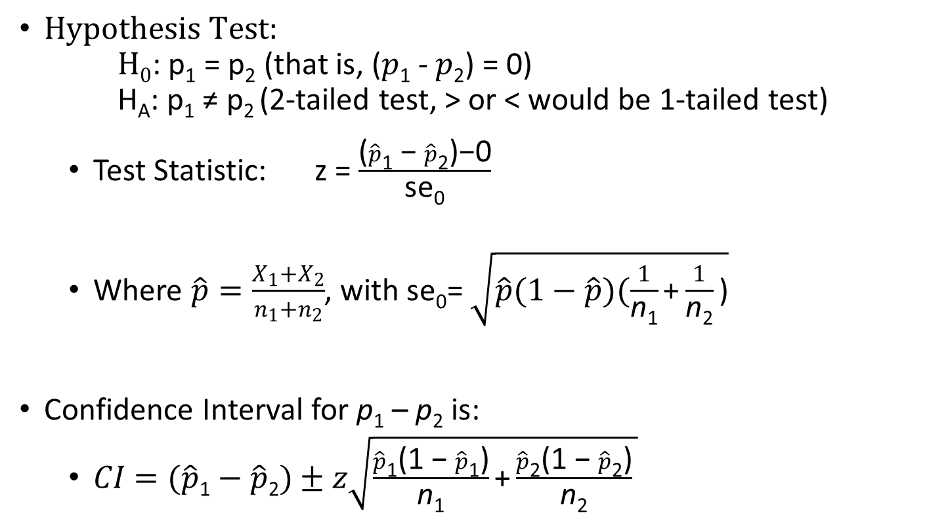
If we wanted to do hypothesis testing…
$Hypothesis Test:$ $H0$: p₁ = p₂ (that is, ($p$₁ - $p$₂) = 0) H_{A}: p₁ ≠ p₂ (2-tailed test, > or < would be 1-tailed test)
Test Statistic: z = $\frac{\text{(}\hat{p}\text{1}\text{ − }\hat{p}\text{2}\text{)}\text{−0}}{\text{se}\text{0}}$
Where $\hat{p}=\frac{X_{1}+X_{2}}{n_{1}+n_{2}}$, with se₀= $\sqrt{\hat{p}(1−\hat{p})(\frac{1}{\text{n}\text{1}}\text{+}\frac{1}{\text{n}\text{2}}\text{)}}$
Confidence Interval for p₁ – p₂ is:
$CI=(\hat{p}\text{1}−\hat{p}\text{2})±z\sqrt{\frac{\hat{p}\text{1}\text{(1 − }\hat{p}\text{1}\text{)}}{\text{n}\text{1}}\text{+}\frac{\hat{p}\text{2}\text{(1 − }\hat{p}\text{2}\text{)}}{\text{n}\text{2}} }$

Slide 36
Questions for Example:
Is there a significant difference between the proportion of men and the proportion of women who will vote Yes on Proposition A? In a random sample, 36 of 72 men and 35 of 50 women indicated they would vote “Yes.” Test at the .05 level of significance. Let p₁ be the proportion of men and p₂ be the proportion of women.
Is the underlying data categorical or quantitative?
Categorical
Quantitative
Are the populations dependent or independent?
Dependent
Independent
What sampling distribution is used?
t-distribution
Z-distribution

Slide 37
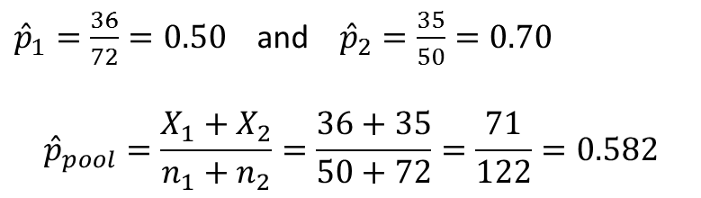
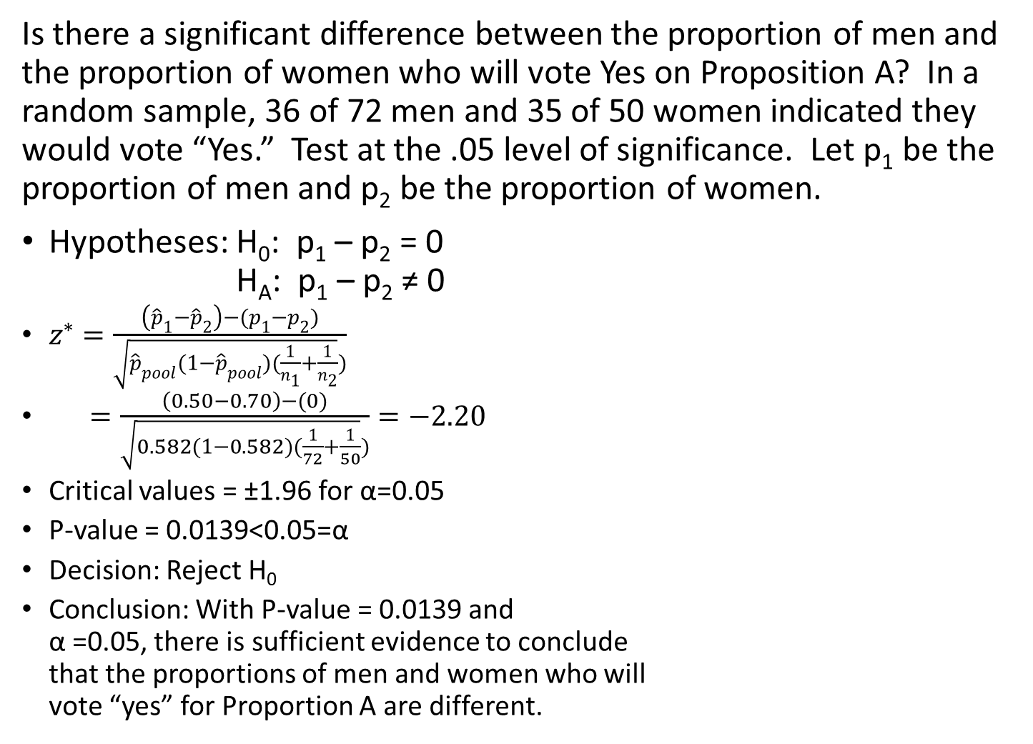
Hypothesis Example: 2 Population Proportions
Is there a significant difference between the proportion of men and the proportion of women who will vote Yes on Proposition A? In a random sample, 36 of 72 men and 35 of 50 women indicated they would vote “Yes.” Test at the .05 level of significance. Let p₁ be the proportion of men and p₂ be the proportion of women.
Hypotheses: H₀: p₁ – p₂ = 0 H_{A}: p₁ – p₂ ≠ 0
$z^{∗}=\frac{\left({\hat{p}}_{1}−{\hat{p}}_{2}\right)−(p_{1}−p_{2})}{\sqrt{{\hat{p}}_{pool}(1−{\hat{p}}_{pool})(\frac{1}{n_{1}}+\frac{1}{n_{2}}})}$
$=\frac{\left(0.50−0.70\right)−(0)}{\sqrt{0.582(1−0.582)(\frac{1}{72}+\frac{1}{50}})}=−2.20$
Critical values = ±1.96 for α=0.05
P-value = 0.0139<0.05=α
Decision: Reject H₀
Conclusion: With P-value = 0.0139 and α =0.05, there is sufficient evidence to conclude that the proportions of men and women who will vote “yes” for Proportion A are different.
${\hat{p}}_{1}=\frac{36}{72}=0.50$ and ${\hat{p}}_{2}=\frac{35}{50}=0.70$
$${\hat{p}}_{pool}=\frac{X_{1}+X_{2}}{n_{1}+n_{2}}=\frac{36+35}{50+72}=\frac{71}{122}=0.582$$

Slide 38
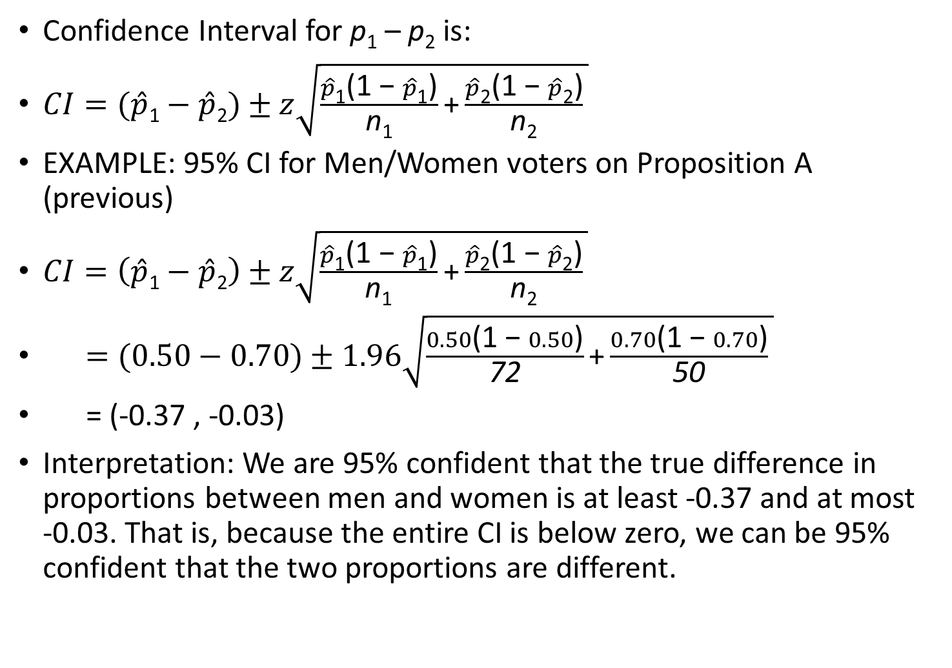
CI for Two Population Proportions
Confidence Interval for p₁ – p₂ is:
$CI=(\hat{p}\text{1}−\hat{p}\text{2})±z\sqrt{\frac{\hat{p}\text{1}\text{(1 − }\hat{p}\text{1}\text{)}}{\text{n}\text{1}}\text{+}\frac{\hat{p}\text{2}\text{(1 − }\hat{p}\text{2}\text{)}}{\text{n}\text{2}} }$
EXAMPLE: 95% CI for Men/Women voters on Proposition A (previous)
$CI=\left(\hat{p}\text{1}−\hat{p}\text{2}\right)±z\sqrt{\frac{\hat{p}\text{1}\text{(1 − }\hat{p}\text{1}\text{)}}{\text{n}\text{1}}\text{+}\frac{\hat{p}\text{2}\text{(1 − }\hat{p}\text{2}\text{)}}{\text{n}\text{2}} }$
$=(0.50−0.70)±1.96\sqrt{\frac{0.50\text{(1 − }0.50\text{)}}{\text{72}}\text{+}\frac{0.70\text{(1 − }0.70\text{)}}{\text{50}} }$
= (-0.37 , -0.03)
Interpretation: We are 95% confident that the true difference in proportions between men and women is at least -0.37 and at most -0.03. That is, because the entire CI is below zero, we can be 95% confident that the two proportions are different.

