Slide 1
Chapter 13
Simple Linear Regression

Slide 2
Ideas in 3.5 (Coefficient of Correlation) and
Chapter 13 (Simple Linear Regression)
Exploring the Association between Two Quantitative Variables
Association versus Causation
Regression and Least Square Regression
Calculating values using Excel

Slide 3
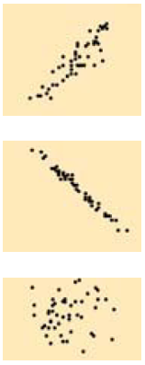
Three cases for exploring the association between two variables:
Two categorical variables (compare conditional proportions)
One quantitative and one categorical variable (compare the center and spread of the quantitative variable for each value of the categorical variable)
Two quantitative variables (discussed in this section)
Exploring the Association between Two Quantitative Variables
Create graphical displays and numerical summaries for both quantitative variables. Look at the shape of the distributions and check for outliers.
Use a scatterplot to examine the association between the two quantitative variables.
Positive association: as values of x increase, values of y increase
Negative association: as values of x increase, values of y decrease
No association: values of x do not affect the values of y
positive
negative
NO association

Slide 4
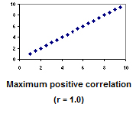
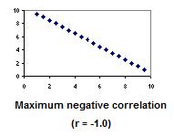
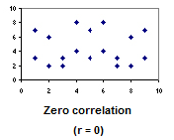
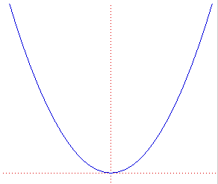
If a linear pattern is present in the scatterplot, calculate the correlation, denoted by r, to measure the strength and direction of the LINEAR relationship between x and y.
Positive values of r indicate a positive relationship between the variables
Negative values of r indicate a negative relationship between the variables
r ranges from -1 to 1. The closer r is to 0, the weaker the relationship. The closer r is to 1 or -1, the stronger the relationship
r = 0

Slide 5
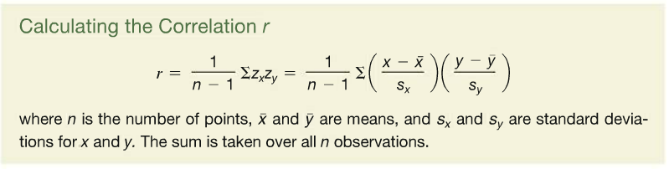
Calculating r (correlation coefficient)
Advice: use Excel (or other software) to calculate

Slide 6
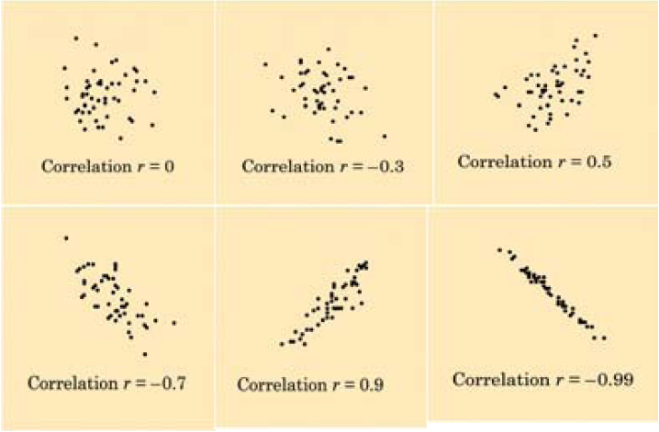
Correlation

Slide 7
Features of the
Coefficient of Correlation
The population coefficient of correlation is referred as ρ.
The sample coefficient of correlation is referred to as r.
Either ρ or r have the following features:
  Unit free
  Range between –1 and 1
  The closer to –1, the stronger the negative linear relationship
  The closer to 1, the stronger the positive linear relationship
  The closer to 0, the weaker the linear relationship

Slide 8
correlation does not imply causation – if two variables are associated with each other, it does not necessarily mean than that changes in one variable cause changes in the other variable
Strong correlation found in northeastern U.S. city
  Weekly sales of hot chocolate
  and
  Weekly sales of facial tissues
  Does hot chocolate cause people to need facial tissues?
Snake bites and ice cream …

Slide 9
The Coefficient of Correlation Using Microsoft Excel Function

Slide 10
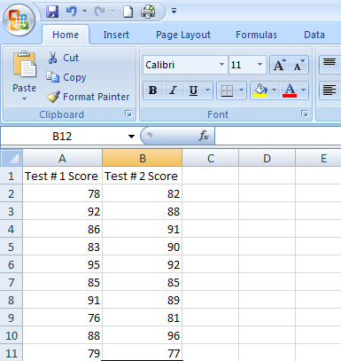
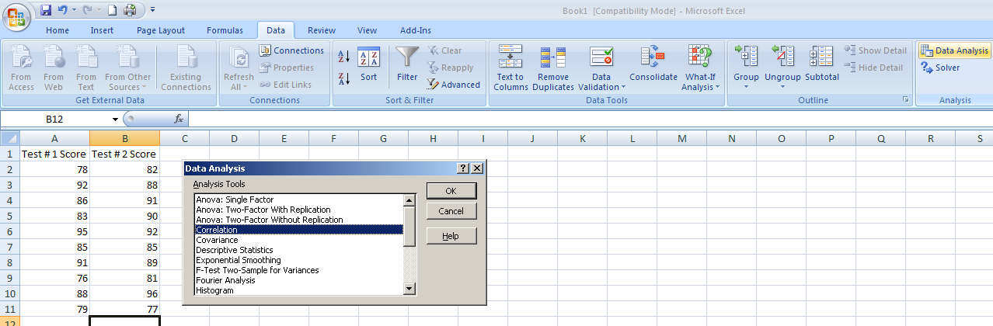
The Coefficient of Correlation Using Microsoft Excel Data Analysis Tool
Select Data
Choose Data Analysis
Choose Correlation & Click OK

Slide 11
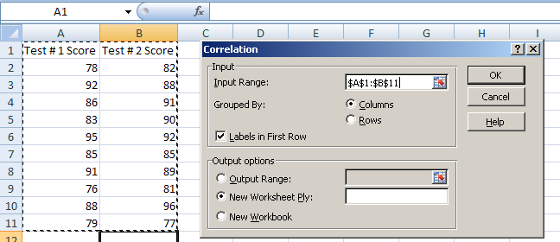
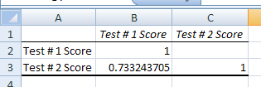
The Coefficient of Correlation
Using Microsoft Excel
Input data range and select appropriate options
Click OK to get output

Slide 12
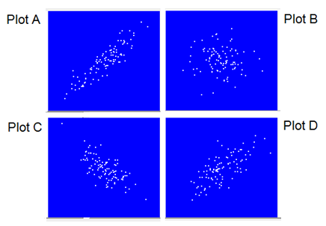
Question:
The correlation coefficients for the plots at the right are:
-0.71 -0.06 0.72 0.90.
Which plot has a correlation of 0.72?
  Plot A
  Plot B
  Plot C
  Plot D
0.90
-0.06
-0.71
0.72

Slide 13
Review:
Use correlation, denoted by r, to measure the strength and direction of the LINEAR relationship between x and y.
Positive values of r indicate a positive relationship between the variables
Negative values of r indicate a negative relationship between the variables
r ranges from -1 to 1. The closer r is to 0, the weaker the relationship. The closer r is to 1 or -1, the stronger the relationship
Excel function for correlation coefficient is:
  =correl(<x-values>,<y-values>) _OR_
  Data➔Data Analysis➔CORRELATION

Slide 14
Introduction to Regression Analysis
Regression analysis is used to:
  Predict the value of a dependent variable based on the value of at least one independent variable
  Explain the impact of changes in an independent variable on the dependent variable
Dependent variable: the variable we wish
to predict or explain
Independent variable: the variable used
to predict or explain
the dependent variable

Slide 15
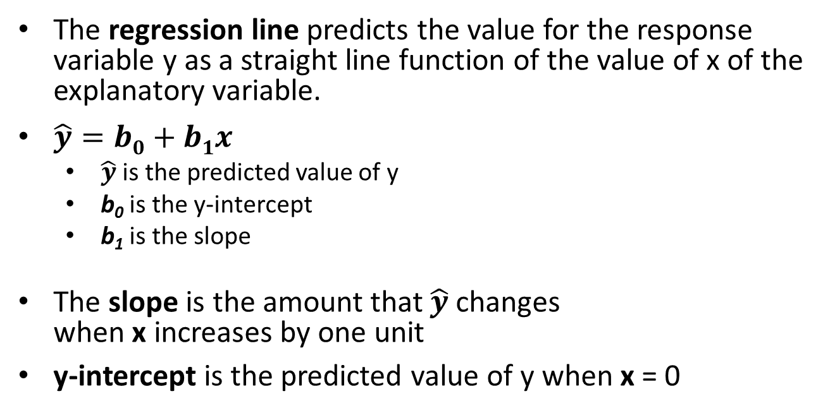
How can we predict the outcome of a Variable?
The regression line predicts the value for the response variable y as a straight line function of the value of x of the explanatory variable.
$\hat{y}=b0+b1x$
  $\hat{y}$ is the predicted value of y
  b₀ is the y-intercept
  b₁ is the slope
The slope is the amount that $\hat{y}$ changes
when x increases by one unit
y-intercept is the predicted value of y when x = 0
Linear Regression is appropriate when:
Scatterplot show a fairly linear relationship between the variables
|r| ≥ 0.7
Rule of thumb… Varies from one discipline to another

Slide 16
Simple Linear Regression Model
Only one independent variable, X
Relationship between X and Y is described by a linear function
Changes in Y are assumed to be related to changes in X
Population Slope
Coefficient
Random Error term
Population
Y intercept
Independent Variable
Dependent Variable
Linear component
Random Error
component

Slide 17
Simple Linear Regression Model
Y
Observed Value of Y for X_{i}
ε_{i}
Slope = β₁
Predicted Value of Y for X_{i}
Random Error for this X_{i} value
Intercept = β₀
X_{i}
X

Slide 18
Simple Linear Regression Equation
(Prediction Line)
The simple linear regression equation provides an estimate of the population regression line
Estimated (or predicted) Y value for observation i
Estimate of the regression
intercept
Estimate of the regression slope
Value of X for observation i

Slide 19
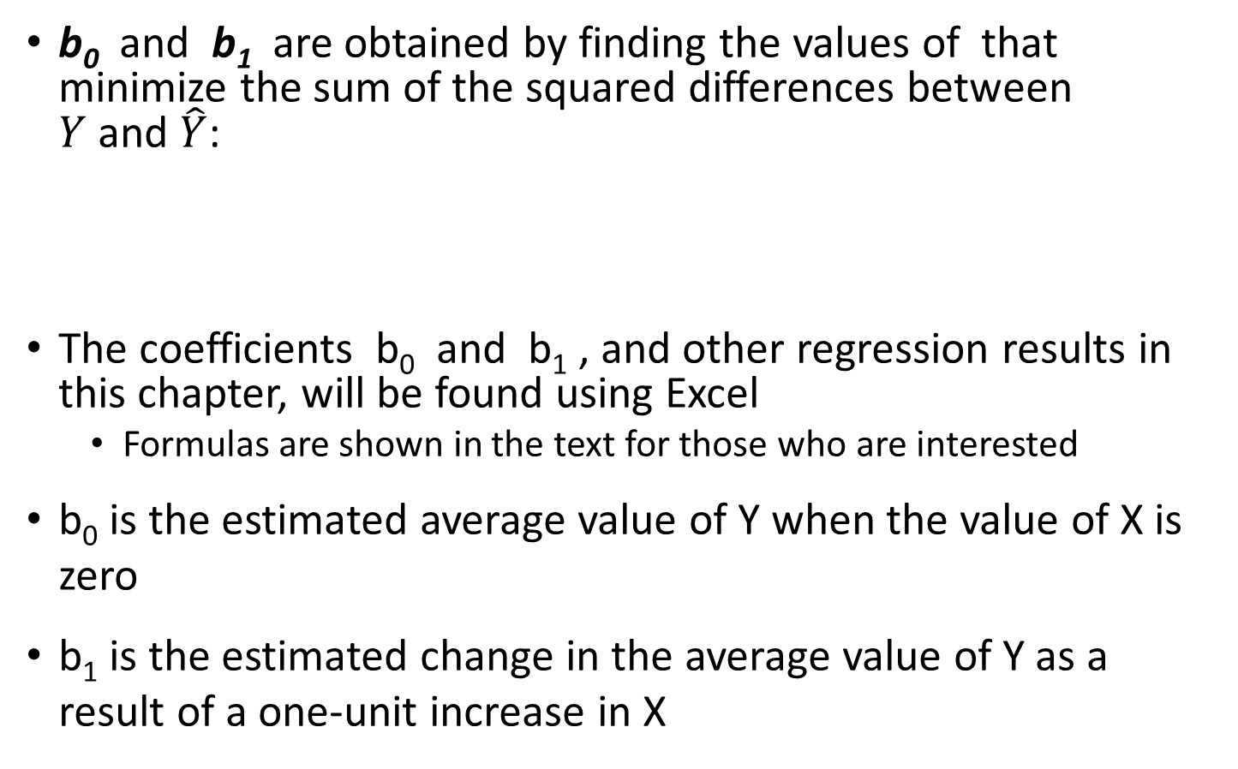
The Least Squares Method
b₀ and b₁ are obtained by finding the values of that minimize the sum of the squared differences between
$Y$ and $\hat{Y}$:
The coefficients b₀ and b₁ , and other regression results in this chapter, will be found using Excel
  Formulas are shown in the text for those who are interested
b₀ is the estimated average value of Y when the value of X is zero
b₁ is the estimated change in the average value of Y as a result of a one-unit increase in X

Slide 20
Simple Linear Regression Example
A real estate agent wishes to examine the relationship between the selling price of a home and its size (measured in square feet)
A random sample of 10 houses is selected
Independent variable (X) = square feet
Dependent variable (Y) = house price in $1000s
House Price in $1000s | Square Feet
(Y) | (X)
245 | 1400
312 | 1600
279 | 1700
308 | 1875
199 | 1100
219 | 1550
405 | 2350
324 | 2450
319 | 1425
255 | 1700

Slide 21
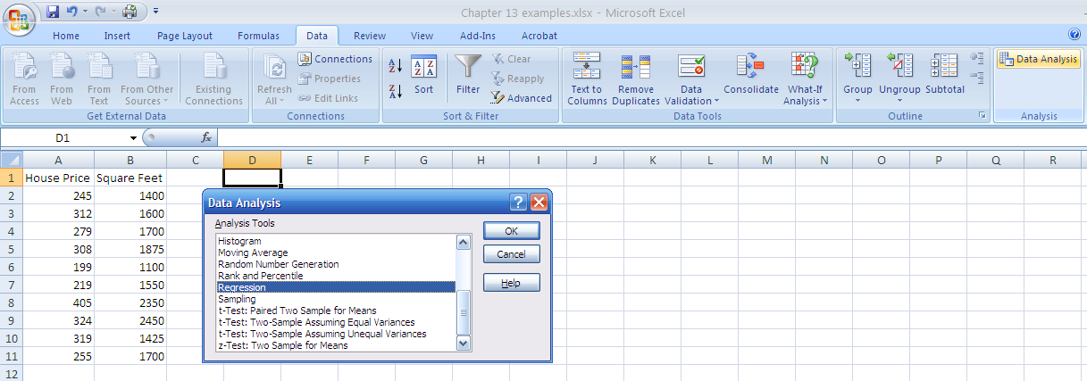
Simple Linear Regression Example: Using Excel Data Analysis Function
1. Choose Data
2. Choose Data Analysis
3. Choose Regression

Slide 22
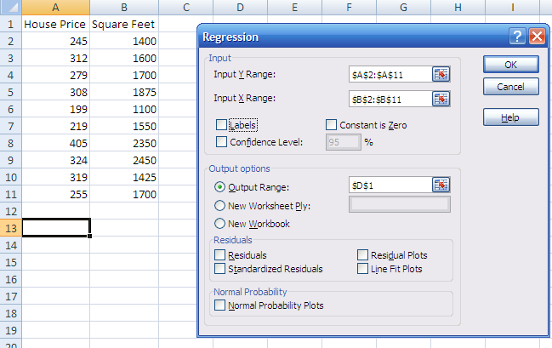
Simple Linear Regression Example: Using Excel Data Analysis Function
Enter Y range and X range and desired options

Slide 23
Simple Linear Regression Example:
Excel Output
Regression Statistics
Multiple R | 0.76211
R Square | 0.58082
Adjusted R Square | 0.52842
Standard Error | 41.33032
Observations | 10
ANOVA | df | SS | MS | F | Significance F
Regression | 1 | 18934.9348 | 18934.9348 | 11.0848 | 0.01039
Residual | 8 | 13665.5652 | 1708.1957
Total | 9 | 32600.5000
 | Coefficients | Standard Error | t Stat | P-value | Lower 95% | Upper 95%
Intercept | 98.24833 | 58.03348 | 1.69296 | 0.12892 | -35.57720 | 232.07386
Square Feet | 0.10977 | 0.03297 | 3.32938 | 0.01039 | 0.03374 | 0.18580
The regression equation is:

Slide 24
Simple Linear Regression Example:
Graphical Representation
House price model: Scatter Plot and Prediction Line
Slope
= 0.10977
Intercept
= 98.248

Slide 25
Simple Linear Regression Example: Interpretation of b₀ and b₁
b₀ is the estimated average value of Y when the value of X is zero (if X = 0 is in the range of observed X values)
  Because a house cannot have a square footage of 0, b₀ has no practical application
b₁ estimates the change in the average value of Y as a result of a one-unit increase in X
  Here, b₁ = 0.10977 tells us that the mean value of a house increases by .10977($1000) = $109.77, on average, for each additional one square foot of size

Slide 26
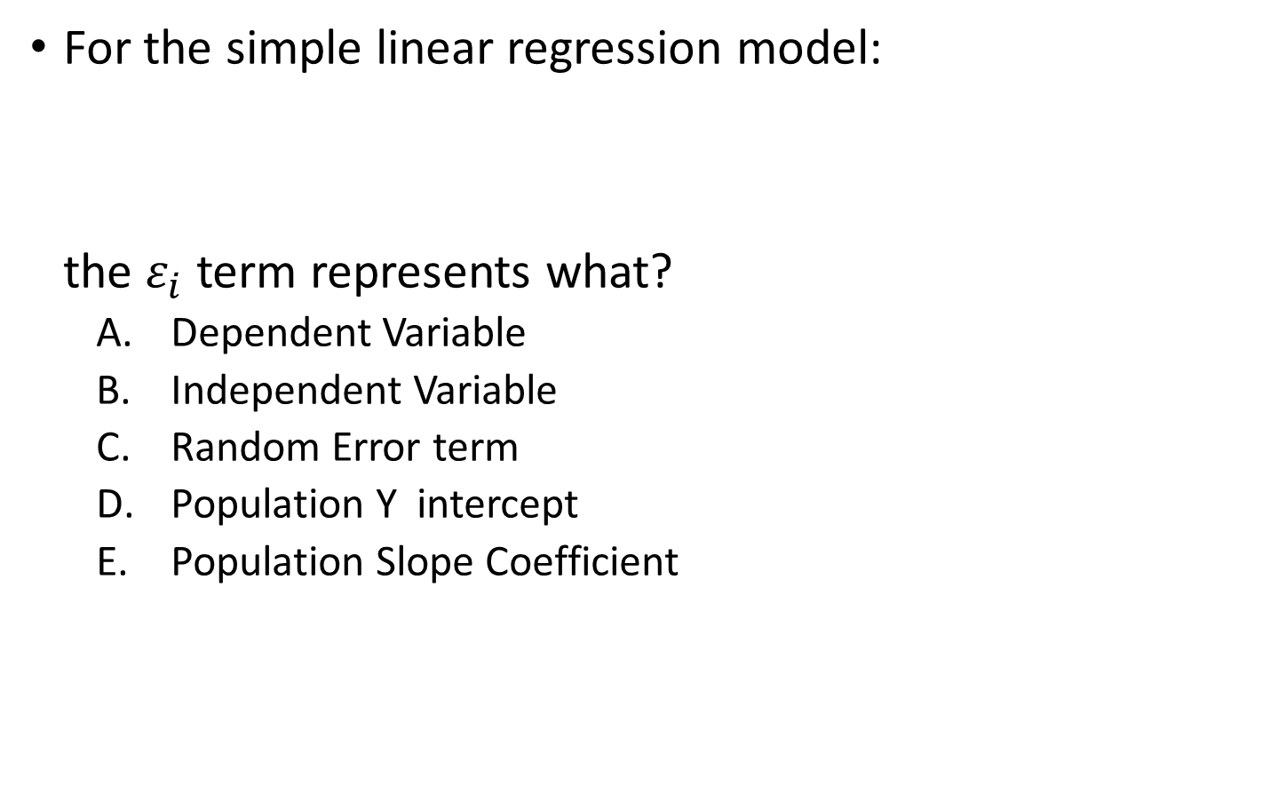
Question:
For the simple linear regression model:
the $ε_{i}$ term represents what?
  Dependent Variable
  Independent Variable
  Random Error term
  Population Y intercept
  Population Slope Coefficient

Slide 27
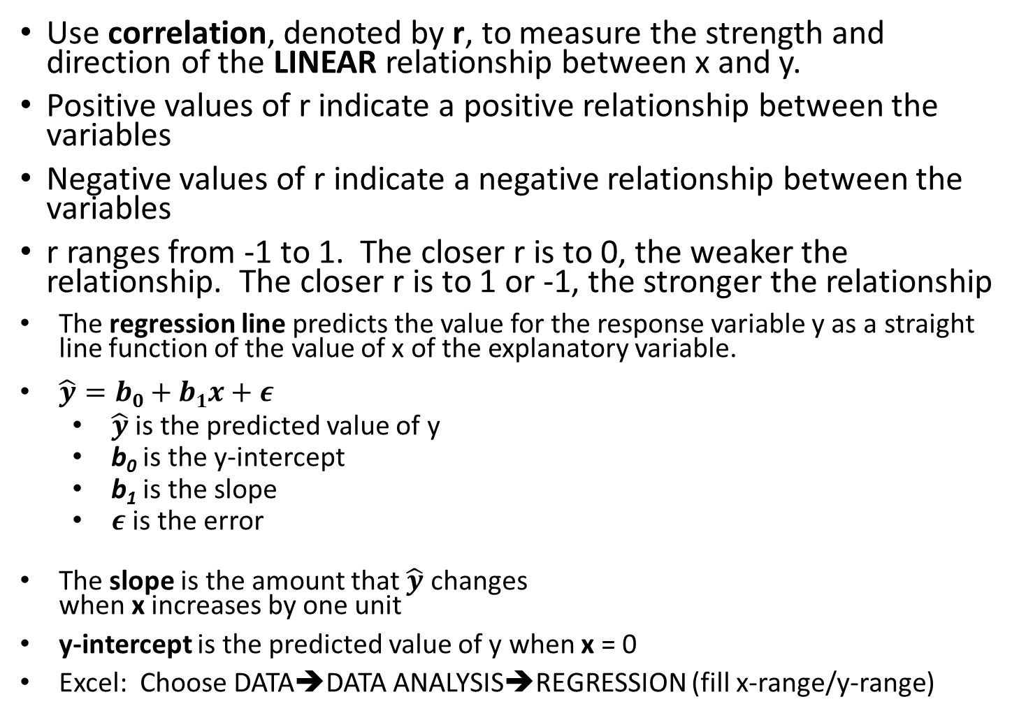
Review:
Use correlation, denoted by r, to measure the strength and direction of the LINEAR relationship between x and y.
Positive values of r indicate a positive relationship between the variables
Negative values of r indicate a negative relationship between the variables
r ranges from -1 to 1. The closer r is to 0, the weaker the relationship. The closer r is to 1 or -1, the stronger the relationship
The regression line predicts the value for the response variable y as a straight line function of the value of x of the explanatory variable.
$\hat{y}=b0+b1x+ε$
  $\hat{y}$ is the predicted value of y
  b₀ is the y-intercept
  b₁ is the slope
  $ε$ is the error
The slope is the amount that $\hat{y}$ changes
when x increases by one unit
y-intercept is the predicted value of y when x = 0
Excel: Choose DATA➔DATA ANALYSIS➔REGRESSION (fill x-range/y-range)

Slide 28
Simple Linear Regression
Example:
Making Predictions
Predict the price for a house with 2000 square feet:
That is, the predicted price for a house with 2000 square feet is 317.85($1,000s) = $317,850

Slide 29
Simple Linear Regression Example:
Making Predictions
When using a regression model for prediction, only predict within the relevant range of data
Relevant range for interpolation
Do not try to extrapolate beyond the range of observed X’s

Slide 30
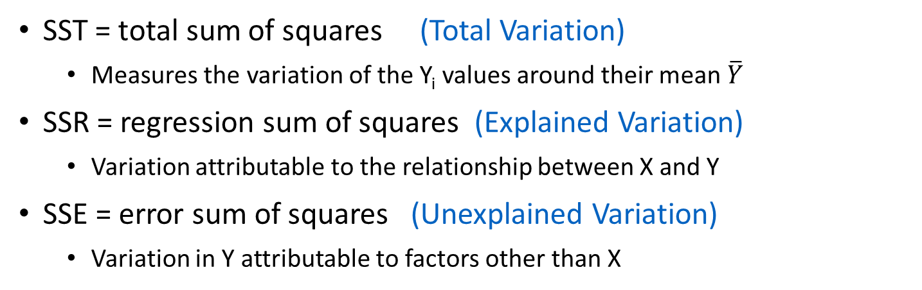
Measures of Variation
Total variation is made up of two parts:
Total Sum of Squares
Regression Sum of Squares
Error Sum of Squares
where: = Mean value of the dependent variable
Y_{i} = Observed value of the dependent variable
= Predicted value of Y for the given X_{i} value
SST = total sum of squares (Total Variation)
  Measures the variation of the Y_{i} values around their mean $\overline{Y}$
SSR = regression sum of squares (Explained Variation)
  Variation attributable to the relationship between X and Y
SSE = error sum of squares (Unexplained Variation)
  Variation in Y attributable to factors other than X

Slide 31
Measures of Variation
Y
Y_{i}
∧
∧
SSE = ∑(Y_{i} - Y_{i} )²
Y
_
SST = ∑(Y_{i} - Y)²
∧
Y
_
∧
_
SSR = ∑(Y_{i} - Y)²
_
Y
Y
X
X_{i}

Slide 32
Coefficient of Determination, r²
The coefficient of determination is the portion of the total variation in the dependent variable that is explained by variation in the independent variable
The coefficient of determination is also called r-squared and is denoted as r²
note:

Slide 33
Examples of Approximate r² Values
r² = 1
Perfect linear relationship between X and Y:
100% of the variation in Y is explained by variation in X
0 < r² < 1
Weaker linear relationships between X and Y:
Some but not all of the variation in Y is explained by variation in X
r² = 0
No linear relationship between X and Y:
The value of Y does not depend on X. (None of the variation in Y is explained by variation in X)

Slide 34
Simple Linear Regression Example
The regression equation is:
Regression Statistics
Multiple R | 0.76211
R Square | 0.58082
Adjusted R Square | 0.52842
Standard Error | 41.33032
Observations | 10
ANOVA | df | SS | MS | F | Significance F
Regression | 1 | 18934.9348 | 18934.9348 | 11.0848 | 0.01039
Residual | 8 | 13665.5652 | 1708.1957
Total | 9 | 32600.5000
 | Coefficients | Standard Error | t Stat | P-value | Lower 95% | Upper 95%
Intercept | 98.24833 | 58.03348 | 1.69296 | 0.12892 | -35.57720 | 232.07386
Square Feet | 0.10977 | 0.03297 | 3.32938 | 0.01039 | 0.03374 | 0.18580

Slide 35
Simple Linear Regression Example
The regression equation is:
Regression Statistics
Multiple R | 0.76211
R Square | 0.58082
Adjusted R Square | 0.52842
Standard Error | 41.33032
Observations | 10
ANOVA | df | SS | MS | F | Significance F
Regression | 1 | 18934.9348 | 18934.9348 | 11.0848 | 0.01039
Residual | 8 | 13665.5652 | 1708.1957
Total | 9 | 32600.5000
 | Coefficients | Standard Error | t Stat | P-value | Lower 95% | Upper 95%
Intercept | 98.24833 | 58.03348 | 1.69296 | 0.12892 | -35.57720 | 232.07386
Square Feet | 0.10977 | 0.03297 | 3.32938 | 0.01039 | 0.03374 | 0.18580
58.08% of the variation in house prices is explained by variation in square feet

