Slide 1
STAT 206: Chapter 2
Organizing and Visualizing Variables

Slide 2
Consider two table summaries of unemployment data
Unemployment rate for high school grads…
Unemployment rate for college grads…
Is it easy to see trends in these data?

Slide 3
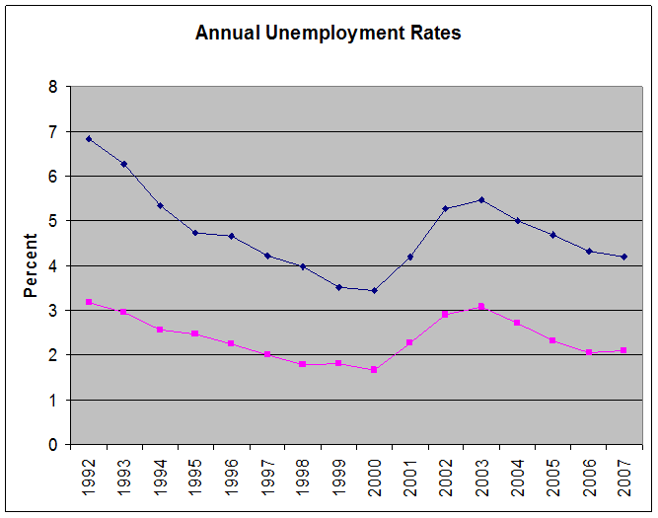
Let’s do it a different way.
Now, what do you see that you couldn’t quickly determine before?
Average Unemployment Rate Blue = High School Grads / Pink = College Grads
Clear patterns nearly identical – one obviously higher than the other, BUT…
Something is going on besides high school/college differences
Possibly state of the economy? Other?

Slide 4
2.1 Organizing Categorical Variables
Must identify variable type to determine the appropriate organization and visualization tools ➔Recall Variable Types
Categorical (Category)
Nominal – Name of a Category
Ordinal – Has a natural ordering
Numerical / Quantitative (Quantity)
Discrete – distinct cutoffs between values
Continuous – on a continuum
Definitions:
Summary Table shows values of the data categories for one variable and the frequencies (counts) or proportions/percentages for each category
Contingency Table shows values of the data categories for more than one variable and the frequencies or proportions/percentages for each of the JOINT RESPONSES
Each response counted/tallied into one and only one category/cell

Slide 5
Example (Problem 2.2, p. 40):
The following data represent the responses to two questions asked in a survey of 40 college students majoring in business:
What is your gender? (M=male; F=female)
What is your major? (A=Accounting; C=Computer Information; M=Marketing)
Gender: | M | M | M | F | M | F | F | M | F | M
Major: | A | C | C | M | A | C | A | A | C | C
Gender: | F | M | M | M | M | F | F | M | F | F
Major: | A | A | A | M | C | M | A | A | A | C
Gender: | M | M | M | M | F | M | F | F | M | M
Major: | C | C | A | A | M | M | C | A | A | A
Gender: | F | M | M | M | M | F | M | F | M | M
Major: | C | C | A | A | A | A | C | C | A | C

Slide 6
Now to combine the two variables:
The following data represent the responses to two questions asked in a survey of 40 college students majoring in business:
Table of Frequencies for all Responses
Table Based on Total Percentages
Table Based on Row Percentages
 | MAJOR CATEGORIES
GENDER | A (Accounting) | C (Computer) | M (Marketing) | TOTALS
Male (M) | 56.0% | 36.0% | 8.0% | 100.0%
Female (F) | 40.0% | 40.0% | 20.0% | 100.0%
TOTALS | 50.0% | 37.5% | 12.5% | 100.0%
Table Based on Column Percentages

Slide 7
Questions:
How many of the surveyed students were females majoring in Marketing?
Table of Frequencies for all Responses
3
What percentage of the surveyed students were females majoring in Marketing?
Table Based on Total Percentages
7.5%
What percentage of the male students surveyed were majoring in Computer?
A. 3 B. 70% C. 7.5% D. 36%
Table Based on Row Percentages
 | MAJOR CATEGORIES
GENDER | A (Accounting) | C (Computer) | M (Marketing) | TOTALS
Male (M) | 56.0% | 36.0% | 8.0% | 100.0%
Female (F) | 40.0% | 40.0% | 20.0% | 100.0%
TOTALS | 50.0% | 37.5% | 12.5% | 100.0%
Table Based on Column Percentages
Of the students majoring in Accounting, what percentage was male?
A. 3 B. 70% C. 7.5% D. 36%
7

Slide 8
Question:
Table of Frequencies for all Responses
Of the female students, what percentage are majoring in Accounting?
A. 6 B. 15% C. 40% D. 30%
Table Based on Total Percentages
Table Based on Row Percentages
 | MAJOR CATEGORIES
GENDER | A (Accounting) | C (Computer) | M (Marketing) | TOTALS
Male (M) | 56.0% | 36.0% | 8.0% | 100.0%
Female (F) | 40.0% | 40.0% | 20.0% | 100.0%
TOTALS | 50.0% | 37.5% | 12.5% | 100.0%
Table Based on Column Percentages
8

Slide 9
2.3 Visualizing Categorical Variables
Pie chart – uses sections of a circle to represent the tallies/frequencies/percentages for each category
Bar chart – a series of bars, with each bars representing the tallies/frequencies/percentages for a single category
Consider our previous example for Major Category
Question: Which major has the lowest concentration of students?
Marketing…
Discussion: Preference?

Slide 10
Other visualization methods
Pareto chart – a series of vertical bars showing tallies/frequencies/percentages in descending order
Example:
Summary Table of Causes of Incomplete ATM Transactions
Cause | Frequency | Percentage
ATM malfunctions | 32 | 4.42%
ATM out of cash | 28 | 3.87%
Invalid amount requested | 23 | 3.18%
Lack of funds in account | 19 | 2.62%
Card unreadable | 234 | 32.32%
Warped card jammed | 365 | 50.41%
Wrong keystroke | 23 | 3.18%
TOTAL | 724 | 100.00%
Discussion: How or why do you think that a Pareto chart would be useful in the business world?
Helps identify the important “few” from the less important “many”

Slide 11
2.2 Organizing Numerical Variables
Ordered array arranges the values of a numerical variable in rank order (smallest value to largest value) Array ➔ Ordered Array
Example (Table 2.8 A & B, p. 42):
City Restaurant Meal Costs
33 | 26 | 43 | 32 | 44 | 44 | 50 | 42 | 44 | 36 | 61 | 50 | 51 | 50 | 76 | 53 | 44 | 77 | 57 | 43 | 29 | 34 | 77 | 50 | 74
56 | 67 | 57 | 66 | 80 | 68 | 42 | 48 | 60 | 35 | 45 | 32 | 25 | 74 | 43 | 39 | 55 | 65 | 35 | 61 | 37 | 54 | 41 | 33 | 27
Suburban Restaurant Meal Costs
47 | 48 | 35 | 59 | 44 | 51 | 37 | 36 | 43 | 52 | 34 | 38 | 51 | 34 | 51 | 34 | 51 | 56 | 26 | 34 | 34 | 44 | 40 | 31 | 54
41 | 50 | 71 | 60 | 37 | 27 | 34 | 48 | 39 | 44 | 41 | 37 | 47 | 67 | 68 | 49 | 29 | 33 | 39 | 39 | 28 | 46 | 70 | 60 | 52
City Restaurant Meal Costs
25 | 26 | 27 | 29 | 32 | 32 | 33 | 33 | 34 | 35 | 35 | 36 | 37 | 39 | 41 | 42 | 42 | 43 | 43 | 43 | 44 | 44 | 44 | 44 | 45
48 | 50 | 50 | 50 | 50 | 51 | 53 | 54 | 55 | 56 | 57 | 57 | 60 | 61 | 61 | 65 | 66 | 67 | 68 | 74 | 74 | 76 | 77 | 77 | 80
Suburban Restaurant Meal Costs
26 | 27 | 28 | 29 | 31 | 33 | 34 | 34 | 34 | 34 | 34 | 34 | 35 | 36 | 37 | 37 | 37 | 38 | 39 | 39 | 39 | 40 | 41 | 41 | 43
44 | 44 | 44 | 46 | 47 | 47 | 48 | 48 | 49 | 50 | 51 | 51 | 51 | 51 | 52 | 52 | 54 | 56 | 59 | 60 | 60 | 67 | 68 | 70 | 71

Slide 12
Frequency Distribution
Frequency Distribution tallies the values of a numerical variable into a set of numerically ordered classes, called a class interval
How many classes? Rule of thumb: at least 5 but no more than 15
Determine the interval width by the following:
Interval width = | (highest value - lowest value)
 | number of classes
Using our Meal Cost data, we estimate that we want 10 classes so interval width = (80 – 25)/10 = 55/10 = 5.5
But we really want to simplify to multiples of $5 increments, say $5 or $10, but $5 produces 13 classes (more than we want) so we choose $10 to produce 7 classes (notice this is sometimes more art than science…)
Meal Cost ($) | City Frequency | Suburb Frequency
20, but <30 | 4 | 4
30, but <40 | 10 | 17
40, but <50 | 12 | 13
50, but <60 | 11 | 10
60, but <70 | 7 | 4
70, but <80 | 5 | 2
80, but <90 | 1 | 0
TOTALS | 50 | 50

Slide 13
Relative Frequency Distribution
Relative Frequency Distribution presents relative frequency, or proportion of the total for each group
Proportion or relative frequency, in each group is equal to the number of values in each class divided by the total number of values
 | CITY |  |  | SUBURBAN
Meal Cost ($) | Frequency | Relative Frequency | Percentage | Frequency | Relative Frequency | Percentage
20, but <30 | 4 | 0.08 | 8.0% | 4 | 0.08 | 8.0%
30, but <40 | 10 | 0.20 | 20.0% | 17 | 0.34 | 34.0%
40, but <50 | 12 | 0.24 | 24.0% | 13 | 0.26 | 26.0%
50, but <60 | 11 | 0.22 | 22.0% | 10 | 0.20 | 20.0%
60, but <70 | 7 | 0.14 | 14.0% | 4 | 0.08 | 8.0%
70, but <80 | 5 | 0.10 | 10.0% | 2 | 0.04 | 4.0%
80, but <90 | 1 | 0.02 | 2.0% | 0 | 0.00 | 0.0%
TOTALS | 50 | 1.00 | 100.0% | 50 | 1.00 | 100.0%
Notes:
TOTAL of the relative frequency column MUST BE 1.00
TOTAL of the percentage column MUST BE 100.00

Slide 14
Cumulative Distribution
Cumulative Percentage Distribution provides a way of presenting information about the percentage of values that less than a specific amount
 | CITY and SUBURBAN
Meal Cost ($) | Frequency | Relative Frequency | Percentage | < lower boundary | Cumulative Percentage < lower boundary
20, but <30 | 8 | 0.08 | 8.0% | <20 | 0 (no meals cost less than $20)
30, but <40 | 27 | 0.27 | 27.0% | <30 | 8% = 0 + 8%
40, but <50 | 25 | 0.25 | 25.0% | <40 | 35% = 0 + 8% +27%
50, but <60 | 21 | 0.21 | 21.0% | <50 | 60% = 0 + 8% +27% + 25%
60, but <70 | 11 | 0.11 | 11.0% | <60 | 81% = 0 + 8% +27% + 25% + 21%
70, but <80 | 7 | 0.07 | 7.0% | <70 | 92% = 0 + 8% +27% + 25% + 21% + 11%
80, but <90 | 1 | 0.01 | 1.0% | <80 | 99% = 0 + 8% +27% + 25% + 21% + 11% + 7%
TOTALS | 100 | 1.00 | 100.0% | <90 | 100% = 0 + 8% +27% + 25% + 21% + 11% + 7% + 1%
Question: What percentage of meal costs was less than $50?
60% (0 + 8% +27% + 25%)

Slide 15
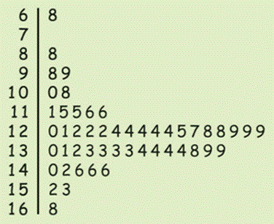
2.4 Visualizing Numerical Variables
Stem-and-Leaf Display – How to create:
Separate each observation into
Stem (all but final digit(s)) and
Leaf (final digit(s)).
Write stems in vertical column – smallest on top
Write each leaf, in increasing numerical order, in row next to appropriate stem
Example: For each state, percentage (with one decimal place) of residents 65 and older
NOTE: Leaf does NOT have to be decimal, value. Must be the FINAL DIGIT, whatever value
Integer value
Decimal value

Slide 16
Stem-and-Leaf Display
Residents age 65 and older data again
FOR THIS EXAMPLE read data values as:
6.8
-
8.8
9.8, 9.9
10.0,10.8
11.1,11.5,11.5,11.6,11.6
12.0,12.1,12.2,12.2,12.2,12.4,12.4,12.4,12.4,12,4,12.5,12.7,12.8,12.8,12.9,12.9,12.9
13.0,13.1,12.3,13.3,13.3,13.3,13.4,13.4,13.4,13.4,13.8,13.9,13.9
14.0,14.2,14.6,14.6.14.6
15.2,15.3
16.8
Notice stem of “7” does not have a leaf ➔ we conclude no value of 7.x – there should be the same number of leaves as observations! Include ALL stems even if no values/leaves
Leave a space holder if no leaf for a stem
No punctuation (i.e., no decimal points, no commas)
Leaves should be lined on top of one another to determine SHAPE
Simple way to deliver a lot of detailed information

Slide 17
Let’s think about SHAPE for a minute…
If we “rotate” our stem-and-leaf display, we see that the SHAPE is very similar to a HISTOGRAM with the same width intervals

Slide 18
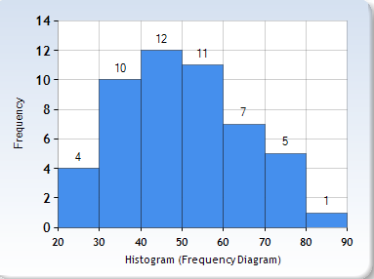
Histogram
Displays a quantitative variable across different groupings of values
Careful when choosing how to group together values!
Groupings must cover the same range so have of equal width
Height used to compare the frequency of each range of values
Steps to create a frequency histogram:
Create equal width classes (groupings)
Count number of values in each class
Draw histogram with a bar for each class
Height of a bar represents the count for that bar’s class
Bars touch since there are NO GAPS between classes
Be careful:
Number of categories can’t be too large or too small
Don’t skip any categories
Be clear about contents of each category
HISTOGRAM of Meal Cost Location = CITY
http://www.socscistatistics.com/descriptive/histograms/

Slide 19
25, 26, 27, 29, 32, 32, 33, 33, 34, 35, 35, 36, 37, 39, 41, 42, 42, 43, 43, 43, 44, 44, 48, 50, 50, 50, 50, 51, 53, 54, 55, 56, 57, 57, 60, 61, 61, 65, 66, 67, 68, 74, 74, 76
http://www.socscistatistics.com/descriptive/histograms/

Slide 20
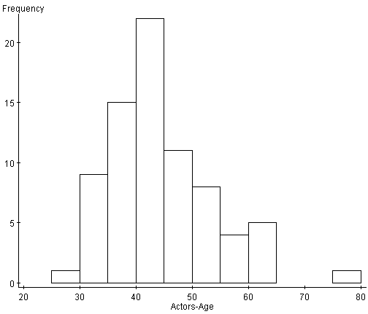
Histogram Example: Age at Time of First Oscar Award
Question: If Jack Nicholson won Best Actor at age 70, which category frequency would increase?
[60,65)
[65,70)
[70,75)
[75,80)
Age at Time of First Oscar
Groupings chosen here are: [20,25) [25,30) [30,35) [35,40) [45,50), …
Where “[“ means the number is INCLUDED in the interval, but “)” means the number is NOT included in the interval

Slide 21
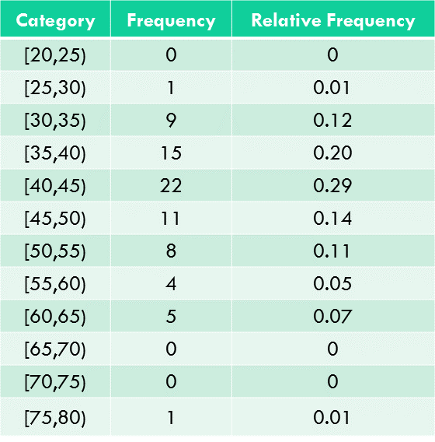
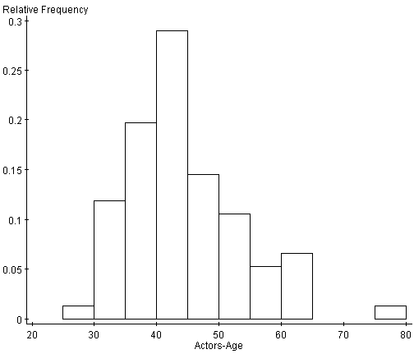
Let’s examine what it means to turn a frequency into a relative frequency by looking at the age at Oscar data
TOTAL 76
Relative frequency histogram depicts the relative frequency rather than the raw frequency (count) of categories
Do shapes of the frequency and relative frequency histograms differ?

Slide 22
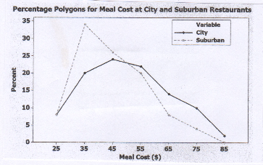
Percentage Polygon
Percentage polygon – used for visualization when dividing the data of a numerical variable into two or more groups
Uses MIDPOINTS of each class to represent the data in the class
Combines data from two groups to allow easier comparison
Conclusions:
City meals concentrated between approximately $30 and $60 (remember, we’re using the midpoint of the classes…) and one meal costing more than $80
Suburban meals concentrated between $30 and $40 with very few meals costing more than $70

Slide 23
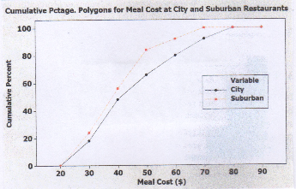
Cumulative Percentage Polygon (Ogive)
Cumulative Percentage Polygon uses the cumulative percentage distribution (discussed previously) to plot the cumulative percentages along the Y axis
LOWER BOUNDS of the class intervals are plotted on the X axis
Conclusions:
Curve leads you to conclude that the curve for city meals is to the RIGHT of the curve for suburban meals
That is, city restaurants have fewer meals that cost less than a particular value
For example, 2% of the meals at city restaurants cost less than $50, compared to 68% of the meals at suburban restaurants…

Slide 24
Question:
Table of Frequencies for all Responses
What percentage of survey students are Males majoring in marketing?
A. 3 B. 5% C. 7.5% D. 36%
Table Based on Total Percentages
Given that a student is majoring in Accounting, what percentage are female?
A. 3 B. 70% C. 7.5% D. 30%
Table Based on Row Percentages
 | MAJOR CATEGORIES
GENDER | A (Accounting) | C (Computer) | M (Marketing) | TOTALS
Male (M) | 56.0% | 36.0% | 8.0% | 100.0%
Female (F) | 40.0% | 40.0% | 20.0% | 100.0%
TOTALS | 50.0% | 37.5% | 12.5% | 100.0%
Table Based on Column Percentages

Slide 25
Review:
Summary Table shows values of the data categories for one variable and the frequencies (counts) or proportions/percentages for each category
Contingency Table shows values of the data categories for more than one variable and the frequencies or proportions/percentages for each of the JOINT RESPONSES
Each response counted/tallied into one and only one category/cell
Pie chart – uses sections of a circle to represent the tallies/frequencies/percentages for each category (AVOID for quantitative variables!)
Bar chart – a series of bars, with each bars representing the tallies/frequencies/percentages for a single category (better for ordinal categorical variables)
Pareto chart – a series of vertical bars showing tallies/frequencies/percentages in descending order (Helps identify the important “few” from the less important “many”)

Slide 26
Question:
Using the concept of a Cumulative Percentage Distribution, what percentage of the City and Suburban meals cost less than $40?
8%
27%
25%
35%
 | CITY and SUBURBAN
Meal Cost ($) | Frequency | Relative Frequency | Percentage
20, but <30 | 8 | 0.08 | 8.0%
30, but <40 | 27 | 0.27 | 27.0%
40, but <50 | 25 | 0.25 | 25.0%
50, but <60 | 21 | 0.21 | 21.0%
60, but <70 | 11 | 0.11 | 11.0%
70, but <80 | 7 | 0.07 | 7.0%
80, but <90 | 1 | 0.01 | 1.0%
TOTALS | 100 | 1.00 | 100.0%
<20: 0%
20, but <30: 8%
30, but <40: 27%
➔ <40 35%

Slide 27
Review:
Organizing/Visualizing Numerical Data
Ordered array
Create class intervals (between 5 and 15, equal widths, art and science)
Relative Frequency tables
Cumulative Percentage Distributions (using lower limits…)
Stem-and-Leaf Display – simple way to show a lot of detailed info for relatively small data sets
Histogram – Displays a quantitative variable across value groupings
Percentage Polygon – Uses MIDPOINTS of each class and can combine data from two groups to allow easier comparison
Cumulative Percentage Polygon – uses the cumulative percentage distribution (lower limits) to plot the cumulative percentages along the Y axis
Meal Cost Location = CITY

